Slide 1
BACHELOR THESIS DEFENSE
Architecture and Evaluation of a SIEM
Integrating Unsupervised Anomaly Detection
and Knowledge-Grounded Language Models
Secărea Diana Maria
Coordinator: prof. univ. dr. Cătălin Boja
Bucharest University of Economic Studies · Faculty of Cybernetics, Statistics and Economic Informatics
Economic Informatics Program · Bucharest 2026
Notes:
Good morning. My thesis integrates two AI paradigms into the Wazuh SIEM: unsupervised anomaly detection and a knowledge-grounded language model. Everything is implemented, deployed and evaluated — and I will show it live.

Slide 2
Objective — score every alert, explain every score, keep knowledge fresh
Extend the open-source Wazuh SIEM with two cooperating AI paradigms,
implemented, deployed, and evaluated on real security telemetry.
▪ Detect: score every alert 0–100 with an unsupervised Isolation Forest + Autoencoder ensemble.
▪ Explain: a local LLM answers only from cited, retrieved threat intelligence.
▪ Stay current: a scheduled agent ingests new CVEs autonomously, with full audit.
Fully local — security data never leaves the machine
Thesis §1 — objectives and scope
Notes:
One sentence: I extend Wazuh with two AI paradigms. Three concrete objectives: detect with an unsupervised ensemble, explain with a grounded local LLM, and keep the knowledge base current autonomously. Everything runs locally.

Slide 3
Contents — what was analyzed, discovered, proposed, and evaluated
Analyzed where rule-based SIEMs fail: alert fatigue, unknown attacks, missing context — thesis §2
Discovered two unsupervised detectors fail differently — fusing them cuts missed attacks — thesis §3.2
Proposed an AI Threat-Hunting Engine: ensemble scoring, RAG copilot, CVE agent — thesis §3
Evaluated 2,171 real alerts · 82 annotated queries · one live deployment — thesis §4
Notes:
The talk follows the thesis structure: I analyzed the limits of rule-based SIEMs, discovered that two unsupervised models fail in complementary ways, proposed the AI Threat-Hunting Engine architecture, and evaluated it on real data end to end.

Slide 4
Why — analysts drown in alerts while novel attacks pass undetected
▪ Alert fatigue: SOCs average ~4,490 alerts per day; about 67% are never investigated.
▪ Blind to the unknown: signature rules match only known patterns — zero-days pass silently.
▪ No context: each alert arrives bare; every investigation starts from zero.
Research question
Can unsupervised scoring
+ grounded reasoning
cut triage time and earn
analyst trust — on a real,
running deployment?
How it helps: fewer missed attacks · faster triage · explanations analysts can verify
Industry SOC statistics [7]; WEF Global Risks Report 2024 [4] — thesis §2
Notes:
Why this matters: most alerts are never investigated, signature detection cannot see novel attacks, and alerts carry no context. The research question: can unsupervised scoring plus grounded reasoning fix triage on a real deployment, not a benchmark.

Slide 5
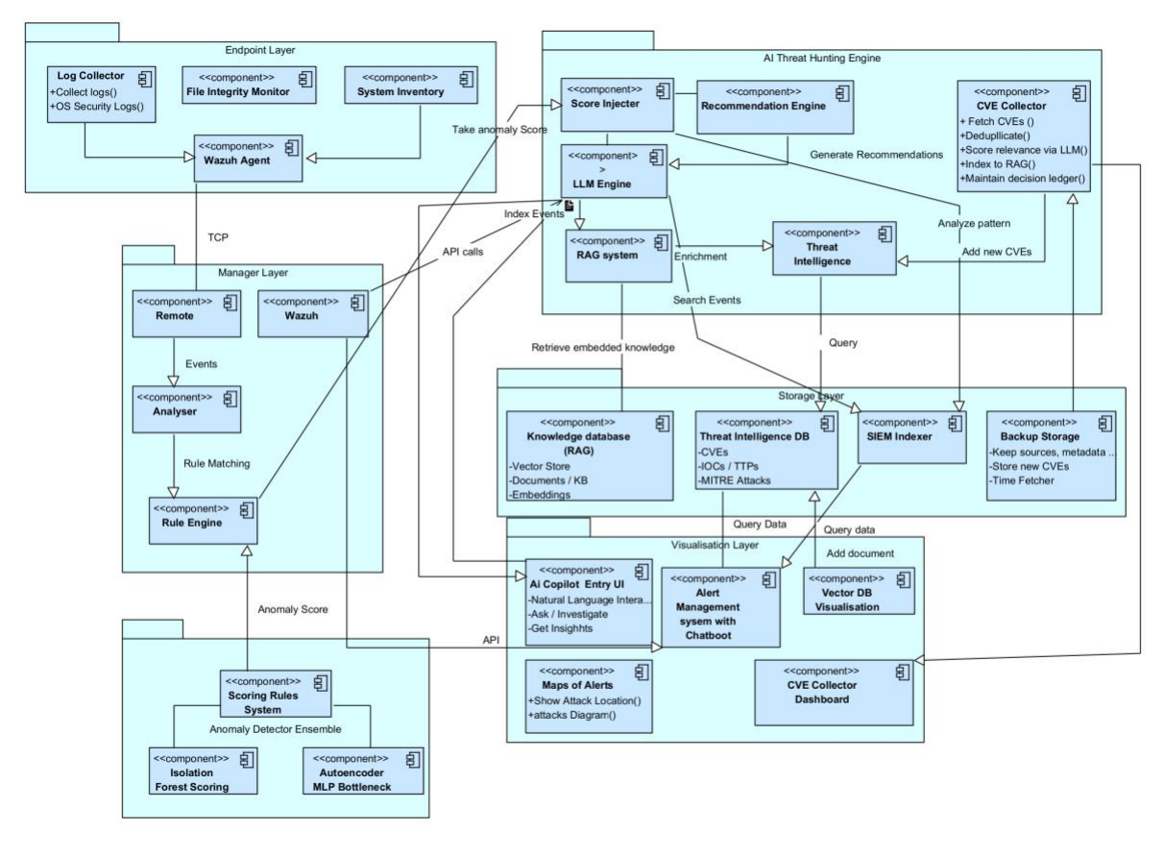
How — architecture: three AI layers on top of standard Wazuh
1 · Anomaly ensemble
IF + Autoencoder score every alert, fused into confidence tiers
2 · RAG copilot
local LLM grounded in MITRE, YARA, Sigma, CVEs — cited answers
3 · CVE agent
fetches, scores, routes new CVEs; PostgreSQL audit ledger
TECHNOLOGY STACK
Wazuh 4.14
Python 3.13
scikit-learn
Ollama · llama3.2
Qdrant
PostgreSQL 17
Flask
Docker
Figure 3.1.1 — thesis, p. 9. Endpoint & manager layers = Wazuh; engine, storage, visualisation = this work.
Notes:
The left half is standard Wazuh — agents, manager, rule engine. Everything above is my contribution: the ensemble scores, the RAG copilot explains with citations, the CVE agent keeps knowledge fresh. Stack is fully local and open source: scikit-learn, Ollama with llama3.2, Qdrant, PostgreSQL, Docker — no cloud API, no per-token cost.

Slide 6
How — the ML flow: train on raw alerts, score every new alert in ~12 ms
TRAINING — offline, zero labels
2,171 real alerts
months of live telemetry
16 features
per alert, z-scaled
Iterative trimming ×3
drop worst-reconstructed 25% → 15%
IF + AE models
calibrated 0–100, saved
SCORING — live, per alert
New Wazuh alert
from alerts.json
Same 16 features
identical extractor
IF score · AE score
two independent opinions
Fusion
0.45·IF + 0.55·AE
Tier
CRITICAL · HIGH · POSSIBLE · NORMAL
No labels anywhere: the model bootstraps its own clean set from contaminated data
Training: thesis §3.2, Tables 4.2.1–4.2.2 · Fusion and tiers: thesis §3.2
Notes:
What the architecture picture cannot show: how training happens. Top lane, offline: months of raw alerts become 16 features; iterative trimming drops the worst-reconstructed tail — where attacks hide — and retrains, three rounds, zero labels. Bottom lane, live: every new alert goes through the same features, both models score it, scores fuse into a tier. About 12 milliseconds per alert, before any human looks at it.

Slide 7
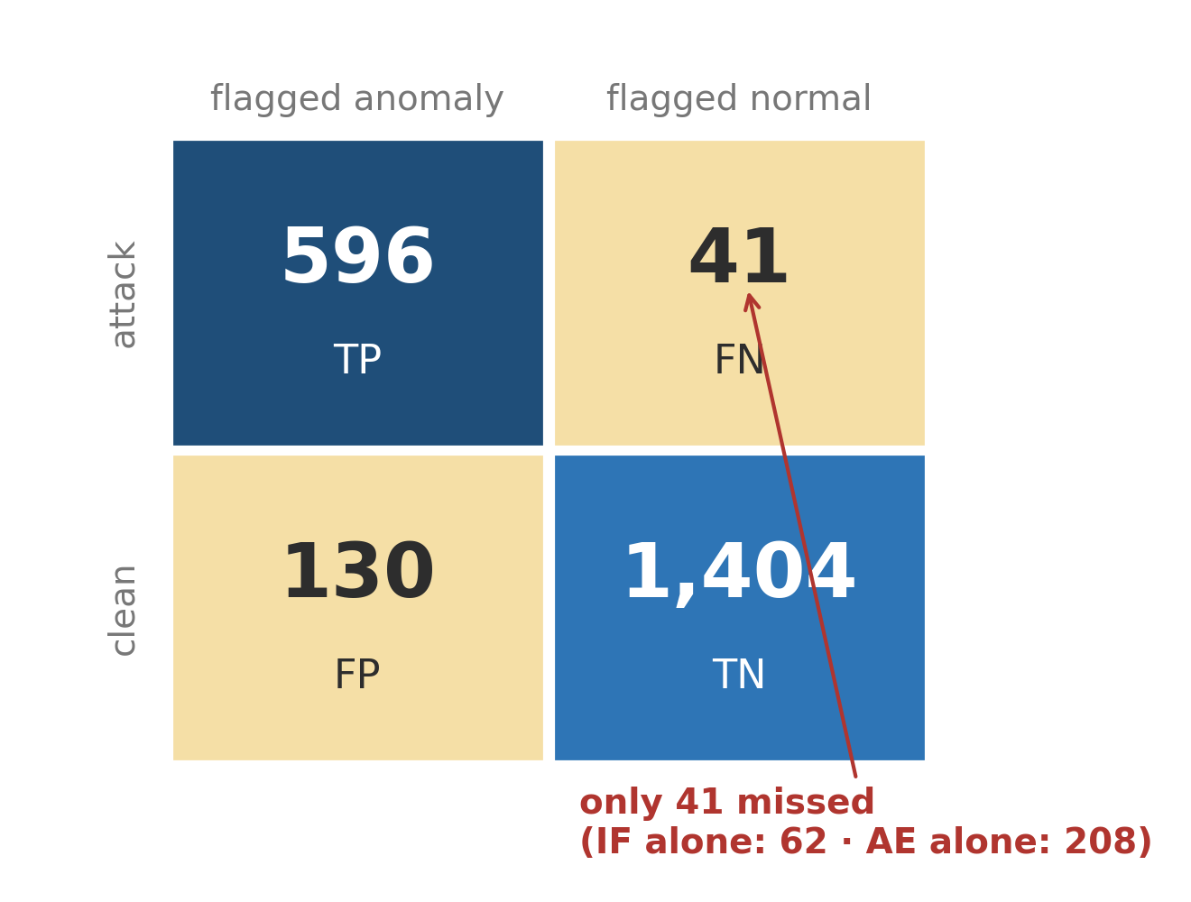
Results — fewest missed attacks, and a copilot that cites instead of inventing
▪ Detection: recall 93.6% with zero labels; false-positive rate down to 6.2%.
▪ Fewest misses: 41 attacks missed — versus 62 (IF alone) and 208 (AE alone).
▪ Retrieval: Hit-Rate 82.9%, MRR 0.695 across 82 annotated queries.
▪ Grounding: 98.3% citation precision — 117 of 119 citations verified correct.
▪ No hallucinations: refused all six fabricated-threat probes; zero wrongful refusals.
Ensemble confusion matrix — 2,171 real alerts
The copilot cites its evidence — and refuses to invent threats
Figure 4.2.7, Table 4.2.4 (detection) · Figure 4.3.6, §4.3 refusal set (generation) — thesis §4
Notes:
Two result families. Detection: the ensemble misses only 41 attacks — the number that matters for a SOC — versus 62 and 208 for the single models, at 6.2% false positives, trained with zero labels. Generation: 98.3% citation precision, and when probed with a fake CVE and an invented APT group it refused every time — while never refusing a real question.

Slide 8
Conclusions — the three claims hold; limits are stated, each one is future work
CONCLUSIONS
FUTURE WORK
▪ Detection works: unsupervised ensemble on real telemetry — no labelling required.
▪ Explanation is measurable: grounded, cited, and it passes the tests.
▪ Knowledge stays current: autonomous agent, human review only where uncertain.
▪ UEBA: entity-level behaviour analytics across alerts.
▪ Baseline: supervised comparison on hand-labelled data.
▪ Retrieval: domain-tuned re-ranker for MITRE technique queries.
Honest limits: ~2,200 training alerts · per-alert scoring · local-LLM latency
github.com/Diana-Secarea/advanced-ai-siem
Notes:
Three conclusions, each shown with evidence: detection works without labels, grounded explanation is measurable and passes, and the knowledge base maintains itself. I state the limits honestly — corpus size, per-alert scoring, LLM latency — and each maps to a concrete future-work item. The full system is public on GitHub.

Slide 9
Live Demo
real attack → live detection → grounded, cited explanation
Questions?
Secărea Diana Maria · diana.secarea1111@gmail.com
github.com/Diana-Secarea/advanced-ai-siem
Notes:
Switch to the browser: Populate Map, Test the Shield — 14 real attack families through the real Wazuh pipeline — click the CRITICAL alert, Investigate with AI, click a source chip to show the exact cited passage. Then take questions with this slide up.

