Slide 1
K-Means model interpretations
Subject: Big Data
Dayan Trijillo
Diana Salazar
Moscow
2024

Slide 2
Content
Data Exploration
Data Manipulation
Data análisis
Normalization
Training Model
Application of the K-Nearest model
Interpretations and hypotheses

Slide 3
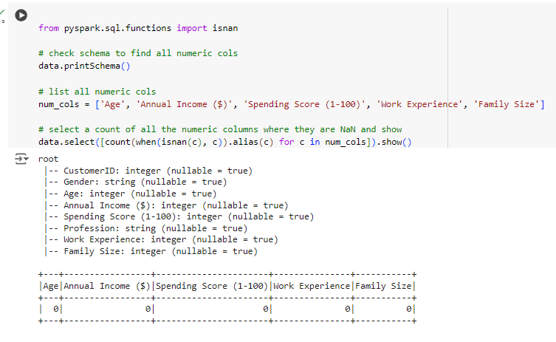
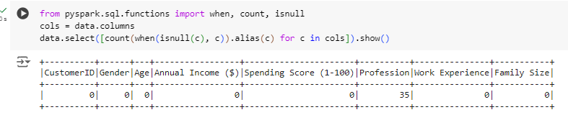
We explore the data
2. We explore the data in search of numeric columns and check if they have undefined values "NaN"
1. We check if the data has null records

Slide 4
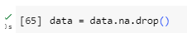
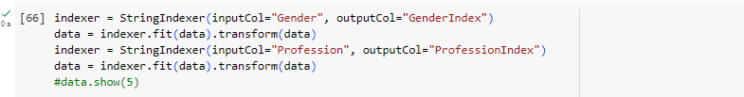
Data manipulation
Remove null entries from the dataframe
We convert non-numerical (categorical) variables into numerical values for further processing

Slide 5
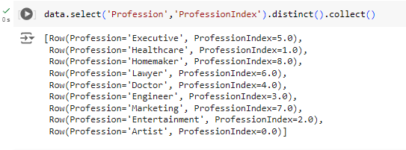
As a result, we see that the "Profession" column, which previously featured null values, now only has nine categories respectively indexed with a numeric entry

Slide 6
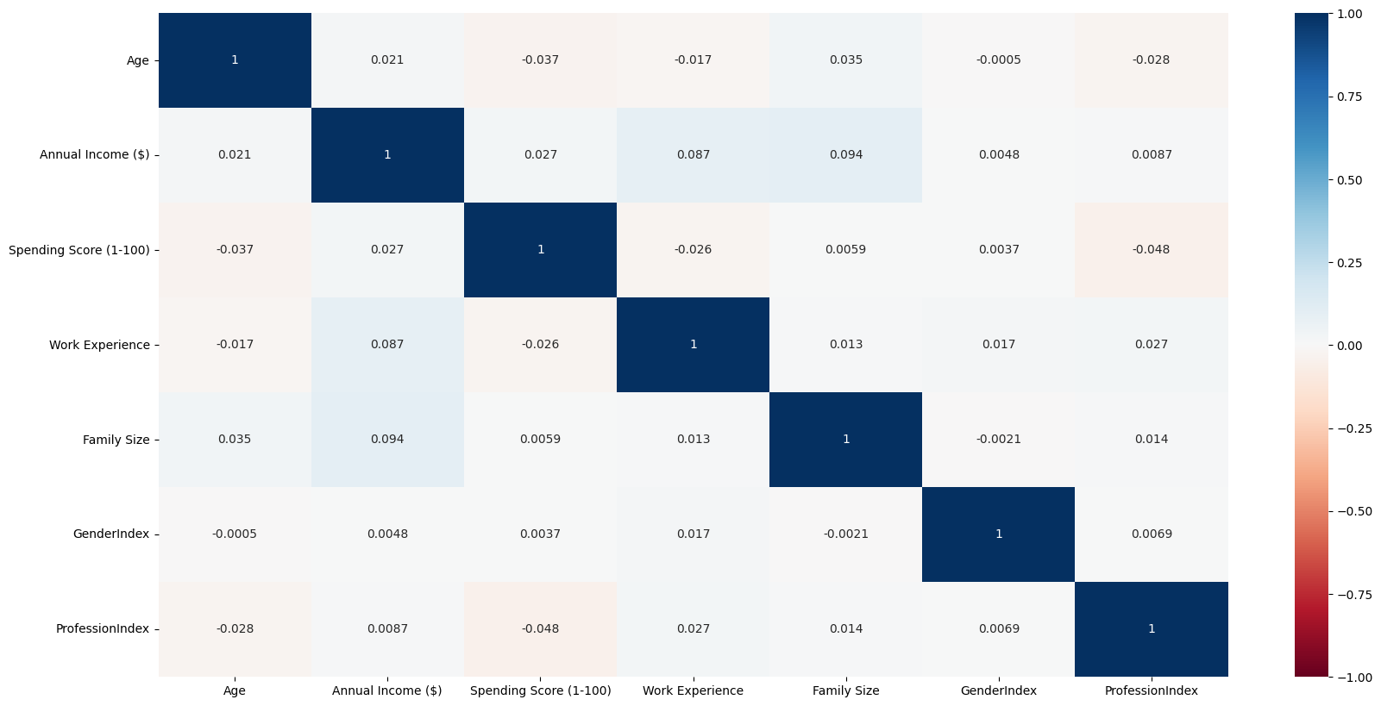
Data analysis
Correlation Matrix

Slide 7
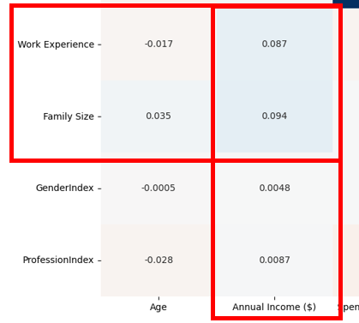
According to the analysis, the variables with the highest correlation index are: "Annual Income ($)" & "Work Experience" and "Annual Income ($)" & "Family Size".

Slide 8
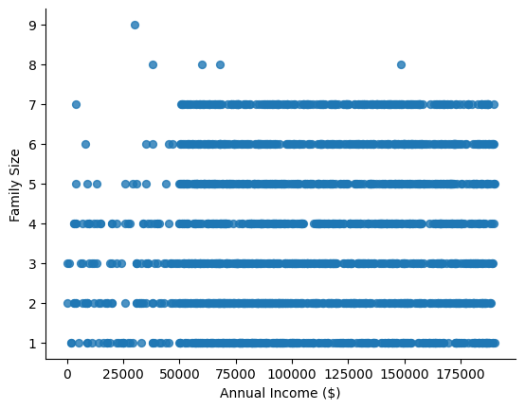
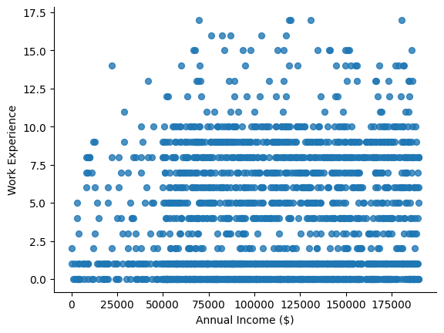
Some graphs to explore these specific variables
Graph 1: Annual Income vs Family Size
Graph 2: Annual Income vs Work Experience

Slide 9
The exploration of these graphs does not offer more information from their interpretation, the only evident observation is that there is low data density when the Annual Income variable is less than 50000 and the Family size variable is greater than 4 in graph 1. Similarly, in graph 2 when the Annual Income variable is less than 50000 and the Work Experience variable is greater than 2 and even if there is not much experience, a worker may have a high salary.

Slide 10
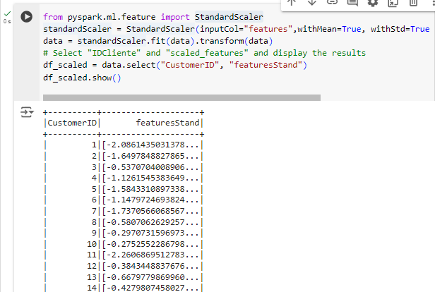
Normalization
We bring the variables to a common scale using the standardization method that guarantees a mean of zero and a unit variance.

Slide 11
Model Training
K-means is an unsupervised classification (clustering) algorithm that groups objects into k groups based on their characteristics. Grouping is done by minimizing the sum of distances between each object and the centroid of its group or cluster.
Since the value of K (number of clusters) is the analyst's choice, we will rely on two methods recorded in the literature to evaluate the heterogeneity of clusters depending on the value of k: Elbow Method: Within Cluster Sum of Squares Silhouette Analysis

Slide 12
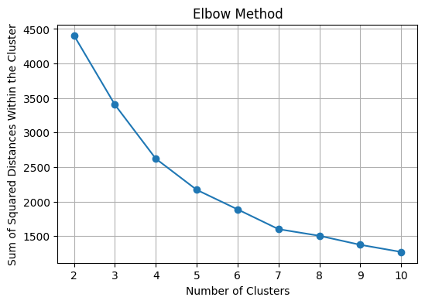
Choosing the number of clusters Elbow Method
Using the Elbow method, we see in the graph the values of the sum of squares within the group (WCSS) on the y-axis, and the different values of K on the x-axis. According with the method, when we see an elbow shape on the graph, we choose the K value where the elbow is created. In our case, this inflection point is not very clear, but it could be k=7 or k=8.

Slide 13
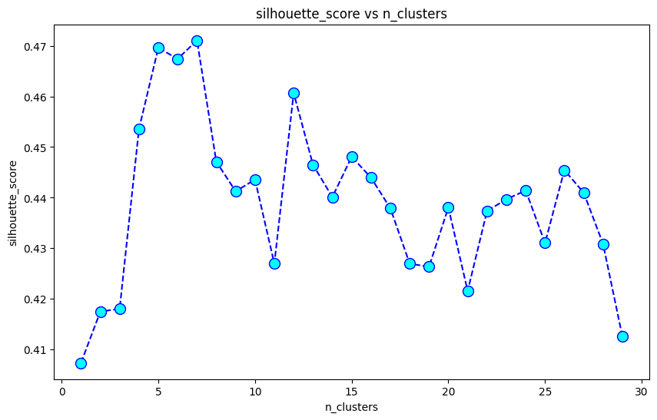
Silhouete score
Because the Silhouette method studies the separation between the resulting clusters, parameterizing it in a range between -1 and 1, the best k to choose is the one that offers the greatest separation between clusters, that is, the number closest to 1. For our case it's 8

Slide 14
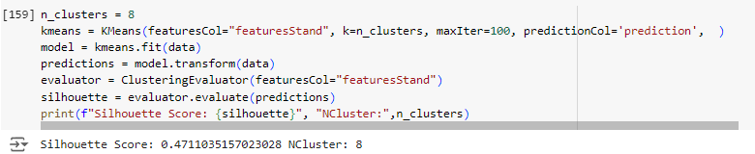
Application of the K-Nearest model
According to the results of Elbow and Silhouette we chose k = 8.

Slide 15
Interpretations and hypotheses

Slide 16
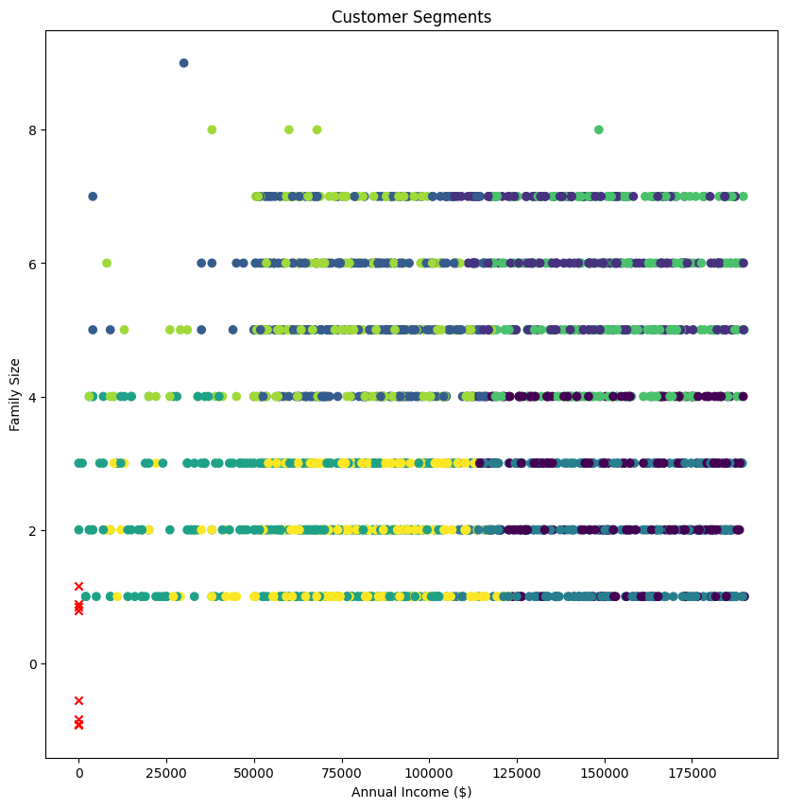
In general, this clustering offers us two thresholds to segment the groups, these are: Family size = 4 and Annual Income ($) = 120000

Slide 17
Interpretaciones e hipótesis "Annual Income ($)“ vs “Family Size“ (a posteriori)
When plotting the results of the k-mean model for the variables "Annual Income ($)" vs "Work Experience" we see that there is a distinction between the clusters as follows: There is a cluster, (yellow color ) that groups families of between 1 and 3 members in salaries between 20000 and maximum 120000 There is a cluster (lime green ) that groups the families with the largest number of members (4 or more) and the lowest salary. There is a cluster (pale blue ) that groups families with the smallest number of members (3 or less) and a salary of more than 125,000.

Slide 18
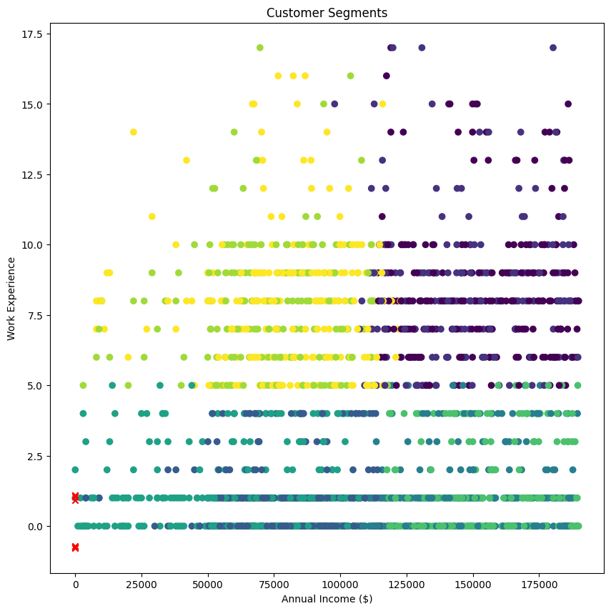
In general, this clustering offers us two thresholds to segment the groups, these are: Work Experience = 5 and Annual Income ($) = 124000

Slide 19
Interpretations and hypotheses "Annual Income ($)" vs "Work Experience" (a posteriori)
When plotting the results of the k-mean model for the variables "Annual Income ($)" vs "Work Experience" we see that there is a distinction between the clusters as follows: There is a cluster, (yellow color ) that groups people with 5 or more years of experience in "low" salaries between 20000 and maximum 120000. This cluster behaves very similar to the color cluster (lime green ). There are very similar clusters (purple) that group people with 5 or more years of experience in "high" salaries of more than 120000 There is a cluster (pale green ) that groups people with less experience (3 or less years) and a salary of more than 125,000.

