Slide 1
Data Collection and Analysis Master of Science in Community Health and Prevention Research
Here is where your presentation begins

Slide 2
Contents of this template
You can delete this slide when you’re done editing the presentation
Fonts | To view this template correctly in PowerPoint, download and install the fonts we used
Used and alternative resources | An assortment of graphic resources that are suitable for use in this presentation
Thanks slide | You must keep it so that proper credits for our design are given
Colors | All the colors used in this presentation
Icons and infographic resources | These can be used in the template, and their size and color can be edited
Editable presentation theme | You can edit the master slides easily. For more info, click here
For more info: SLIDESGO | BLOG | FAQs
You can visit our sister projects: FREEPIK | FLATICON | STORYSET | WEPIK | VIDEVO

Slide 3
Table of contents
01
02
03
04
05
06
Introduction
Techniques
Misconception
You can describe the topic of the section here
You can describe the topic of the section here
You can describe the topic of the section here
Historical
Practices
Exercises
You can describe the topic of the section here
You can describe the topic of the section here
You can describe the topic of the section here

Slide 4
Whoa!
This can be the part of the presentation where you introduce yourself, write your email…

Slide 5
01
Introduction
You can enter a subtitle here if you need it

Slide 6
Introduction
Mercury is the closest planet to the Sun and the smallest one in the entire Solar System. Contrary to popular belief, this planet’s name has nothing to do with the liquid metal. Mercury was, instead, named after the famous Roman messenger god Mercurius
Mercury takes a little more than 58 days to complete its rotation, so try to imagine how long days must be there! Since the temperatures are so extreme, albeit not as extreme as on Venus, Mercury has been deemed to be non-habitable for humans

Slide 7
Data collector & analysis
Do you know what helps you make your point crystal clear? Lists like this one:
They’re simple
You can organize your ideas clearly
You’ll never forget to buy milk!
And the most important thing: the audience won’t miss the point of your presentation

Slide 8
Data collection techniques
Surveying
Observation
Mercury is the closest planet to the Sun and the smallest one in the Solar System—it’s only a bit larger than the Moon
Venus has a beautiful name and is the second planet from the Sun. It’s hot and has a very poisonous atmosphere

Slide 9
Data analysis demystified
Descriptive
Inferential
Predictive
Mercury is the closest planet to the Sun and the smallest of them all
Venus has a beautiful name and is the second planet from the Sun
Despite being red, Mars is actually a cold place. It’s full of iron oxide dust

Slide 10
Unlocking the power
Data insights
Predictive modeling
Mercury is the closest planet to the Sun and the smallest of them all
Venus has a beautiful name, but also very high temperatures
Optimization
Data visualization
Saturn is the second-largest planet in the Solar System
Jupiter is a gas giant and the biggest planet in the Solar System

Slide 11
Data analysis for beginners
Collection
Cleaning
Exploratory
Despite being red, Mars is a cold place
Venus has extremely high temperatures
Neptune is the farthest planet from the Sun
Statistical
Visualization
Hypothesis
Mercury is the closest planet to the Sun
Saturn is a gas giant and has several rings
Jupiter is the biggest planet of them all

Slide 12
Awesome words

Slide 13
—Someone Famous
“This is a quote, words full of wisdom that someone important said and can make the reader get inspired”

Slide 14

A picture is worth a thousand words

Slide 15

A picture always reinforces
the concept
Images reveal large amounts of data, so remember: use an image instead of a long text. Your audience will appreciate it

Slide 16
98,300,000
Big numbers catch your audience’s attention

Slide 17
9h 55m 23s
333,000
386,000 km
Jupiter’s rotation period
The Sun’s mass compared to Earth’s
Distance between Earth and the Moon

Slide 18
Three percentages related
75%
50%
25%
Collection
Quality
Insight
Mercury is the closest planet to the Sun and the smallest of them all
Venus has a beautiful name and is the second planet from the Sun
Despite being red, Mars is actually a cold place. It’s full of iron oxide dust

Slide 19

Computer mockup
You can replace the image on the screen with your own work. Just right-click on it and select “Replace image”

Slide 20
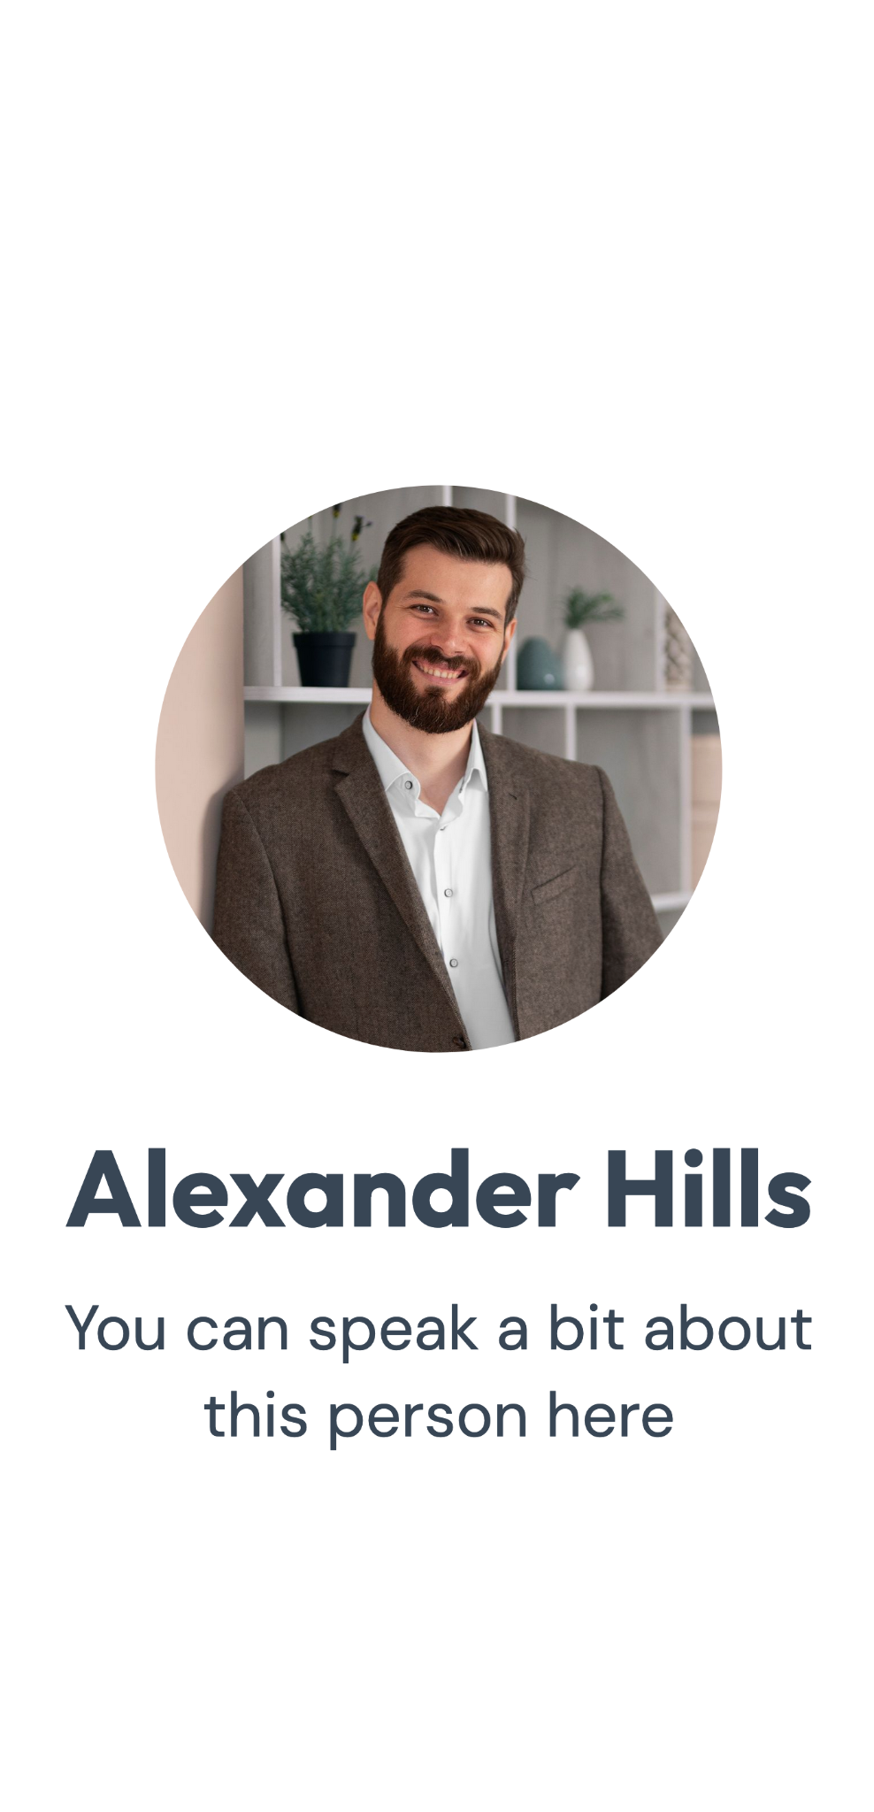
Phone mockup
You can replace the image on the screen with your own work. Just right-click on it and select “Replace image”

Slide 21
Where did we take the sample from?
United Kingdom
Mercury is the closest planet to the Sun and the smallest of them all
United States
Venus has a beautiful name and is the second planet from the Sun

Slide 22
Historical
1XXX
1XXX
1XXX
1XXX
Venus has a beautiful name
Mercury is very small planet
Mars is full of iron oxide dust
Jupiter is an enormous planet
2XXX
2XXX
2XXX
Now
Saturn is a gas giant and has rings
Uranus is one of the ice giants
Earth is the planet that harbors life
Neptune is very far from the Sun

Slide 23
Data collection: best practices
Clarity
Precision
Mars is actually a very cold place
Saturn is a gas giant and has several rings
Privacy
Variety
Mercury is the closest planet to the Sun
Venus has extremely high temperatures

Slide 24
Example of data collection tasks
Tasks | Descriptions | Timeline
Task A | You can add a description here | 1 week
Task B | You can add a description here | 2 weeks
Task C | You can add a description here | 3 weeks
Task D | You can add a description here | 4 weeks

Slide 25
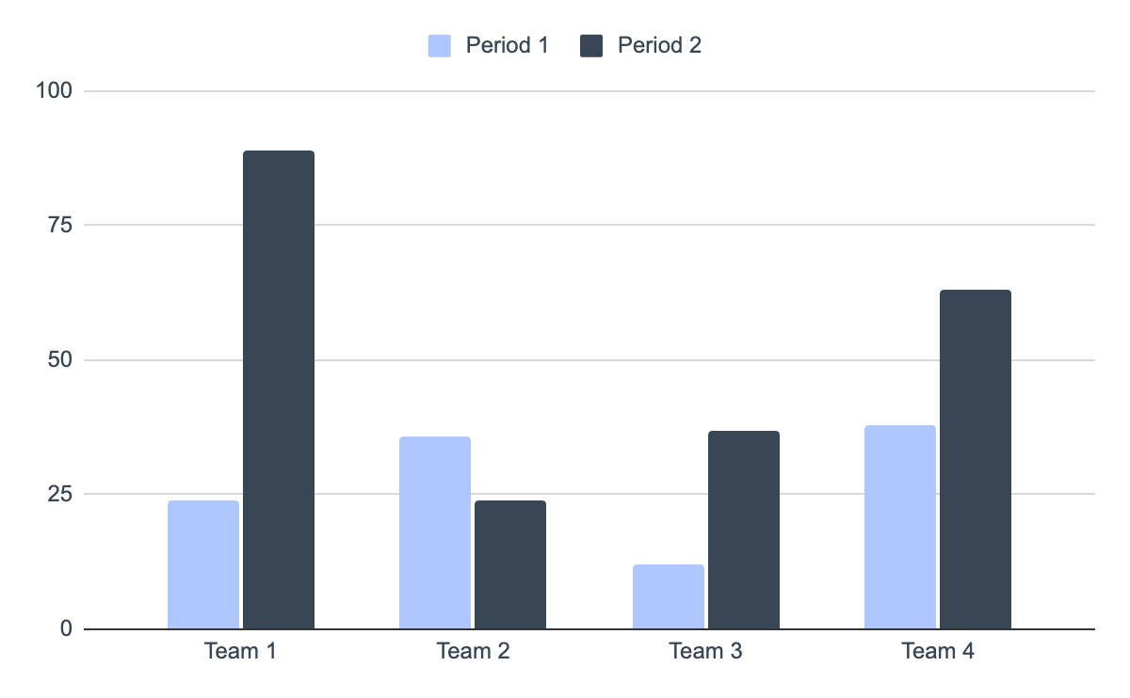
You can use this graph
Mercury
Mercury is the closest planet to the Sun and the smallest of them all
Venus
Venus has a beautiful name and is the second planet from the Sun
Follow the link in the graph to modify its data and then paste the new one here. For more info, click here

Slide 26


Our team
Alexander Hill
Maria Karla
You can speak a bit about this person here
You can speak a bit about this person here

Slide 27
Data collection vs data analysis
Data collection
Data analysis
Despite being red, Mars is actually a cold place. It’s full of iron oxide dust
Mercury is the closest planet to the Sun and the smallest of them all
Venus has a beautiful name and is the second planet from the Sun
Saturn has several rings. It’s composed mostly of hydrogen and helium
Neptune is the farthest planet from the Sun and the fourth-largest
Jupiter is a gas giant and the biggest planet in the Solar System

Slide 28
Project planner
November 2XXX
Project | Mon | Tue | Wed | Thu | Fri | Sat | Sun
Project 1
Project 2
Project 3
Project 4
Project 5

Slide 29
Assignment brief
Qualification | Mercury is a small planet
Unit number & tittle | Venus is a hot planet
Learning aim(s) | We all live on Earth
Assignment title | Saturn is a gas giant and has rings. It’s composed mostly of hydrogen and helium
Assessor | Jupiter is a huge gas giant
Issue date | 12/10/2XXX
Hand in deadline | 12/12/2XXX
Scenario | Community health and prevention research relies heavily on the collection and analysis of data to inform effective interventions. In this essay, critically examine the impact of different data collection methods on the success of community health initiatives
Task 1 | Discuss the advantages and limitations of various data collection techniques, such as surveys, interviews, observational studies, and secondary data analysis, and how they influence the development and implementation of prevention strategies

Slide 30
Rubric
 | Level 1 | Level 2 | Level 3 | Level 4
Performance 1 | You can add a description here | You can add a description here | You can add a description here | You can add a description here
Performance 2 | You can add a description here | You can add a description here | You can add a description here | You can add a description here
Performance 3 | You can add a description here | You can add a description here | You can add a description here | You can add a description here
Performance 4 | You can add a description here | You can add a description here | You can add a description here | You can add a description here

Slide 31
Exercise 1
What is the term for the process of ensuring that data collected is accurate and reliable?
In data collection, what is the term for a representative subset of a population?
A | Data analysis
A | Sample
B | Data interpretation
B | Survey
C | Data validation
C | Experiment
D | Data visualization
D | Observation

Slide 32
Exercise 2
Explain what is the difference between data collection and data analysis?
You can answer here
How to unlock the power of data collection and analysis?
You can answer here

Slide 33
What’s the difference?
Data collection
Data analysis
Survey
Descriptive
Mars is actually a very cold place
Jupiter is a huge gas giant
Interview
Inferential
Venus has high temperatures
Mercury is a small planet
Observation
Hypothesis
Earth is the planet with life
Saturn has several rings

Slide 34
Let’s review before wrapping up
Data collection
Data analysis
Information-gathering
Insights-generation
Venus has a beautiful name and is the second planet from the Sun
Despite being red, Mars is actually a cold place. It’s full of iron oxide dust

Slide 35
Thanks!
Do you have any questions?
youremail@freepik.com
+34 654 321 432
yourwebsite.com
Please keep this slide for attribution

Slide 36
Icon pack

Slide 37
Alternative resources
Here’s an assortment of alternative resources whose style fits that of this template:
Vectors
Geometric models background in flat design

Slide 38
Resources
Did you like the resources used in this template? Get them on these websites:
Vectors
International nurses day template
Icons
Icon Pack: Research and Development | Lineal
Photos
Student posing during a group study session with colleagues
Friends learning in a study group
Front view smiley man holding laptop
Portrait of senior woman in professional blazer outdoors

Slide 39
Instructions for use
If you have a free account, in order to use this template, you must credit Slidesgo by keeping the Thanks slide. Please refer to the next slide to read the instructions for premium users.
As a Free user, you are allowed to:
Modify this template.
Use it for both personal and commercial projects.
You are not allowed to:
Sublicense, sell or rent any of Slidesgo Content (or a modified version of Slidesgo Content).
Distribute Slidesgo Content unless it has been expressly authorized by Slidesgo.
Include Slidesgo Content in an online or offline database or file.
Offer Slidesgo templates (or modified versions of Slidesgo templates) for download.
Acquire the copyright of Slidesgo Content.
For more information about editing slides, please read our FAQs or visit our blog:
https://slidesgo.com/faqs and https://slidesgo.com/slidesgo-school

Slide 40
Instructions for use (premium users)
As a Premium user, you can use this template without attributing Slidesgo or keeping the Thanks slide.
You are allowed to:
Modify this template.
Use it for both personal and commercial purposes.
Hide or delete the “Thanks” slide and the mention to Slidesgo in the credits.
Share this template in an editable format with people who are not part of your team.
You are not allowed to:
Sublicense, sell or rent this Slidesgo Template (or a modified version of this Slidesgo Template).
Distribute this Slidesgo Template (or a modified version of this Slidesgo Template) or include it in a database or in any other product or service that offers downloadable images, icons or presentations that may be subject to distribution or resale.
Use any of the elements that are part of this Slidesgo Template in an isolated and separated way from this Template.
Register any of the elements that are part of this template as a trademark or logo, or register it as a work in an intellectual property registry or similar.
For more information about editing slides, please read our FAQs or visit our blog:
https://slidesgo.com/faqs and https://slidesgo.com/slidesgo-school

Slide 41
Fonts & colors used
This presentation has been made using the following fonts:
Outfit
(https://fonts.google.com/specimen/Outfit)
DM Sans
(https://fonts.google.com/specimen/DM+Sans)
#384655
#ffffff
#afc7ff
#9fcbfd
#68daf8

Slide 42





Storyset
Create your Story with our illustrated concepts. Choose the style you like the most, edit its colors, pick the background and layers you want to show and bring them to life with the animator panel! It will boost your presentation. Check out how it works.
Pana
Amico
Bro
Rafiki
Cuate

Slide 43
Use our editable graphic resources...
You can easily resize these resources without losing quality. To change the color, just ungroup the resource and click on the object you want to change. Then, click on the paint bucket and select the color you want. Group the resource again when you’re done. You can also look for more infographics on Slidesgo.

Slide 46
JANUARY
FEBRUARY
MARCH
APRIL
MAY
JUNE
PHASE 1
Task 1
Task 2
PHASE 2
Task 1
Task 2
JANUARY
FEBRUARY
MARCH
APRIL
PHASE 1
Task 1
Task 2

Slide 49
...and our sets of editable icons
You can resize these icons without losing quality.
You can change the stroke and fill color; just select the icon and click on the paint bucket/pen.
In Google Slides, you can also use Flaticon’s extension, allowing you to customize and add even more icons.

Slide 50
Educational Icons
Medical Icons

Slide 51
Business Icons
Teamwork Icons

Slide 52
Help & Support Icons
Avatar Icons

Slide 53
Creative Process Icons
Performing Arts Icons

Slide 54
Nature Icons

Slide 55
SEO & Marketing Icons

Slide 56


