Slide 1
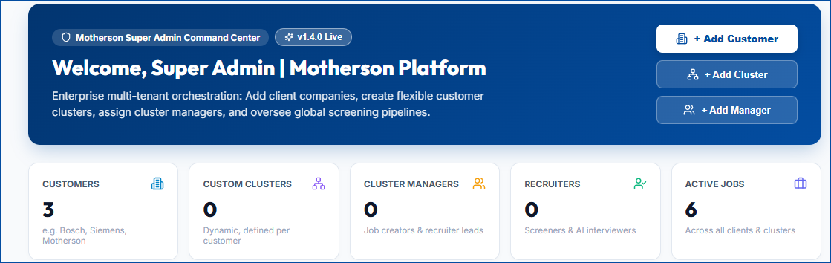
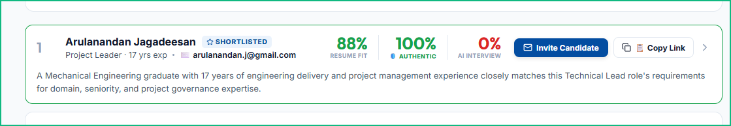
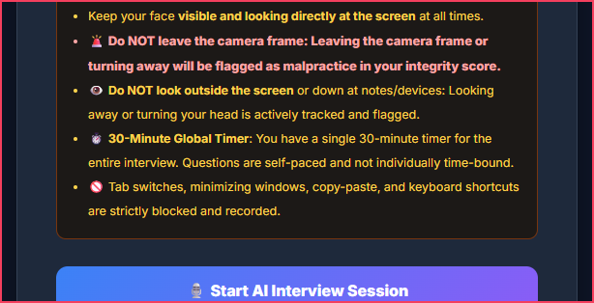
m
MOTHERSON GROUP • ENTERPRISE TALENT OS • V1.4.0 PRODUCTION LIVE
Motherson CogniHire
Autonomous AI Candidate Screening, Multi-Tenant Governance & Anti-Cheat Proctoring
85% CUT
Time-to-Shortlist
99.4%
Anti-Cheat Accuracy
4-PILLAR
Multi-Factor Scoring
100%
Tenant RBAC Isolated
01 • HIERARCHY & GOVERNANCE
Enterprise RBAC Hierarchy
02 • MULTI-FACTOR INTELLIGENCE
4-Pillar AI Fit Scoring
03 • ZERO-TRUST SECURITY
AI Anti-Cheat & Proctoring
👑 Motherson Super Admin: Global platform owner; configures enterprise clients & clusters.
🏢 Enterprise Customers: Isolated tenants (Bosch, Siemens) with dynamic scoping.
⚡ Dynamic Clusters: Zero hardcoded clusters; created on-the-fly (Mechanical, SAP).
👔 Managers & 🎯 Recruiters: Cluster managers post jobs; recruiters screen candidates.
Technical Skills (40%) — Hard requirements match & tool proficiency
🛡️ Prompt-Injection Defense: Strips hidden text; penalizes verbatim JD echo.
👁️ Gaze & Teleprompter: Flags downward glances (>3.5s) at smartphones.
⌨️ Keystroke Cadence Dynamics: Detects clipboard dumps & high WPM typing bursts.
🤖 ChatGPT Stylometry Audit: Calculates AI Probability % & synthetic bot phrasing.
Experience Fit (25%) — Tenure progression, seniority & impact
Domain Relevance (20%) — Automotive & industrial engineering depth
Education & Creds (15%) — Degree pedigree, verified credentials
⚖️ Comparative Delta: #1 Arulanandan (88%) vs #2 Varaprasad (52% [+36% margin]). Claude memos eliminate keyword bias.
Live UI: Super Admin Command Center & Dynamic Customer Clusters
Live UI: 30-Min Proctored Assessment with Gaze Malpractice Rules
04 • JOB REQUISITION CONTROL
Job Lifecycle & Client Manager
05 • DECISION GOVERNANCE
Reversible Hiring Decisions
06 • REPORTING & PERSISTENCE
Multi-Sheet Excel & Cloud Sync
• 3-Stage Pipeline: Draft Requisition ➔ [Post to Recruiters] ➔ [Close Job].
• Client Manager Name: Directly assigned in JD (e.g., Klaus Richter - Bosch).
• Stage Gates: Recruiter upload unlocked only when manager opens requisition.
• Dynamic Decision Toggle: 1-click switch [✓ Selected] / [✕ Not Selected].
• Live Vacancy Counter: Real-time progress bar (e.g. 3 of 4 Positions Staffed).
• Zero-Risk Undo: Instant reversal & reset safety to prevent HR errors.
• Multi-Sheet Excel (.xlsx): Sheet 1 (Openings/Pipeline) + Sheet 2 (Candidates/Scores).
• 1-Click Export: In-browser SheetJS generation with zero backend latency.
• Dual Persistence: Local ACID SQLite (sift.db) + Cloud auto-sync (GCS).
Motherson CogniHire v1.4.0 • Enterprise Autonomous Candidate Screening & Proctoring System • Confidential & Proprietary • © 2026 Motherson Group

