Slide 1
m
MOTHERSON GROUP • ENTERPRISE TALENT OS
CogniHire
Next-Generation Autonomous Candidate Screening, Multi-Tenant Governance & Video Proctoring
85% CUT
Time-to-Shortlist Cut
From 14 days to under 4 hours via automated multi-model pipeline
99.4%
Anti-Cheat Integrity
Detects smartphone teleprompters, ChatGPT stylometry & gaze shifts
4-PILLAR
Multi-Factor Fit Scoring
Skills (40%), Experience (25%), Domain (20%), Education (15%)
100%
Multi-Tenant Isolation
Strict data separation across Super Admin, Customers, Clusters & Recruiters

Slide 2
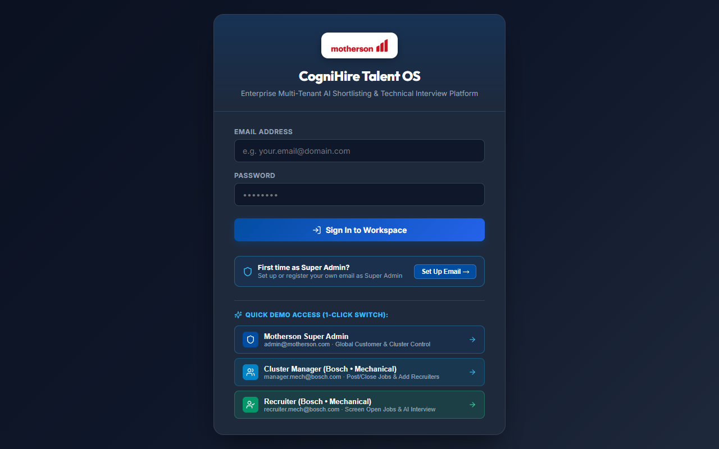
m
01 • AUTHENTICATION & ACCESS CONTROL
CogniHire Live Login & Dynamic Role Switcher
Single-pane authentication with 1-click persona switching for instant stakeholder demonstration
85% CUT
Time-to-Shortlist
99.4%
Anti-Cheat Accuracy
4-PILLAR
Multi-Factor Scoring
100%
Tenant RBAC Isolated
KEY CAPABILITIES & ARCHITECTURE
✔ Motherson Corporate Authentication
Secure sign-in supporting self-service Super Admin registration, enterprise JWT sessions, and role persistence.
✔ 1-Click Quick Demo Access
Instant switching between Motherson Super Admin, Cluster Manager (Bosch Mechanical), and Recruiter personas with zero friction.
✔ Strict Multi-Tenant Scoping
Session context binds every request to client tenant and cluster boundaries with complete cryptographic isolation.
Live Production Interface: Authentication Portal & 1-Click Role Switcher
Motherson CogniHire v1.4.0 • Enterprise Autonomous Candidate Screening & Proctoring System • Confidential & Proprietary • © 2026 Motherson Group

Slide 3
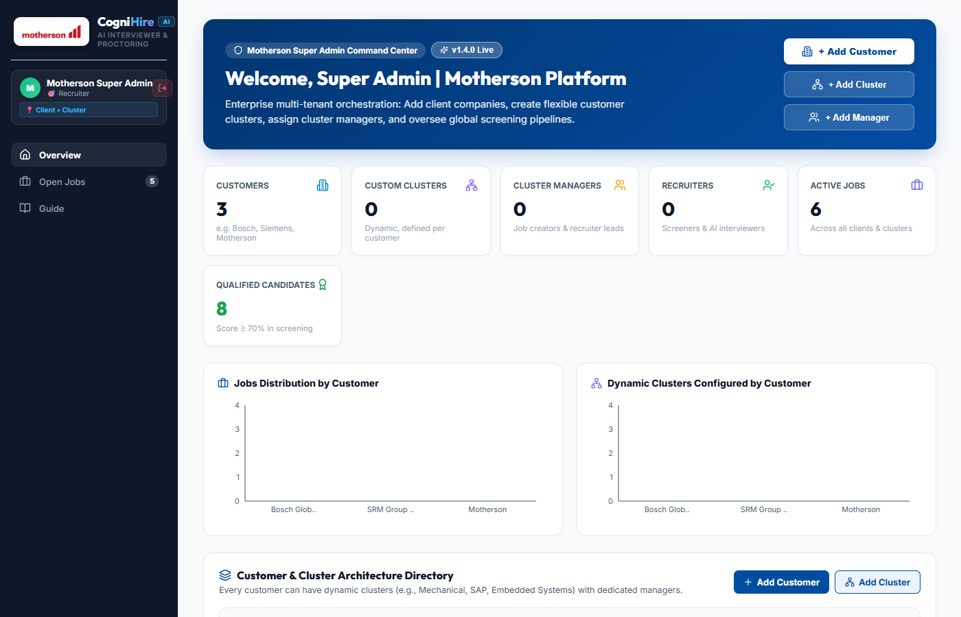
m
02 • ENTERPRISE GOVERNANCE
Motherson Super Admin Command Center
Centralized enterprise governance: customer onboarding, dynamic cluster mapping, and global pipelines
85% CUT
Time-to-Shortlist
99.4%
Anti-Cheat Accuracy
4-PILLAR
Multi-Factor Scoring
100%
Tenant RBAC Isolated
KEY CAPABILITIES & ARCHITECTURE
✔ Customer & Client Onboarding
Super Admin onboards enterprise accounts (e.g., Bosch, Siemens, Motherson) with full tenant parameter isolation.
✔ Zero-Hardcoding Dynamic Clusters
Create functional business clusters on-the-fly (Mechanical, SAP, Mobility, Embedded) customized to client organizational trees.
✔ Manager Allocation & Analytics
Assign dedicated cluster leads, track aggregate requisition quotas, and view cross-client screening distributions.
Live Production Interface: Super Admin Command Center with Dynamic Clusters & Analytics
Motherson CogniHire v1.4.0 • Enterprise Autonomous Candidate Screening & Proctoring System • Confidential & Proprietary • © 2026 Motherson Group

Slide 4
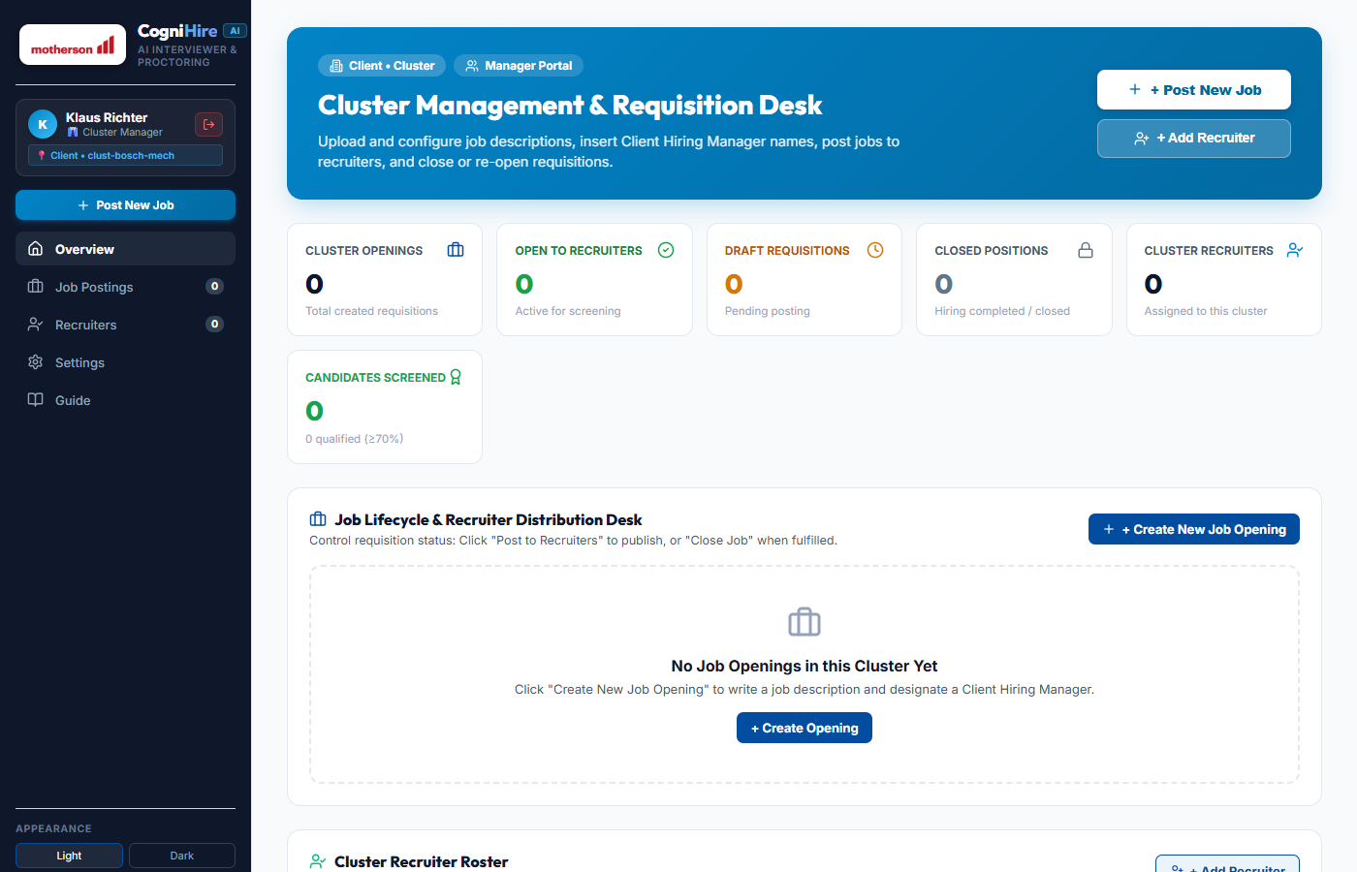
m
03 • REQUISITION GOVERNANCE
Cluster Management & Requisition Desk
Stage-gated job lifecycle control with explicit Client Hiring Manager designation
85% CUT
Time-to-Shortlist
99.4%
Anti-Cheat Accuracy
4-PILLAR
Multi-Factor Scoring
100%
Tenant RBAC Isolated
KEY CAPABILITIES & ARCHITECTURE
✔ Client Hiring Manager Designation
Managers insert client manager names (e.g., Klaus Richter - Bosch) directly into requisitions for end-to-end attribution.
✔ 3-Stage Job Lifecycle Gates
Draft Requisition ➔ [Post to Recruiters] (unblocks screening) ➔ [Close Job] (freezes pipeline when quotas are met).
✔ Recruiter Delegation Desk
Cluster managers invite and manage recruiters assigned specifically to their functional domain cluster.
Live Production Interface: Cluster Manager Requisition Desk with Job Status Gates
Motherson CogniHire v1.4.0 • Enterprise Autonomous Candidate Screening & Proctoring System • Confidential & Proprietary • © 2026 Motherson Group

Slide 5
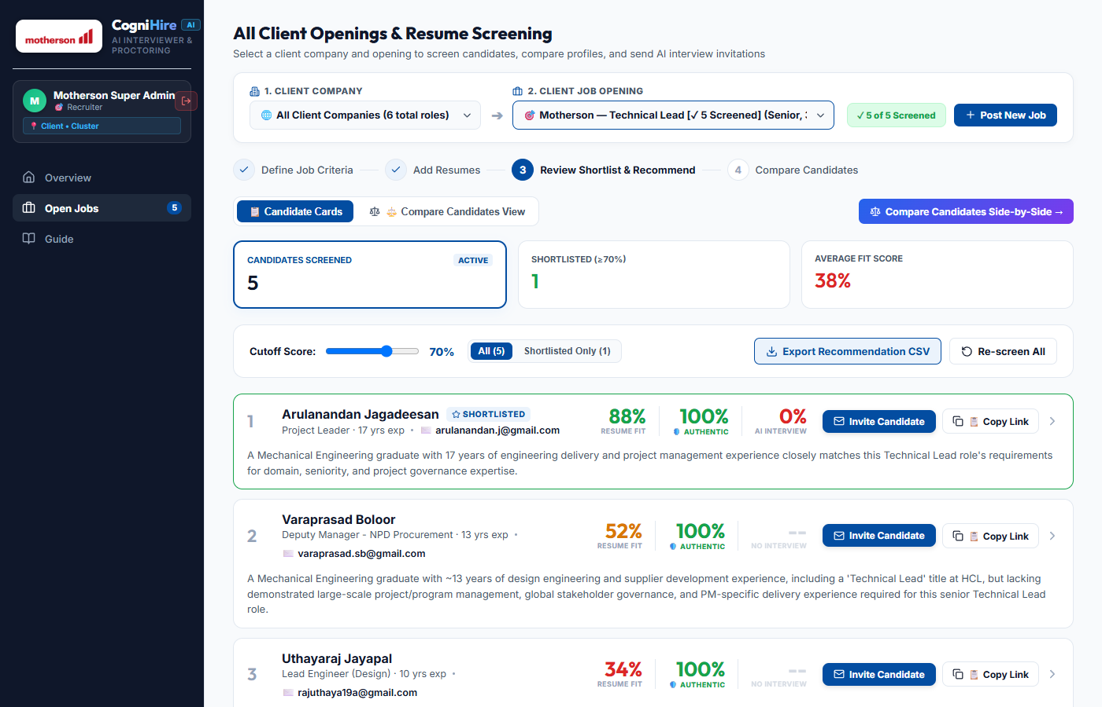
m
04 • AUTONOMOUS RESUME SCREENING
Automated Shortlisting & 4-Pillar AI Fit
Multi-criteria fit evaluation powered by Claude & Gemini, eliminating keyword stuffing
85% CUT
Time-to-Shortlist
99.4%
Anti-Cheat Accuracy
4-PILLAR
Multi-Factor Scoring
100%
Tenant RBAC Isolated
KEY CAPABILITIES & ARCHITECTURE
✔ 4-Pillar Weighted Fit Engine
Technical Skills (40%), Experience (25%), Domain (20%), and Education (15%) mathematically combined into a unified fit index.
✔ Reversible HR Hiring Decisions
Dynamic 1-click toggle [✓ Selected] / [✕ Not Selected] with live vacancy fulfillment meter (3 of 4 Staffed) and undo safety.
✔ Dynamic Cutoff Threshold
Interactive score slider dynamically segments candidate pool into Shortlisted, Moderate, and Non-matching tiers.
Live Production Interface: Candidate Shortlist Table with 88% Match & Reversible Verdicts
Motherson CogniHire v1.4.0 • Enterprise Autonomous Candidate Screening & Proctoring System • Confidential & Proprietary • © 2026 Motherson Group

Slide 6
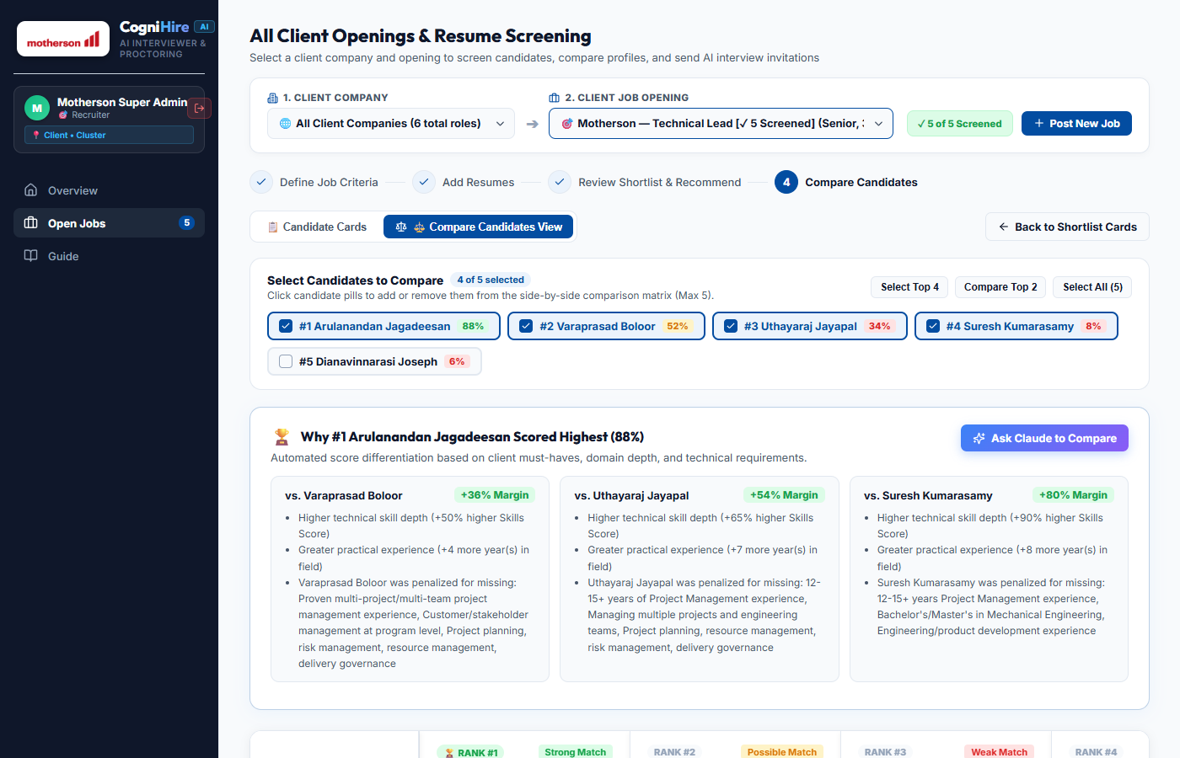
m
05 • COMPARATIVE TALENT INTELLIGENCE
Head-to-Head Candidate Comparison Matrix
Automated delta score analysis and side-by-side multi-attribute radar evaluation
85% CUT
Time-to-Shortlist
99.4%
Anti-Cheat Accuracy
4-PILLAR
Multi-Factor Scoring
100%
Tenant RBAC Isolated
KEY CAPABILITIES & ARCHITECTURE
✔ Why #1 Scored Highest
Algorithmic score justification memos: #1 Arulanandan (+36% margin vs #2, +54% margin vs #3) across must-have criteria.
✔ Side-by-Side Multi-Attribute Matrix
Compares technical depth, practical tenure, degree pedigree, and domain alignment across Top 5 contenders simultaneously.
✔ Executive Comparison Memo
One-click Claude executive summary generator producing board-ready hiring rationales.
Live Production Interface: Top Candidate Comparison Matrix with Margin Justifications
Motherson CogniHire v1.4.0 • Enterprise Autonomous Candidate Screening & Proctoring System • Confidential & Proprietary • © 2026 Motherson Group

Slide 7
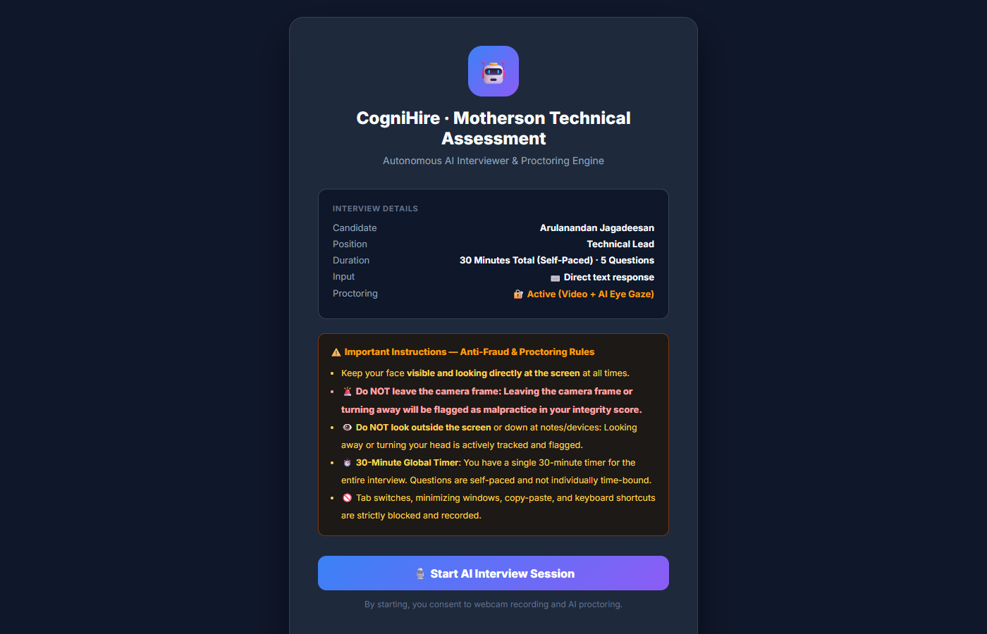
m
06 • ZERO-TRUST PROCTORING
AI Video Interview Proctoring & Anti-Cheat
Two-tier defense neutralizing adversarial prompt injections, copy-paste, and smartphone teleprompters
85% CUT
Time-to-Shortlist
99.4%
Anti-Cheat Accuracy
4-PILLAR
Multi-Factor Scoring
100%
Tenant RBAC Isolated
KEY CAPABILITIES & ARCHITECTURE
✔ Sustained Gaze Telemetry
MediaPipe video tracking flags downward glances (>3.5s) at hidden smartphone teleprompters placed in front of screens.
✔ Keystroke Dynamics & WPM Cadence
Detects instant clipboard dumps and superhuman typing speed bursts devoid of human thinking pauses.
✔ ChatGPT Stylometry & Global Timer
Calculates AI Content Probability % and enforces a tamper-monitored 30-minute global exam countdown clock.
Live Production Interface: Proctored Technical Assessment Portal with Gaze Malpractice Rules
Motherson CogniHire v1.4.0 • Enterprise Autonomous Candidate Screening & Proctoring System • Confidential & Proprietary • © 2026 Motherson Group

