Slide 1
Structure of computer systems
Cursul 10
Interconnection systems

Slide 2
Interconnection systems
Purpose:
  connect different components of a computer system (CPU, memory, interfaces, peripheral devices) - buses
  interconnect multiple computer systems – networks
why?
  exchange of data and instruction codes
  synchronization and coordination of actions
  events signaling

Slide 3
Interconnection systems
Evolution
  Inside of a computer system:
    first 3 generation of computers – dedicated connections between computer modules
    microprocessors (4th generation) – system bus
    high performance processors – multiple buses with different speeds and destinations
    multi-core processors – network-on-chip
  Between computer systems:
    first generations – dedicated point-to-point serial connections
    the 80’s – network communication and Internet
    last years – very high speed interconnection systems for Grids and clusters (e.g. InfiniBand)

Slide 4
Interconnection systems
Design decisions
  general purpose or dedicated connections
  serial or parallel
  synchronous or asynchronous
  speed
  dimension/distance (in circuit, on board, on system, inter-system)
  single or multi-master

Slide 5
Interconnection systems
Interconnection system examples
  General purpose, parallel, asynchronous, single and multi-master bus (classical system bus)
  General purpose, parallel, synchronous bus
  Transactional parallel buses
  Specialized, parallel buses
  Serial, point-to-point, and multipoint asynchronous buses
  Serial, synchronous buses
  Peripheral serial buses

Slide 6
General purpose, parallel, asynchronous bus (classical bus)
purpose – one interconnection environment for all the components of a computer
features:
  parallel bus – transfer is made on multiple parallel lines (signals)
  asynchronous – the bus in not controlled by clock signal; signals travel on the bus with a limited speed causing delays
  single master – only one module (the CPU) can initiate transfers on the bus
  multi-master – multiple modules can initiate transfers on the bus

Slide 7
General purpose, parallel, asynchronous bus (classical bus)
signals (sub-buses):
  address signals A₀- A_{n} – used for specifying the location of the transfer (memory location or I/O register/port
    2^{n} – the maximum addressing space allowed by the bus
    selecting an optimal n:
      too small – limit the addressing space
      too big – wasted space on the board
  data bus D₀-D_{m} – used for transferring data or instruction codes
    m - the maximum width of the data, which can be transferred in a bus cycle; in accordance with the CPU structure (e.g. 8, 16, 32 or 64 bits)

Slide 8
General purpose, parallel, asynchronous bus (classical bus)
signals (cont.)
  control and command signals – used to control the traffic on the bus (examples from ISAx86)
    command signals – determine the type of the transfer cycle
      MRDC\ (memory read command), MWTC\, IORC\, IOWC\, INTA\
    control signals – enable and disable data and address amplifiers, validate transfers, reset the system
      DEN (data enable), ALE (address latch enable), Ready, RST (reset)
    interrupt signals – used for signaling events
      IRQ₀-IRQ₇ (interrupt request)
    bus arbitration signals – in multi-master buses, used for deciding who has the control of the bus
      BRQ, BGT or HOLD, HOLDA
    clock signals – used for synchronization or for generating other useful frequencies
      CLK, BCLK (bus clock), PCLK (peripheral clock)
  power signals
    GND, Vcc, +12V, -12V

Slide 9
General purpose, parallel, asynchronous bus (classical bus)
a single bus configuration with: CPU(s), memory modules, Input/Output interfaces and devices
CPU
Memory
Memory
Address bus
Data bus
System bus
Control bus
I/O int.
I/O int.
I/O dev.
I/O dev.

Slide 10
General purpose, parallel, asynchronous bus (classical bus) - time diagrams
Memory Read Cycle
A₀-A_{n}
valid address
MRDC
MWTC
Ready
D₀-D_{m}
valid data
t_{access}
t_{cycle}

Slide 11
General purpose, parallel, asynchronous bus (classical bus) - time diagrams
Memory Write Cycle
A₀-A_{n}
valid address
MRDC
MWTC
Ready
D₀-D_{m}
valid data
t_{access}
t_{cycle}

Slide 12
General purpose, parallel, asynchronous bus (classical bus)
Advantages:
  simple operation (easy to understand and debug)
  simple design of bus modules
  no dimensional limitations (asynchronous mode)
  single communication environment for all the components of a computer
Drawbacks:
  low speed – limited to the slowest module
  limited number of modules connected on the bus (10-16 – see fan-out of a TTL circuit)

Slide 13
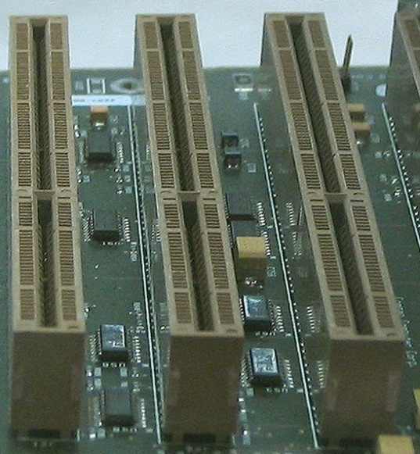
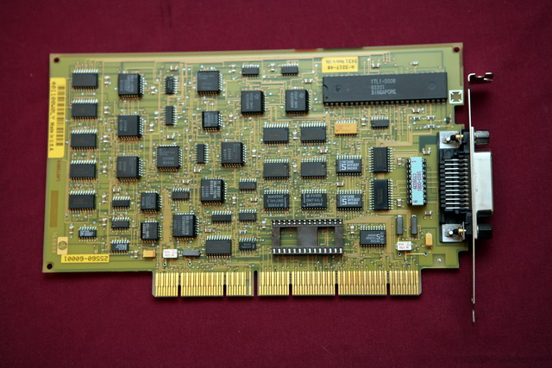
General purpose, parallel, asynchronous bus (classical bus)
Examples of general purpose, parallel, asynchronous buses:
  8086 bus
  ISA (Industry Standard Architecture), EISA (extended ISA)
  S-100
EISA connectors and Interface board

Slide 14
General purpose, parallel, synchronous bus
Why ? (Purpose): increase the speed through a better control of timing
How ? (Principles)
  every signal on the bus is related (synchronized) with the clock signal
  modules may anticipate next steps (does not have to wait until a signal arrives to the module, as in asynchronous mode)
  modules on the bus must have some intelligence
Examples:
  PCI
  P6 (Pentium Pro) bus

Slide 15
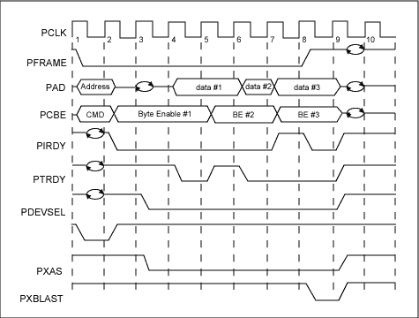
General purpose, parallel, synchronous bus
Block read cycle (PCI bus)
  request for a block of data (first period)
  memory generates data from consecutive addresses

Slide 16
General purpose, parallel, synchronous bus
Advantages:
  higher transfer speed
  small average access time
  promotes block transfers (good for cache line transfers)
Disadvantages:
  dimension of the bus is limited by the clock frequency
    if the bus is too long, clock signal is not synchronized with itself at the two ends of the bus (the speed of the signal is limited)
  more complex design of modules connected on the bus
  harder debugging process

Slide 17
Transactional, parallel, synchronous buses
Why ? (Purpose): increase the speed of the bus
How ?(Principles):
  pipeline implementation of a transfer on the bus
  use transaction (set of operations) instead of transfer cycles
  a transaction divided into stages that use different signal groups and therefore can be executed in a pipeline manner
Example:
  P6 (Pentium pro) bus

Slide 18
Transactional, parallel, synchronous buses
Example: the P6 bus
  Phases:
    Arbitration – decides which master has access on the bus
    Transfer request – specifies the request (read or write, start address, number of bytes)
    Snooping – detect and solve cache inconsistencies
    Error – detect and solve transmission errors (ECC – error correction code on data and parity on address and command signals)
    Response – specifies the type of the answer (now, delayed, refused)
    Transfer – data transfer in accordance with the request

Slide 19
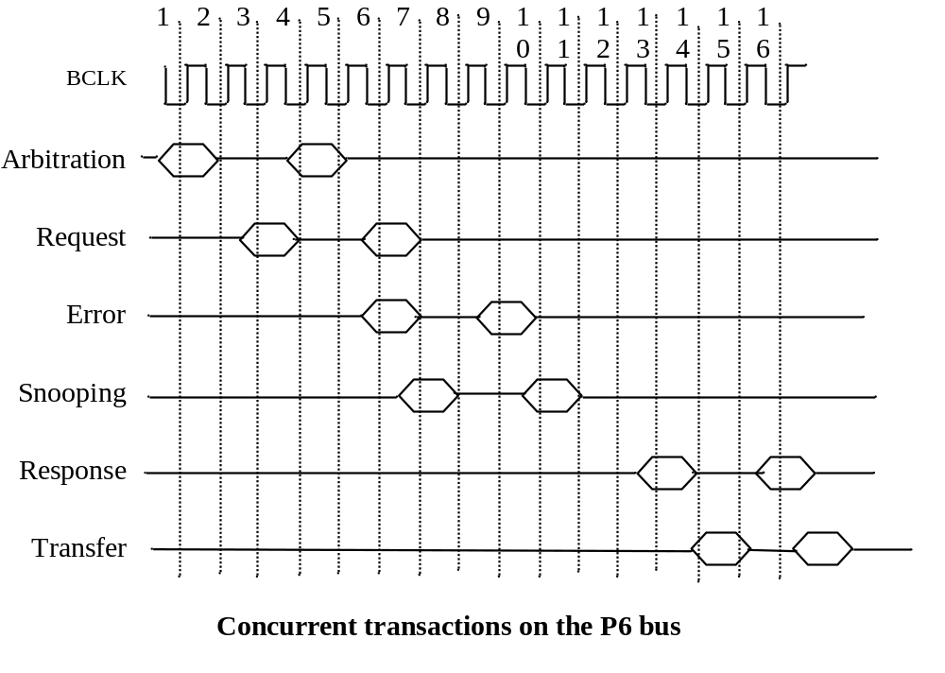
Transactional, parallel, synchronous buses
P6 bus (cont.)

Slide 20
Specialized, parallel buses
buses specialized for a group of peripheral devices (e.g. HDD, DVD, etc.)
Examples: IDE, SCASI (read “scazi”), ATA
SCASI details:
  assures communication between an initiator (computer) and a target (peripheral device)
  protocol steps:
    initiator sends a command (command descriptor block) to the target
    target respond with a status code (success, error or busy)
    target returns a Check condition and the initiator respond with SCI Request sense command
  there are about 60 command types grouped in 4 categories:
    non-data, read, write and bidirectional
SCASI and ATA have serial versions too

Slide 21
Multi-master parallel buses
Issue:
  the bus is a shared resource; only one master can control the bus at a given moment
  how to establish who has the control of the bus
Solutions:
  centralized control
    the central CPU is controlling the access on the bus –
      example: DMA transfer (HOLD, HOLDA handshaking mechanism)
    bus arbiter circuit
      example: I8289 – bus arbiter (BRQ, BGT, CBRQ)
  distributed control
    every master has an arbitration component:
      serial link
      token bases

Slide 22
Serial buses
Serial bus v.s. parallel bus
  less signals (lines)
  longer transmission distances
  cheaper implementation (e.g. less wires, less space on the PCB - printed circuit board, less pins on the circuits)
  speed:
    old view – lower speed than parallel connection
    new view – higher speed than parallel connection
    explanation - its easier to increase more than 10 times the transmission frequency on serial bus than on a parallel one (see electro-magnetic interferences in case of long parallel lines)
    consequence – most of the parallel buses are replaced with serial ones:
      serial ATA and SCASI
      network-on-chip
      serial system buses – e.g. I2C for microcontrollers

Slide 23
Serial buses
Design decisions:
  synchronous or asynchronous
  point-to-point or multipoint
  character-based or message-base
  information coding: voltage levels, differential voltages, light impulses, radio waves
  flow control: hardware, software, protocol-based
  error detection and correction

Slide 24
Serial buses –
Synchronous transmission
synchronous – an extra clock signal controls the transmission
Data signal
Shift reg.
Shift reg.
Clock signal
Sender
GND
Receiver
Clk
Data
0 1 1 0 1 0 0 0

Slide 25
Serial buses –
Synchronous transmission
Features
  easy to implement, no other synchronization mechanisms are needed
  requires an extra signal (clock), inefficient use of wires
  hard to synchronize sender and receiver on long distances

Slide 26
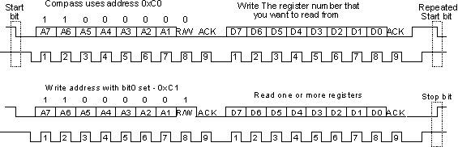
Serial buses –
Synchronous transmission
Example: I2C protocol (read: eye to see)
  multi-point, serial, synchronous bus
  used in microcontroller systems to connect external components: memory circuits, analog-digital converter
  master-slave protocol (1 master controls the traffic on the bus)
  uses two lines: SCL- clock and SDA - data
address

Slide 27
Serial buses
Asynchronous transmission
Features
  no clock signal
  synchronization made through the specific structure of the transmitted data
  the sender and the transmitter must use the same protocol that specifies:
    transmission frequency
    number of bits/character or bytes/message
    coding of logical 0 and 1
    data-flow control mechanisms
    error detection method

Slide 28
Serial buses
Asynchronous transmission
best known protocol (standard): RS232 or V24
Specifications of RS232 protocol:
  point-to-point bidirectional transmission on characters
  standard frequencies: 300,600, 1200 ...9600 ...Bauds
  bits/character: 6,7, 8 bits
  1 START bit = 0 and 1or 2 STOP bits = 1
  error detection – optional parity bit, even or odd
  flow-control protocols:
    software (XON/XOFF) – with ASCII codes for starting (XON) and stopping (XOFF) the transmission
    hardware – with 2 pairs of signals: RTS-CTS or DSR-DTR

Slide 29
Serial buses –
Asynchronous transmission
Specifications of RS232 protocol (cont.):
  signals:
    RXD – receive data
    TXD – transmit data
    GND – ground (voltage reference)
    RTS – request to send
    CTS – clear to send
    DSR - data set ready
    DTR – data terminal ready
  max. transmission distance: 100m
  data format: Start (1 bit = 1), data (6-8 bits), Parity (1 bit), Stop (1-2 bits=1)
RXD
TXD
GND
RTS
CTS
DSR
DTR
RXD
TXD
GND
RTS
CTS
DSR
DTR
Sender Receiver
Start data bits (6-8 bits) Parity Stop (1-2 bits)

Slide 30
Serial buses –
Asynchronous transmission
Specifications of the RS485 protocol:
  multi-point, serial, asynchronous transmission on characters
    transceivers (receiver-transmitter circuit) with three-state capability
  transmission on two twisted wires (A and B)
  bit coding: differential voltage

Slide 31
Multipoint interconnections
Ring
bus
tree
matrix
hyper-cube
switch fabrics

Slide 32
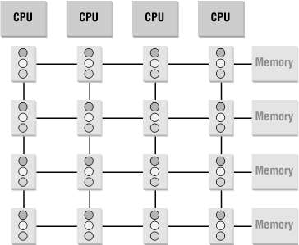
Multipoint interconnections
Crossbar switch
  multiple connections between multiple components
    multi-bus access of CPUs to memory modules

Slide 33
Multipoint interconnections
Issues:
  reduce the number of connections
  reduce the number of interfaces
  reduce communication delays (data latency)
  reduce the number of hops (nodes) involved in a transfer
  increase the bandwidth

Slide 34
Multipoint interconnections
Implementations:
  latest Intel processors (Sand Bridge)
    internal ring between cache memories
    QPI – QuickPath Interconnect – connection between CPUs
  InfiniBand
    a switched fabric communications link used in high-performance computing and enterprise data centers
    features:
      high throughput,
      low latency,
      quality of service and failover,
      scalable.
    The InfiniBand architecture specification defines a connection between processor nodes and high performance I/O nodes such as storage devices. Infiniband host bus adapters and network switches are manufactured by Mellanox and Intel

Slide 35
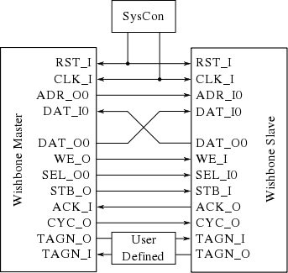
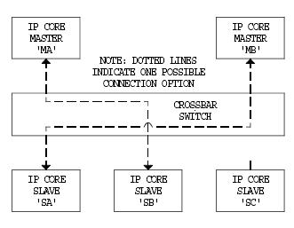
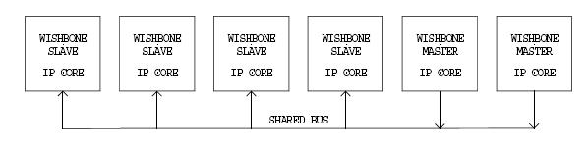
Multipoint interconnections
Wishbone Bus:
  an open source hardware computer bus intended to let the parts of an integrated circuit communicate with each other.
  the aim is to allow the connection of differing cores to each other inside of a chip.
  is used by many designs in the OpenCores project.

