Slide 1
Structure of Computer Systems
Course 2
Computer performance and optimality

Slide 2
Performance requirements
small execution time
short reaction time to external events
high memory capacity and speed
many input/output facilities (interfaces)
reach development facilities
small dimensions and specific shapes
predictability, safety and fault tolerance
small costs: absolute and relative

Slide 3
Optimal computer architecture
A compromise between performance parameters
Depends on the purpose and type of the computer
Computer types (based on purpose):
  General purpose computers
    high performance computers (HPC)
    personal computers
    mobile computers
  Computers for dedicated purposes
    scientific computing
    military computers (safety critical and highly reliable)
    industrial control and automation (embedded systems)
    measurement and analysis (e.g. medical devices, intelligent sensors)
Old classification:
  mainframes – e.g. IBM 360/370, Felix 256
  minicomputers – PDP11, SUN station, Independent, Coral
  microcomputers – microprocessor-based computers (e.g. PC, home computers)

Slide 4
Optimal computer architecture
Classification based on architecture:
  single processor computer
  multiprocessor computers:
    parallel systems
      multi-core processors
      symmetric and asymmetric parallel systems
    distributed systems
      personal computers and network communication for a specific (common) purpose
      GRIDs
      Clouds:
        computer as a service
        storage as a service
        platform as a service
        software as a service

Slide 5
Optimal computer architecture
Optimal performance parameters for different type of computers:
  HPC – high performance computers:
    highly parallel computers – 1.024 – 10.000.000 cores or processors
    usage: scientific computing (physics, astronomy, bioinformatics, chemistry), simulation (fluid’s flow, weather), cryptography
    speed: 1-20.000 Tflops
    memory capacity: 1-700 TBytes
    communication: InfiniBand (2-300 Gbs), Cray Gemini
    power consumption: 10KW- 10MW (Mariselu power station ~200MW)
    price: hard to tell
    see top 500 supercomputers (http://www.top500.org/list/2012/06/100/)
      no 1 Fugaku/Japonia, 7,630,848 cores, 30 MW
      no. 2 Summit, IBM power system/SUA, 2,414,592 cores
      no. 3 SIERRA - IBM POWER SYSTEM/ SUA, 1,572,480 cores
      No. 4. Sunway TaihuLight/China, 10,649,600 cores

Slide 6
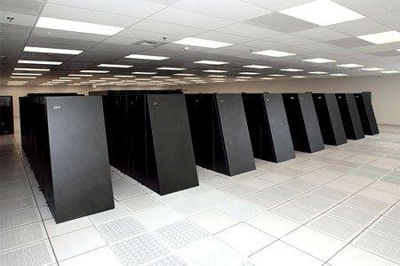
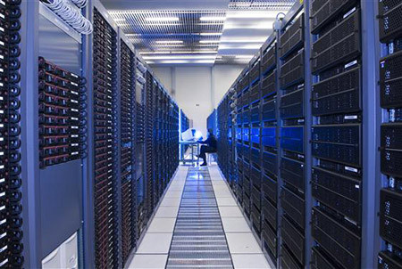
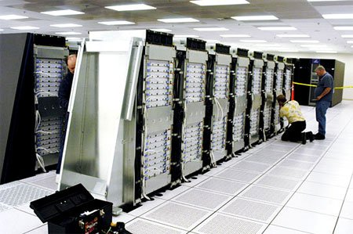
HPC – high performance computers
1+1=3 ?
Where is that bit?
HPC at CERN
  architecture: GRID
  organization: 3 tires
  at least 100.000 processors in 32 countries
  serves 5000 scientists
  in UTCN: 128 quad-core processors, 512 cores
Blue Gene - IBM
  architecture: parallel
  65,536 dual-core processors
  360 teraflop peak speed

Slide 7
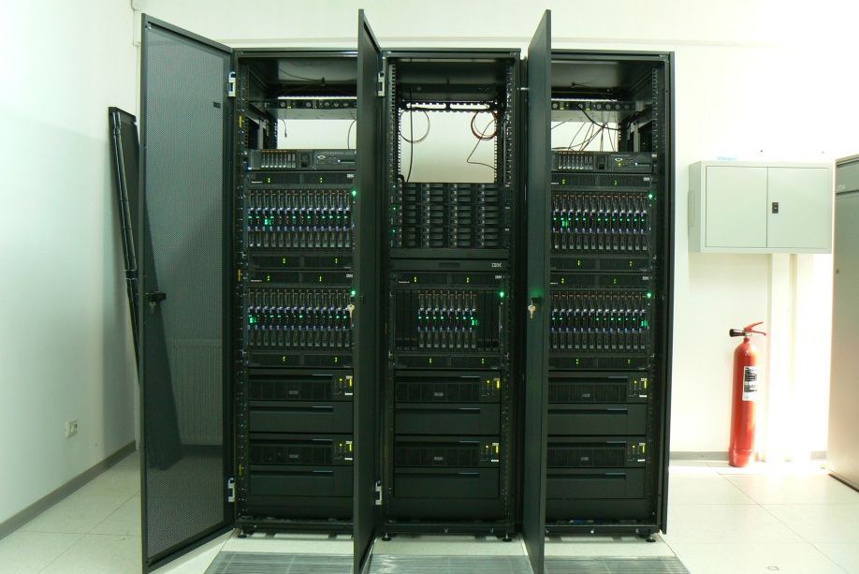
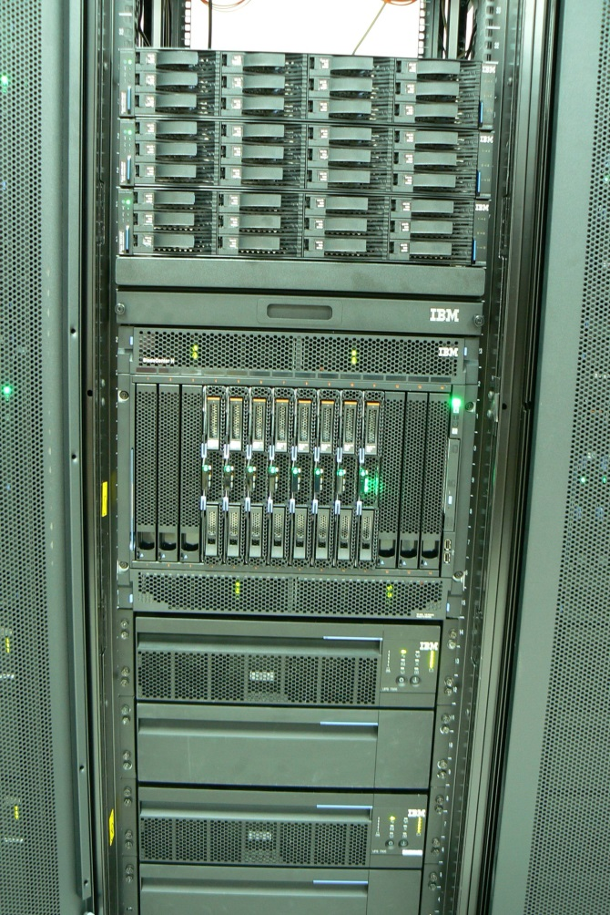
HPC – high performance computers
CG-UTCN – Centrul GRID al UTCN
64 processor boards
128 quad-core processors,
512 cores
1024 virtual processors (hyper-threading)
storage: 12 Tbytes
price: 2.000.000 RON

Slide 8
Optimal computer architecture
Optimal performance parameters for different type of computers
  PC - personal computers:
    single or multi-core systems – 1-8 cores (1-2 processors)
    usage: engineering, accounting, administration, entertainment, document processing, communication
    speed: 1-200 Gflops
    memory capacity: 1-16 GBytes (internal), 0,5-1TBytes (external)
    communication: Ethernet (0,1-1 Gbs)
    power consumption: 400-800 W
    price: 500-1000 USD
    dimensional types: desktop, laptop, tablet, hand-held

Slide 9
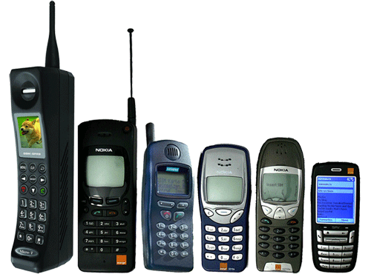
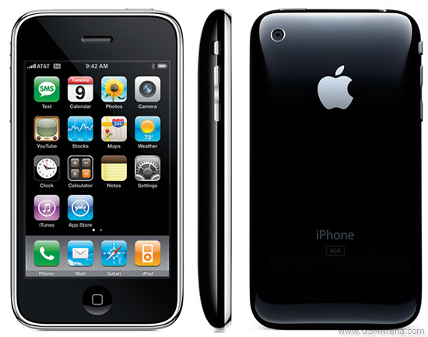
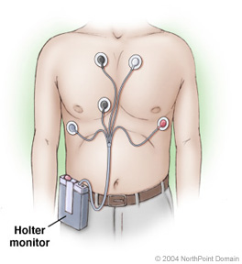
Optimal computer architecture
Optimal performance parameters for different type of computers
  Mobile devices:
    single or multi-core systems – 1-4 cores (1 processors)
    usage: communication, entertainment, place-holder for PC
    speed: 20-600 Mflops
    memory capacity: 0.5-2 GBytes (internal),
    communication: WiFi, Bluetoth (10-100 Mbs)
    power consumption: limited to the accumulator’s capacity
    price: 1- 500 USD
    dimensional limitations

Slide 10
Optimal computer architecture
Optimal performance parameters for different type of computers
  Dedicated and embedded systems
    single processor systems – microcontroller, DSP (digital signal processor), MSP (mixed signal processor)
    usage: automation, measurement, sensors, medical devices
    speed: 1-20 MIPS
    memory capacity: 128-512 bytes (data), 0-32Kbytes (program), 1-2Kbyte EEPROM
    communication: serial RS232, CAN, I2C (300-9600 bits/s)
    power consumption: very low (battery powered), with low power modes (1μA-10mA)
    price: 1- 20 USD
    dimension: very small packages (8, 16, 28, 40 pins)

Slide 11
Measuring the performance of a computer – benchmark programs
Definition 1 (wikipedia): a benchmark is the act of running a computer program, a set of programs, or other operations, in order to assess the relative performance of an object, normally by running a number of standard tests and trials against it.
Definition 2: a method of comparing the performance of various computer systems
Measuring and assessing the performance of a system is not a trivial task:
  some computers/CPUs perform better for some tests and worse for others (e.g. good results for image processing but less good for database applications)
  performance should be a weighted average of a number of specific tests

Slide 12
Benchmark programs
Component Benchmarks/ micro-benchmarks
  programs designed to measure performance of a computer's basic components
  automatic detection of computer's hardware parameters like number of registers, cache size, memory latency
Synthetic Benchmarks
  Procedure for programming synthetic benchmark:
    take statistics of all types of operations from many application programs
    get proportion of each operation
    write program based on the proportion above
  Types of Synthetic Benchmark are:
    Dhrystone – integer arithmetic
    Whetstone – integer and floating point arithmetic
Real programs
  word processing software
  user's application software
Micro-benchmarks
  Designed to measure the performance of a very small and specific piece of code.
Kernel
  contains codes that perform a specific basic operation
  normally abstracted from actual program
  popular kernel: Livermore loops (every loop is a mathematical operation)
  Linpack benchmark (contains basic linear algebra subroutines)
  results are represented in MFLOPS

Slide 13
Benchmark programs
Other benchmarks
  I/O benchmarks
  Database benchmarks: to measure the throughput and response times of database management systems (DBMS')
  Parallel benchmarks: used on machines with multiple cores, processors or systems consisting of multiple machines
Issues regarding good benchmarking:
  some processor architectures were designed for best benchmarking results, but with less overall performance
  many benchmarks concentrate on computations and less on other aspects such as: memory access time, input/output operation’s delays
  benchmarks are not relevant for wide distributed systems
  there is no unique measure of “performance” in computing

Slide 14
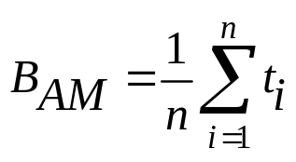
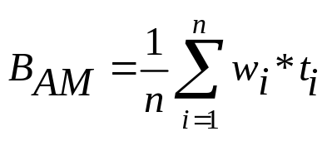
Computing the benchmark results
Arithmetical mean benchmark
where: t_{i} – execution time of program “i” from the set of n test programs
Weighted arithmetic mean
where: w_{i} – the weight of program “i” from the set indicating its frequency of execution
  w_{i} chosen so that on a reference computer the execution time of each benchmark (program) is equal => NORMALIZATION

Slide 15
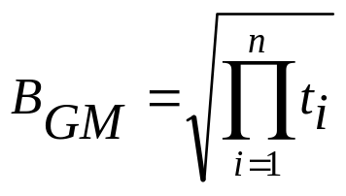
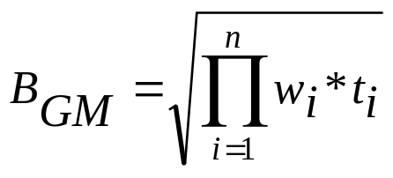
Computing the benchmark results
Geometrical mean
Normalized Geometrical mean

Slide 16
Computing the benchmark results
Effects of normalization:
  the result depends on the machine used as a reference: A, B and C
 | t on A (s) | t on B (s) | t on C (s) | Normalized to A for A,B and C | Normalized to B for A,B and C | Normalized to C for A,B and C
Program 1 | 1 | 10 | 100 | 1 10 100 | 0.1 1 10 | 0.01 0.1 1
Program 2 | 1000 | 100 | 10000 | 1 0,1 10 | 10 1 100 | 0.1 0.01 1
Arithm. mean | 500.5 | 55 | 550 | 1 5,05 55 | 5.05 1 55 | 0,055 0,055 1
Geom. mean | 31.6 | 31.6 | 316.22 | 1 1 31,6 | 1 1 31.6 | 0,031 0,031 1

Slide 17
Conclusions of the previous table:
for arithmetic mean:
  if the reference is computer A:
    A is as fast as A ☺
    B is ~5 times slower than A
    C is 55 times slower than A
  if the reference is computer B:
    A is ~5 times slower than B
    B is as fast as B
    C is 55 times slower than B
  if the reference is computer C
    A is 18 times faster than C
    B is 18 times faster than C
    C is as fast as C
for geometric mean:
  if the reference is computer A:
    A is as fast as A ☺
    B is as fast as A
    C is ~32 times slower than A
  if the reference is computer B:
    A is as fast as B
    B is as fast as B
    C is ~32 times slower than A
  if the reference is computer C
    A is ~32 times faster than C
    B is ~32 times faster than C
    C is as fast as C

Slide 18
Computing the benchmark results
  Advantages of geometric mean:
    It is independent of the running times of the individual programs
    It does not matter which machine is used for normalization
  Disadvantage of geometric mean:
    It does not predict execution time

Slide 19
Benchmark programs
Goal: to write a package of programs that best measure the performance of a computer system
Solutions:
  real programs – that solve different classical problems
  synthetic programs – no practical result, but preserve the frequency of instructions measured in real cases

Slide 21
Features of a good benchmark
Specify a certain load "workload" | A clear definition of the operations that are performed
Produces at least one metric | A numerical representation of performance. Common values include:
 | Time - For example, seconds to complete the workload .
 | Flow - the volume of work completed per unit of time, for example, jobs per hour.
If it is reproducible | If repeted it will generate the same results
If it is portable | If it can be executed on different systesm
If it can be compared | If the obtained values can be compared between systems
Verifies the correctness of the operations | Verifies if a result is generated and the result is correct
 | “The results may be as good as you want if the corrtectness of the results is not verified”
Has execution rules | A clear definition of necessary and prohibited hardware, software, optimization, adjustment and procedures.

Slide 22
Examples of benchmark programs
Whetstone synthetic program
  Published in 1976 by the National Physical Laboratory (NPL), Great Britain
  preserves the frequency of instructions in scientific and engineering applications written in Algol and later in Fortran and Pascal
  floating point instructions have an important role
Dhrystone synthetic program
  Published in 1984
  preserves the frequency of instructions in system programming (e.g. operating system components) using Ada and C programming language
  frequency measurements are published
  no emphasis on FP operations
Issues with synthetic benchmarks:
  does not reflect well the needs of a real application
  some computer architectures were optimized for best performance regarding synthetic benchmarks, but with less performance on real applications

Slide 23
Examples of benchmark programs
Kernel benchmark programs
  based on time-critical components of real applications
  focused on measuring the performance of supercomputers running scientific applications
  examples:
    Livermore Loops:
      benchmark for parallel computers
      24 “do” loops caring out different mathematical operations (e.g. solve linear systems, hydrodynamics matrix operations, etc.)
    Linpack:
      performs numerical linear algebra

Slide 24
Examples of benchmark programs
SPEC - Standard Performance Evaluation Corporation
  a non-profit international organization focused on developing standard tools for measuring the performance of computer systems
  www.spec.org
  develops standard sets of benchmarks based on real applications
  benchmark sets contain source codes
  there are also tools for generating performance reports

Slide 25
Examples of benchmark programs
Evolution of SPEC benchmark standards:
  SPEC89
    The first benchmark set, released in 1989
    benchmark value: geometric mean of execution times normalized to the VAX‑11/780 computer
  SPEC92
    contains different benchmarks for integer (SPECINT) and floating‑point instructions (SPECFP)
  CPU95, CPU2000
  Current version: CPU2006
  Next version: CPUv6
SPEC consists of three interest groups
  Open Systems Group (OSG): Component and system level benchmarks
  High Performance Group (HPG): Benchmarks for high-performance computing
  Graphics Performance Characterization Group (GPCG): Benchmarks for graphics subsystems

Slide 26
Examples of benchmark programs
Details for CPU 2017:
  Contains 43 tests organized in 4 collections :
    SPECspeed 2017 Integer,
    SPECspeed 2017 Floating Point,
    SPECrate 2017 Integer and
    SPECrate 2017 Floating Point.
  it can measure:
    speed: SPEC ratio - the time to execute one copy of the benchmark
    rate: SPEC rate - the number of jobs that can be executed in a given time (e.g. 24h)
  results are combined with geometric mean
  normalization is made on a Sun Microsystems Ultra 5/10 workstation, with a SPARC processor; for this system the result of the measurement is 1

Slide 27
Details for CPU2006
Examples of integer benchmarks
  401.bzip2: compression program based on bzip2
  403.gcc: C compiler based on gcc 3.2
  445.gobmk: plays the game of go
  458.sjeng: chess program
  462.libquantum: library for the simulation of a quantum computer
  473.astar: path-finding library for 2D maps (A* algorithm)

Slide 28
Details for CPU2006
Example floating-point benchmarks
  435.gromacs: simulates the Newtonian equations of motion for particles
  444.namd: simulates bio-molecular systems
  459.GemsFDTD: solves the Maxwell equations in 3D in the time domain
  465.tonto: quantum chemistry package
  481.wrf: weather forecasting
  482.sphinx3: speech recognition
look on the Internet for the results of your processor

