Slide 1
Structure of Computer Systems
Course 7 – examples of CPU implementations - Microprocessors

Slide 2
Microprocessors
Definition 1:
  It is a VLSI circuit that integrates a central processing unit (CPU)
Definition 2:
  An integrated circuit that contains:
    one or more central processing units (CPUs)
      Symmetric multiprocessor architecture
      Asymmetric multiprocessor architecture
    Cache memory
    Other components:
      Interrupt controller,
      Bus management unit,
      Memory Management unit (MMU)

Slide 3
Microprocessors -
First microprocessor:
  Intel Company, I4004 – 4 bits organization
First successful microprocessor:
  Intel I8080 – 8 bits processor
First 16 bits processor
  Intel I8086 –
First 32 bit processor
  Intel I80386
Superscalar microprocessor architecture
  Pentium Pro
64 bits processors, multi-core architectures
  Pentium IV, dual core, Core Duo

Slide 4
Year | Processor | structure | Memory space | Main characteristics
1971 | I4004 | 4 biti |  | first μP
1972 | I8008 | 8 biti | 16ko | First μP on 8 bits
1974 | 8080 | 8 biti | 64ko | First successful μP
1978 | 8086, 8088 | 16 biti | 1Mo | First μP on 16 bits, bases for the first PC
1982 | 80286 | 16 biti | 16Mo | PC-AT
1985 | 80386 | 32 biti | 4Go | First μP on 32 bits
1989 | 80486 | 32 biti | 4 Go | Incorporated FPU
1993 | Pentium | 32 biti | 4Go | pipeline
1995 | P. Pro | 32 biti | 64 Go | P6 super-pipeline architecture
1997 | P. II | 32 biti | 64 Go | MMX technology
1999 | P. III | 32 biti | 70 To | SSE2 technology
2002 | P. IV | 32 biti | 70 To | NetBurst architecture
2004 | P. IV | 64 biti | 70 To | Hyper-threading technology
2006 | Core 2 | 64 biti | 70 To | Multicore architecture (2 cores/chip)
2007 | Dual Core | 64 biti | 70 To | 2 processors/chip
2008-9 | I5, I7 | 64 biti | 70 To, | Nehalem architecture, multicore and hyper-threading 4cores/8 multithread cache 8Mo (L3)
2011 | Sandy Bridge

Slide 5
Microprocessors’ evolution– cont.
Anul | Cod model | Structura pipeline | Frecventa ceas
2011 | Sandy bridge | 12-14 | 2,5 GHZ
2013 | Silvermont | 14-17 (16-19 with fetch/retire) | 2,67-3 GHz
2013 | Haskell | 14 (16 with fetch/retire) | ≈4 GHz
2015 | Skylake | 14 (16 with fetch/retire) | ≈4 GHz
2016 | Goldmont | 20 unified with branch prediction (Atom microarchitecture) | 3,5 GHz
2016 | Kabylake | 14 (16 with fetch/retire) | ≈4,2 GHz
2017 | Cannonlake | ? | 4.5GHz
2018-21 | Coffe, Tiger, Comet, Rocket, Alder Lake | 20 de nuclee logice | 5 GHz (in mod turbo)

Slide 6
Components of a microprocessor
Traditional components:
  Control Unit (CU)
  Arithmetical and Logical Unit (ALU)
  General and special Registers (GR, SR)
Supplementary components:
  Cache memories (Cache)
    high speed low capacity memories
    hierarchical organization on 2-3 levels
  Mathematical co-processor (CoP)
    for floating point arithmetic
  Memory Management Unit (MMU)
    controls the traffic (instructions and data) between the main memory and the cache memory
  Interrupt controller
    handles internal and external events
    synchronize the processor with I/O interfaces

Slide 7
Signals of a microprocessor – the System Bus
Memory
Memory
μP
Address
Data
Commands
I/O interface
I/O interface
I/O dev.
I/O dev.

Slide 8
Structure of a PC
(a more realistic view)
μP
SVGA
Mem
Mem
AGP
Chipset
N
Net
PCI
Chipset
S
Keyboard
Mouse

Slide 9
Typical signals for a microprocessor
Address signals
Interrupt signals
Micro-processor
Bus arbitration signals
Data signals
Clock signal(s)
Command signals
Other signals (e.g. status, control)
Power supply signals

Slide 10
Typical signals for a microprocessor
Address signals: A₀-A_{n}
  Used for specifying memory locations or I/O ports (registers)
  Generated by the microprocessor to other components in order to address them (read or write operations)
  The number of address lines determine the maximum addressing space of a microprocessor
    Ex: 20 lines=> 1MB
    32 lines =>4GB
Data signals: D₀-D_{m}
  Bidirectional lines used to transfer instruction codes and data between the microprocessor and the other components of the system
  The number of data lines is usually in accordance with the internal organization of the processor (there are also exceptions, see 8088, Pentium Pro)
  The number of data lines determine the maximum width of a data transferred on a bus
    Ex: 8, 16, 32, 64 lines

Slide 11
Typical signals for a microprocessor
Command and control signals
  Command signals:
    MRDC\, MWTC\, IORC\, IOW\, INTA\
    determine memory and interface read and write cycles
    very important signals,
    similar signals for any microprocessor
  Control signals: ALE (Address Latch Enable), DEN (Data enable)
    help controlling the address and data amplifiers
    specific for every microprocessor
  Interrupt signals: INTR, NMI
  Clock signals: CLK, PCLK
Power supply signals: GND +5V, 3,3V

Slide 12
Instructions execution
Steps:
  Instruction fetch
  Operands read
  Operation execution
  Write the result
Seen from outside:
  Instruction fetch cycle – read from the memory - mandatory
  Operand(s) read - optional
  Write the result - optional
Transfer cycle (on the bus)
  a transfer on the bus that involve:
    Processor and memory or
    Processor and an I/O interface
  A cycle has a fixed number of clock periods (determined by the microprocessors architecture)
    it may be extended on request with an integer number of clock periods, if a slow module is addressed (e.g. EPROM memory)
  A cycle is a sequence of signal activations on the bus (address, data and command)
    a cycle is described by a time diagram

Slide 13
Time diagrams for transfers on a classical bus
Read Memory Cycle
A₀-A_{n}
valid address
MRDC
MWTC
D₀-D_{m}
valid data
t_{access}
t_{cycle}
Write Memory Cycle
A₀-A_{n}
valid address
MRDC
MWTC
D₀-D_{m}
valid data
t_{access}
t_{cycle}

Slide 14
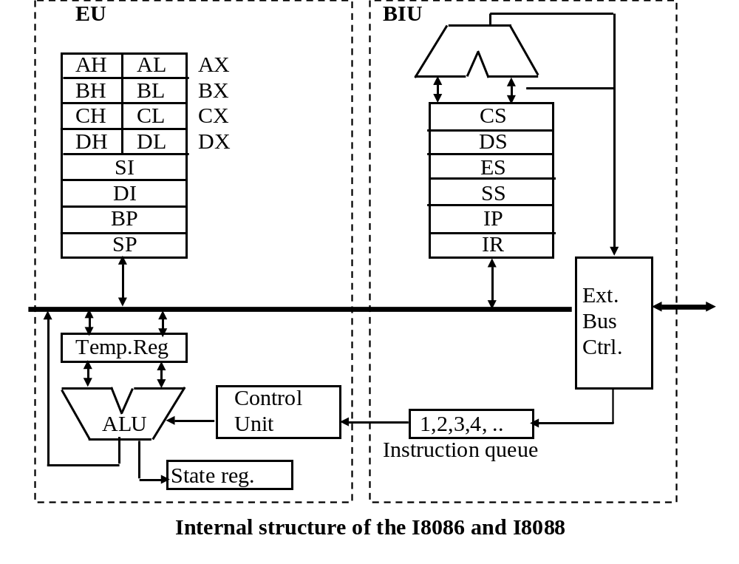
Processors of the Intel x86 family
I8086 and I8088

Slide 15
I8086, I8088
I8086
  16 bits processor with 16 data lines, 20 address lines (1MB addressing space)
  40 pins integrated circuit
  Supporting circuits:
    8087 – mathematic co-processor (floating point)
    8288 – bus controller
    8289 – bus arbiter
  Structure:
    EU –Execution Unit – dedicated for instruction execution
      CU, ALU, general registers, state register
    BIU – Basic Interface Unit – a unit responsible for the operations (transfer cycles) with the external bus
      transfers instructions (in advance) and data
      contains:
        Special registers (segment registers, IP)
        Instruction queue, bus amplifiers
8088
  identical with 8086 but with 8 data signals on the external bus

Slide 16
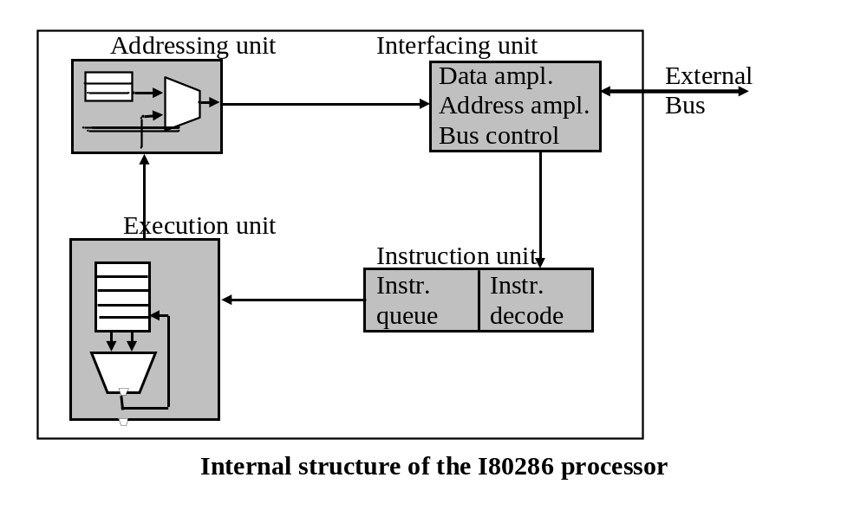
I80286
16 bits processor
16 data lines, 24 address lines (16MB addressing space)
Working modes: real and protected (privileged)

Slide 17
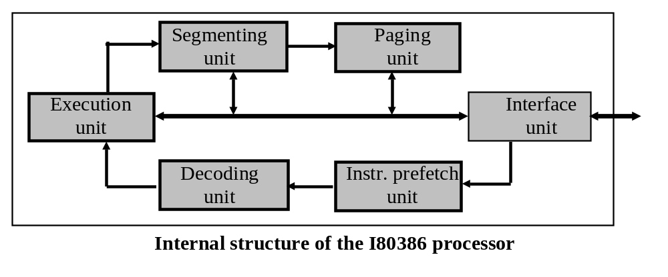
I80386
32 bits processor, 32 data lines, 32 address lines (4GB addressing space)
General registers extended to 32 bits
2 extra segment registers (FS and GS)
Protected mode improved

Slide 18
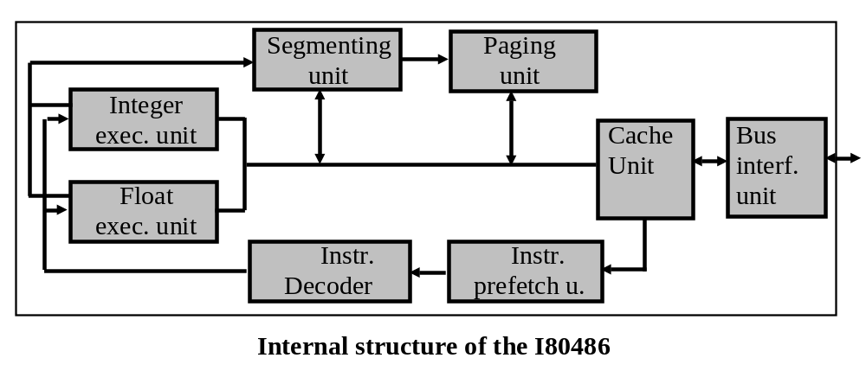
I80486
Integrates: processor + co-processor + MMU
Enables the use of cache memory
Protected mode improved

Slide 19
Pentium
Two pipelines: U (integers) and V (floats)
64 bits external bus (for a 32 bits processor)
Versions:
  Pentium –2 pipeline architecture
  Pentium Pro
  Pentium II - superscalara P6 architecture
  Pentium III
  Pentium IV – NetBurst architecture
  I7, I5, I3 - multicore and hyperthreading

Slide 20
Pentium Processors
Pentium Pro
  Superscalar P6 architecture (CPI<1)
  Dynamic instruction execution:
    Data flow analysis
    Branch prediction
    Speculative execution of instructions
Pentium II
  MMX technology:
    a SIMD execution unit dedicated for multimedia data
    Parallel (SIMD) execution of arithmetic operations
    57 new MMX instructions
Pentium III
  SSE2 technology
    Parallel execution (SIMD) on floating point variables
    good for 2D/3D graphics

Slide 21
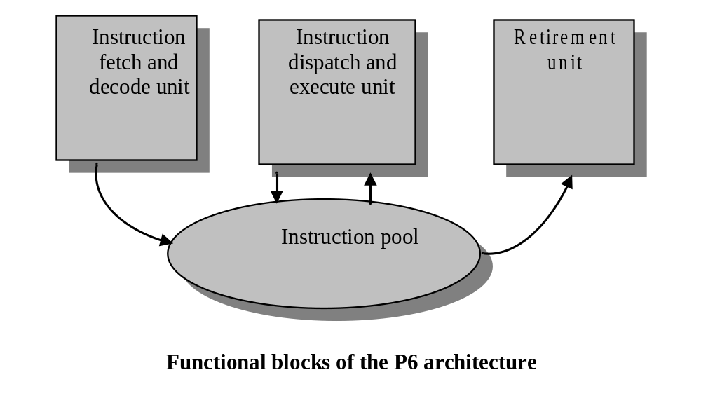
P6 superscalar architecture
3 autonomous units, 12 pipeline stages
Speculative execution

Slide 22
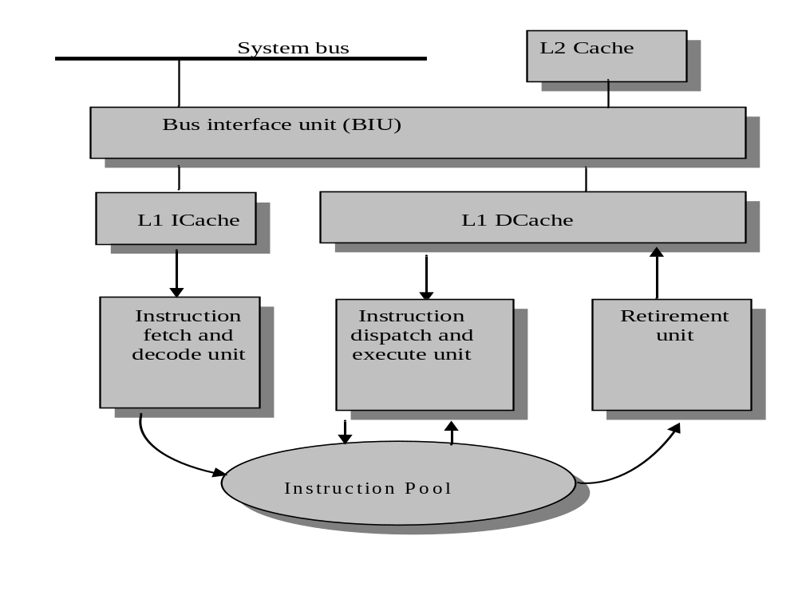
Detailed view of the P6 architecture

Slide 23
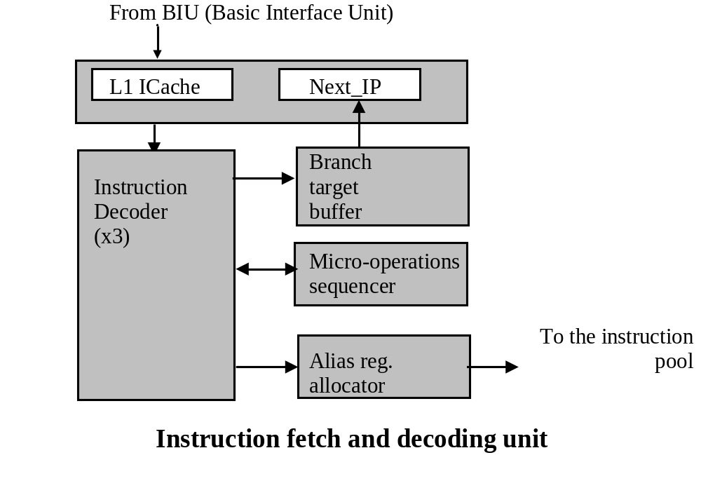
Instruction fetch and decoding unit
Fetch and decode instructions in advance
In-order unit
3 instructions decoded /clock
Branch prediction
Components:
  Decoder (3 units)
  Address generator unit (next_IP)
  Branch target buffer
  Micro-operation sequencer
  Alias registers allocator

Slide 24
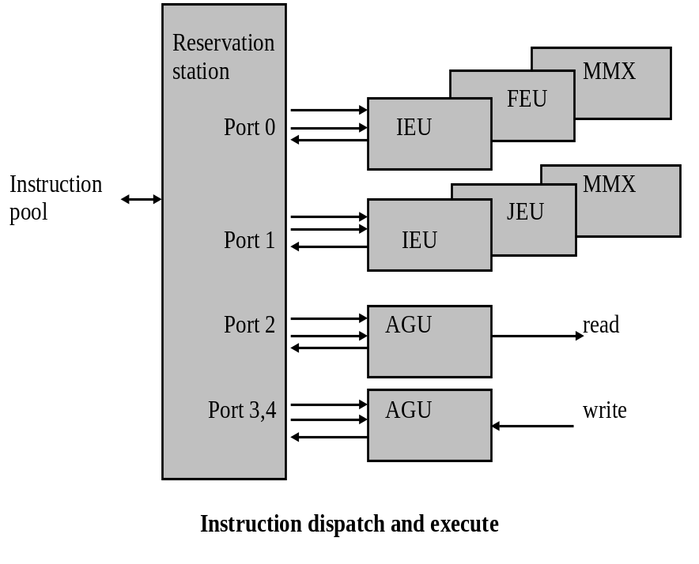
Instruction dispatch and execute unit
Responsible for instruction execution
Out-of-order unit
7 execution units + reservation station
  IEU – Integer Execution Unit
  FEU – Floating-point Execution Unit
  MMX – Multimedia execution unit
  AGU – Address generation unit
  JGU – Jump generation unit

Slide 25
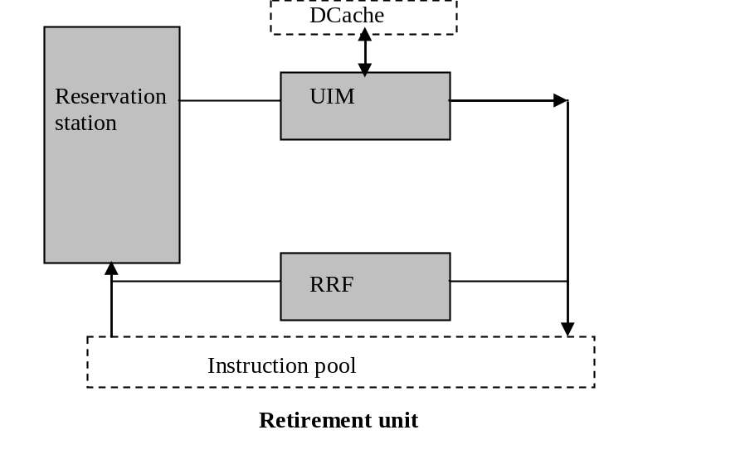
Retirement Unit
Reestablish the normal order of the instructions (of results)
In-order unit
Components:
  MIU – memory interface unit
  RRF – Retirement register file

Slide 26
Solving hazard cases in the P6 architecture
Control hazard:
  complex branch prediction, BTB, next address predictor
  out-of-order instruction execution
  execute both branches of an if
Data hazard:
  alias registers: renaming of registers and more internal registers (40) than those seen by the programmer
  out-of-order instruction execution
  data dependency tree
Structural hazard
  multiple execution units (7 ALUs)
  separate instruction and data cache
  reservation stations
In essence it is an implementation of Tomasulo’s method

Slide 27
The P6 Bus
The main elements of the P6 bus:
  the bus works in a synchronous mode; every signal is considered on clock signal edges
  transfers are made through transactions that may be executed in parallel
  it is a multi-processor bus; more processors on the same bus
  block transfers are preferred
  there are error detection and correction mechanisms
  there are mechanisms that assure cache memory consistency
  a new digital technology (different amplifiers) that assure high frequency transmissions on bus

Slide 28
Transfer on the P6 bus
Parallel transactions (pipeline)
Phases:
  Arbitration – decides which master has access on the bus
  Transfer request – specifies the request (read or write, start address, number of bytes)
  Snooping – detect and solve cache inconsistencies
  Error – detect and solve transmission errors (ECC – error correction code on data and parity on address and command signals)
  Response – specifies the type of the answer (now, delayed, refused)
  Transfer – data transfer in accordance with the request
Technology: GTL (instead of TTL)

Slide 29
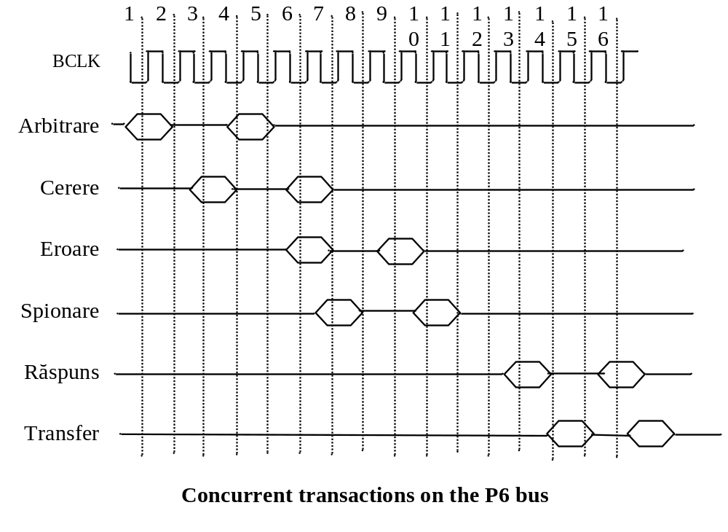
Time diagram for the P6 bus

Slide 30
Pentium IV –
NetBurst Architecture (7th generation)
a 20 stage pipeline architecture
  double compared with P6
bus frequency is increased 4 times
  400MHz, with "quad pump“ technology,
  3.2Gbytes/s transfer speed
doubles the speed of the ALU,
  2 arithmetical operations are executed in every clock period;
  the ALU works with a double frequency clock
the use of very high speed cache memory
  Advanced Transfer Cache, that assures at 2GHz 64Gbytes/s data transfer
extension of the MMX technology
  the SSE – Streaming SIMD Extension
  144 new SIMD instructions that extend the data width to 128 bits (16 bytes processed in parallel)
improvement of branch prediction with aprox. 30%
  through the extension of the BTB unit and
  increasing the instruction queue to 126 instructions

Slide 31
Pentium IV
L2 Cache and control
Interface with the external bus
BTB
Instruction fetch and decode
Decoder
Trace cache
ROM
Alias reg alocator
Instr. queues for microoperations
Schedulers
Instruction scheduling and execution
Reg. for „floats” Registers for „integers”
ALU-F
ALU-F
ALU
ALU
ALU
ALU
AGU
AGU
L1 D-Cache
The NetBurst Pentium IV architecture

Slide 32
Pentium IV
New tendencies:
  Hyper-threading technology
    two threads executed in parallel on the same core
  Multi-core technology
    more processors on the same chip
  64 bits architecture

Slide 33
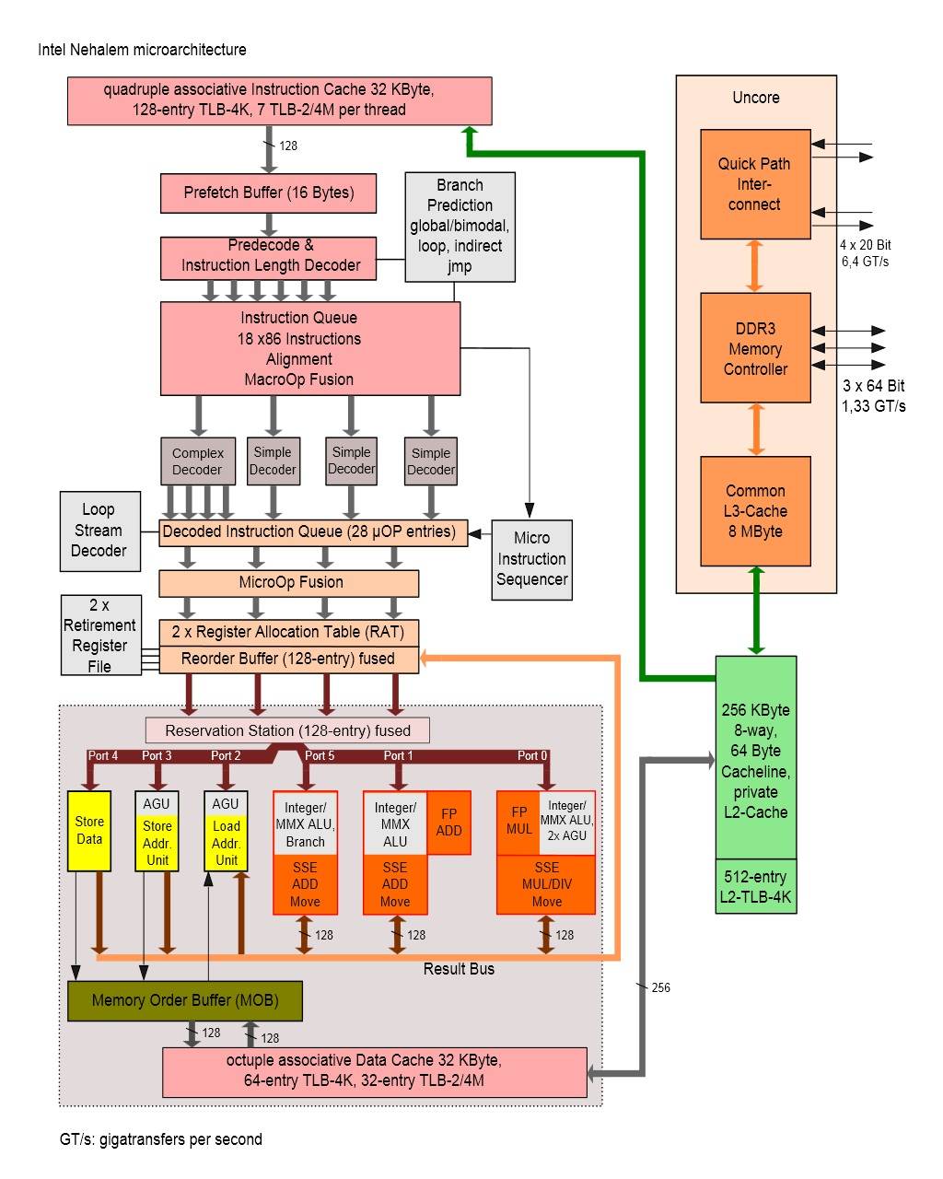
I7, I5, I3
Nehalem architecture - internal view

Slide 34
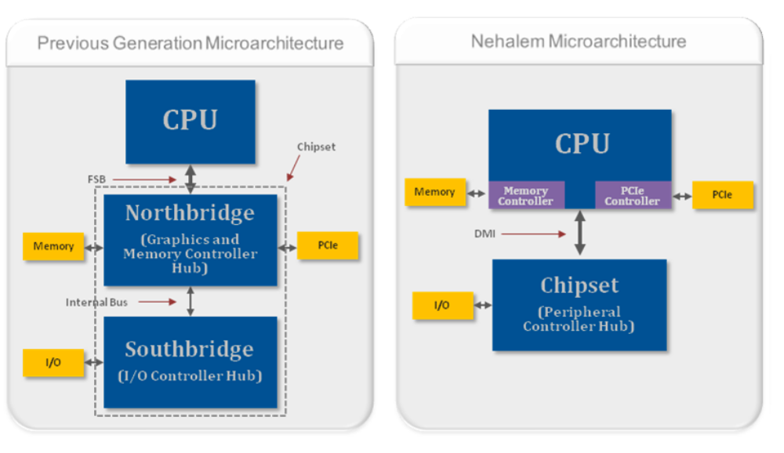
Nehalem architecture external view

Slide 35
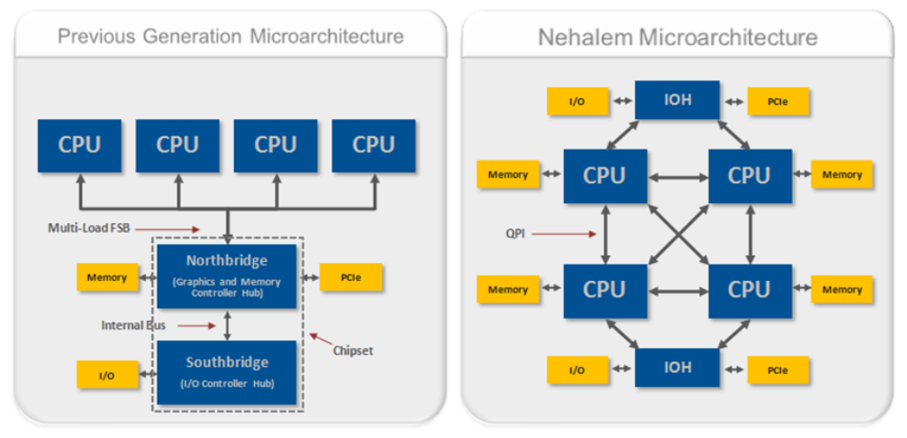
Nehalem architecture multiprocessor configuration
Communication on FSB – Front side bus
Communication on QPI – QuickPath Interconnect

Slide 36
Sandy bridge architecture
The north bridge (memory controller, graphics controller and PCI Express controller) is integrated in the same chip as the rest of the CPU. First models will use a 32-nm manufacturing process
Ring architecture - 256-bit/cycle
Two load/store operations per CPU cycle for each memory channel
New decoded microinstructions cache (L0 cache, capable of storing 1,536 microinstructions, which translates in more or less to 6 kB)
32 kB L1 instruction and 32 kB L1 data cache per CPU core (no change from Nehalem)
L2 memory cache was renamed to “mid-level cache” (MLC) with 256 kB per CPU core
L3 memory cache is now called LLC (Last Level Cache), it is not unified anymore, and is shared by the CPU cores and the graphics engine
Next generation Turbo Boost technology
New AVX (Advanced Vector Extensions) instruction set
Up to 8 physical cores or 16 logical cores through Hyper-threading

Slide 37
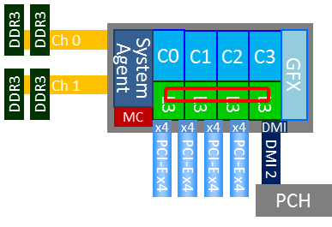
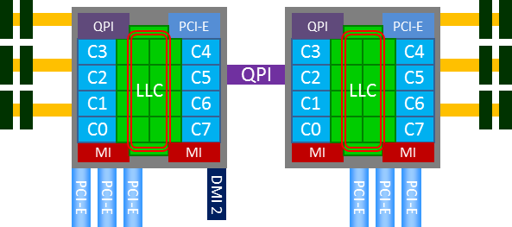
Sandy bridge architecture
1 processor
4 cores
2 processor
8 cores/processor

Slide 38
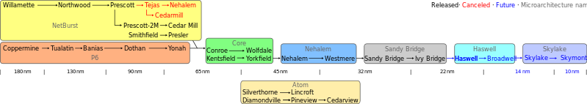
Evolution of Intel processor architectures

