Slide 1
Structure of Computer Systems
Curse 9 Memory hierarchy

Slide 2
Memory hierarchies
Why memory hierarchies?
  what we want:
    big capacity, high speed at an affordable price
    no today’s memory technologies can assure all 3 requirements in the same time
  what we have:
    high speed, low capacity - SRAM, ROM
    medium speed, big capacity – DRAM
    low speed, almost infinite capacity – HDD, DVD
  how to achieve all 3 requirements?
    combining technologies in a hierarchical way

Slide 3
Performance features of memories
 | SRAM | DRAM | HDD, DVD
Capacity | small 1-64ko | Medium 256-2Go | Big 20-160Go
Access time | Small 1-10ns | Medium 15-70ns | Big 1-10ms
Cost | big | medium | small

Slide 4
Memory hierarchies
Processor
Internal memory (operative)
Virtual memory
Cache
SRAM DRAM HD, CD, DVD

Slide 5
Principles in favor of memory hierarchies
Temporal locality – if a location is accessed at a given time it has a high probability of being accessed in the near future
  examples: exaction of loops (for, while, etc.), repeated processing of some variables
Spatial locality – if a location is accessed than its neighbors have a high probability of being accessed in the near future
  examples: loops, vectors and records processing
90/10 – 90% of the time the processor executes 10% of the program
The idea: to bring memory zones with higher probability of access in the future, closer to the processor

Slide 6
Cache memory
High speed, low capacity memory
The closest memory to the processor
Organization: lines of cache memories
Keeps copies of zones (lines) from the main (internal) memory
The cache memory is not visible for the programmer
The transfer between the cache and the internal memory is made automatically under the control of the Memory Management Unit (MMU)

Slide 7
Typical cache memory parameters
Parameter | Value
Memory dimension | 32kocteţi-64Moctet
Dimension of a cache line | 16-256 bytes
Access time | 0.1-1 ns
Speed (bandwidth) | 800-5000Mbytes/sec.
Circuit types | Processor’s internal RAM or external static RAM

Slide 8
Design of cache memory
Design problems:
  1. Where should we place a new line ?
  2. How do we find a location in the cache memory ?
  3. Which line should be replace if the memory is full and a new data is requested ?
  4. How are the “write” operations solved ?
  5. Which is the optimal length of a cache line ? Cache efficiency?
Cache memory architectures:
  cache memory with direct mapping
  associative cache memory
  set associative cache memory – (N-way cache)
  cache memory organized on sectors

Slide 9
Cache memory with direct mapping (1-way cache)
Principle: the address of the line in the cache memory is determined directly from the location’s physical address – direct mapping
  a memory line can be placed in a unique places in the cache (1-way cache)
  the tag is used to identify lines with the same position in the cache memory
Main memory
Cache memory

Slide 10
Cache memory with direct mapping
Example:
  4GB – internal memory – 32 address lines
  4 MB – cache memory – 22 address lines
  64 KLines – 16 Line index signals
  64 locations/line – 6 Location index signals
Physical address (32 bits)
Cache lines Tag
10 bits 16 bits 6 bits
Line 0
Line 1
Line 2
Line index
Line 3
Location index
...........
Line FFFF
Hit/Miss
Comp.
Tag

Slide 11
Cache memory with direct mapping
Design issues:
  1. Where to place a new line?
    in the place pointed by the line index field
  2. How do we find a location in the cache memory ?
    based on tag, line index and location index (compare tags of the current address and the one in the indicated cache line – hit or miss)
  3. Which line should be replace when a new data is requested ?
    the one indicated by the line index (even if the present one is occupied and other lines are free)

Slide 12
Cache memory with direct mapping
Advantages:
  simple to implement
  easy to place, find and replace a cache line
Drawbacks:
  in some cases, repeated replacement of lines even if the cache memory is not full
  inefficient use of the cache memory space

Slide 13
Associative cache memory
(N-way cache memory)
Principle: a line is placed in any place of the cache memory (N-way cache)
Main memory
Cache memory

Slide 14
Associative cache memory
Example:
  4GB – internal memory – 32 address lines
  1 MB – cache memory – 22 address lines
  256 locations/line – 8 Location index signals
  4096 cache lines
Physical address (32 bits)
Descriptor Cache line Counter
24 bits (11223344h) 8 bits
0
1
78345579
2
11223344
3
Location
4094
12345678
4095
Line descriptor
Hit/Miss
Comp.

Slide 15
Associative cache memory
Design issues:
  1. Where to place a new line?
    in any free cache line or in a line less used in the near past
  2. How do we find a location in the cache memory ?
    compare the line field in the address with the descriptor part in the cache lines
      compare in parallel – number of comparators is equal with the number of cache lines – too many comparators
      compare sequentially - one comparator – too much time
  3. Which line should be replace if the memory is full and a new data is requested ?
    random choice
    leased used in the near past – it uses a counter for every line

Slide 16
Associative cache memory
advantages:
  efficient use of the cache memory's capacity
Drawback:
  limited number of cache lines, so limited cache capacity – because of the comparison operation (hardware limitation or time limitation)

Slide 17
Set associative cache memory
(2, 4, 8 .. WAY cache)
Principle: combination of associative and direct mapping design:
    lines organized on blocks
    block identification through direct mapping
    line identification (inside the block) through associative method
Main memory
Cache memory
2 blocks,
2 lines in each block
2-way memory

Slide 18
Set associative cache memory
Example: 16-way cache
  4G – internal memory
  4 MB - cache
  256 locations/line
  16 lines/block
  1024 blocks
Descriptor Content Block no.
Physical address (32 bits)
14 10 8
0
......
1
......
2
......
......
1023
Hit/Miss
Comp.

Slide 19
Set associative cache memory
Advantages:
  combines the advantages of the two techniques:
    many lines are allowed, no capacity limitation
    efficient use of the whole cache capacity
Drawback:
  more complex implementation

Slide 20
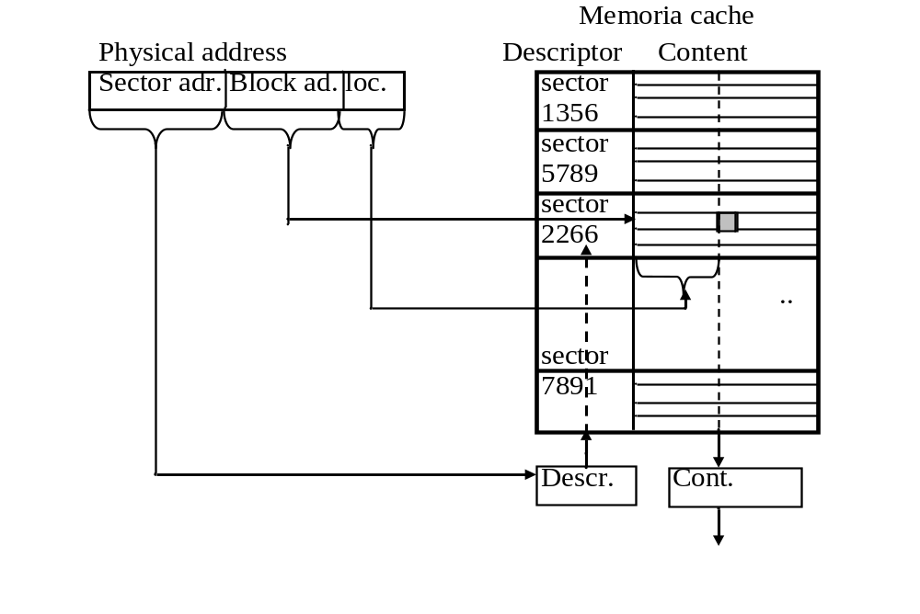
Cache memory organized on sectors

Slide 21
Cache memory organized on sectors
Principle: similar with the Set associative cache, but:
  the order is changed, the sector (block) is identified through associative method and the line inside the sector with direct mapping
Advantages and drawbacks: similar with the previous method

Slide 22
Writing operation in the cache memory
The problem: writing in the cache memory generates inconsistency between the main memory and the copy in the cache
Two techniques:
  Write back – writes the data in the internal memory only when the line is downloaded (replaced) from the cache memory
    Advantage: write operations made at the speed of the cache memory – high efficiency
    Drawback: temporary inconsistency between the two memories – it may be critical in case of multi-master (e.g. multi-processor) systems, because it may generate errors
  Write through – writes the data in the cache and in the main memory in the same time
    Advantage: no inconsistency
    Drawback: write operations are made at the speed of the internal memory (much lower speed)
      but, write operations are not so frequent (1 write from 10 read-write operations)

Slide 23
Efficiency of the cache memory
  Hit/miss rate influence the access time
    reduce memory access time t_{a}
  t_{a} = t_{c} + (1-R_{s})*t_{i}
    where:
      t_{a} – average access time
      t_{i} – access time of the internal memory
      t_{c} – access time of the cache memory
      R_{s} – success rate
      (1-R_{s}) – miss rate

Slide 24
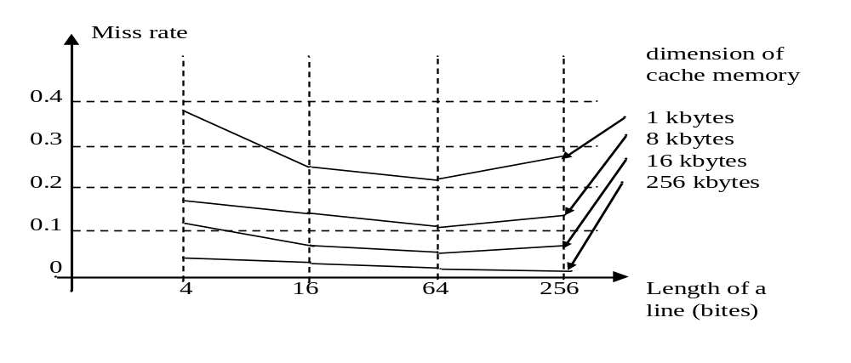
Cache memory
Which is the optimal length of a cache line ?
  depends on the internal organization of the cache, bus and the configuration of processors

Slide 25
Virtual memory
Objectives:
  Extension of the internal memory over the external memory
  Protection of memory zones from un-authorized accesses
Implementation techniques:
  Paging
  Segmentation

Slide 26
Segmentation
Why? (objective)
  divide and protect memory zones from un-authorized accesses
How? (principles)
  Divide the memory into blocks (segments)
    fixed or variable length
    with or without overlapping
  Address a location with:
  Physical_address = Segment_address + Offset_address
  Attach attributes to a segment in order to:
    control the operations allowed in the segment and
    describe its content

Slide 27
Segmentation
Advantages:
  access of a program or task is limited to the locations contained in segments allocated to it
  memory zones may be separated according to their content or destination: cod, date, stack
  a location address inside of a segment require less address bits – it’s only a relative/offset address
    consequence: shorter instructions, less memory required
  segments may be placed in different memory zones
    changing the location of a program does not require the change of relative addresses (e.g. label addresses, variable addresses)
Disadvantage:
  more complex access mechanisms
  longer access time

Slide 28
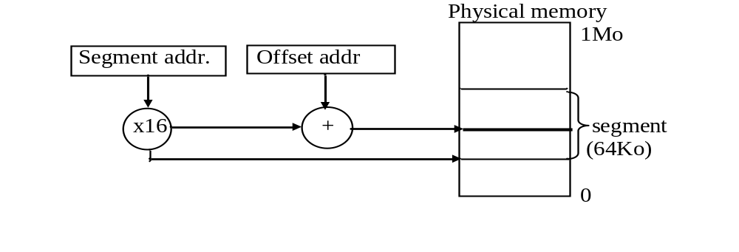
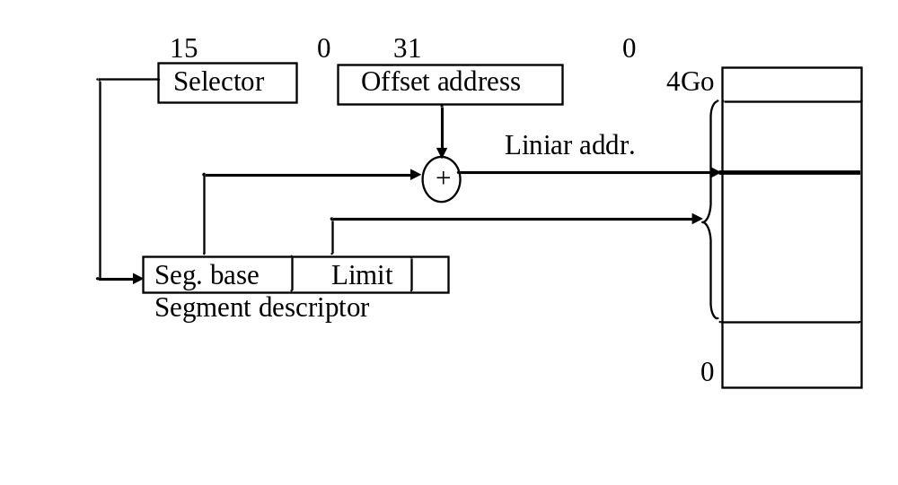
Segmentation for Intel Processors
Address computation in Real mode
Address computation in Protected mode

Slide 29
Segmentation for Intel Processors
Details about segmentation in Protected mode:
  Selector:
    contains:
      Index – the place of a segment descriptor in a descriptor table
      TI – table identification bit: GDT or LDT
      RPL – requested privilege level – privilege level required for a task in order to access the segment
  Segment descriptor:
    controls the access to the segment through:
      the address of the segment
      length of the segment
      access rights (privileges)
      flags
  Descriptor tables:
    General Descriptor Table (GDT) – for common segments
    Local Descriptor Tables (LDT) – one for each task; contains descriptors for segments allocated to one task
  Descriptor types:
    Descriptors for Code or Data segments
    System descriptors
    Gate descriptors – controlled access ways to the operating system

Slide 30
Segmentation
Protection mechanisms (Intel processors)
  Access to the memory (only) through descriptors preserved in GDT and LDT
    GDT keeps the descriptors for segments accessible for more tasks
    LDT keeps the descriptors of segments allocated for just one task => protected segments
  Read and write operations are allowed in accordance with the type of the segment (Code of data) and with some flags (contained in the descriptor)
    for Code segments: instruction fetch and maybe read data
    for Data segments: read and maybe write operations
  Privilege levels:
    4 levels, 0 most privileged, 3 least privileged
    levels 0,1, and 2 allocated to the operating system, the last to the user programs
    a less privileged task cannot access a more privileged segment (e.g. a segment belonging to the operating system)

Slide 31
Paging
Why ? (Objective)
  increase the internal memory over the external one (e.g. hard disc)
How ? (Principles)
  Internal and external memory is divided into blocks (pages) of fixed length
  bring into the internal memories only those pages that have a high probability of being used in the near future
    justified by the temporal and spatial locality and 90/10 principles
Implementation:
  similar with the cache memory – associative approach

Slide 32
Paging
Design issues:
  Placement of a new page in the internal memory
  Finding the page in the memory
  Replacement policy – in case the internal memory is full
  Implementation of “write” operations
  Optimal dimension of a page
    4kb for ISA x86

Slide 33
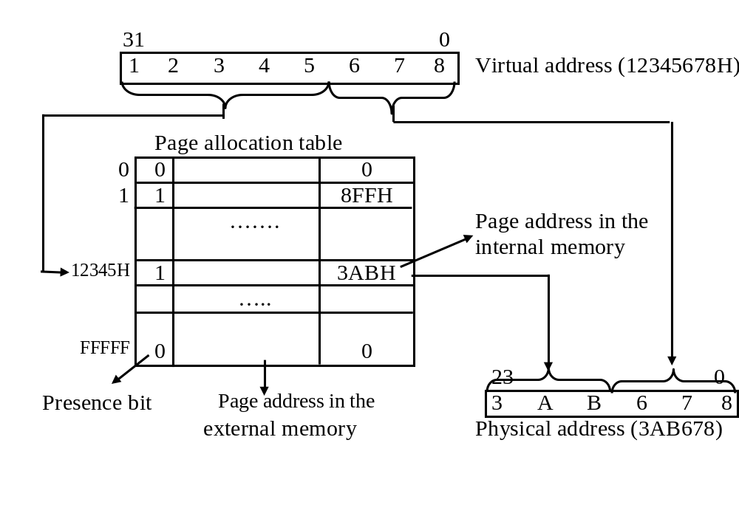
Paging implementation through associative technique

Slide 34
Paging - implementation
Implementation example:
  virtual memory - 1Tbyte
  main memory – 4Gbytes
  one page – 4Kbytes
  number of pages = virtual memory/page
  = 1TB/4kb = 256kpages
  dimension of the page directory table =
  = 256Kpages * 4bytes/page_entry =
  = 1Gbyte !!!! => ¼ of the main memory allocated for the page directory table
  solution: two levels of page directory tables – Intel’s approach

Slide 35
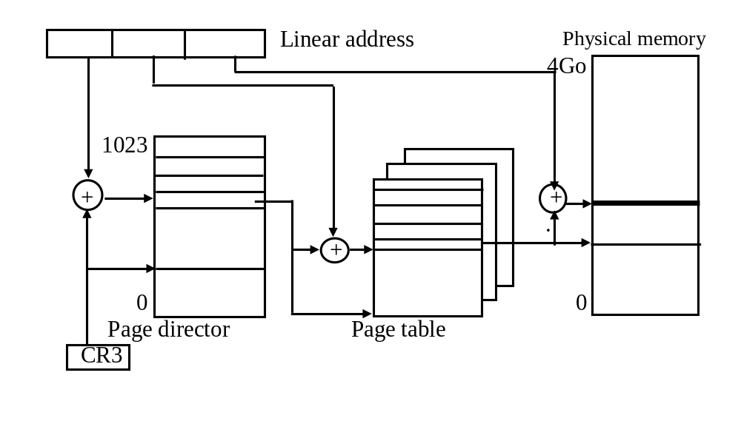
Paging implemented in Intel processors

Slide 36
Paging – Write operation
Problem:
  inconsistency between the internal memory and the virtual one
  it is critical in case of multi-master (multi-processor) systems
Solution: Write back
  solve the inconsistency when the page is downloaded into the virtual memory
  the write through technique is not feasible because of the very low access time of the virtual (external) memory

Slide 37
Virtual memory
Implementations:
  segmentation
  paging
  segmentation and paging
The operating system may decide which implementation solution to use
  no virtual memory
  only one technique (segmentation or paging)
  both techniques
Offset address
Segmentation
Linear addrress
Paging
Physical address

Slide 38
Memory hierarchy
cache memory
  implemented in hardware
  MMU – memory management unit responsible for the transfers between the cache and main memory
  transparent for the programmer (no tools or instructions to influence its work)
virtual memory
  implemented in software with some hardware support
  the operating system is responsible for allocation memory space, handle transfers between the external memory and the main memory
  partially transparent for the programmer:
    in protected mode – full access
    in real or virtual mode – transparent for the programmer

