Slide 1
ABDOMINAL TRAUMA DETECTION
Author: Diana Nduta Mwaura

Slide 2
Background
I hold a strong background in biomedical engineering.
Parallel to my engineering education, I developed a keen interest in data science and analytics. This fascination led me to take a course and engage in self study to develop a strong foundation of data science concepts.
Currently, I am excited to be working as a data science intern.
My aspiration is to work in the healthcare industry where I can leverage data- driven insights to improve patient care and develop innovative medical technologies

Slide 3
Project Definition
There are estimated to be more than 5 million annual deaths worldwide from traumatic injury.
Abdominal trauma may result in damage and internal bleeding of the internal organs, including the liver, spleen, kidneys, and bowel.
Detection and classification of injuries are key to effective treatment and favorable outcomes.
Prompt diagnosis of abdominal trauma using medical imaging is thus critical to patient care.

Slide 4
Problem Statement
Interpreting CT scans for abdominal trauma, however, can be a complex and time-consuming task, especially when multiple injuries or areas of subtle active bleeding are present.
This project aims at harnessing the power of machine learning to assist medical professionals in rapidly and precisely detecting injuries and grading their severity
Link to the project on github RSNA project

Slide 5
Data Source
The datasets were obtained from Kaggle RSNA Abdominal Trauma Detection Competition.
The datasets used in the project include: train.csv, image_level_labels.csv and train_images.
The train.csv dataset contains the labels of the various injuries.
The image_level_labels.csv dataset is composed of the specific images that contain either the bowel or extravasation injury.

Slide 6
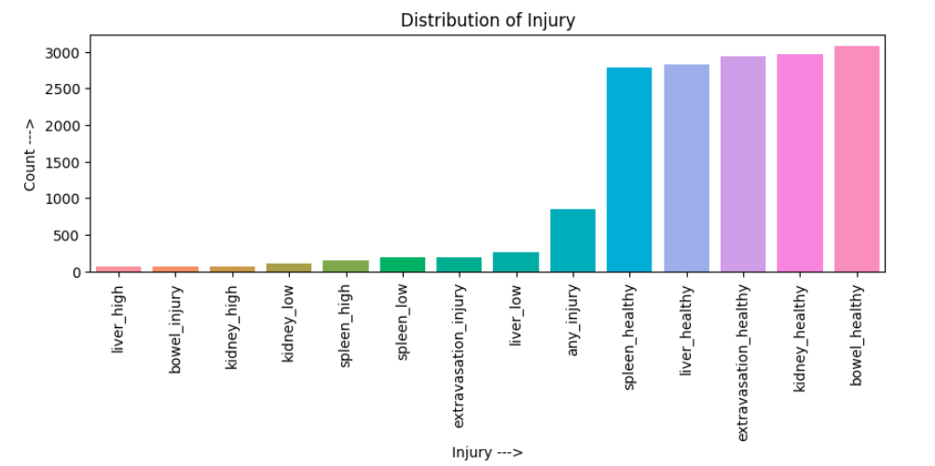
Distribution of Injuries

Slide 7
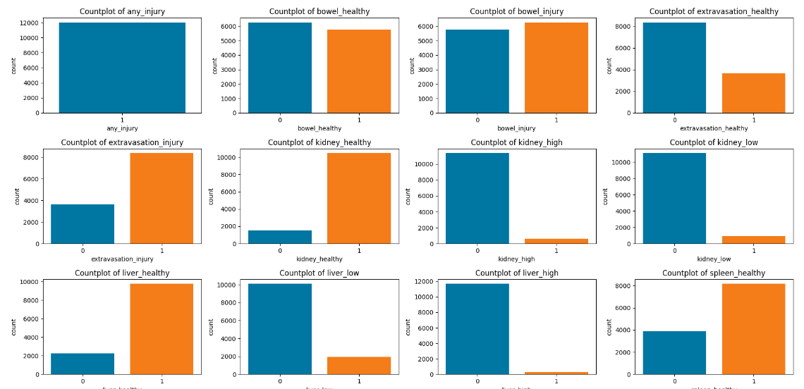
Count of Observations for Injuries

Slide 8
Modeling
In this section the dataset was split into train, test and validation sets.
Convolutional Neural Networks were used to generate the first and second model.
Transfer learning models such as RESNET50 was also used to train the models.

Slide 9
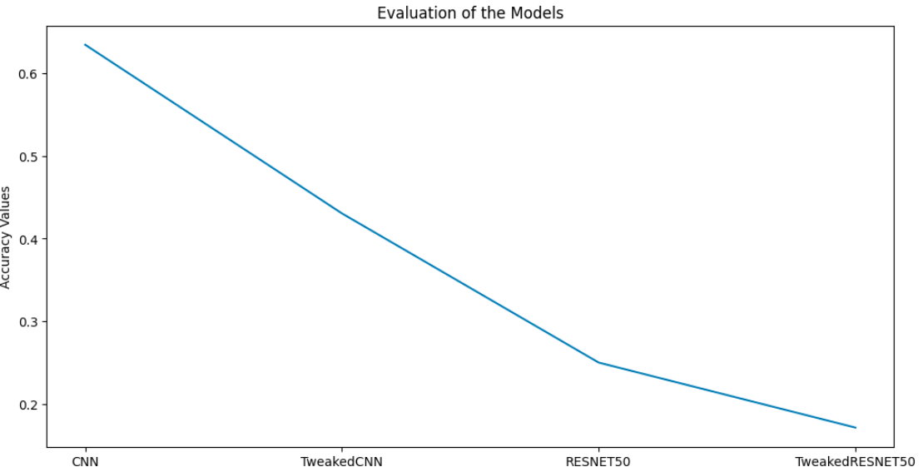
Results

Slide 10
Conclusion
Leveraging the CNN model using the Adam classifier as the primary predictive model for image classification can assist medical practitioners to make accurate and fast diagnosis on patients with abdominal trauma.
This has the potential to substantially improve patient care and health outcomes in emergency settings.

Slide 11



THANK YOU!!!

