Slide 1
ABDOMINAL TRAUMA DETECTION
Author: Diana Nduta Mwaura

Slide 2
Table of contents
01
02
03
04
05
06
Overview
Problem Statement
Data Understanding
Modeling
Conclusion
Exploratory Data Analysis

Slide 3
Overview
There are estimated to be more than 5 million annual deaths worldwide from traumatic injury.
Abdominal trauma may result in damage and internal bleeding of the internal organs, including the liver, spleen, kidneys, and bowel.
Detection and classification of injuries are key to effective treatment and favorable outcomes.
Prompt diagnosis of abdominal trauma using medical imaging is thus critical to patient care.

Slide 4
Problem Statement
Interpreting CT scans for abdominal trauma, however, can be a complex and time-consuming task, especially when multiple injuries or areas of subtle active bleeding are present.
This project aims at harnessing the power of machine learning to assist medical professionals in rapidly and precisely detecting injuries and grading their severity

Slide 5
Data Understanding
The dataset was obtained from Kaggle competition RSNA 2023 Abdominal Trauma Detection.
The competition is composed of different datasets that contain columns that aid in training the models.
The train.csv dataset contains the labels of the various injuries.
The image_level_labels.csv dataset is composed of the specific images that contain either the bowel or extravasation injury.
All the datasets had no missing values or duplicates

Slide 6
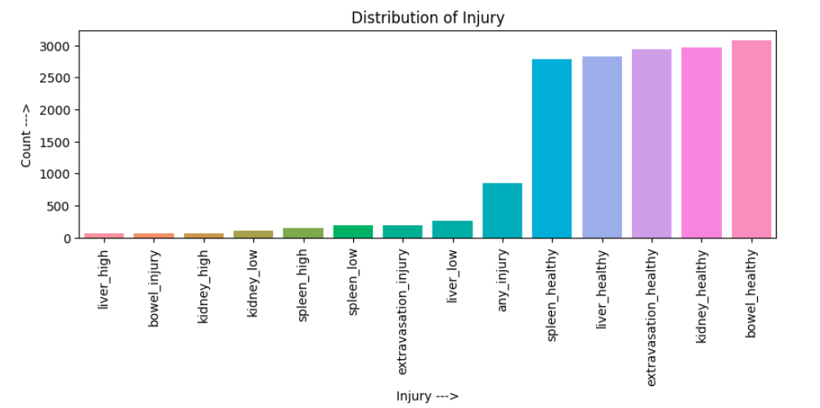
Exploratory Data Analysis

Slide 7
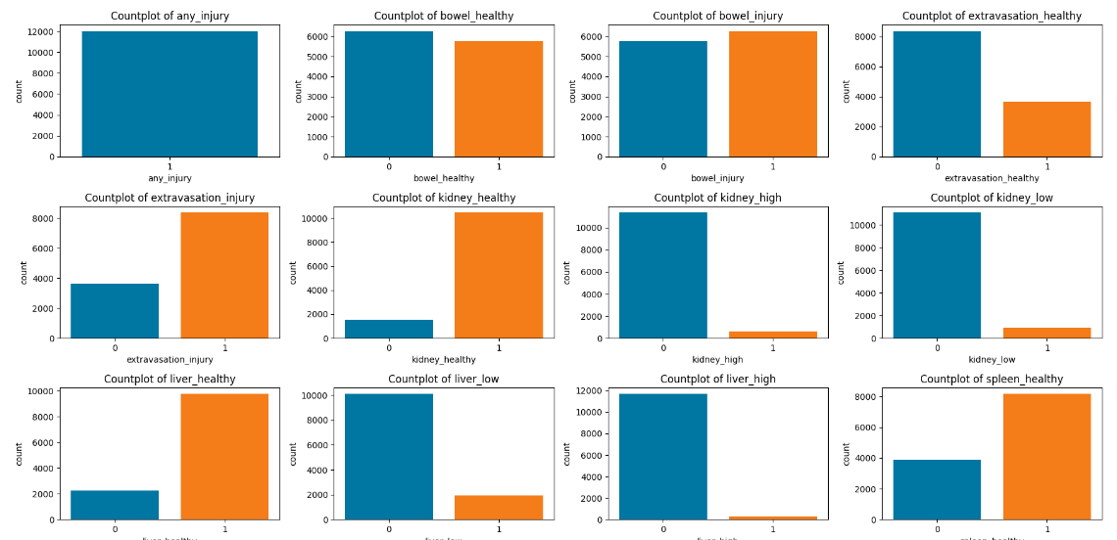
Exploratory Data Analysis

Slide 8
Modeling
In this section the dataset was split into train, test and validation sets.
Convolutional Neural Networks were used to generate the first and second model.
Transfer learning models such as RESNET50 was also used to train the models.

Slide 9
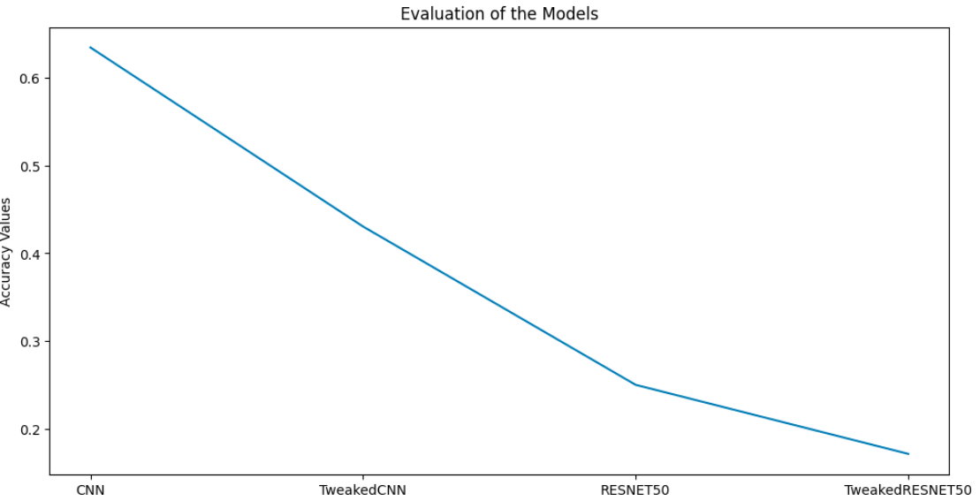
Modeling

Slide 10
Conclusion
Leveraging the CNN model using the Adam classifier as the primary predictive model for image classification can assist medical practitioners to make accurate and fast diagnosis on patients with abdominal trauma.
This has the potential to substantially improve patient care and health outcomes in emergency settings.

Slide 11
THANK YOU!!

