Slide 1
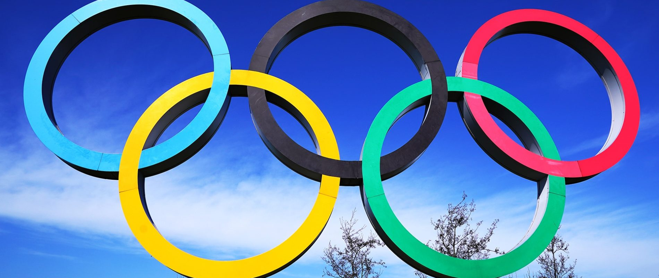
Olympic Hockey
Diana Ospina

Slide 2
Olympic Games
Summer Olympics started in 1896 and have been held every 4 years since
Winter Olympics started in 1924 and have been held every 4 years since
No edition held in 1916, 1940 & 1944 for either modality.
SELECT DISTINCT edition, edition_id
FROM Olympic_Athlete_Event_Results oaer
ORDER BY edition

Slide 3
Hockey & Ice Hockey
Hockey was introduced to the Olympics in 1908 and has been present every edition except 1912 & 1924
Ice Hockey was introduced to the Olympics in 1920 but as of 1924 moved to winter edition
Countries that participated in Hockey intro edition:
GER
FRA
GBR
Countries that participated in Ice Hockey intro edition:
BEL
TCH
CAN
FRA
SUI
SWE
USA

Slide 4
Women in Hockey
Women Hockey was introduced to the Olympics in 1980 and has been present every edition
Women Ice Hockey was introduced to the Olympics in 1998 and has been present every edition

Slide 5
Number of countries that have participated in men modality per edition
1908 Summer Olympics 82
1920 Summer Olympics 55
1928 Summer Olympics 173
1932 Summer Olympics 45
1936 Summer Olympics 214
1948 Summer Olympics 237
1952 Summer Olympics 177
1956 Summer Olympics 197
1960 Summer Olympics 280
1964 Summer Olympics 262
1968 Summer Olympics 278
1972 Summer Olympics 285
1976 Summer Olympics 176
1980 Summer Olympics 96
1984 Summer Olympics 192
1988 Summer Olympics 192
1992 Summer Olympics 192
1996 Summer Olympics 192
2000 Summer Olympics 192
2004 Summer Olympics 192
2008 Summer Olympics 216
2012 Summer Olympics 216
2016 Summer Olympics 217
2020 Summer Olympics 216

Slide 6
Number of countries that have participated in women modality per edition
1980 Summer Olympics 96
1984 Summer Olympics 96
1988 Summer Olympics 128
1992 Summer Olympics 128
1996 Summer Olympics 128
2000 Summer Olympics 160
2004 Summer Olympics 160
2008 Summer Olympics 216
2012 Summer Olympics 216
2016 Summer Olympics 215
2020 Summer Olympics 216

Slide 7
Which modality is more popular by number of country participation
Men
Hockey 42
Ice Hockey 37
Women
Hockey 22
Ice Hockey 16

Slide 8
Countries that have won medals
Gold
IND 8
PAK 3
GER 3
GBR 3
NED 2
NZL 1
FRG 1
BEL 1
AUS 1
ARG 1
Silver
NED 4
AUS 4
PAK 3
ESP 3
GBR 2
FRG 2
KOR 1
JPN 1
IND 1
GER 1
DEN 1
BEL 1
Bronze
AUS 5
GER 4
NED 3
IND 3
GBR 3
PAK 2
USA 1
URS 1
ESP 1
BEL 1

