Slide 1
Optimizing LLMs for Italian: Reducing Token Fertility and Enhancing Efficiency Through Vocabulary Adaptation
Moroni et al., 2025
Reproducibility Study
CS 421 — Fall 2025
Diana Gontero – Margherita Boanini

Slide 2
Why Optimize for Italian?
LLMs are mostly trained on English
Morphologically rich languages (like Italian) → subtoken fragmentation
Consequences:
more tokens
generation cost
zero-shot language quality
Paper’s objective: semantically adapt vocabulary to improve Italian representations and efficiency.

Slide 3
Project Goal & Method
Adapt LLaMA 3.1-8B for Italian
Reducing token fertility
Method:
Quantitative analysis of pre-trained models
Goal:
Preserve generative quality (translation, QA)
Improving efficiency (tokenization speed, inference)
Mini-Continual training (Mini-CT) reproduction

Slide 4
Our Reproducibility Project
Token Fertility
Simplified SAVA implementation
Quantitative Check-Up
Token Count
Tokenization Speed
Light Inference Time
Mini-Continual Training
Model initialization
Mini-Continual Training with LoRA, 1 epoch
Generative evaluation (BLEU/ROUGE)
Using official models: Base Llama, LAPT, SAVA, FVT

Slide 5
Models and Tokenizers
BASE MODEL:
LAPT – Continual Training without vocabulary adaptation
FVT – Fast Vocabulary Transfer
Llama-3.1-8B
SAVA — Semantic-Aligned Vocabulary Adaptation
Align embeddings from helper model (Minerva-3B)
Initialize new tokens in the target vocabulary
SAVA M-CT Reproduced
Our mini-CT reproduction of SAVA

Slide 6
Dataset
Corpus:
2,000 Italian Wikipedia sentences
2,000 English translations
Mini-CT Training Split:
75% Italian
25% English
Purpose:
Preserve English knowledge
Teach Italian efficiently

Slide 7
Limitations
Element | Paper | Our Project
Continual Training | 12B tokens, 16×A100 GPUs | ~500 sentences, 1 epoch (LoRA)
Dataset | CulturaX | Sampled Wikipedia IT
Models | FP16 on multi-node | 4-bit + single GPU
Metrics | ITA-Bench suite | small MT/QA test set
Reproducibility focus: maintain methodology, validate trends, document differences.

Slide 8
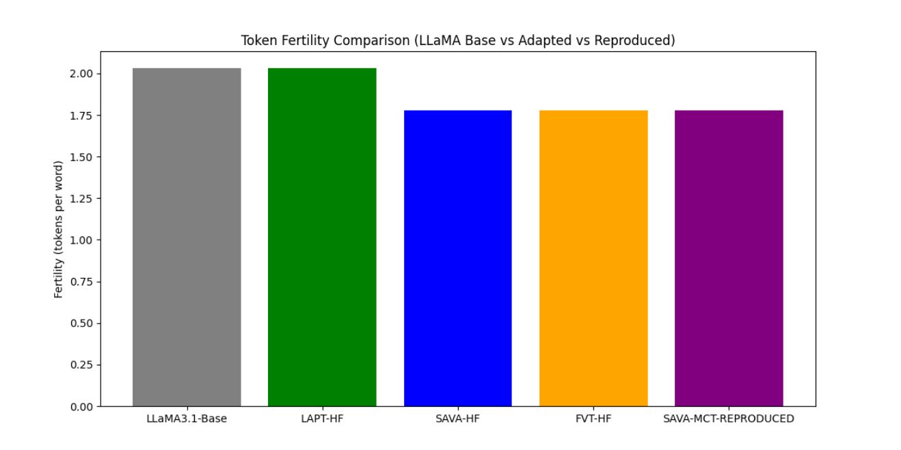
G1: Fertility
Vocabulary adaptation reduces token fertility
Mini-CT preserves gains

Slide 9
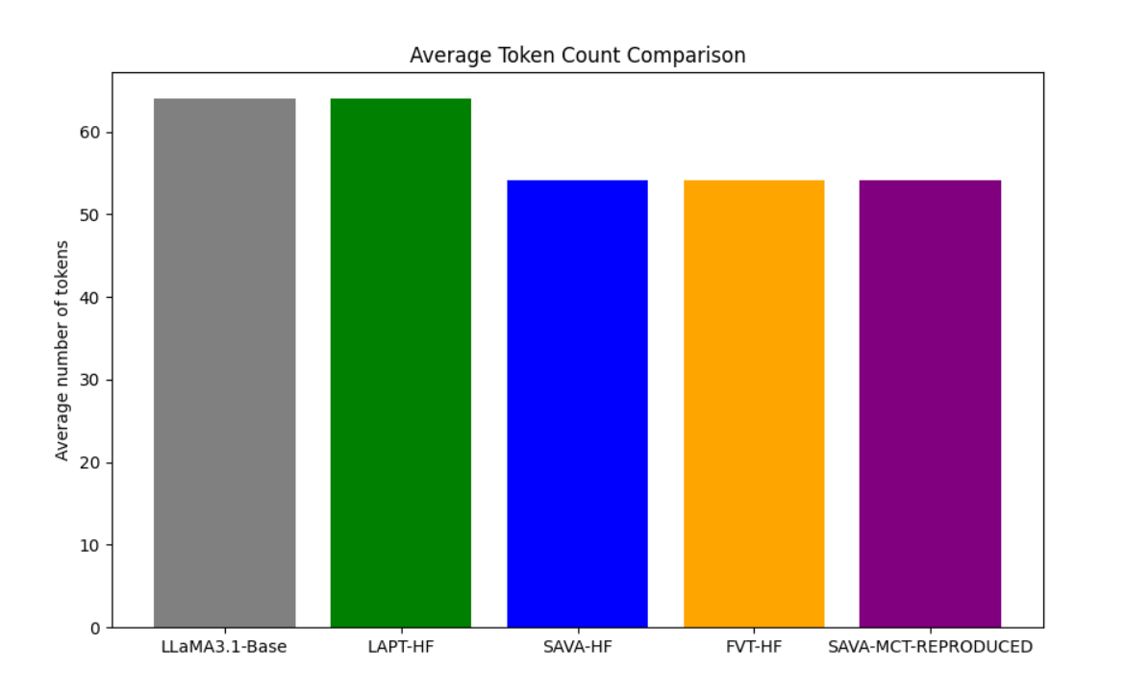
G2: Token count
SAVA & FVT reduce token count
Slight speed improvement in tokenization

Slide 10
G2: Tokenization speed

Slide 11
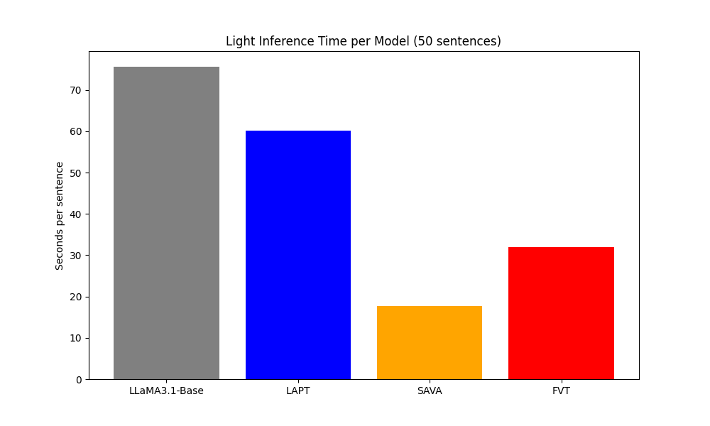
G3: Inference Time
SAVA achieves fastest inference (~76% faster than Base)
Reduced token fertility directly improves generation speed

Slide 12
G4: Generative evaluation (BLEU/ROUGE)
Tokenizer | BLEU | ROUGE-1 | ROUGE-2 | ROUGE-L | Avg_latency_MT | Avg_Latency_QA
LLaMA3.1-Base | 0.25 | 0.08 | 0.06 | 0.08 | 1.83 | 0.90
LAPT | 0.26 | 0.21 | 0.14 | 0.20 | 1.81 | 1.09
SAVA | 0.20 | 0.27 | 0.21 | 0.25 | 1.79 | 1.09
FVT | 0.20 | 0.22 | 0.16 | 0.20 | 1.79 | 1.07

Slide 13
CONCLUSIONS
Methodology Validated
Fast Convergence Confirmed
Project Success Despite Technical Fragility
Efficiency Claims Proven
Fertility:
2.03 → 1.78
Training Loss:
10.16 → 8.46

Slide 14
Thank you for your attention!
Diana Gontero
Margherita Boanini

