Slide 1
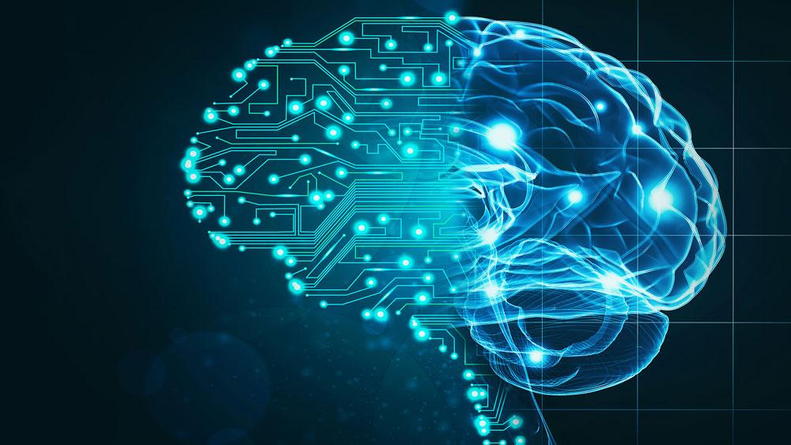
Machine Learning
Diana Romanenko, Alexander Krois, Niklas Lorber
Notes:
Hello and welcome,
we are going to talk about Machine Learning,
what it is and does,
how and why to use it,
and show one application of it in our practical part about mobile phone tariff plans.

Slide 2
Machine Learning is a type of artificial intelligence (AI) that provides computers with the ability to learn without explicit programming.
Notes:
Generally speaking,
—”—
What this means specifically, i will explain a bit later,
But first, let’s have a quick historical rundown

Slide 3
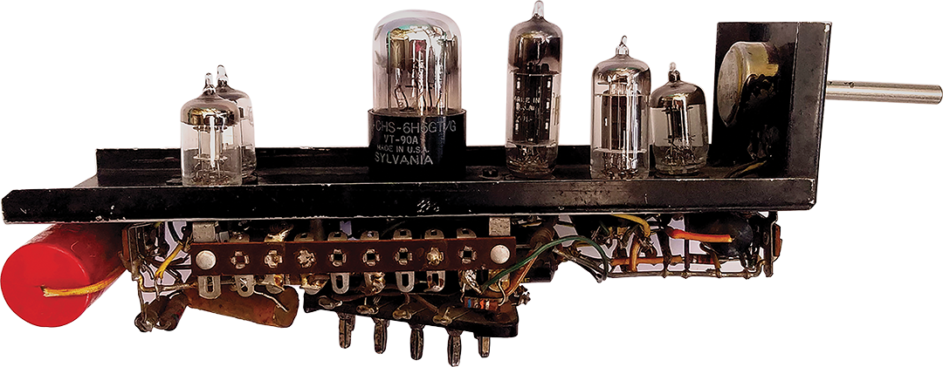
History
Based on “old mathematics”
1800s Bayes Theorem, Least squares linear regression
1900s Markov Chains
First postulations around 1950:
Alan Touring: "learning machines"
SNARC
Checkers program
Notes:
Necessary baseline statistical methods discovered way before any ideas and applications, going back as far as the 19th century.
Actual work on machine learning really started around the 1950s, with
Alan Touring: writing about "learning machines" - which later become genetic algorithms
SNARC: first neural network machine - IMAGE
First machine learning program playing checkers – utilising limited memorisation, alpha-beta pruning & MinMax algorithm

Slide 4
Timeline
“Machine Learning” coined in 1959
Synonym "self-teaching computers“
1970s pessimism caused "AI Winter"
1980s Resurgence
1990s knowledge-driven → data-driven approach
2000s Boom
Notes:
Ever since then, continuous research and progress was done in the field,
becoming prevalent in public perception only sporadically,
and mainstream about 50 years later.
There was a bit of stagnation in the 70s known as “AI Winter”
But with the rediscovery of backpropagation it resurged.
In the 90s the approach shifted from a knowledge to a data-driven one.
And finally, with advancements in hardware, connectivity and data availability, the boom we know today starts in the 2000s.

Slide 5
Groundwork
Established ideas before 2000s
Multi-layer networks
Perceptrons
Convolutional neural networks
Markov decision process
Nearest neighbour algorithm
Backpropagation
Boosting
Random decision forests
…
Notes:
The theoretical groundwork for advanced applications like deep learning are already established before the boom,
Like convolutional neural networks, Nearest nighbour algorithm, Random decision forests..

Slide 6
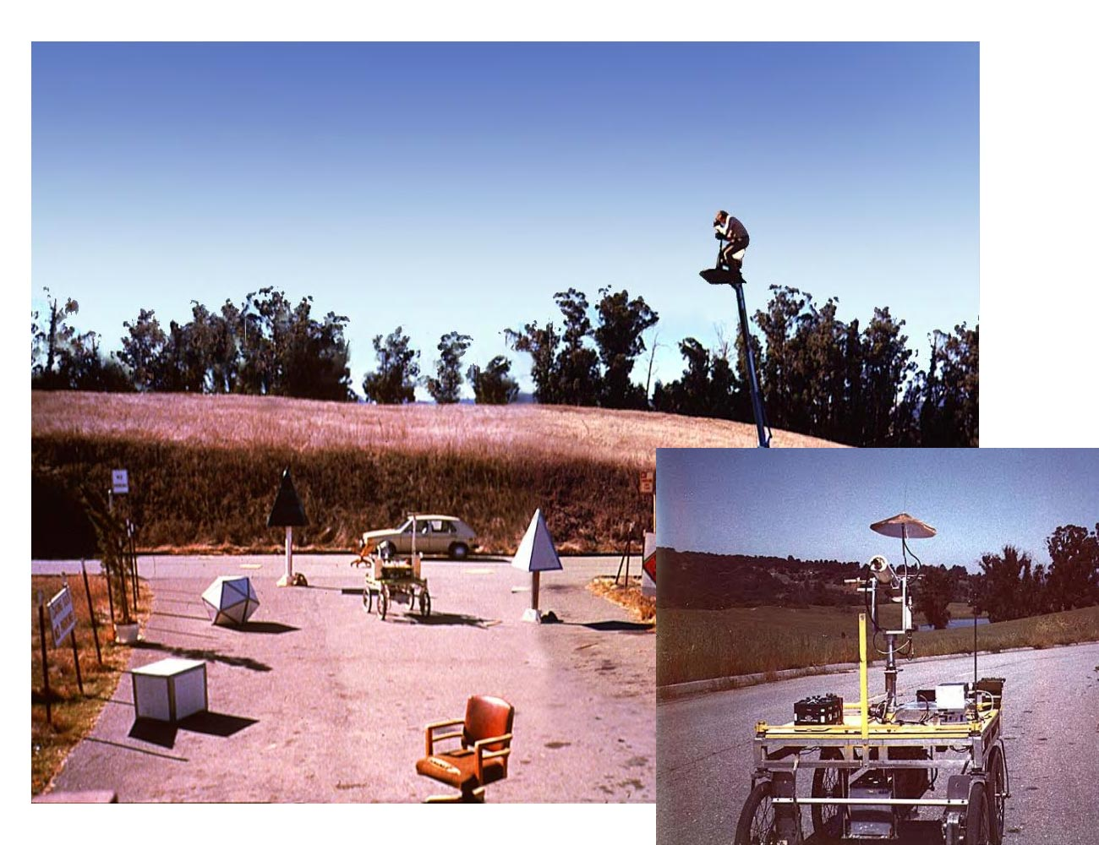
Achievements
1979 Stanford cart
1997
IBM Deep Blue
First Deepfake software
2009 ImageNet
2016 AlphaGo
Notes:
Some public milestones are
1979 Stanford cart: autonomous cart navigating around obstacles with 3D mapping
1997:
IBM Deep Blue wins a chess match against a World Champion
First deepfake software
2009 ImageNet was created
a massive visual training database so algorithms have something big enough to work with
for many this is the catalyst for the AI Boom
2016 AlphaGo beats a professional player in a game thought to be near-impossible for a computer

Slide 7
What is Machine Learning?
Imitate human learning
Use of Data and Algorithms
Gradually improving its accuracy
Different Approaches
Achieve either or both
Classify data
Predict data
Notes:
Basically wants to imitate human learning
By REPEATEDLY applying algorithms to BIG amounts of data
Gradually improving its accuracy with and on this training data
To achieve this, there are different approaches which I will explain in a moment
In General, machine learning builds a model with training data, to then make decisions on new data, to either or both:
classify data based on developed models
make predictions on future outcomes based on these models

Slide 8
What is Machine Learning?
ML vs Artificial Intelligence
ML imitates human learning
AI replaces human agent
ML vs Data Mining
ML predicts with known properties
DM finds unknown properties
Notes:
ML grew out of the need for AI to learn from data
ML learns and predicts based on passive observations - provide tailored advertisements
AI actively interacts with environment to learn and take action - ultimately replacing the human agent, like Siri
There is also a small distinction between ML and Data Mining
They apply the same technologies but with different goals.
while
ML predicts based on known properties from the training data - Reproduction
DM finds unknown properties in the data - Discovery

Slide 9
Approaches #1
Supervised Learning
Unsupervised Learning
labelled input & output
interpret pattern
e.g. image recognition
unlabelled input & output
find hidden pattern
e.g. product recommendations
Notes:
SUPERVISED LEARNING is about
interpreting patterns utilising known input and desired output training data to then better predict unlabeled data.
e.g. image recognition, distinguishing cats from dogs
UNSUPERVISED LEARNING is about
Finding HIDDEN patterns in unlabeled input and output,
For example online shopping makes product recommendations based on purchase histories

Slide 10
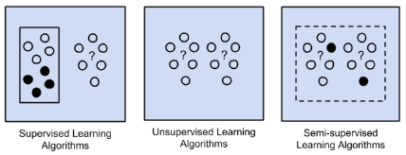
Approaches #2
Semi-Supervised Learning
Reinforcement Learning
partly labelled input
Easier training
Better accuracy
dynamic environment
achieve goal
maximise reward
e.g. autonomous driving, playing games (against humans)
Notes:
SEMI SUPERVISED LEARNING combines
easier obtainable training data of unlabelled data with
An increase in accuracy through a small subset of labelled data
REINFORCEMENT LEARNING is important
For AI agents, as those navigate a dynamic environment like streets or digital worlds.
Here, agents have a set of goals they want to achieve, with constraints and rewards,
Which they want to maximise the latter.
For example an AI player aims for the highest score and no “game over” states,
or a car wants to go efficiently from A to B, while staying in lane, within tempo limits and keeping appropriate distance

Slide 11
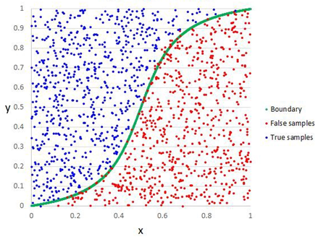
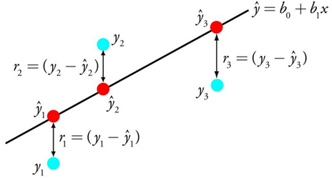
Regression Algorithms
Linear Regression
Logistic Regression
remove correlated variables
remove noisy data
minimize error of the model
mainly used in binary classification problems
get weights of input variable
Output predicted non linear function
Works best with elimination of correlated data

Slide 12
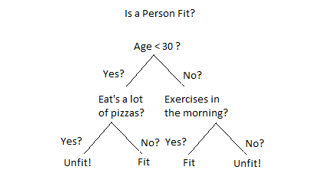
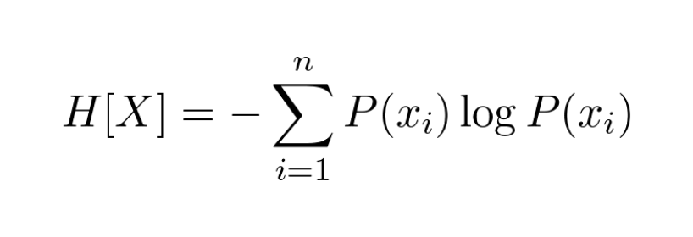
Decision Tree
square represent nodes
accuracy increases with nodes
decission is choosen -> leaves
intuitive easy to build -> fall short on accuracy
IG = E(Parent) - ∑ѡ_{i} E(child_{i})

Slide 13
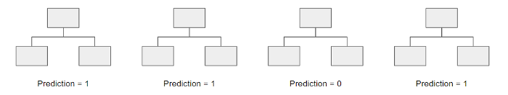
Random Forest
build up on multiple decission trees
randomly selecting subsets of variables each step
model selects all predictions of each tree
„majority wins“ model
risk of individual error reduced

Slide 14
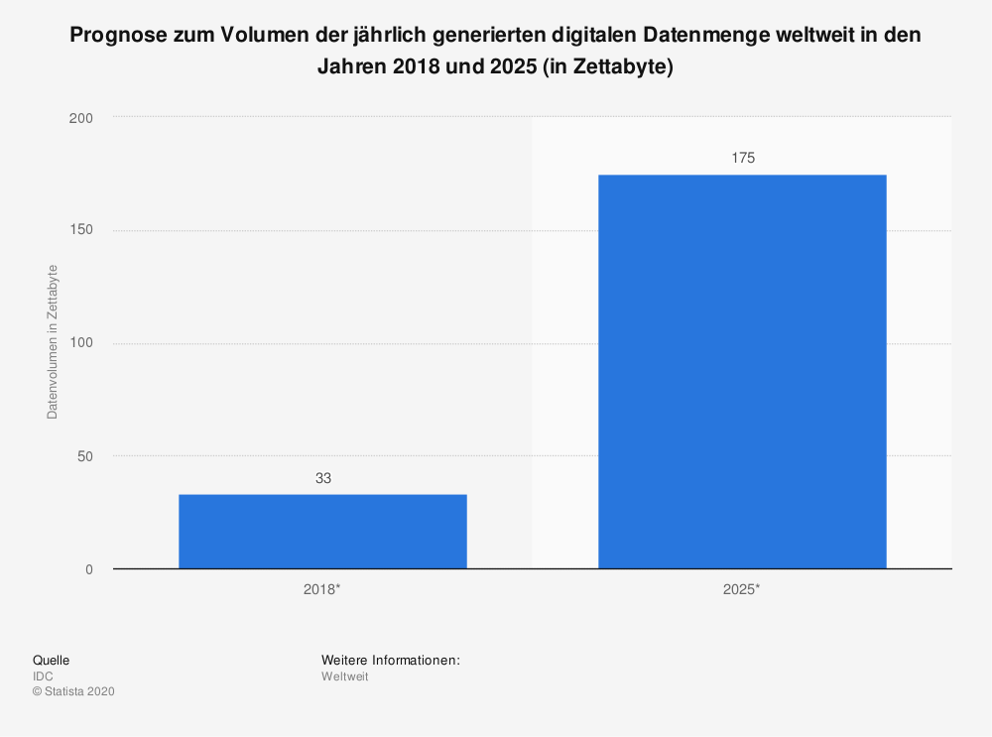
Why Machine Learning?
exponential data growth
information must be obtained
Decisions must be made

Slide 15

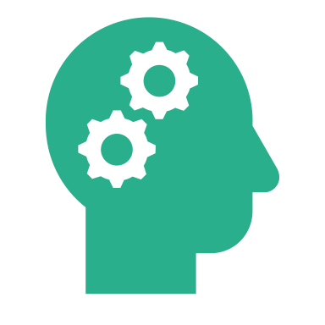



Applications of Machine Learning
Data Analytics (large DBs)
Natural Language Processing
Computer Vision
Robotics
Product Recommendations

Slide 16



Future Predictions
Trend will continue
applied in more and more areas
Basis of further technologies (AI, Autonomous driving, Recommender Systems)

Slide 17
Practical Part
System capable offering users new tariffs
Data from previous tariff changes available
Classification problem
Goal -> System capable of analyzing customer and making predictions
Tested 3 Models (Decision Tree Algorithm, Random Forest Classifier, Logic Regression)
Now we will show you in detail what we did!

