Slide 1
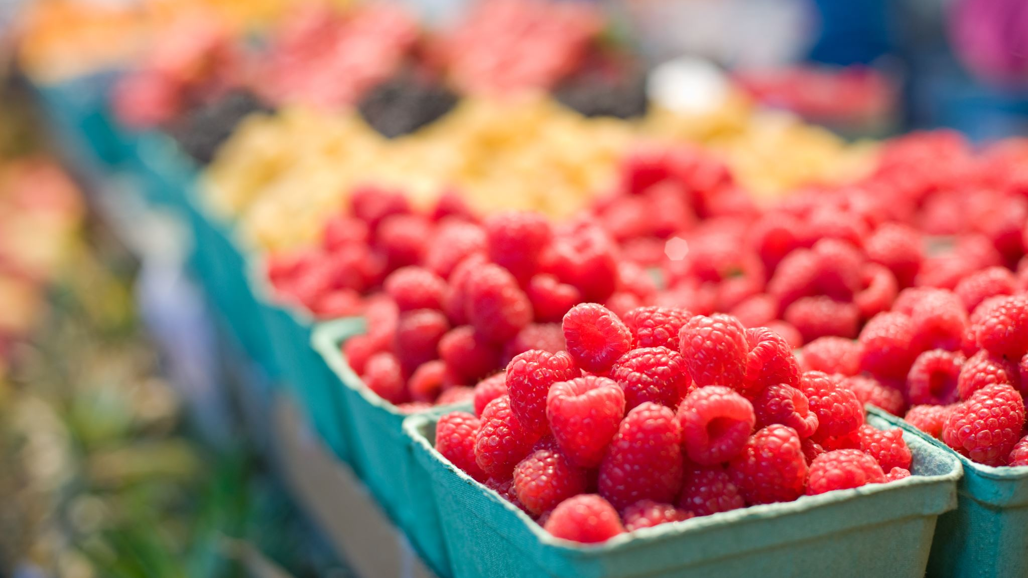
Fruit Prices By Form in The United States
NAME: Dianah Mutanda
COURSE ID: CSIT 558
COURSE NAME: Data Mining
TASK: Data Preprocessing

Slide 2
Dataset Description
The USDA, Economic Research Service (ERS) estimated average prices for more than 150 commonly consumed fresh and processed fruits. Reported estimates include each product's average retail price and price per edible cup equivalent. Average retail prices are reported per pound. For many fruits, a 1-cup equivalent equals the weight of enough edible food to fill a measuring cup.
https://www.ers.usda.gov/data-products/fruit-and-vegetable-prices.aspx
The dataset includes information about the different types of fruits, their state or form at the retail store, their retail price, cup equivalent size, and cup equivalent price.
FOCUS
The main agenda of this project will be to compare the prices across different states of fruits at retail stores.

Slide 3
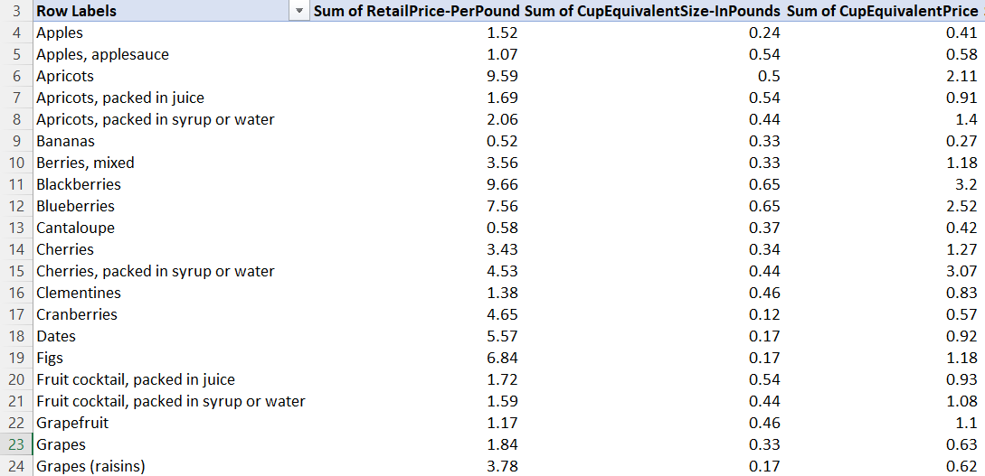
The resulting dataset used in this project contains 52 rows and 12 columns after data cleaning, integration, and selection. All the retail prices are presented in dollars per pound.
52 rows x 12 columns

Slide 4
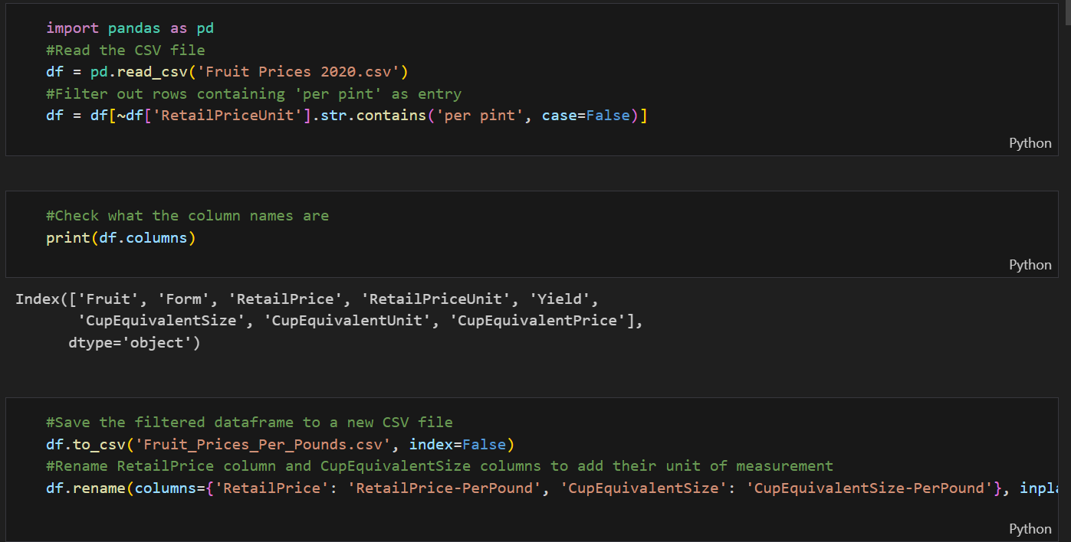
Data Cleaning
Drop every row that has “per pint” as a unit of measurement in the RetailPriceUnit column
Check the existing columns
Rename the price columns to add the unit of measurement
Save the resulting data frame to a new csv file

Slide 5
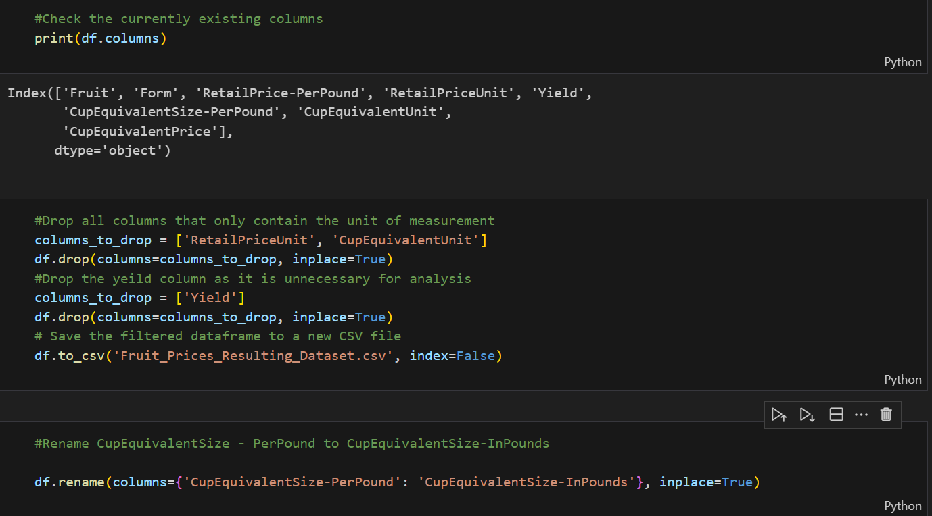
Data Cleaning
Drop all columns that only contain the unit of measurement
Drop all unnecessary columns for data analysis
Save the resulting data frame as a new csv file
Rename the size columns to have the unit of measurement
Check for any duplicate values after combining column one and column two.
Eliminate any duplicate data to avoid redundancy

Slide 6
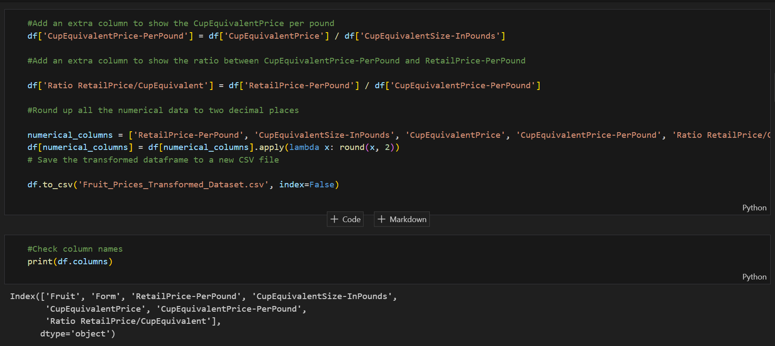
Data Cleaning & Transformation
Add an extra column to convert price from per cup to per pound
Add an extra column to show the ratio between CupEquivalentPrice-PerPound and RetailPrice-PerPound
Round up all the numerical data to two decimal places

Slide 7
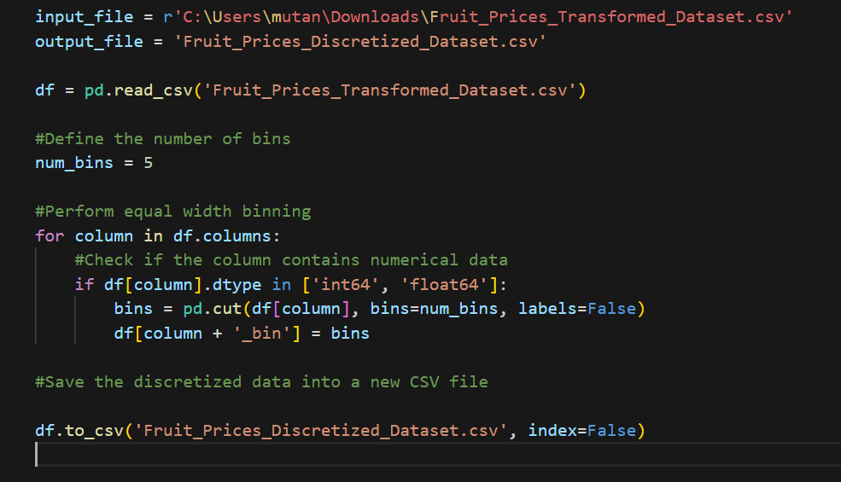
Data Discretization
Bin numbers are 0-4
Use the concept of binning to group fruit prices into five bins
The type of binning use is equal width binning
This helps to simplify the data for analysis and interpretation

Slide 8
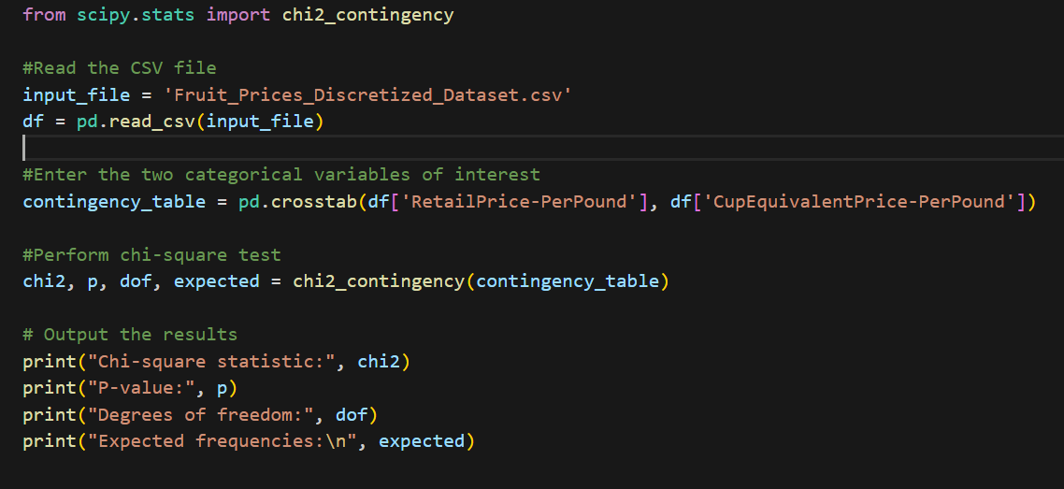

Chi-Square Test
Using chi2 contingency from SciPy stats to perform the chi-square test of independence and calculate the following:
Chi-square statistic: This measures of how much the observed counts deviate from the expected counts. The chi-square statistic is 2295. This large value suggests that there is a notable difference between the observed and expected frequencies.
P-value: It represents the probability of observing a chi-square statistic as extreme as or more extreme than the one calculated, assuming that the null hypothesis is true. In this case, the p-value is 0.09897. This is greater than the significance level of 0.05, suggesting that there is weak evidence against the null hypothesis.
Degrees of freedom: This is the number of independent pieces of information in the contingency table. The degrees of freedom is 2209.
Using the fruit prices 2020 dataset, create a cross tabulation between two categorical variables: RetailPrice-PerPound and CupEquivalentPrice-PerPound

Slide 9
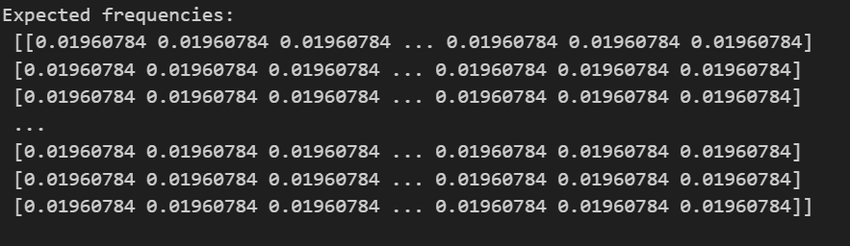
Null Hypothesis (H0): There is no association between the two categorical variables in the population.
Alternative Hypothesis (H1): There is an association between the two categorical variables in the population.
The p-value is 0.09897, which is greater than the significance level of 0.05. This suggests that there is weak evidence against the null hypothesis. Therefore, there is not enough evidence to reject the null hypothesis of independence between the two variables at a conventional significance level. We can then conclude that there is no significant association between the two variables.

Slide 10
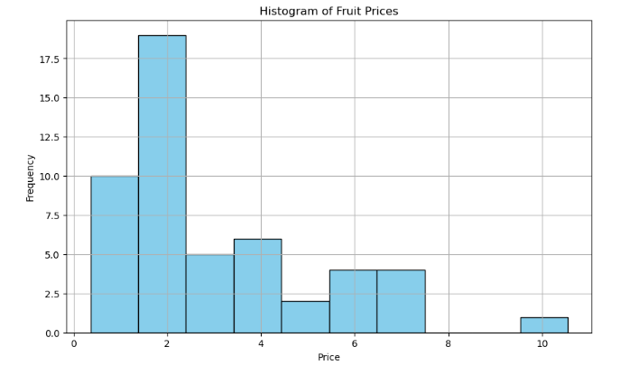
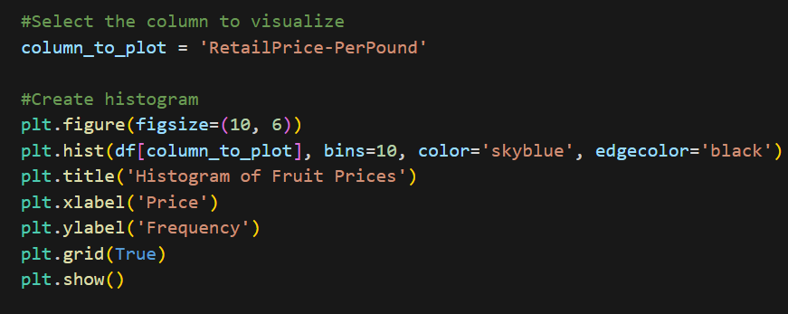
VISUALIZATION Histogram for summarization
A histogram representing the various frequencies of the different prices of different fruit forms.
Majority of the prices fall in the $2 per pound range

Slide 11
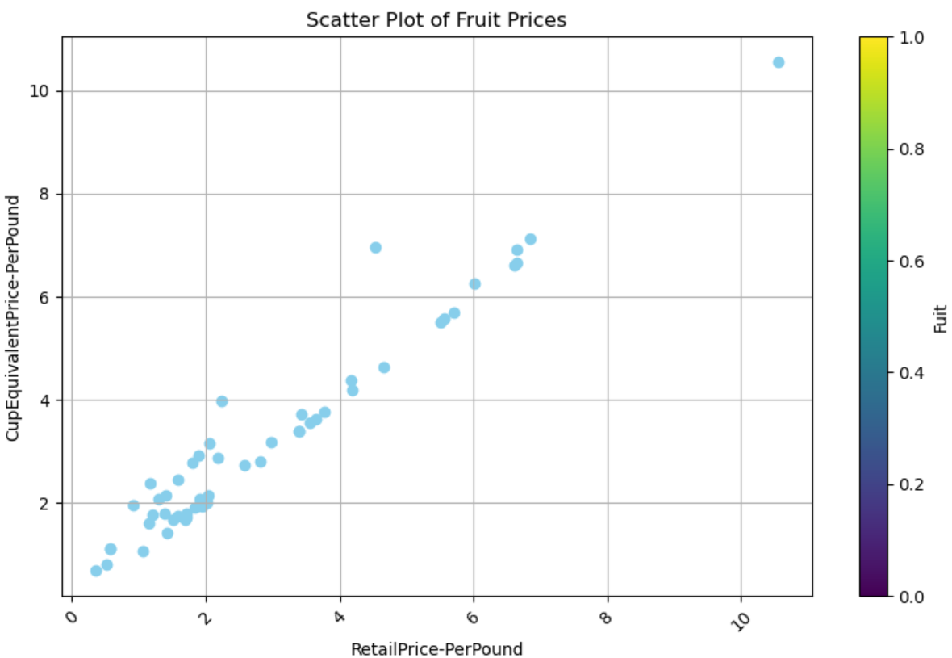
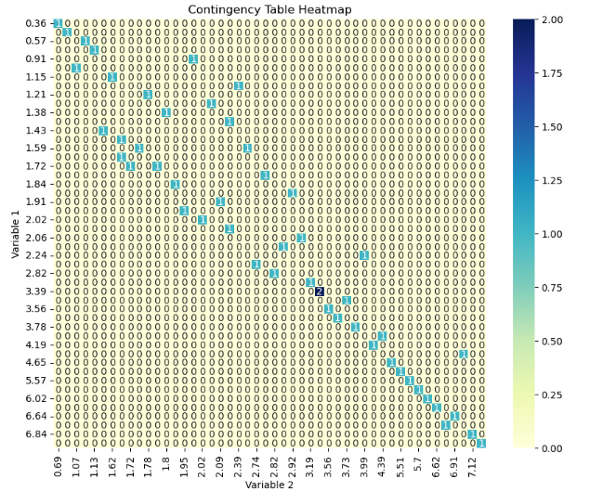
VISUALIZATION CONTINUATION
Scatter plot summarization
Contingency table summarization

Slide 12
References
R. Agrawal, T. Imielinski, and A. Swami (1993). "Mining associations between sets of items in massive databases," in Proceedings of the 1993 ACM-SIGMOD International Conference on Management of Data (pp. 207–216), New York: ACM Press.
https://www.ers.usda.gov/data-products/fruit-and-vegetable-prices.aspx
Scipy.stats.chi2_contingency#. scipy.stats.chi2_contingency - SciPy v1.11.3 Manual. (n.d.). https://docs.scipy.org/doc/scipy/reference/generated/scipy.stats.chi2_contingency.html

