Slide 1

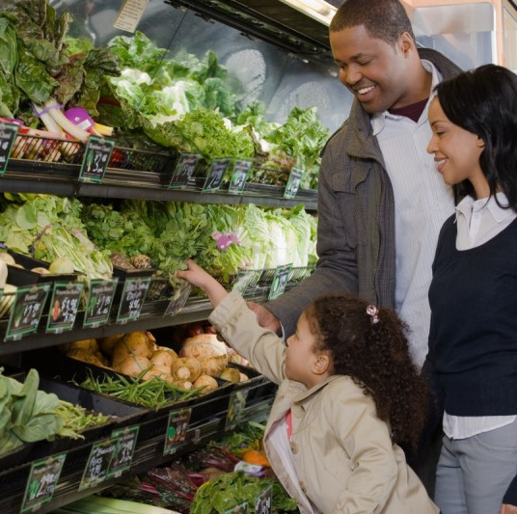
Groceries Market Basket Dataset
Name: Dianah Mutanda
Course ID: CSIT 558
COURSE NAME: Data Mining
TASK: Descriptive Data Mining

Slide 2
Dataset Description & Objective
The Groceries Market Basket Dataset contains 9835 transactions by customers shopping for groceries. The data contains 169 unique items. It contains transactional data recording items purchased together during a single shopping trip. Each entry lists the products bought in a transaction, enabling analysis of customer behavior, association rules, and pattern recognition for targeted marketing or inventory management.
From the left side is the number of items in a basket then Item 1, 2, 3, etc, stands for list of the item.
This is the link to access the data:
https://www.kaggle.com/datasets/irfanasrullah/groceries
Goal:
To apply descriptive data mining on this dataset using association rules. The dataset contains categorical data and by converting these values to binary, the Apriori algorithm can be used. Apriori was chosen to discover patterns of co-occurrence among items frequently purchased together by customers.
Objective:
This analysis aims to identify patterns of co-occurrence among items frequently purchased together by customers, allowing businesses to understand buying habits, optimize product placement, and implement targeted marketing strategies to enhance sales and customer satisfaction.

Slide 3
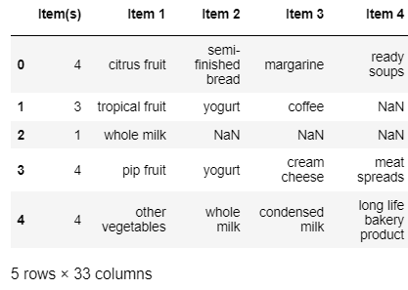

The resulting dataset used in this project previously contained 9835 rows and 33 columns and now contains 7676 rows and 24 columns after data cleaning, integration, and selection.

Slide 4
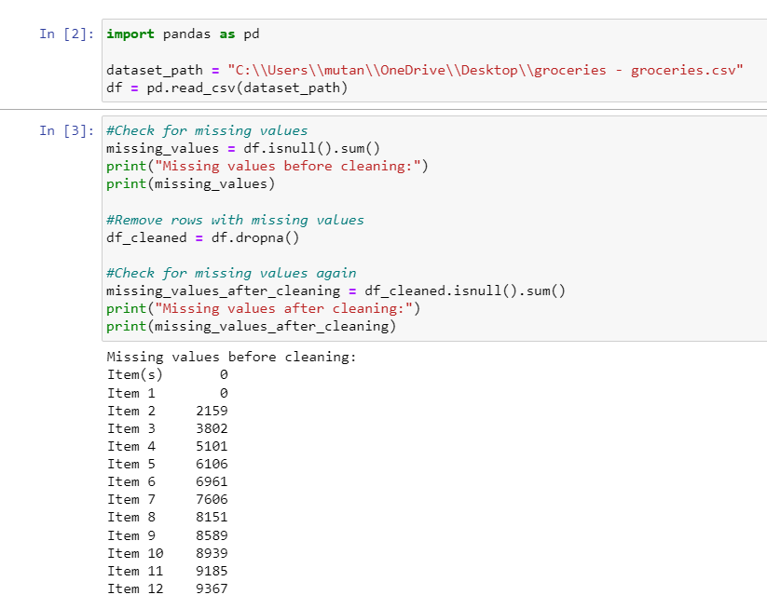
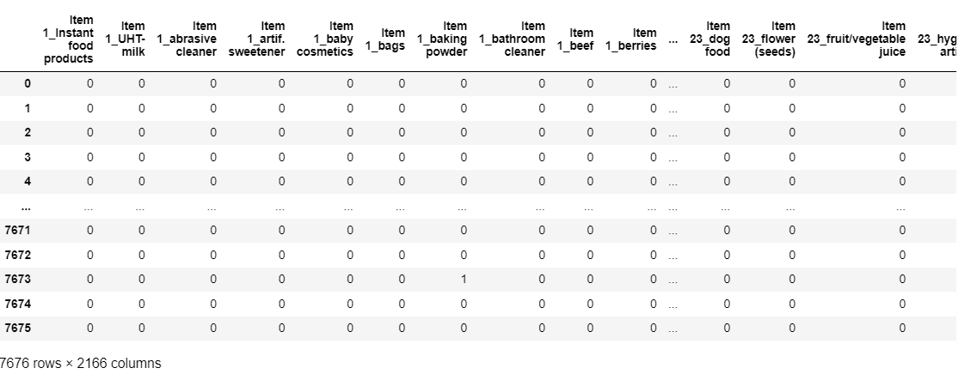
Data Preprocessing
Read transaction by transaction and save each transaction
as a list
Drop all the null columns
Drop all the columns with less than 10 entries
Drop all the null rows
Add a new column that lists unique transaction IDs
Convert the data into binary form
Data frame with binary values: 0 represents presence and
1 represents absence

Slide 5
Definition of terms related to apriori algorithm
Apriori Algorithm: This is a classic algorithm used in data mining and association rule learning. It is used to discover frequent itemsets in a transaction database and to derive association rules from these itemsets.
Support: This refers to the frequency or occurrence of an itemset in a dataset. This helps to determine which items are impactful in determining association rules.
Confidence: This is a measure of the strength of a rule indicating the likelihood that itemset Y will be purchased when itemset X is purchased. A higher confidence value indicates a stronger association between X and Y, implying that Y is likely to be purchased when X is purchased.
Association Rules: These are rules that describe relationships or associations between items in large datasets. These rules are often derived from transactional data, where each transaction consists of a set of items.
Lift: This measures the strength of association between the antecedent and consequent beyond what would be expected by chance. Lift values greater than 1 indicate that the presence of X increases the likelihood of Y, while values less than 1 indicate the opposite.

Slide 6
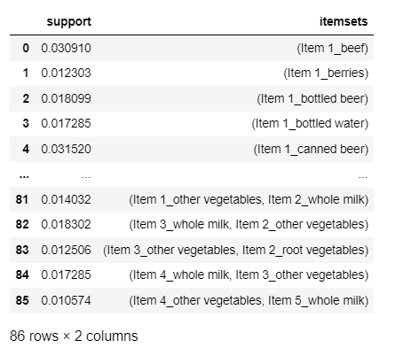
Apriori Experiment 1
Find the frequent itemsets with a minimum support threshold of 0.005, where only itemsets with at least 0.5% support are considered frequent.
Code:
Summary of the frequent itemsets with a minimum support threshold of 0.005:

Slide 7
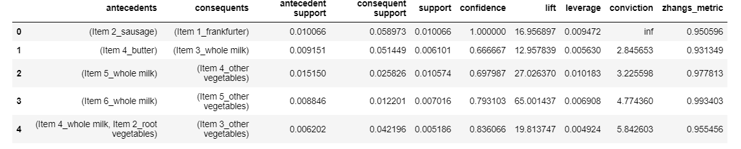
Apriori Experiment 1
Find the association rules with a minimum confidence threshold of 0.6, where only rules greater than or equal to 60% are considered.
Code:
Summary of the frequent
itemsets with a minimum
confidence threshold of
0.6:
This experiment was run with low support of 0.005 and high confidence of 0.6. The association rules are observed to have high confidence [all the values for lift are greater than one] implying that the itemsets are positively correlated.

Slide 8
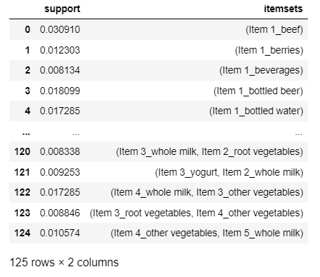
Apriori Experiment 2
Find the frequent itemsets with a minimum support threshold of 0.008, where only itemsets with at least 0.8% support are considered frequent.
Code:
Summary of the frequent itemsets with a minimum support threshold of 0.008:

Slide 9
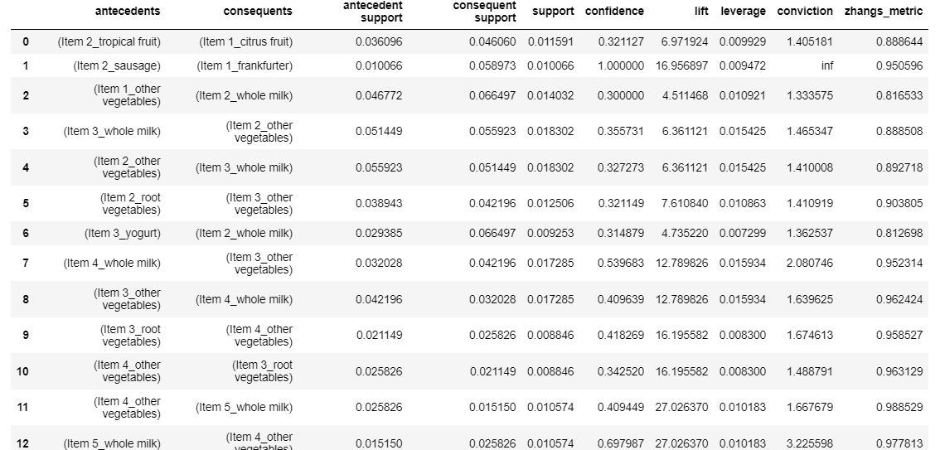
Apriori Experiment 2
Find the association rules with a minimum confidence threshold of 0.3, where only rules greater than or equal to 30% are considered.
Code:
Summary of the frequent
itemsets with a minimum
confidence threshold of
0.3:
This experiment was run with a higher support of 0.008 and a lower confidence of 0.3. The association rules are observed to have high confidence [all the values for lift are greater than one] implying that the itemsets are positively correlated.

Slide 10
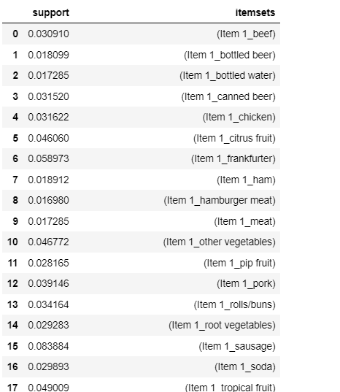
Apriori Experiment 3
Find the frequent itemsets with a minimum support threshold of 0.015, where only itemsets with at least 1.5% support are considered frequent.
Code:
Summary of the frequent itemsets with a minimum support threshold of 0.015:

Slide 11
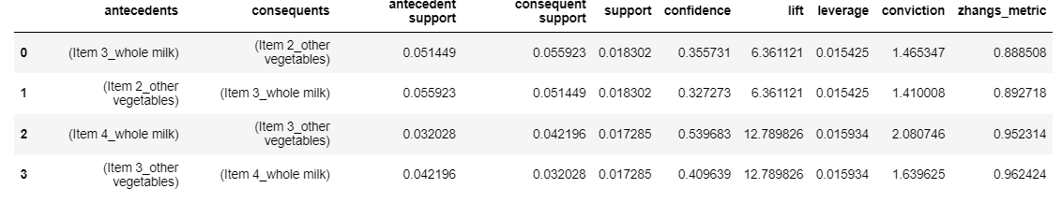
Apriori Experiment 3
Find the association rules with a minimum confidence threshold of 0.2, where only rules greater than or equal to 20% are considered.
Code:
Summary of the frequent
itemsets with a minimum
confidence threshold of
0.2:
This experiment was run with a support of 0.015 and confidence of 0.2. These are not the best parameters to use as they only list a few associations out of the large group of products in the entire grocery store. The association rules are observed to have high confidence [all the values for lift are greater than one] implying that the itemsets are positively correlated.

Slide 12
CONCLUSION
The main objective was to identify patterns of co-occurrence among items frequently purchased together by customers, allowing businesses to understand buying habits, optimize product placement, and implement targeted marketing strategies to enhance sales and customer satisfaction.
Experiment | Support | Confidence
1 | 0.005 | 0.6
2 | 0.008 | 0.3
3 | 0.15 | 0.2
All the three experiments produced results with strong positive association rules with regards to the lift calculation. However, experiment 2 produces the most relevant results that can be used for decision making. From that, it can be noted that low support and average confidence are likely to return the best results for this dataset and objective.
From the association table output, you can identify which products are frequently purchased together and place them together in shelves or use them to run an advertisement to a consumer immediately after they have purchased one product from an itemset. For instance, we have observed that there is a really strong association between whole milk and other vegetables. Therefore, it would be an excellent idea to place the two iteams close to each to encourage consumers to purchase both at the same time.

Slide 13
References
Agrawal, R., Imielinski, T., & Swami, A. (1993). Mining Association Rules between Sets of Items in Large Databases. In Proceedings of the 1993 ACM SIGMOD International Conference on Management of Data (pp. 207-216).
Han, J., Pei, J., & Yin, Y. (2000). Mining Frequent Patterns without Candidate Generation. In Proceedings of the 2000 ACM SIGMOD International Conference on Management of Data (pp. 1-12).
mlxtend Documentation: https://rasbt.github.io/mlxtend/
pandas Documentation: https://pandas.pydata.org/docs/

