Slide 1
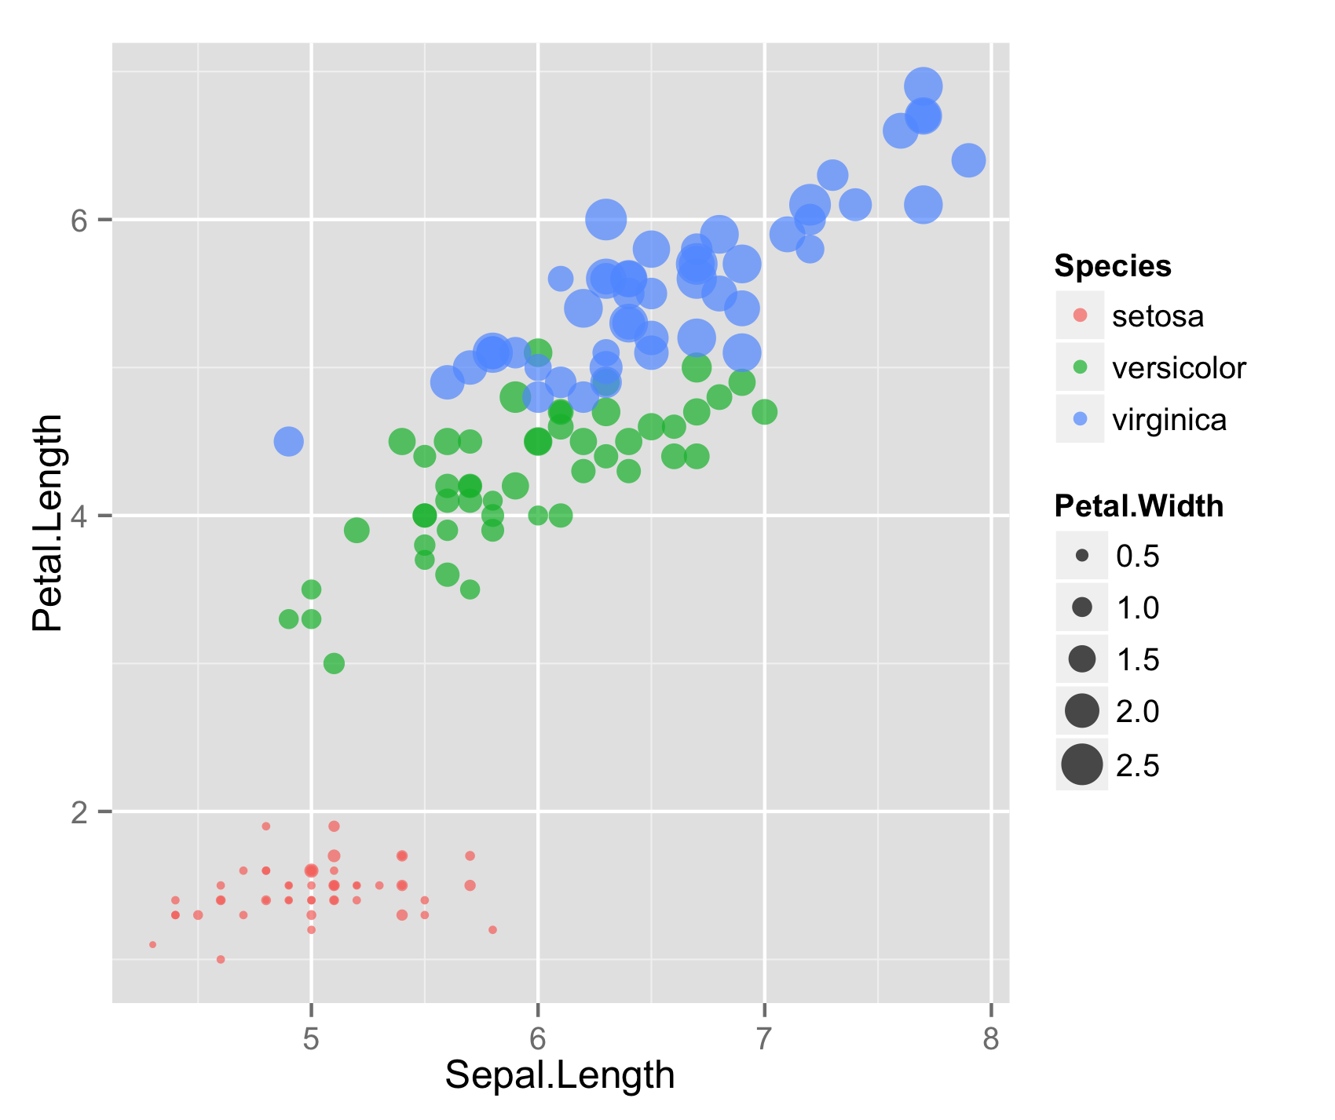
Vector graphics format versus raster format
6
Species
setosa
versicolor
virginica
4
Petal.Width
Petal.Length
0.5
1.0
1.5
2.0
2.5
2
5
6
7
8
Sepal.Length

