Slide 2


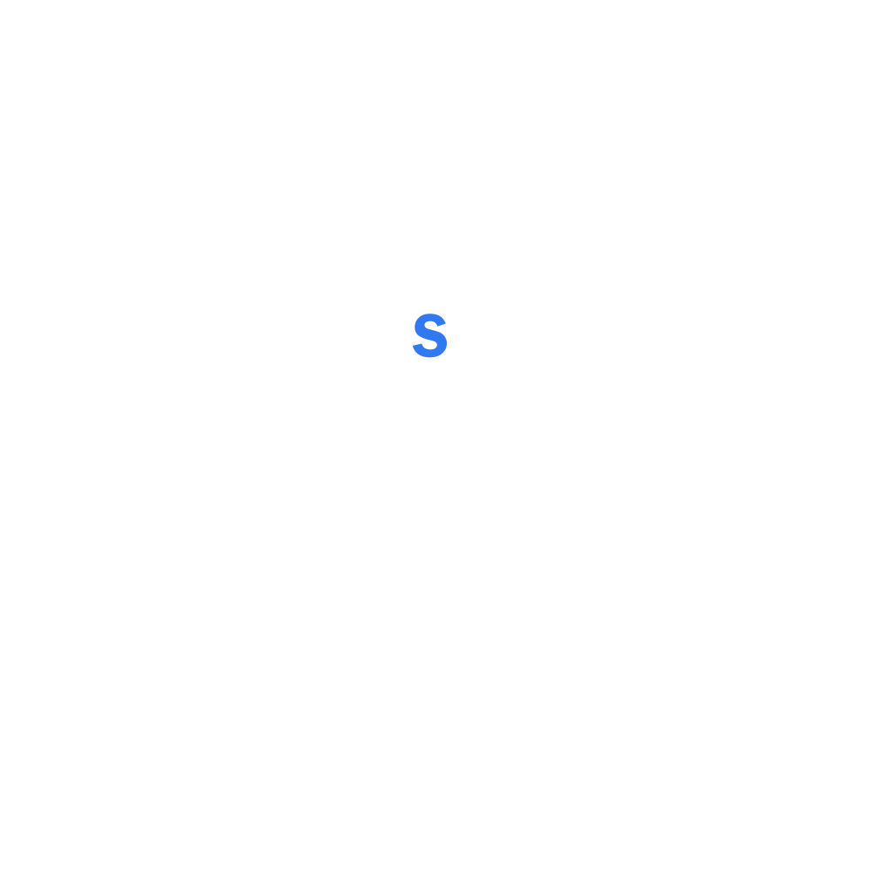

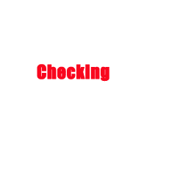

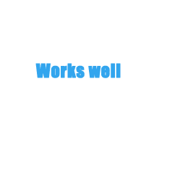
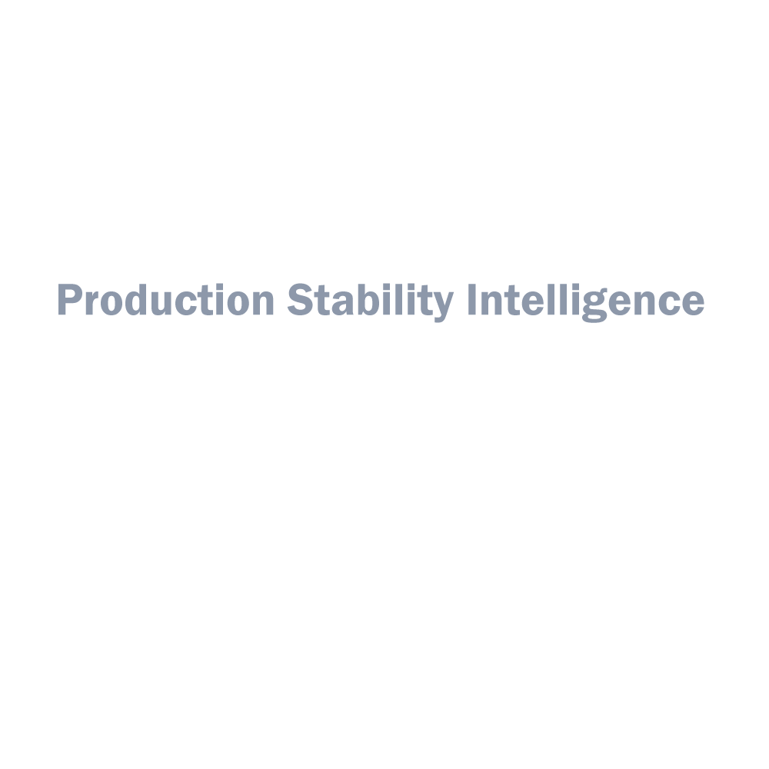
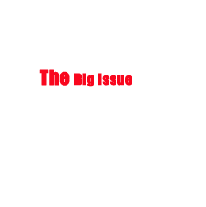
ICG Unit IV
Equity QA Framework

Slide 3


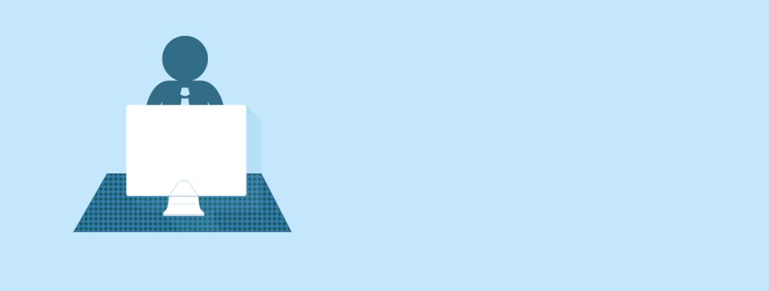


Wechat
IV Geeks…(243)
Many tools to manage the development process…can we use only a powerful one
Production
Attach approval email, test cases, doc…in different places…confused…
Can't get full information of projects from sign off email
BA, QA, DEV, Support…spend much time on communication…meeting…to resolve prod issues
…Development
Disadvantages…
I Want to say
I’m new employee, there is no directly way to help me understand projects…
As a support, sometimes, I do not how to handle unexpected error …
…

Slide 4
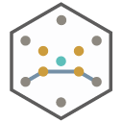




Production Stability Analysis and Rating
Production Monitor and Recovery
Production Change Control Assistance
PSI your
Trustworthy
friend
PSI

Slide 5
PSI
Data collector

Slide 6

Production Stability
Analysis and Rating
Leader/Senior Manager
APP Score
Acquire app info based on the analysis report
TDM
98
Dev/Trader
Ocean
Enhance apps performance and complete
requirement with priorities
68
EQEdting
QA/Support
48
Razor
Locate and resolve issues with efficiency

Slide 7
Production Change
Control Assistance
Code review
Requirement
XXXXX
XXX
SignOff
Make the development process more standard
Provide details info for QA/App sign off
Avoid meaningless meeting

Slide 8
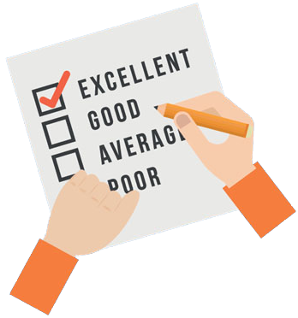

Production Monitor
and Recovery
?
?
?
Advance alert
Automatic revovery
Service start/restart

