Slide 1
Big Data
& Analysis
By Diane
DM18232

Slide 2
1 Introduction
-Development of big data
-Relationship between some concepts
2 Industry
-Overview diagrams
-A platform Example
3 My work
-Purpose
-Data analysis process
1
Big Data
CSTC

Slide 3
Development of big data
Database machine
Jim Gray:
The Fourth Paradigm
Obama Administration：
Big Data Research and Development Plan
《Extracting Values from Chaos》:
Big data
Google：GFS
MapReduce
BigTable
2003-
2006
1970
2007
2011
2012
《Big data: a survey》[J]. Chen M, Mao S, Liu Y. Mobile Networks and Applications, 2014, 19(2): 171-209.
2
Big Data
CSTC

Slide 4
Relationship between some concepts
transforms the IT architecture
as an advanced IT solution
various devices and machines are deployed into the network
influences business decision-making
a service mode
focuses on business operations
the big data are generated by IoT
Cloud computing
IoT
_{Big data}
3
Big Data
CSTC

Slide 5
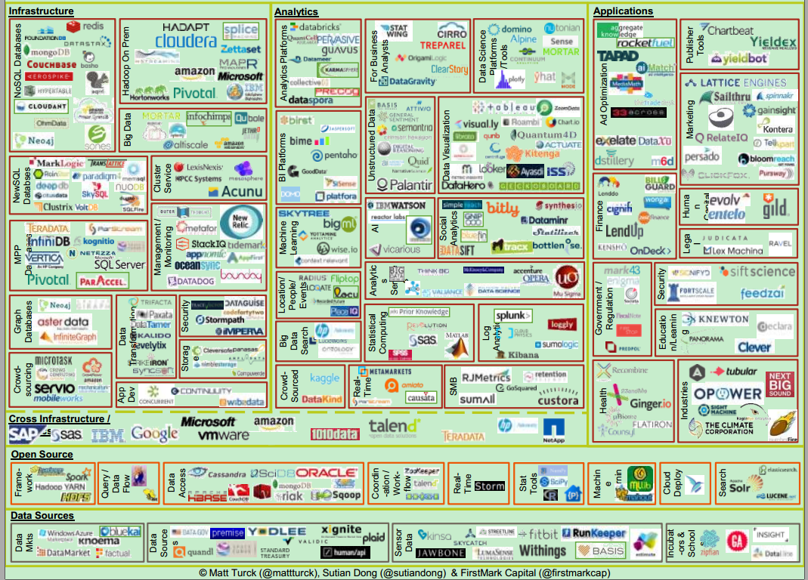
Overview diagrams
《the state of big data》
Matt Turck：has worked in Bloomberg Ventures，now in FirstMark Capital
4
Big Data
CSTC

Slide 6
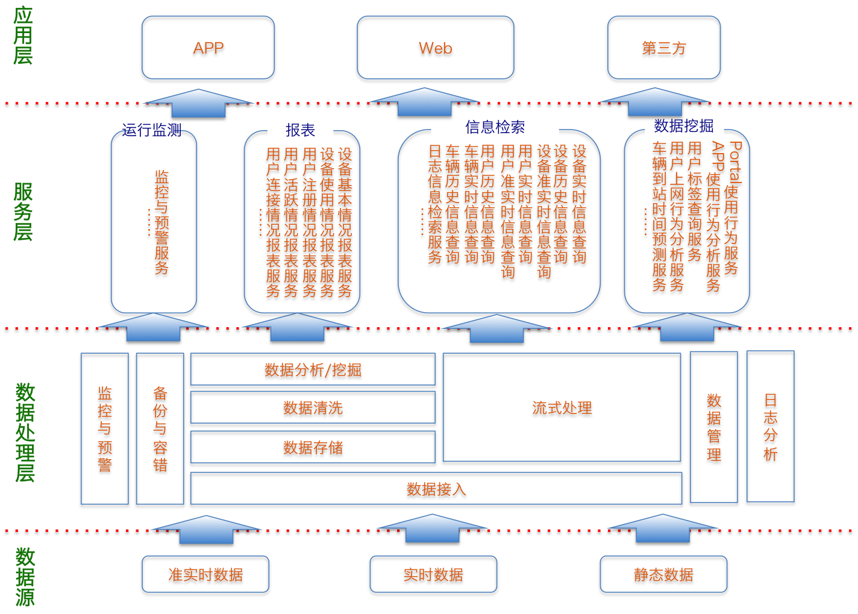
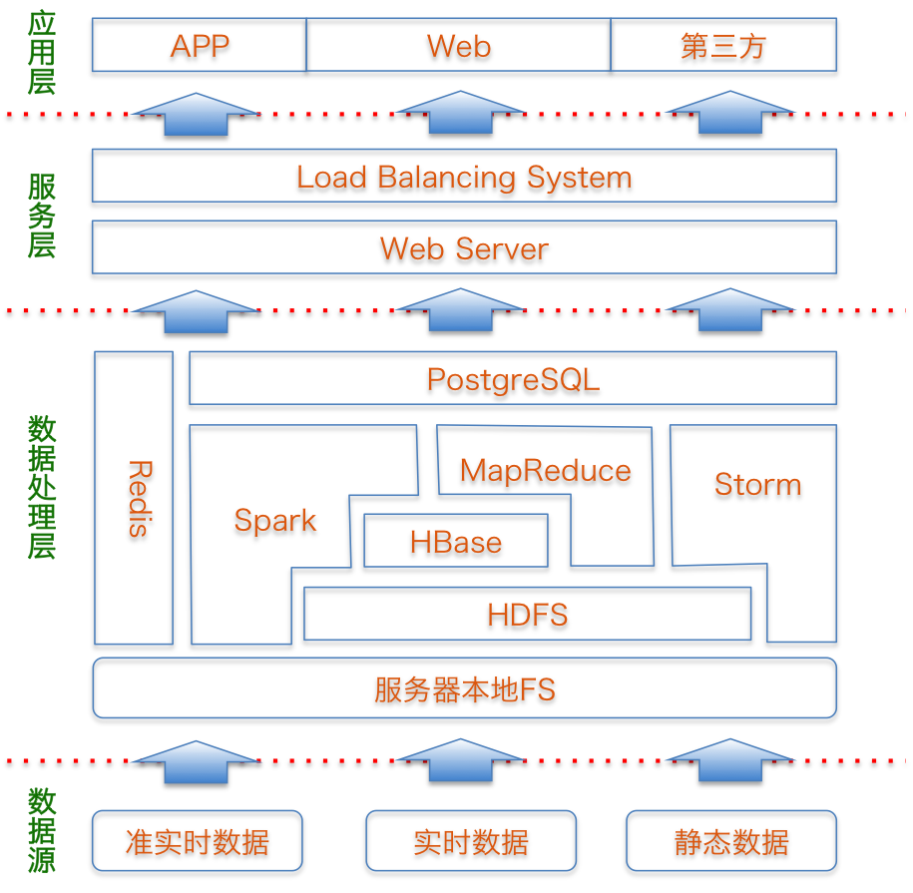
A platform I have been involved with
Explanation: the two figures come from the graduated thesis of a colleague who was involved in the project with me.
5
Big Data
CSTC

Slide 7
My Main work
Mobile phone data analysis
WiFi and base station data
Individual: Tracing Mobility
Group : trading area and movement
Interaction data
Behavior pattern
Classify people
Sensor data
Activity analysis
Privacy protection
6
Data Analysis
CSTC

Slide 8
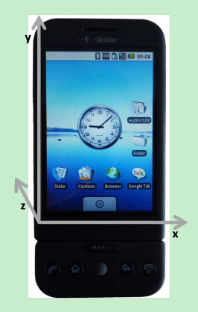
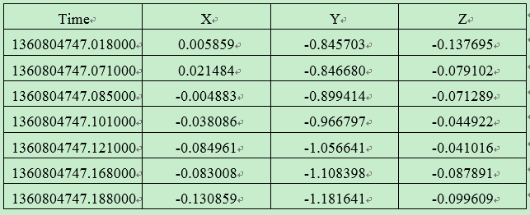
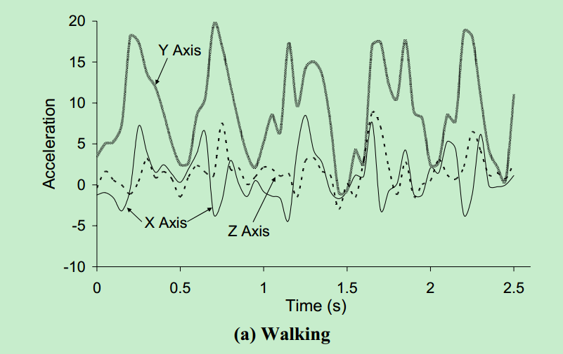
Activity analysis
Different activity has different acceleration
Activities are periodic
For a same activity, the acceleration is varied with people
Activities of a people have good stability in a period of time
Purpose:
Activity and Identity recognition
7
Data Analysis
CSTC

Slide 9
Activity analysis
Data cleaning
Segmentation
time domain
random Forest
frequency domain
Hadoop
Pig
Shell
Python
Weka
Scikit-learn
preprocess
extract
features
recognition
8
Data Analysis
CSTC

Slide 10
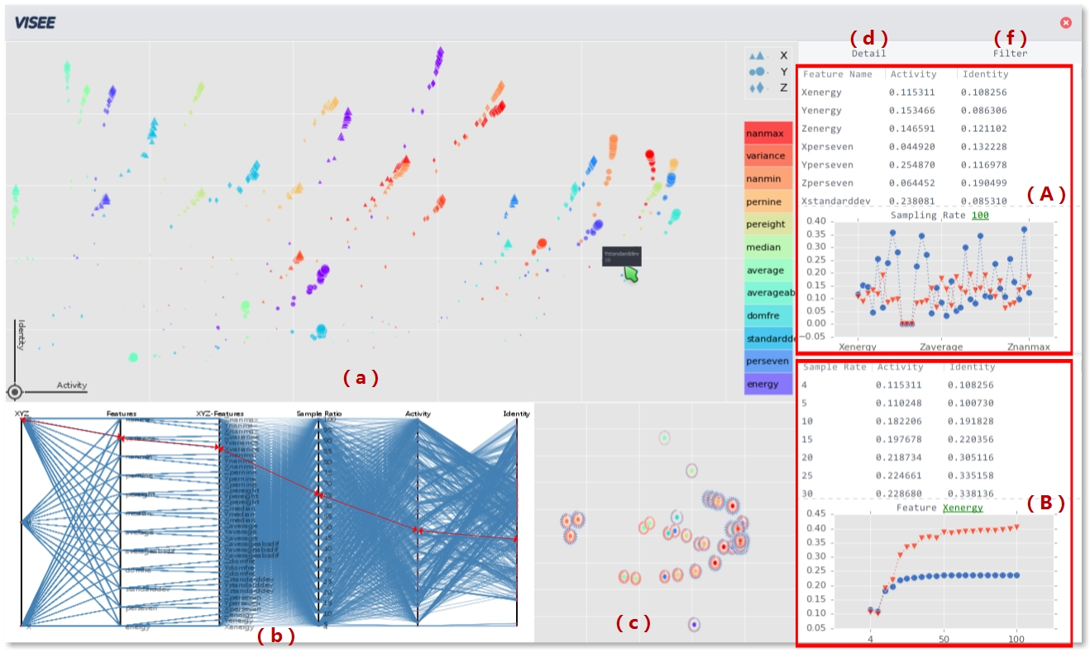
Activity analysis
9
Data Analysis
CSTC

Slide 11
Thank you

