Slide 2



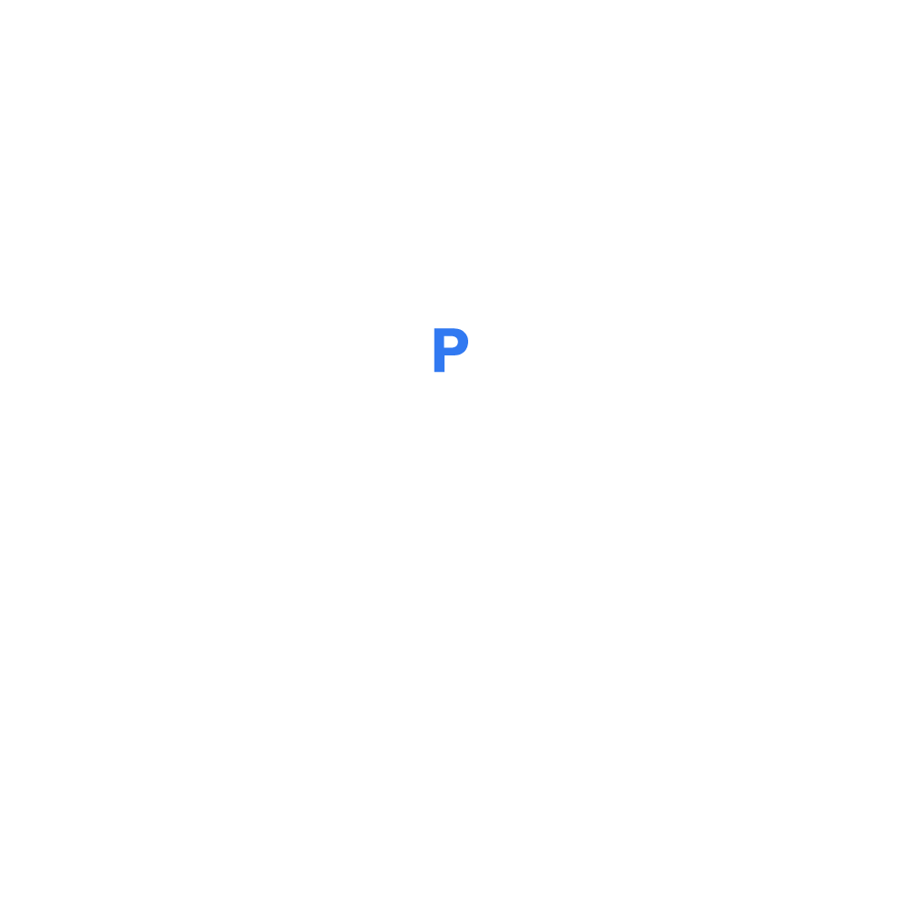



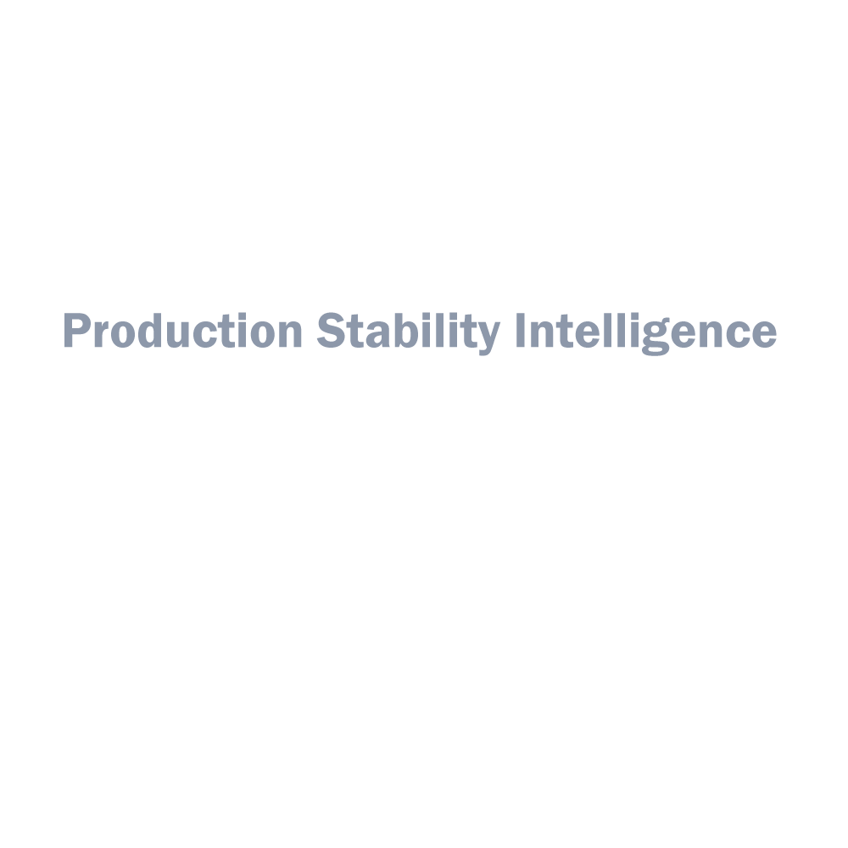

ICG Unit IV
Equity QA Framework

Slide 3





Wechat
IV Geeks…(243)
Many tools to manage the development process…can we use only a powerful one
Production
Attach approval email, test cases, doc…in different places…confused…
Can't get full information of projects from sign off email
BA, QA, DEV, Support…spend much time on communication…meeting…to resolve prod issues
…Development
Disadvantages…
I Want to say
I’m new employee, there is no directly way to help me understand projects…
As a support, sometimes, I do not how to handle unexpected error …
…

Slide 4





Production Stability Analysis and Rating
Production Monitor and Recovery
Production Change Control Assistance
PSI your
Trustworthy
friend
PSI

