Slide 1













Factory
SecFin
Data
Data
Data
Data

Slide 2

Factory
SecFin
Data
Data
Data
Data
downstream

Slide 3
Data Exception Detector
Aqua SecFin

Slide 4
Here is an interesting story...
You will like it…

Slide 5

Data issue!SecFin!!!
Trade Price is large!
Please Check!!!!
Factory
SecFin
Data
Data
Data
Data
Cusip | Business date | Trade price
24hkf278 | 2017-03-10 | 4635.839
24hkf278 | 2017-03-09 | 46.35839
24hkf278 | 2017-03-08 | 46.35839
24hkf278 | 2017-03-07 | 46.35839
Downstream

Slide 6














Use DQ
check
SecFin Data Issue
I agree
Code
Avoid
Such…
Logic?
Filter
condition
Great！
Our view is right!
Here’s the
problem

Slide 7






















Data Exception
Detector!
You want it!
Linkage
Optimization
Generator
Data
Recover
Outbound
Arriving
Loading
Processing
Delivering

Slide 8


Bus Date | Cusip | Source sys | Trade price | Currency | Loan amt | Quantity | …
05-17 | 37h23 | FDTS | 105.97 | USD | 1200 | 3600 | …
05-17 | 32783 | MATRIX | 1003 | JYP | 100 | 400
Source
sys1
Source
sys1
Sum each source system
Average of sum each source system with 3 days data
Source
sys2
Source
sys2
Current data
History data

Slide 9


Source
sys1
Source
sys1
Sum each source system
Average of sum each source system with 3 days data
Source
sys2
Source
sys2
Current data
History data

Slide 10


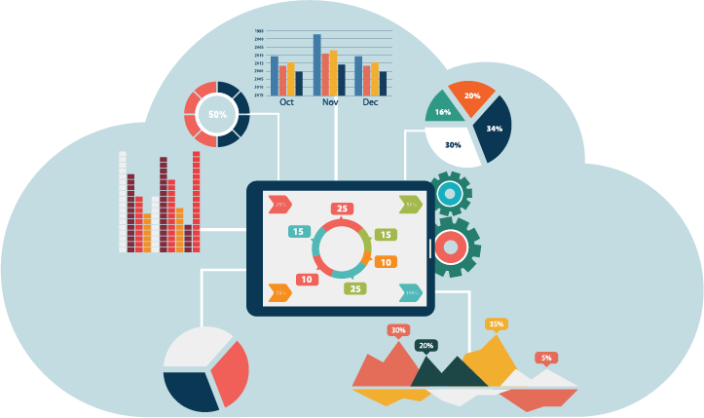


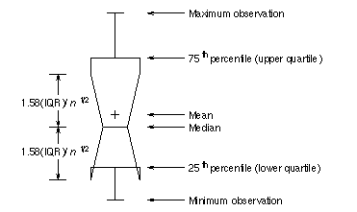
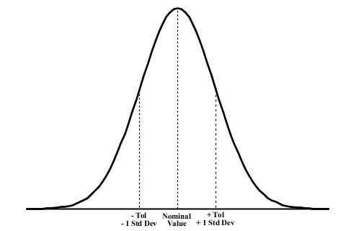




Based on Machine Learning
-Classification、Clustering …
Based on Statistics Theory
-Parametric：Normal Distribution and Percentile
-Non-parametric：Histogram

Slide 11

Bus Date | Cusip | Source sys | Trade price | Currency | Loan amt | Quantity | …
05-17 | 37h23 | FDTS | 105.97 | USD | 1200 | 3600 | …
05-17 | 32783 | MATRIX | 1003 | JYP | 100 | 400
Trade price
Trade price
Bus date
Bus date
Stable security
Volatile security

Slide 12

02
01
Stable security
Volatile security
securit4
Cluster2
security3
normal
exception
security2
Distance
security1
Mean value
Cluster1
15th percentile
75th percentile
Mean value
– 10SD
Mean value
+10SD
50th percentile

Slide 13
Online
Offline
Features table
Filter &
Generator
2
3
1
Current feed
3
Checker
5
History data
4
report

Slide 14
challenge
Parameter is hard to determine at first
Inconvenient to observe exception
solution
Visualization analysis tool

