Slide 1
USE CASE for Agile

Slide 2
Use Case Name: Place Order
Actors:
Shopper
Fulfillment System
Billing System
Use Case Description:
After the user has selected items to purchase and then order the items, the user will provide payment and shipping information. The system will respond with confirmation of the order and a tracking number that the user can use to check on order status in the future. The system will also provide the user with an estimated delivery date for the order, which will include all selected items. The user may already have an account with the company with billing and shipping information.

Slide 3
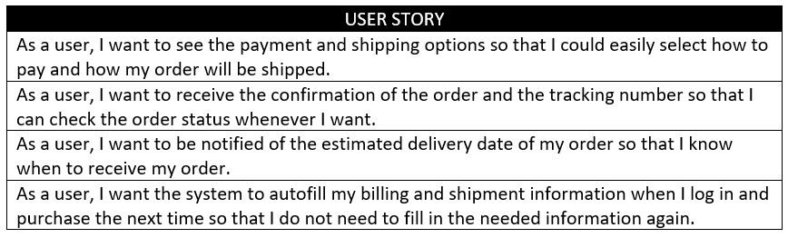
Product Backlog Creation

Slide 4
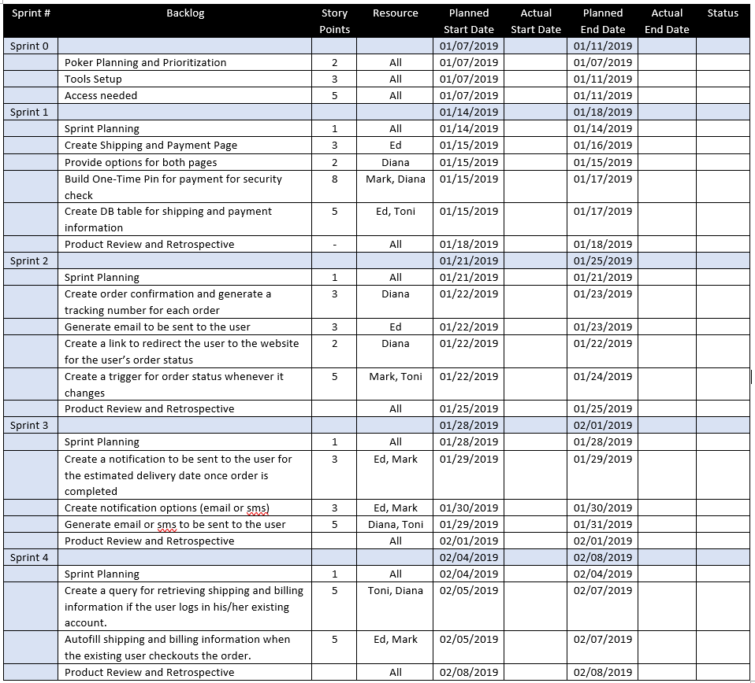
Sprint Planning and Sprint Backlog Creation

Slide 5
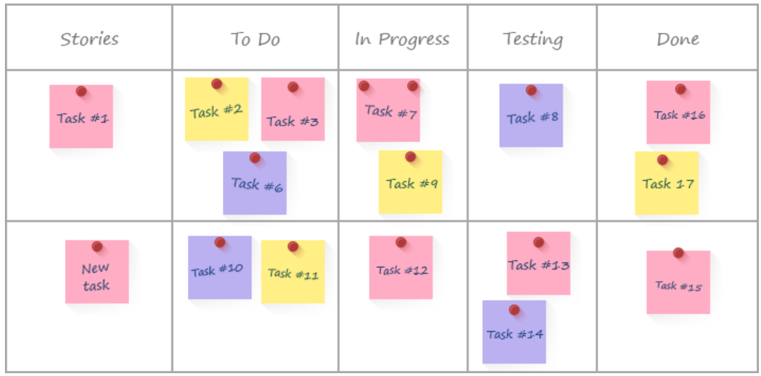
Working on the sprint and scrum meetings

Slide 6
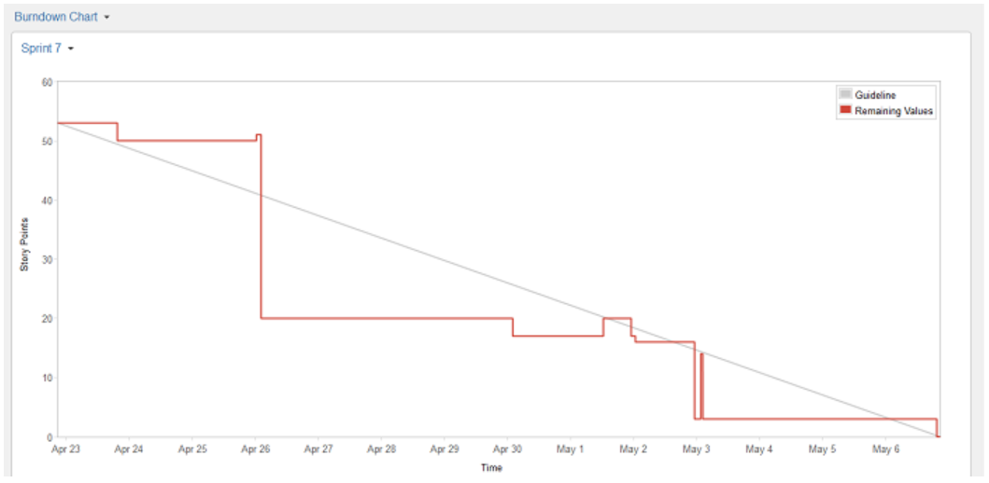
Burndown chart

Slide 7
Testing and Product demonstration

Slide 8
Use case for sql

Slide 9
Use Case Name: Book a Flight (Online)
Actors:
Passenger
Fulfillment System
Billing System
Use Case Description:
The user will login and will check for flight availability after entering necessary flight details. Afterwards, the user will book a ticket and will choose a seat. The user may also have the option to choose a meal set for the flight. The system will then prompt for payment and will validate the user’s card details. The system will respond with confirmation of the booking and a booking number that the user can use to check on flight status in the future.

Slide 10
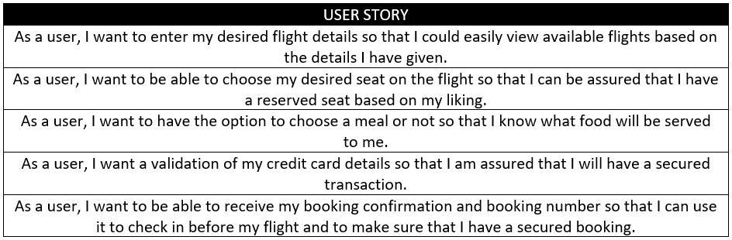
Product backlog Creation

Slide 11
SQL Codes (User story 1):
qFlightDetails
flight_departure_date | flight_id | from_location | to_location | departure_time | arrival_time | available_seats | price
5/24/2019 | AM185 | Tijuana | Mexico City | 17:20 | 20:30 | 52 | $353.00
5/26/2019 | AM647 | Los Angeles | Mexico City | 20:30 | 0:10 | 25 | $502.00
5/21/2019 | AM98 | Tokyo | Shanghai | 23:31 | 1:56 | 65 | $192.00
5/21/2019 | AM98 | Tokyo | Shanghai | 23:31 | 1:56 | 65 | $192.00
5/22/2019 | AM99 | Tijuana | Mexico City | 20:02 | 23:22 | 43 | $249.00
SELECT t_FlightDetails.flight_departure_date, t_Flight.flight_id, t_Flight.from_location, t_Flight.to_location, t_Flight.departure_time, t_Flight.arrival_time, t_FlightDetails.available_seats, t_FlightDetails.price
FROM t_FlightSeats INNER JOIN (t_Flight INNER JOIN (((t_PassengerProfile INNER JOIN t_TicketInfo ON t_PassengerProfile.profile_id = t_TicketInfo.profile_id) INNER JOIN t_FlightDetails ON t_TicketInfo.flight_id = t_FlightDetails.flight_id) INNER JOIN t_CreditCardDetails ON t_PassengerProfile.profile_id = t_CreditCardDetails.profile_id) ON t_Flight.flight_id = t_FlightDetails.flight_id) ON t_FlightSeats.airline_id = t_Flight.airline_id;

Slide 12
SQL Codes (User story 2):
qSeats
airline_id | seat_number | seat_type | from_location | to_location
N776AM | E26 | Center | Tijuana | Mexico City
N776AM | F14 | Center | Tijuana | Mexico City
N776AM | F40 | Center | Tijuana | Mexico City
N776AM | L09 | Window | Tijuana | Mexico City
N776AM | J12 | Aisle | Tijuana | Mexico City
CREATE PROCEDURE AvailableSeats @from_location nvarchar(50), @to_location nvarchar(50), @airline_id nvarchar(50)
AS
SELECT t_Flight.airline_id, t_FlightSeats.seat_number, t_FlightSeats.seat_type, t_Flight.from_location, t_Flight.to_location
FROM t_FlightSeats INNER JOIN (t_Flight INNER JOIN (((t_PassengerProfile INNER JOIN t_TicketInfo ON t_PassengerProfile.profile_id = t_TicketInfo.profile_id) INNER JOIN t_FlightDetails ON t_TicketInfo.flight_id = t_FlightDetails.flight_id) INNER JOIN t_CreditCardDetails ON t_PassengerProfile.profile_id = t_CreditCardDetails.profile_id) ON t_Flight.flight_id = t_FlightDetails.flight_id) ON t_FlightSeats.airline_id = t_Flight.airline_id
WHERE t_Flight.from_location = @from_location AND t_Flight.to_location = @to_location AND t_Flight.airline_id = @airline_id;
EXECUTE AvailableSeats @from_location = N ‘Tijuana’, @to_location = N ‘Mexico City’, @airline_id = N ‘N776AM’;

Slide 13
SQL Codes (User story 5):
qTicketNum
ticket_id | flight_id | "Passenger's Name" | flight_departure_date | status
91347658343 | AM99 | Graciela Bell | 5/22/2019 | Confirmed
SELECT DISTINCT t_TicketInfo.ticket_id, t_TicketInfo.flight_id, t_PassengerProfile.first_name + ' ' + t_PassengerProfile.last_name AS "Passenger's Name", t_TicketInfo.flight_departure_date, t_TicketInfo.status
FROM t_FlightSeats INNER JOIN (t_Flight INNER JOIN (((t_PassengerProfile INNER JOIN t_TicketInfo ON t_PassengerProfile.profile_id = t_TicketInfo.profile_id) INNER JOIN t_FlightDetails ON t_TicketInfo.flight_id = t_FlightDetails.flight_id) INNER JOIN t_CreditCardDetails ON t_PassengerProfile.profile_id = t_CreditCardDetails.profile_id) ON t_Flight.flight_id = t_FlightDetails.flight_id) ON t_FlightSeats.airline_id = t_Flight.airline_id
WHERE t_TicketInfo.ticket_id = 91347658343;

