Slide 1
Course Project
Task 1: Student Assignment Manager | Task 2: Heap + Heap Sort
Name: Yan Chudong SID: 14042677

Slide 2
Task 1 — What we built
Student Assignment Manager (CLI)
Add tasks: Assignment / Exam / General
List tasks with status, due date, and details
Search and filter by course / keyword
Sort by due date
Mark completed / uncompleted
Save/load data via JSON file

Slide 3
Task 1 — OOP & modular design
Modules
OOP Concepts shown
models.py — Task base class + subclasses
manager.py — TaskManager (business logic)
storage.py — JSON persistence
main.py — CLI entry + menu
Abstraction: Task is an abstract base class
Inheritance: AssignmentTask / ExamTask / GeneralTask
Polymorphism: kind() and details() per subclass
Encapsulation: TaskManager hides internal storage
Demo flow
Add → List → Search → Sort → Mark complete → Save

Slide 4
Task 2 — Self-study: Heap + Heap Sort
Data Structure: Binary Heap
Array-backed complete binary tree
Supports push, pop (extract-top), peek, heapify
Used for priority queues (scheduling, top-K)
Algorithm: Heap Sort
Build heap (bottom-up heapify)
Repeatedly extract top element
Total time: O(n log n)

Slide 5
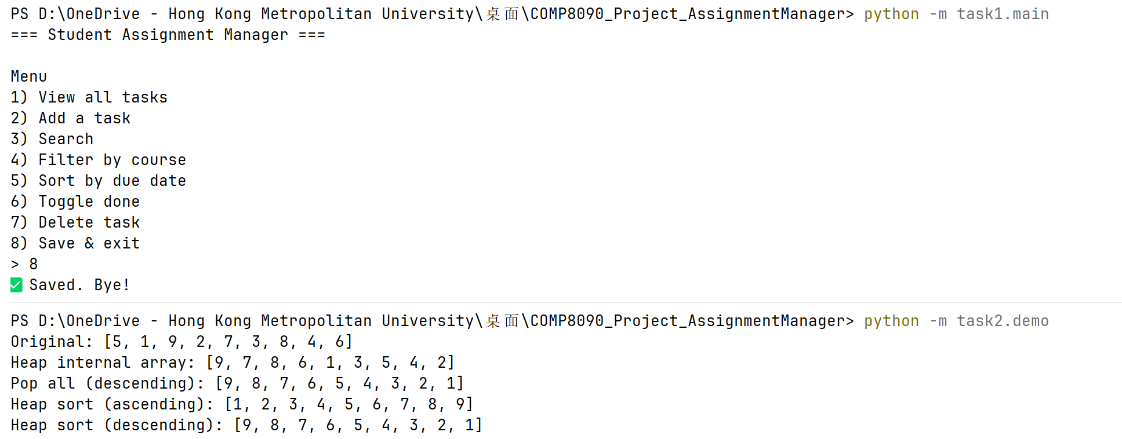
How to run (quick demo)
Task 1
python -m task1.main
Task 2
python -m task2.demo

Slide 6
Thank you
Q&A
Repository structure: task1/ task2/ reports/ slides/

