Slide 1
This is Jeremy Miles’s (jnvm1@york.ac.uk) collection of path diagrams.
When I want to draw a path diagram, I find the one most similar to what I want, and I modify it. I then store it on a new page.
Please feel free to use these in your work, without royalty, or acknowledgement. If you want to send some files back to me with your new diagrams in, that would be nice.
Disclaimer: Nothing in any of these images is necessarily true, or correct. Some of the diagrams were created to illustrate a point. Some weren’t finished.

Slide 2
ξ
λ₁₁
λ₄₁
λ₂₁
λ₃₁
y₁
y₂
y₃
y₄
θ₁
θ₂
θ₃
θ₄

Slide 3
y₁
0.5
-0.05
x
y₂
-0.05
0.5
-0.05
0.5
y₃

Slide 4
F
F
q1
q2
q3
q4
q5

Slide 5
ξ₁
ξ₂
x₁
x₂
x₃
x₄
x₅
x₆

Slide 6
F₁
F₂
x₁
x₂
x₃
x₄
x₅
x₆

Slide 7
Consequences (Patient)
Consequences (Relative)
Control – Cure Illness
Control-Cure - Practitioner
Timeline - Chronic
Timeline – Episodic
Q1
…
Q9
Q10
…
Q14
Q15
…
Q19
Q20
Q21
Q22
Q23
Q24
Q25

Slide 9
L₁
L₂
x₁
x₂
x₃
x₄
x₅
y₁
y₂
y₃
y₄
e₁
e₂
e₃
e₄
e₅
e₆
e₇
e₈
e₉

Slide 10
1.00
ξ₁
ξ₂
x₁
x₂
x₃
x₄
x₅
x₆

Slide 11
.51
L₁
.70
L₂
.53
.94
.47
.50
.89
.70
.82
.55
.54
x₁
x₂
x₃
x₄
x₅
y₁
y₂
y₃
y₄
.72
.12
.78
.75
.21
.50
.33
.70
.70

Slide 12
F₁
L₁
L₂
L₃
L₄
L₅
L₆
x₁
x₂
x₃
x₄
x₅
x₆
e₁
e₂
e₃
e₄
e₅
e₆

Slide 13
ξ₂
ξ₃
x₁
x₂
x₃
x₄
x₅
x₆
ξ₁

Slide 14
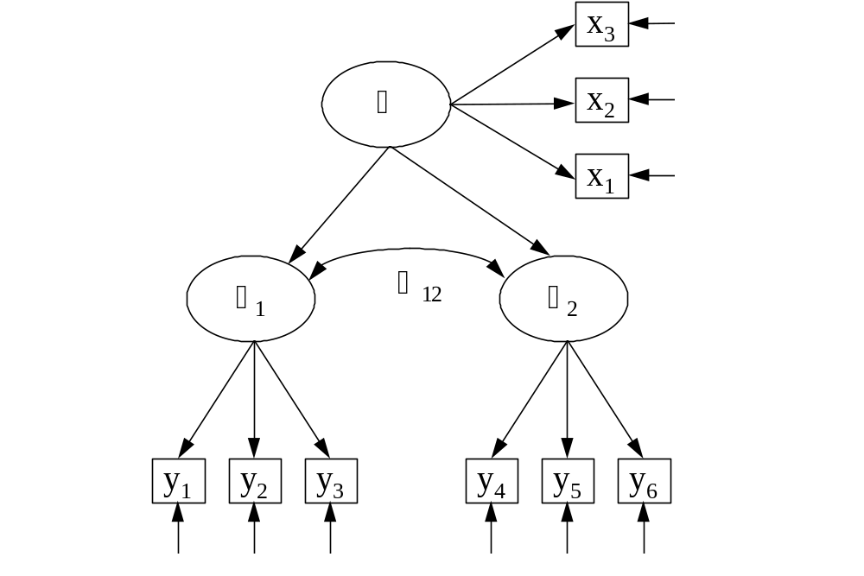

Slide 15

1
x
x
x
x
x
x
x
1
2
3
4
5
6
7

Slide 16
General
x
x
x
x
x
x
x
1
2
3
4
5
6
7
Stress

Slide 17
Age
5
Stress
15
16
Male
Beliefs

Slide 18
86
Beliefs
Attributions
74
33
94
59
61
69
B
B
B
B
A
A
1
2
3
4
1
2
For the sake of clarity, decimal points and
δ 
values have been omitted

Slide 19
t
x
t
N
SC
y
t
z

Slide 21
Time
Apparent direction
Actual direction of causation
of causation
Psychological
Memories
Variable
Symptoms
Emerge
manifest
Repressed
Variable
Memories
not
manifest

Slide 22
MZ=1
DZ=0.5
MZ=DZ=1
Α
C
Ε
Α
C
Ε
0.76
c
e
ξ₁
ξ₂
0.80
0.80
0.80
0.80
0.80
0.80
0.80
0.80
t₁x₁
t₁x₂
t₁x₃
t₁x₄
t₂x₁
t₂x₂
t₂x₃
t₂x₄
0.36
0.36
0.36
0.36
0.36
0.36
0.36
0.36

Slide 23
MZ=1
DZ=0.5
MZ=DZ=1
A
C
E
A
C
E
a
c
e
a
c
e
T₁
T₂

Slide 24
A
E
A
E
A
E
D
E
EO
TO
SD
D

Slide 25
A
E
A
E
A
E
D
E
EO
TO
SD
D

Slide 26
MZ=1
DZ=0.5
MZ=DZ=1
Α
C
Ε
Α
C
Ε
c
e
a
c
e
a
ξ₁
ξ₂
f
g
h
i
f
g
h
i
t₁x₁
t₁x₂
t₁x₃
t₁x₄
t₂x₁
t₂x₂
t₂x₃
t₂x₄
j
k
l
m
j
k
l
m

Slide 27
N
DIF
DDF
EOT
cvbvvbb

Slide 30
Intercept
S
1
1
1
1
2
3
1
x₁
x₂
x₃
x₄

Slide 31
A₁
A₂
A₃
A₄
A₅

Slide 32
e
x
y
x
y

Slide 33
Defeat
0.25
0.59
Anhedonia
Entrapment
0.19
Social comparison
Anxiety
shame

Slide 34
L₁
L₂
L₃
L₄
L₅
A₁
A₂
A₃
A₄
A₅

Slide 35
rules
d
a
sex
c
demands
b

Slide 36
I
D
Males
x₁
x₂
I
D
Females
x₁
x₂

Slide 37
x₁
a
a
x₂
x

Slide 38
T₂
T₃
T₄
Day 1
1
1
1
1
T₁
x
intercept
slope
T₁
1
x
1
1
1
Day 2
T₂
T₃
T₄

Slide 39
T₁
T₂
T₃
T₄
Day 1
1
1
1
1
1
x
intercept
slope
1
1
x
1
1
1
Day 2
T₁
T₂
T₃
T₄

Slide 40
Covariate(s)
intercept
slope
T₁
1
x
1
1
1
T₂
T₃
T₄

Slide 41
C₁
C₂
C₃
Error
F
E₁
E₂
E₃

Slide 42
Intercept
Slope
1
1
1
1
2
3
1
x₁
x₂
x₃
x₄

Slide 43
Med school
Level 3
Features of Trust
Baseline
Rate
R
B
triallable
B
R
Level 2
Features of innovation
Baseline
Rate
Level 1
Effects of time
Baseline
Rate

Slide 44
Intercept
Outcome
Predictor
Slope

Slide 45
Intercept
Shape
1
1
x
1
1
0
1
x
t₁
t₁
t₁
t₁
0.01
1
1
1
1
1
1
1
1
Day 1
Day 2
Day 1
Day 2
Day 1
Day 2
Day 1
Day 2

Slide 48
Depression
Anxiety
Intercept
Linear
Slope
Quadratic
Slope
4
9
1
16
81
256
1
1
1
1
16
1
1
1
7:00
8:00
11:00
16:00
23:00

Slide 49
Level 2 – Practitioner Level
sex
PCC.A
years of practice
PCC.I
type
EI
Level 1 – Patient Level
Slope of PCC on age
(PCC.A)
age
PCC
sex
PCC
Intercept of PCC
PCC.I
(other)

Slide 50
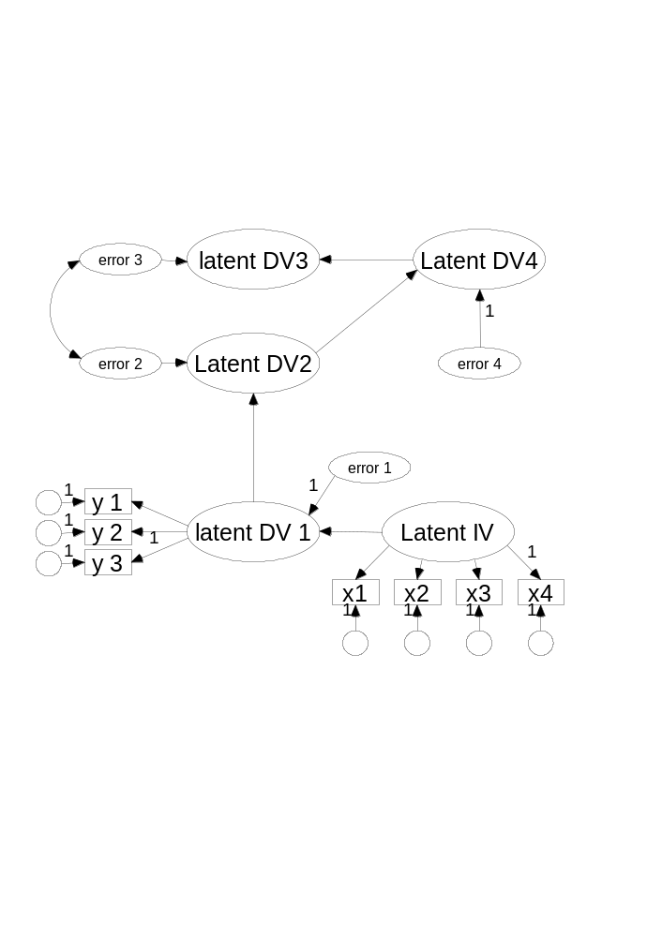

Slide 51
0.75
y₁
0.5
0.75
-0.05
x
y₂
-0.05
0.5
-0.05
0.5
0.75
y₃

Slide 52
y₁
e
y₂
x
y₃

Slide 53
Childhood emotional invalidation
Negative emotional socialisation
Psychological Abuse
Uns
Emotional inhibition
Thought suppression
Current avoidance
Chronic avoidance
Adult psychological distress
Depressive symptoms
Anxiety symptoms

Slide 54
Interested
Interested
…
Stimulated
Happy
Frustrated
Happy
Unhappy
…
Pleased
Irritated
Valued
Valued
…
Cared For

Slide 55
Time 1
Time 2
5 items
5 items
36
4 items
4 items
Life Satisfaction
77
Life Satisfaction
26
02
-31
46
00
Self Regulation
67
Self Regulation
55
02
29
Efficacy
23
-18
Efficacy
20
70
51
58
00
38
Adherence
Adherence
52
3 items
52
3 items
48
42
3 items
3 items

Slide 56
F01P
F01P
F03P
F03P
1
1
F07P
F07P
F12P
F12P
F19P
F19P
Time 1
Time 2
F21P
F21P
F25P
F25P
1
1
1
F29P
F29P
Inter
Slope
F32P
F32P
F33P
F33P
Age

Slide 57
change
verb1
verb2
1
Group 1
1
intercept
noun1
1
noun2
Group 2
change
verb2
1
verb1
1
intercept
1
noun1
noun2
Notes:
Constraint 0: regressions of t2 on t1 equal for each group (not an interesting test)
Constraint 1: intercept equal for each group (test of group effect)
Constraint 2: mean of latent variable change fixed to zero (test of verbs v. nouns)
Constraint 3: Mean of latent variable change fixed equal for each group (test of interaction effect)
There are a couple of additional tests you could do:
T2 on T1 regressions equal for both groups (equivalent to test of homogeneity of slopes assumption in ANCOVA; could do that in SPSS).
Correlation of slope and intercept (separately and constrained – not possible in SPSS)

Slide 58
rd1
rd2
rd
rd3
rd4
rhyme
rp1
rp2
rp
rp3
rp4
pi1
pi2
pi
pi3
pi4
phoneme
pf1
pf2
pf
pf3

Slide 59
q1
q2
F
Predictor(s)
q3
q4

Slide 60
T1
T2
T3
T4
T5
25
24
19
hcst
0
53
29
52
48
50
67
38
68
21
35
-12
31
31
31
36
idt
0
75
56
61
74
55
64
34
78
24
-13
31
26
17
dset
0
62
46
58
61
50
77
57
81
13
24
38
31
24
38
15
13
wdt
0
38
25
18
36
34
55
39
57
18
18
24
17
25
24
dht
0
62
47
56
57
51
70
48
68
13
16

Slide 61
T1
T2
T3
T4
T5
25
24
19
hcst
0
53
29
52
48
50
67
38
68
21
35
-12
31
31
31
36
idt
0
75
56
61
74
55
64
34
78
24
-13
31
26
17
dset
0
62
46
58
61
50
77
57
81
13
24
38
31
24
38
15
13
wdt
0
38
25
18
36
34
55
39
57
18
18
24
17
25
24
dht
0
62
47
56
57
51
70
48
68
13
16

Slide 62
read0
read1
0.59
(0.36, 0.82)
Boys
0.71
-0.86, 2.24
Girls
-1.02
-1.7, -0.31
-1.55
-0.18, -2.92
Girls
0.64
-0.31, 1.68
2.6
(-1.10, 6.24)
0.09
(0.02, 0.17)
Boys
1.84
0.86, 2.82
age
group
Age x group
Boys
-0.64
-1.94, 0.65
Girls
-1.80
-5.33, 1.74
0.36
(-1.50, 2.22)
0.29
(0.16, 0.41)
Girls
-1.02
-1.7, -0.31
0.20
-0.49, 0.88
Boys
1.83
-1.00, 4.66
spell0
spell1
0.71
(0.66, 0.76)

Slide 64
c
intervention
group
read1
age
read0
spell1
spell0

Slide 65
E
T
R
Cov1
O
Cov2

Slide 66
0.75
y₁
0.5
0.75
-0.05
x
y₂
-0.05
0.5
-0.05
0.5
0.75
y₃

Slide 67
iqvbest
c
dvg11

Slide 68
x1
iqvbest
c
x2
dvg11

Slide 69
y₁
0.5
-0.05
x
y₂
-0.05
0.5
-0.05
0.5
y₃

Slide 70
Q1
y₁
Q2
F
Q3
Q4
Q5

Slide 71
Social Power
Social Comparison
Power of voice
Voice frequency
Depression

Slide 72
Anx is sig here
y₁
y₂
y₃
y₃
anx
isch
diabetes
Ischaemia is sig here
etc

Slide 73
Outcome 1
t₁
t₂
t₃
…
t_{k}
inter
slope
inter
slope
Outcome 2
t₁
t₂
t₃
…
t_{k}

