Slide 1
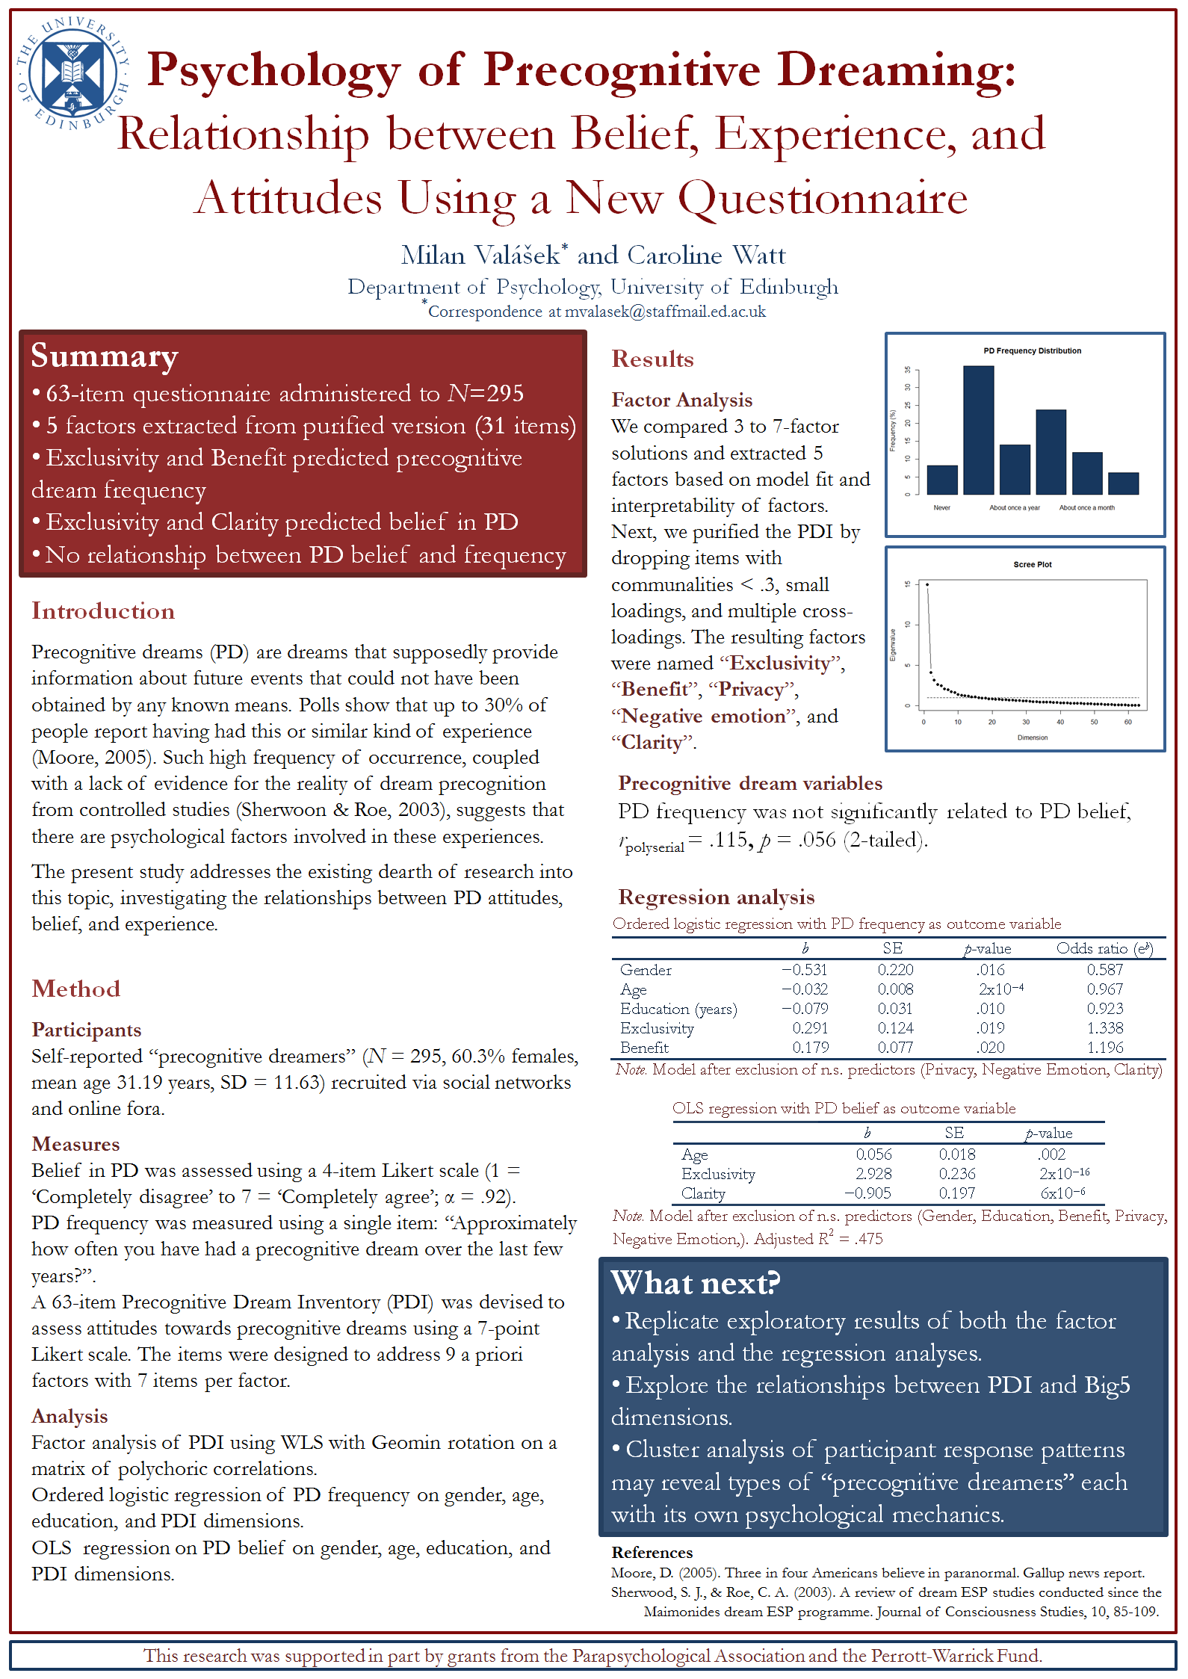

Slide 2

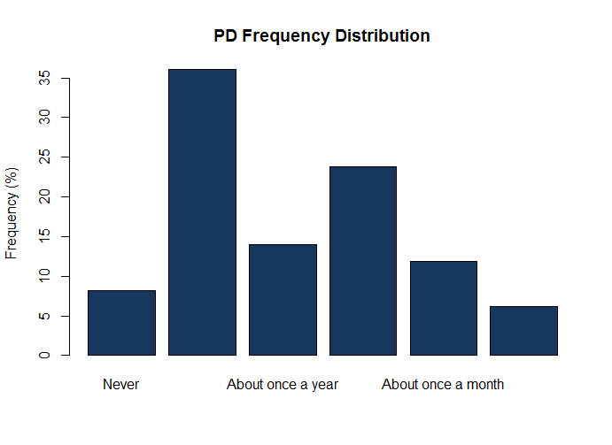
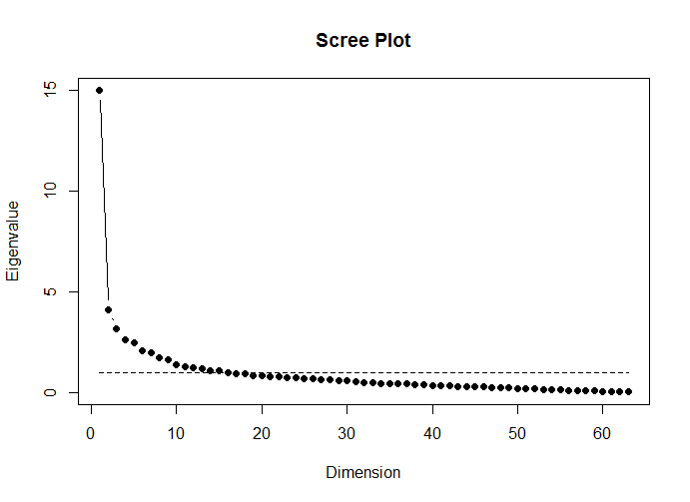
Psychology of Precognitive Dreaming: Relationship between Belief, Experience, and Attitudes Using a New Questionnaire
Milan Valášek* and Caroline Watt
Department of Psychology, University of Edinburgh
*Correspondence at mvalasek@staffmail.ed.ac.uk
Summary
63-item questionnaire administered to N=295
5 factors extracted from purified version (31 items)
Exclusivity and Benefit predicted precognitive dream frequency
Exclusivity and Clarity predicted belief in PD
No relationship between PD belief and frequency
Results
Factor Analysis
We compared 3 to 7-factor solutions and extracted 5 factors based on model fit and interpretability of factors. Next, we purified the PDI by dropping items with communalities < .3, small loadings, and multiple cross-loadings. The resulting factors were named “Exclusivity”, “Benefit”, “Privacy”, “Negative emotion”, and “Clarity”.
Introduction
Precognitive dreams (PD) are dreams that supposedly provide information about future events that could not have been obtained by any known means. Polls show that up to 30% of people report having had this or similar kind of experience (Moore, 2005). Such high frequency of occurrence, coupled with a lack of evidence for the reality of dream precognition from controlled studies (Sherwoon & Roe, 2003), suggests that there are psychological factors involved in these experiences.
The present study addresses the existing dearth of research into this topic, investigating the relationships between PD attitudes, belief, and experience.
Method
Participants
Self-reported “precognitive dreamers” (N = 295, 60.3% females, mean age 31.19 years, SD = 11.63) recruited via social networks and online fora.
Measures
Belief in PD was assessed using a 4-item Likert scale (1 = ‘Completely disagree’ to 7 = ‘Completely agree’; α = .92).
PD frequency was measured using a single item: “Approximately how often you have had a precognitive dream over the last few years?”.
A 63-item Precognitive Dream Inventory (PDI) was devised to assess attitudes towards precognitive dreams using a 7-point Likert scale. The items were designed to address 9 a priori factors with 7 items per factor.
Analysis
Factor analysis of PDI using WLS with Geomin rotation on a matrix of polychoric correlations.
Ordered logistic regression of PD frequency on gender, age, education, and PDI dimensions.
OLS regression on PD belief on gender, age, education, and PDI dimensions.
Precognitive dream variables
PD frequency was not significantly related to PD belief, r_{polyserial} = .115, p = .056 (2-tailed).
Regression analysis
What next?
Replicate exploratory results of both the factor analysis and the regression analyses.
Explore the relationships between PDI and Big5 dimensions.
Cluster analysis of participant response patterns may reveal types of “precognitive dreamers” each with its own psychological mechanics.
References
Moore, D. (2005). Three in four Americans believe in paranormal. Gallup news report.
Sherwood, S. J., & Roe, C. A. (2003). A review of dream ESP studies conducted since the Maimonides dream ESP programme. Journal of Consciousness Studies, 10, 85-109.
This research was supported in part by grants from the Parapsychological Association and the Perrott-Warrick Fund.

