Slide 1
ANP Milestone 3 – Diar Kamberi
Quick overview of the data structures

Slide 2
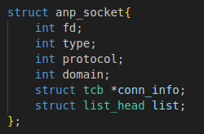
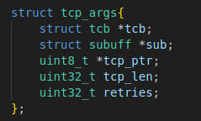
This is the anp_socket structure. As you can see it is pretty basic. It includes a pointer to a Transmission Control Block (TCB), which is created in the connect() function. It also is part of the sockets list, which allows for multiple connections at once.
This is a helper struct used to pack arguments for retransmitting. We save the tcp header pointer and the tcp segment length as the ip_output() changes the structure of the subuff.

Slide 3
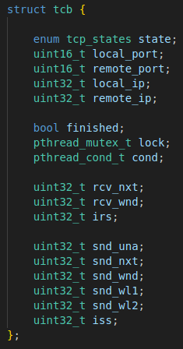
The tcb struct is heavily inspired from the Transmission Control Block (TCB) suggested in RFC 793. A high level overview is that it contains connection information (ports and address which make a unique connection), receiving variables, sending variables, and some synchronization variables to signal other threads of events (used in milestone 3 to signal connect() thread that the connection has been established or not).

Slide 4
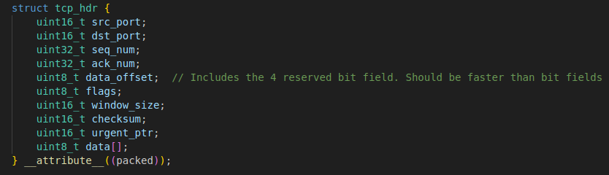
This is the tcp_hdr. It follows a basic implementation. The reserved bit field was merged into the data_offset for quicker access. When working with headers, we must adhere to the protocol, thus, we are restricted in how we define it.

Slide 5
Ports and file descriptors
For the file descriptor, there is a boolean array. A file descriptor being used is represented by a value of true in the slot. The actual file descriptor number has to be decremented with the fd starting value to get its index on the array. There is a lock that allows for safer concurrent access.
For the ports, there is no explicit data structure. There is a starting port which gets increased on each increment with a lock to prevent two threads from getting the same port number.

