Slide 1
ATTS Vibration Manual
by Diar Abdlkarim
diarkarim@gmail.com

Slide 2
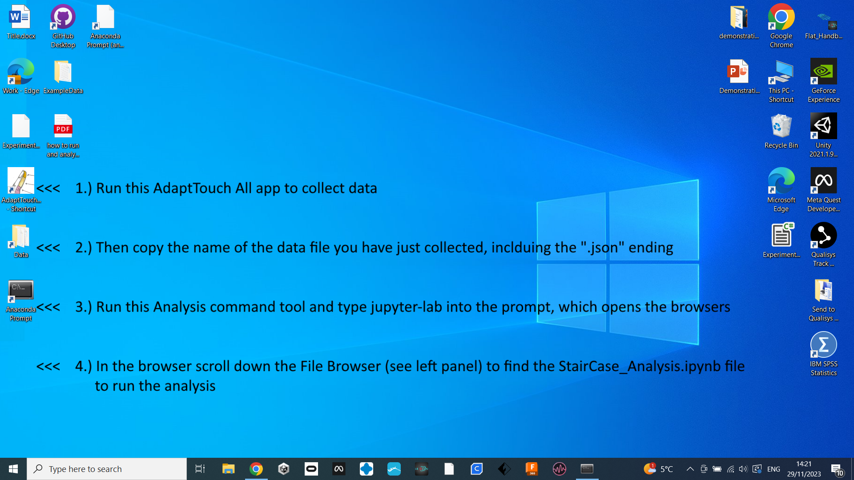
Step 1
Open this app

Slide 3
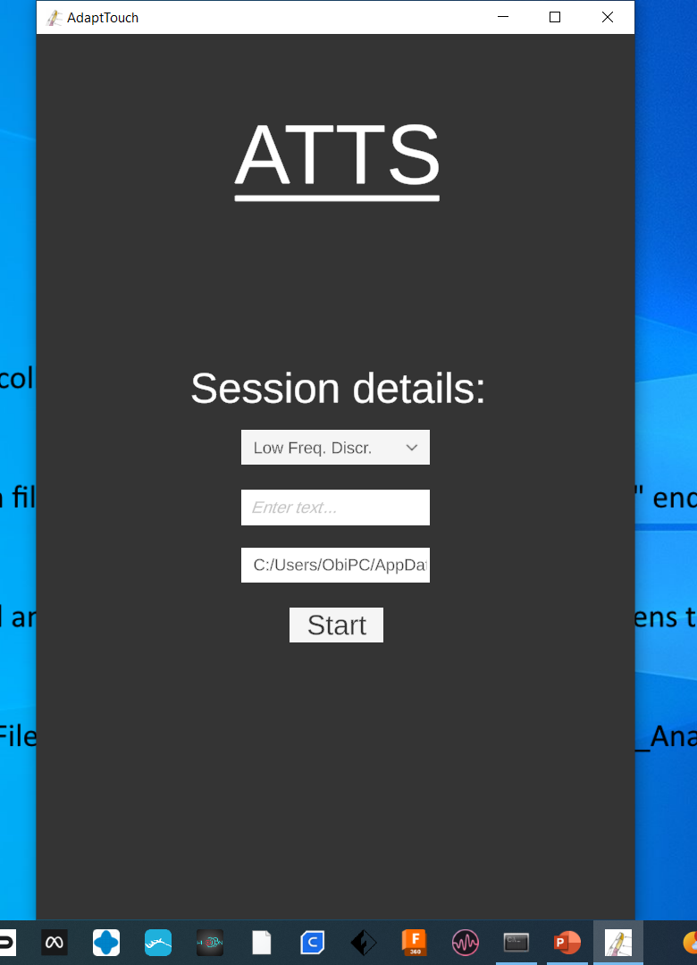
Step 2
The app will then open
Run the experiment until the end
The file should be saved in a particular folder
As shown in the next slide
When you are done with the data collection
You can close the app window on the right

Slide 4
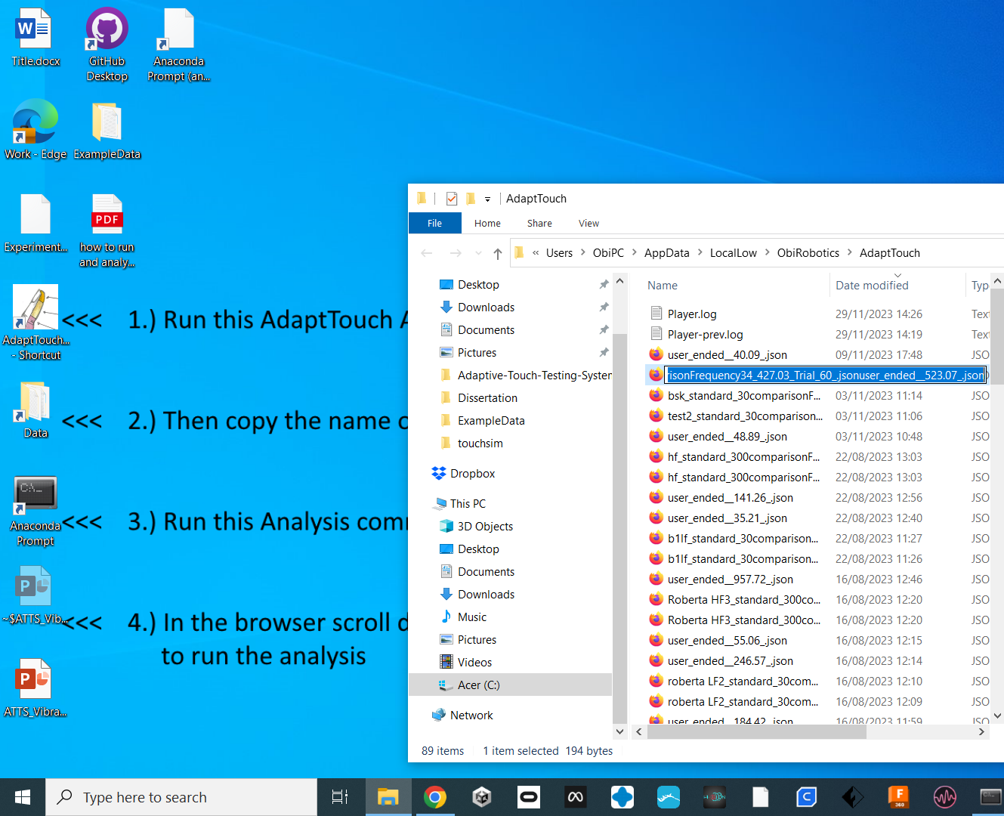
Step 3
Open this folder
Sort the file names by “Date modified”
Copy the full name of the latest file i.e. the file that was just produced at the end of your experiment, including the
“.json” ending

Slide 5
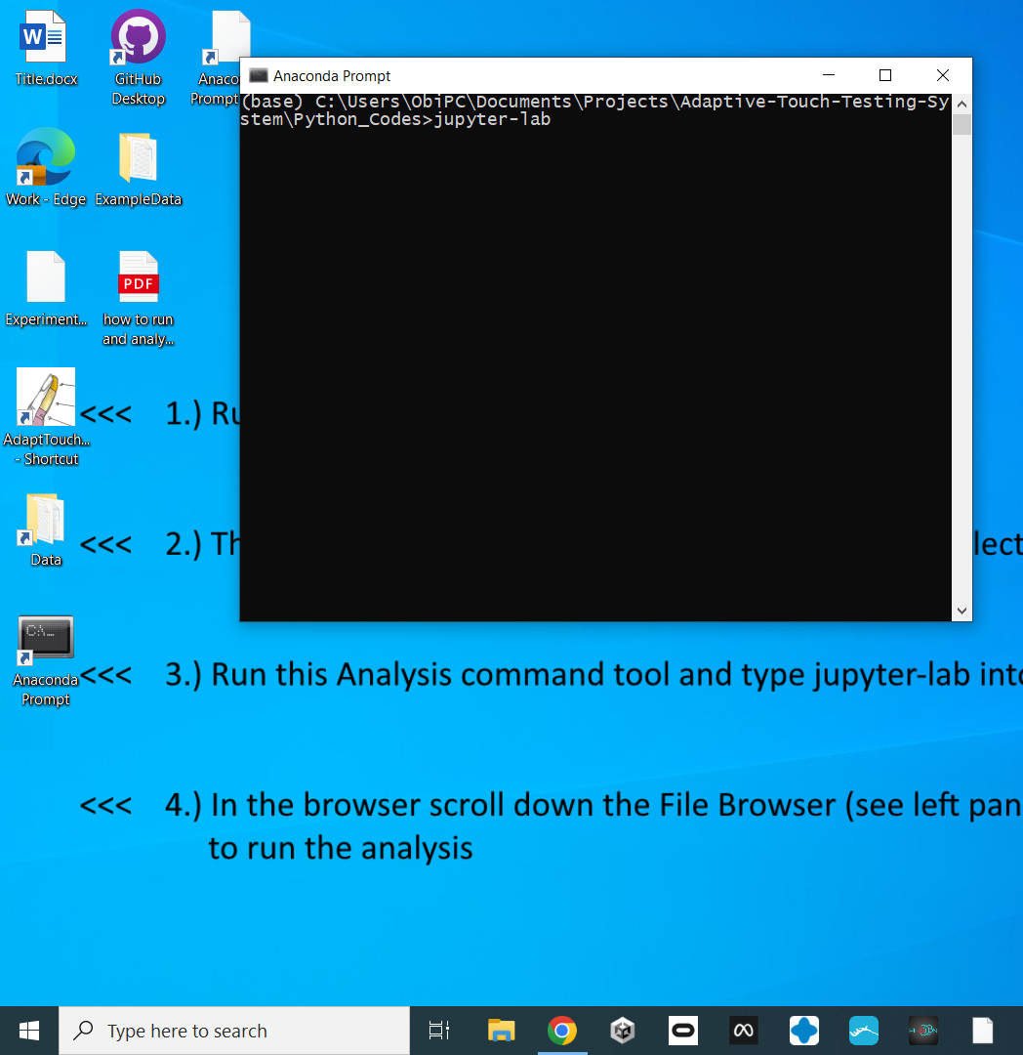
Step 4
Open the “Anaconda Prompt”
This should open with the correct path as shown here
If not, then copy and paste the following command into the prompt:
cd C:\Users\ObiPC\Documents\Projects\Adaptive-Touch-Testing-System\Python_Codes>jupyter-lab
Then type into the command prompt:
jupyter-lab
And hit the enter key, which will open the browswer with the notebook, see next slide

Slide 6
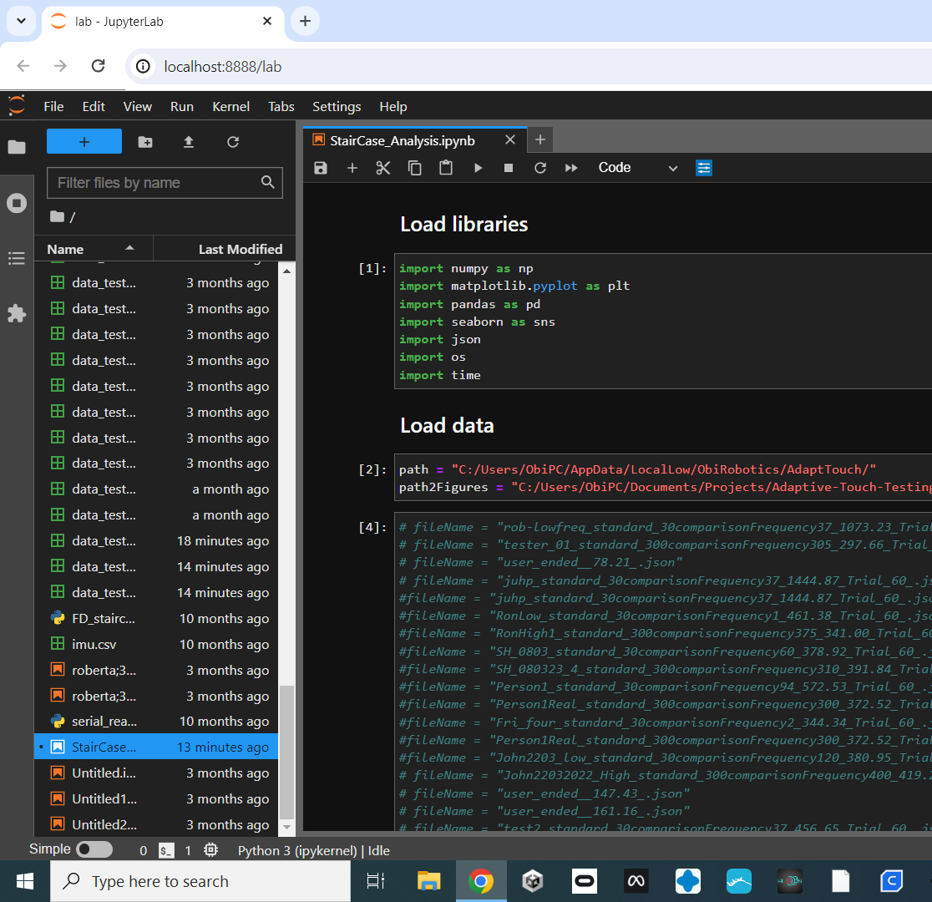
Step 5
This will open a browser with the jupyter-lab interface.
To get to the same view as on the left:
1: Click the folder icon to bring up the list of files in that folder
2. Scroll down and double click the file:
StairCase_Analysis.ipynb
3. This is the jupyter-lab notebook with the analysis code, which allows you to visualise the staircase.
4. Make sure you replace the file name variable “fileName” with the text (file name) that you just copied in Step 3
5. Run each cell with the Ctrl+Enter button or the Shit+Enter button

