Slide 1



Analysing Duration Data
Professor Vernon Gayle
AQMEN
University of Edinburgh
March 2019
© Vernon Gayle

Slide 2
Alternative terminology
Duration models
Survival models
Cox regression
Cox models
Failure time analysis
Hazard models
Event history analysis

Slide 3
Models for duration data allow the data analyst to assess the relative influence of a number of explanatory factors upon how long it takes for an event to occur
Original paper Cox (1972)

Slide 4
Applications
Study the lifetimes of machine components in engineering
Duration of unemployment in economics
Time taken to complete cognitive tasks in psychology
Lengths of tracks on a photographic plate in particle physics
Survival times of patients in clinical trials

Slide 5
Research Examples
Heckman and Borjas (1980) used duration modelling approaches to study unemployment
Blossfeld and Hakim (1997) studied female part-time employment
Mulder and Smits (1999) investigated first time home ownership
Lillard et al. (1995) studied premarital cohabitation and subsequent marital dissolution

Slide 6
Research Examples
Kiernan and Mueller (1998) undertook an analysis of divorce using the BHPS and the NCDS
Boyle et al. (2008) examined union dissolution using the Austrian Family and Fertility Survey (FFS)
Chan and Halpin (2002) used BHPS to examine gender role attitudes and the domestic division of labour on divorce
Pevalin and Ermisch (2004) investigated mental health, union dissolution and re-partnering

Slide 7
Measuring a Duration
Three requirements for correctly determining a duration
A starting time must be unambiguously defined
Time must have a defined unit of measurement
The event must be clearly defined

Slide 8
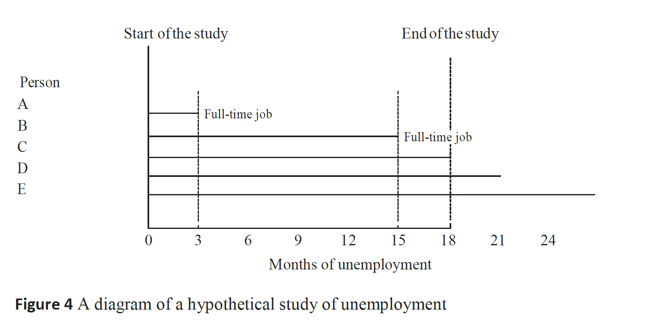

Slide 9
The Accelerated Life Model
Regression models can be estimated with duration data
Historically the log of the duration has been modelled

Slide 10
Censored Observations
Censored observations affect regression model results
The impact on the results may sometimes be negligible
Plewis (1997) states that when there is a very small proportion of censored cases they will have little effect, and an accelerated life model might still be suitable
Supervisors, examiners and referees may not be convinced

Slide 11
Duration Modelling
No longer directly modelling the duration
The focus is on modelling the probability that an event occurs at time t , conditional on it not having occurred before t

Slide 12
Codebook for the College Skills Program Dataset
Variable Obs Unique Mean Min Max Label
-------------------------------------------------------------------------------------------
id 628 628 314.5 1 628 student id
time 628 338 234.7038 2 1172 number of days until test passed
test 628 2 .8089172 0 1 test passed (or censored)
age 623 31 32.36918 20 56 age at enrolment
no_jobs 611 28 4.574468 0 40 number of previous jobs
mooc 628 2 .4904459 0 1 taught by massive open online course
campus 628 2 .2929936 0 1 college campus
quals1 628 2 .4601911 0 1 no qualifications
quals2 628 2 .1815287 0 1 lower qualifications (below A'level)
quals3 628 2 .3582803 0 1 higher qualifications(above A'level)
-------------------------------------------------------------------------------------------

Slide 13
Output: Kaplan-Meier Plot of Time to Passing the Test (College Skills Program Data)

Slide 14
Output: Kaplan-Meier Plot of Time to Passing the Test (College Skills Program Data)

Slide 15
Output: Log-Rank Test for Equality of Survivor Functions
failure _d: test
analysis time _t: time
Log-rank test for equality of survivor functions
| Events Events
mooc | observed expected
------+-------------------------
0 | 265 235.80
1 | 243 272.20
------+-------------------------
Total | 508 508.00
chi2(1) = 6.80
Pr>chi2 = 0.0091

Slide 16
Output: Cox Regression Model Time to Passing the Test (College Skills Program Data)
failure _d: test
analysis time _t: time
Iteration 0: log likelihood = -2868.555
Iteration 1: log likelihood = -2851.6989
Iteration 2: log likelihood = -2851.0884
Iteration 3: log likelihood = -2851.0863
Refining estimates:
Iteration 0: log likelihood = -2851.0863
Cox regression -- Breslow method for ties
No. of subjects = 610 Number of obs = 610
No. of failures = 495
Time at risk = 142994
LR chi2(6) = 34.94
Log likelihood = -2851.0863 Prob > chi2 = 0.0000
------------------------------------------------------------------------------
_t | Coef. Std. Err. z P>|z| [95% Conf. Interval]
-------------+----------------------------------------------------------------
age | -.0237543 .0075611 -3.14 0.002 -.0385737 -.0089349
no_jobs | .034745 .0077538 4.48 0.000 .0195478 .0499422
mooc | -.2540169 .091005 -2.79 0.005 -.4323834 -.0756504
campus | -.1723881 .1020981 -1.69 0.091 -.3724966 .0277205
quals2 | .2467753 .1227597 2.01 0.044 .0061706 .4873799
quals3 | .125668 .1030729 1.22 0.223 -.0763513 .3276873
------------------------------------------------------------------------------

Slide 17
Output: Test of the Effects of Previous Education in Cox Regression Model of Time to Passing the Test (College Skills Program Data)
( 1) quals2 = 0
( 2) quals3 = 0
chi2( 2) = 4.36
Prob > chi2 = 0.1130

Slide 18
Output: Hazard Ratios Cox Regression Model Time to Passing the Test (College Skills Program Data)
Cox regression -- Breslow method for ties
No. of subjects = 610 Number of obs = 610
No. of failures = 495
Time at risk = 142994
LR chi2(3) = 27.76
Log likelihood = -2854.6735 Prob > chi2 = 0.0000
------------------------------------------------------------------------------
_t | Haz. Ratio Std. Err. z P>|z| [95% Conf. Interval]
-------------+----------------------------------------------------------------
age | .9794475 .0072674 -2.80 0.005 .9653067 .9937955
no_jobs | 1.036128 .0078949 4.66 0.000 1.020769 1.051718
mooc | .7940896 .0716076 -2.56 0.011 .6654445 .9476047
------------------------------------------------------------------------------

Slide 19
Output: Time to Passing the Test - Survival Functions Comparing Women Aged 30 with 5 Previous Jobs by Teaching Methods (College Skills Program Data)

