Slide 1



Predictive Analytics ©
Dr Diarmuid McDonnell & Prof. Vernon Gayle
AQMEN
University of Edinburgh
March 2019
© Diarmuid McDonnell, Vernon Gayle

Slide 2
Welcome
Notes:
Cover the preliminaries:
Timings
Programme
Fire drills

Slide 3
Why are we here today?
U.K. Industrial Strategy aims to utilise big data to improve economic performance and increase productivity.
Major barrier is the lack of a suitably trained workforce.
U.K. social science stakeholders (e.g. ESRC, Nuffield) believe this discipline can make a major contribution to Industrial Strategy.

Slide 4
Why this type of training?
“Many organizations can barely find a way to use their R/Python programmers on reasonable datasets.”
“The piece missing from the data science movement right now is really simple: intelligent application of data science tools.”
https://www.linkedin.com/pulse/data-science-dead-5-years-less-justin-b-dickerson-phd-mba-pstat- accessed 16.07.2018.

Slide 5
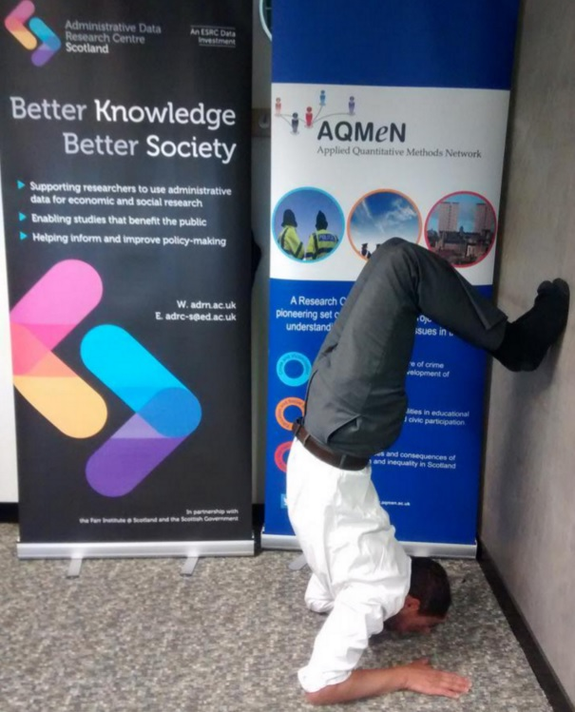


Slide 6
What is the social science contribution?
Data Science ≠ Computer Science
Big Data ≈ Small Data
QM Social Scientists = Data Literate

Slide 7
The Workflow

Slide 8
The Workflow
Research Idea
Proposal
Ethical Approval
Data Collection
Exploratory Data Analysis
Formal Data Analysis
Presentations
Publications
Archiving

Slide 9
Academic / Commercial Life
Measured by outputs
Structured by deadlines
Organised workflow helps to make progress

Slide 10
ALL SERIOUS WORK MUST BE
REPRODUCIBLE!
There MUST be an audit trail

Slide 11

Documentation

Slide 12
Consistent Working Practices
Standard and routinized ways of doing things
Style of scripts (.do .sps files etc.)
Directory structures
File names
Variable names
Variable labels

Slide 13


Estimating Work Time…

Slide 14
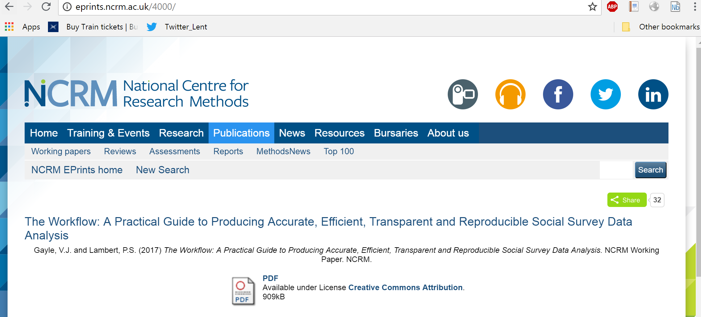
http://eprints.ncrm.ac.uk/4000/

Slide 15
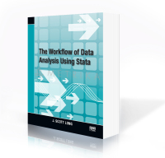
J. Scott Long has posted a really good pdf version of a talk on the workflow http://www.ihrp.uic.edu/files/Workflow%20Slides%20JSLong%20110410.pdf

Slide 16
Thinking Predictively
(Statistical Models of Predictive Analytics for Social Research)
Vernon Gayle
Professor of Sociology & Social Statistics
University of Edinburgh
vernon.gayle@ed.ac.uk
@profbigvern
2019
© Vernon Gayle

Slide 17
Thinking Predictively
(Statistical Models/Predictive Analytics for Social Research)

Slide 18



Slide 19
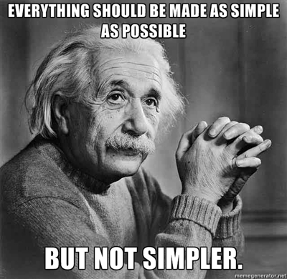

Slide 20
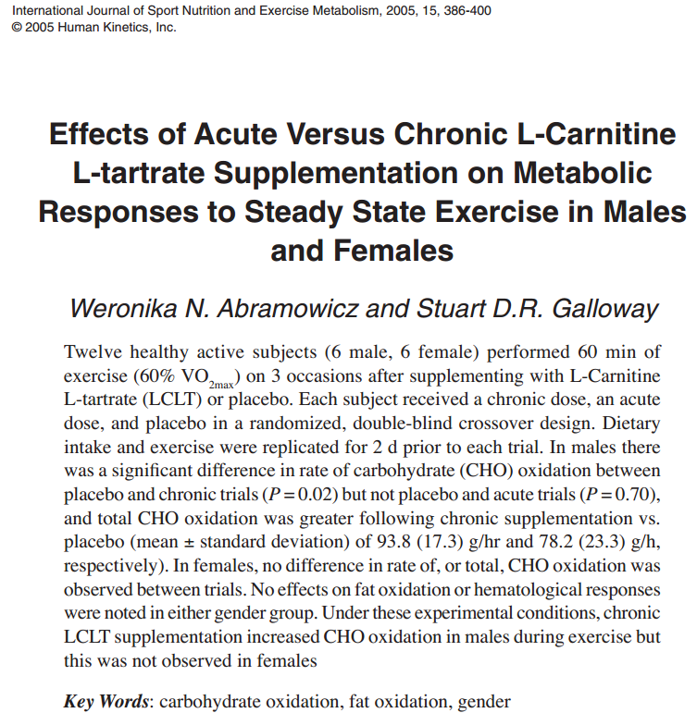

Slide 21
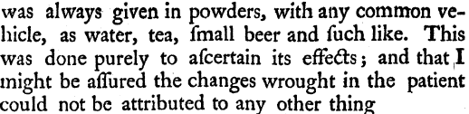
Rev Edward Stone (1702-1768)
Discovered the active ingredient of aspirin
He wrote to the Royal Society on 25 April 1763

Slide 22
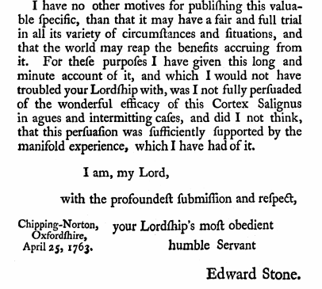

Slide 23
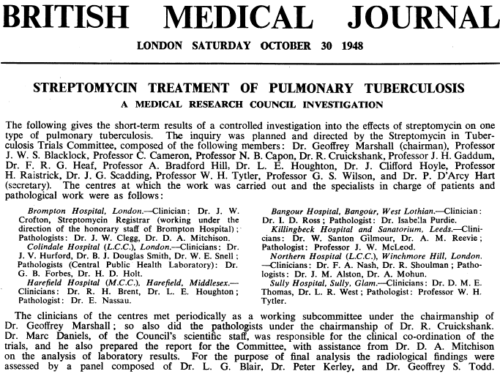

Slide 24
“If your experiment needs statistics, then you ought to have done a better experiment”
Ernest Rutherford (1871-1937)

Slide 25
Therein lies the rub….
With the notable exception of psychology, and to a lesser extent economics, in the social sciences experimentation is often not routinely possible
(e.g. we cannot randomise people to ethnic and gender groups, social housing, schools, local authorities etc. etc.)

Slide 26
The social world is complex!
In the non-experimental social sciences we must use more comprehensive statistical methods which might better help us to identify, and then quantify, the multifaceted relationships that characterise contemporary social life

Slide 27
Is there a relationship between fat intake and breast cancer?

Slide 28
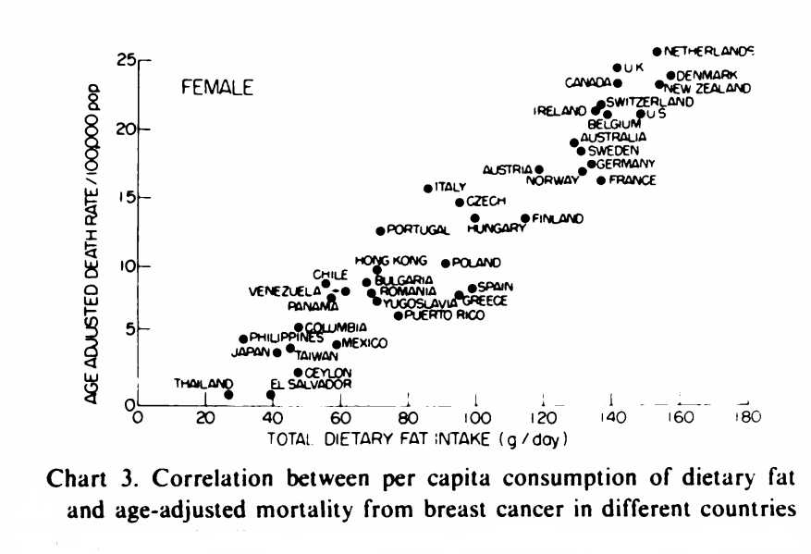
Carroll, K. (1975) ‘Experimental Evidence of Dietary Factors and Hormone-dependent Cancers’, Cancer Research, 35, pp.3374-3383.

Slide 29
Is there a relationship between fat intake and breast cancer?
Yes all other things being equal
But all other things are not equal, or are they?

Slide 30
Is there a relationship between fat intake and breast cancer?
For example countries with a lot of fat in their diet might also have a lot of sugar in their diet
In richer countries people tend to eat more fat and more sugar

Slide 31
The American Cancer Society website (www.cancer.org) suggests a series of Breast Cancer Risks related to lifestyle choices
Risks
Suggested Risks?
Recent use of birth control pills
Not having children / late childbirth
Not breastfeeding
Alcohol use
Being overweight or obese
Diet
Antiperspirants
Bras
Pollution
Tobacco smoke
Night work

Slide 32
Thinking Predictively
Simple question –
but deceptively difficult to answer
What lies on the causal pathway?

Slide 33
Thinking Predictively
What lies on the causal pathway?
Experimental Data are easy – it is part of the design!
Observational Data require ‘sophisticated multivariate analyses’

Slide 34
We need a statistical model
i.e. a multivariate statistical approach
Explanatory variables
X₁
X₂
X₃
X₄
X….
X….
X….
X_{n}
Outcome
variable

Slide 35
Examples variables in a real paper
Explanatory variables
Gender
Parental social class
School year
Parental education
Housing tenure
Outcome
variable
GCSE attainment
Connelly, Murray and Gayle (2013) Sociological Research Online

Slide 36
Sir Francis Galton (1822-1911)
Darwin’s cousin
Developed finger printing
First weather map (Times 1st April 1875)
Cutting a Round Cake on Scientific Principles (Nature 1906)
Strawberry Cure for Gout (Nature 1899)
On Spectacles for Divers
Beauty Map of Britain (I found London to rank highest for beauty: Aberdeen lowest, Memoire p.153)

Slide 37
A Statistical Model - AKA
Simplest statistical model
A regression model
Multiple regression
Linear regression model
General linear model
Vanilla regression
A (slightly drunk) statistician once said to me “Vernon, if we didn’t have so many confusing terms we couldn’t charge high consultancy fees”

Slide 38
Writing Down A Simple Statistical Model
Y_{i} = β₀+β₁X_{1i} +…+ β_{k}X_{ki} + ε_{i}
These equations are all Greek to me…

Slide 39
Left Hand Side = Right Hand Side + Error

Slide 40
Left Hand Side (e.g. outcome variable) ….
Y

Slide 41
Left Hand Side (possibly add a subscript)
Y_{i} =

Slide 42
Constant
Y_{i} = β₀

Slide 43
First X variable
Y_{i} = β₀+β₁X_{1i}

Slide 44
More X variables
Y_{i} = β₀+β₁X_{1i} + β₂X_{2i}

Slide 45
Right Hand Side
= β₀+β₁X_{1i} +…+ β_{k}X_{ki}

Slide 46
Error term
Y_{i} = β₀+β₁X_{1i} +…+ β_{k}X_{ki} + ε_{i}

Slide 47
Left Hand Side = Right Hand Side + Error
Y_{i} = β₀+β₁X_{1i} +…+ β_{k}X_{ki} + ε_{i}

Slide 48
Decoding a more exotic model …
Y_{it} = β₀ + λ_{i} + β₁X_{1it} +…+ β_{k}X_{kit} + ε_{it}

Slide 49
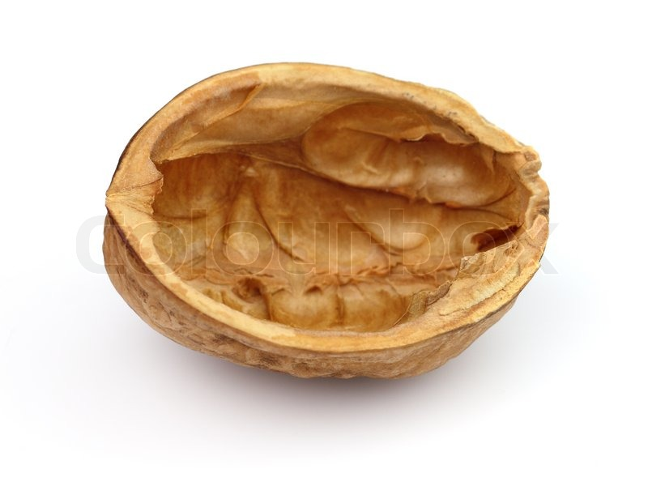
Statistical Models in a Nutshell

Slide 50
Strength

Slide 51
Strength
Direction

Slide 52
Strength
Direction
Statistical Significance

Slide 53
Is what we’ve uncovered important?
Strength
Direction
Statistical Significance

Slide 54
Four Important Components of a Statistical Model
Beta (β) size for each eXplanatory variable
Beta (β) sign for each eXplanatory variable
p values for each eXplanatory variable
Goodness of fit - R² , Adj. R², BIC, etc.

Slide 55
Component # 1
The size of Beta (β)
when Beta (β) is LARGE a one unit change has a BIG effect on Y (net of all the other eXplanatory variables)
(In some example (β) is standardized so all eXplanatory variables are on the same scale)

Slide 56
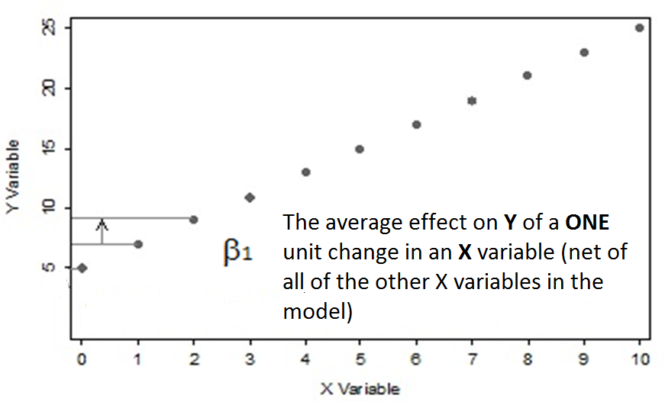
Component # 1 continued

Slide 57
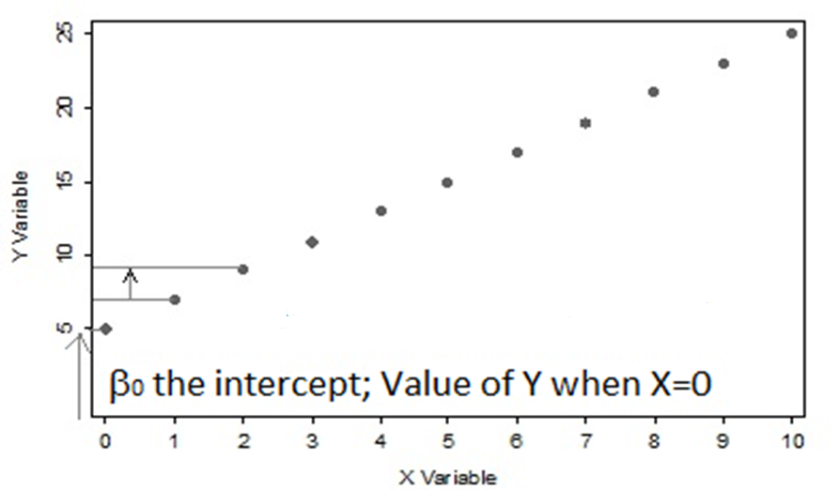
The Constant is Beta Zero (β₀)

Slide 58
Component # 2
Beta (β) – one for each eXplanatory variable
If it is positive (+) increasing X has a positive effect on Y (net of all the other variables)
If it is negative (-) increasing X has a negative effect on Y (net of all the other variables)

Slide 59
Component # 3
p value for EACH variable in the model
p value tells us if the variable is significant, NET of all of the OTHER variables in the model
(The old text books used to say Ceteris paribus or ‘all other things being equal’)
Debates rage about interpreting the p value (i.e. is it less than .05 etc)

Slide 60
Component # 4
R² the Coefficient of Multiple Determination
Takes on values between 0 and 1
The proportion of variability in Y that is explained by ALL of the EXPLANATORY variables in the model
In practice a R² value of .25 could be quite high in many studies

Slide 61
Component # 4
Adjusted R²
BIC Bayesian Information Criterion
AIK Akaike’s Information Criterion

Slide 62
Four Important Components of a Statistical Model
Beta (β) size for each eXplanatory variable
Beta (β) sign for each eXplanatory variable
p values for each eXplanatory variable
Goodness of fit - R² , Adj. R², BIC, etc.

Slide 63

Model Building
John Tukey – Exploratory Data Analysis
X variables should have the means, the motive and the opportunity to commit the crime of changing the Y variable –
Robert Luskin, U. of Texas

Slide 64
Which Model…
Generally…..
Depends on the outcomes (or outcomes) you are modelling?
Depends on the structure of your data?
Depends on the underlying process that has generated the data?

Slide 65
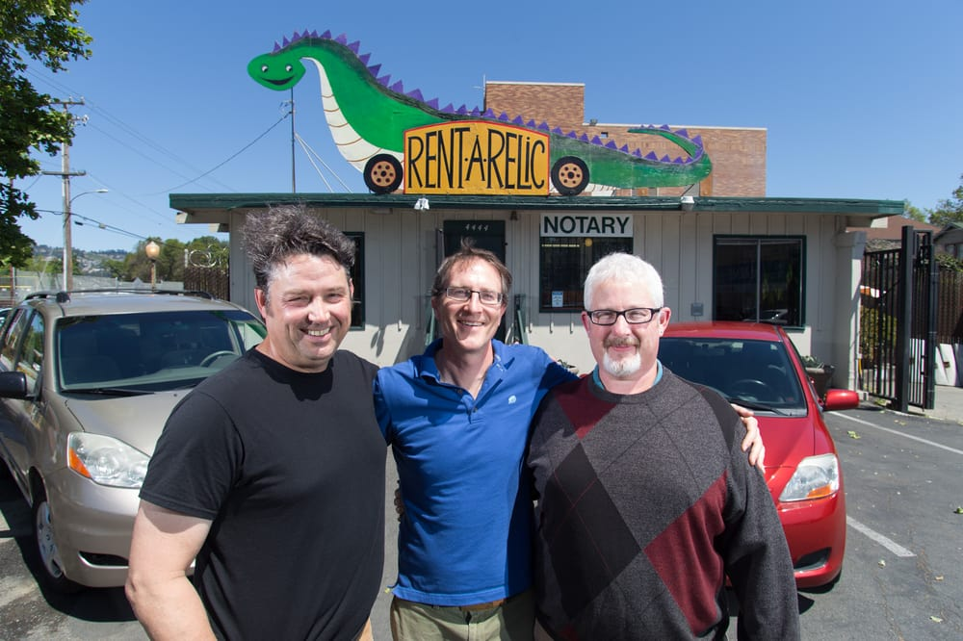

Slide 66
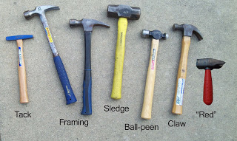
Which tool?

Slide 67

Generalized Linear Latent and Mixed Models
Generalized Linear Mixed Models
Generalized Linear Model

Slide 68
MODEL | OUTCOME | DATA STRUCTURE | PROCESS GENERATING THE DATA
Linear Regression | Metric | Tabular – wide format | Standard cross-section (e.g. one off)
Logistic Regression | Binary (0,1) | Tabular – wide format | Standard cross-section (e.g. one off)
Poisson Regression | Count (e.g. beach visits) | Tabular – wide format | Standard cross-section (e.g. one off)
Panel Regression | Various | Tabular – long format | Repeated contacts
Duration Regression | Time or ‘Hazard’ | Tabular – wide or long format | Time to event

Slide 69
Workshop

Slide 70
R
Growing in popularity (e.g. data science, statistics, science etc.)
Popular with statisticians
Free (open source)
Difficult to learn
Development and support is not commercial
Help resources are under-developed

Slide 71
Programme
Mix of talks and self-directed practical activities.
Predictive Analytics challenge (“Hackathon”).
Tutor and peer support.
Use of a variety of data sets, especially messy administrative records.

Slide 72
Top tips
Ask plenty of questions.
Take your time.
Complete as many of the tasks and exercises, and answer as many of the questions as you can.
Annotate your work.
Be positive.

Slide 73

Estimating Work Time…

Slide 74
Good Luck
Our aim is to equip you, as rapidly and painlessly as possible, with a proficiency in predictive analytics using R.
We think it is an ambitious yet achievable goal.
Them: “Are you any good at predictive analytics/statistical modelling?”
You: “Yes, yes I am.”

