Slide 1
Charity density and material deprivation in the UK: A longitudinal perspective
Dr Diarmuid McDonnell, Univ. of Birmingham
Prof. John Mohan, Univ. of Birmingham

Slide 2
Motivation
The distribution of voluntary activity in an equitable and socially-just manner is a long-standing policy concern in the UK and many other jurisdictions (Mohan & Breeze, 2016; Mohan, 2016).
J. S. Mill: “charity almost always does too much or too little. It lavishes its bounty in one place, and leaves people to starve in another.”
Notes:
Right back to J. S. Mill: “charity almost always does too much or too little. It lavishes its bounty in one place, and leaves people to starve in another.”
Mention charity deserts briefly.

Slide 3
Theory
Theoretical basis:
  Voluntary failure theory (Anheier, 2005; Salamon, 1987): amateurism, paternalism, particularism of service or cause, and resource inadequacy.
Empirical basis (US):
  link between charity density and racial-ethnic diversity (Grønbjerg & Paarlberg, 2001; Salamon, Wojciech, & Anheier, 2000), income inequality (Kim, 2015), social capital (Coffe & Geys, 2006; Saxton & Benson, 2005), size of the public sector (Lecy & Van Slyke, 2013), and political engagement (Putnam, 1993; 2000).
Notes:
Demand and supply side to resource inadequacy also. In the US there is a long-running tradition of spatial analyses of nonprofits. The consensus is uneven distribution and not a very strong link to social needs.

Slide 4
Data
Two administrative datasets:
  Register of Charities
  Popchange
Linkage provides us with a balanced panel of 1650 observations for 330 geographical units over five census years (1971-2011).
Information on the number of registered charities, population estimates and level of material deprivation.

Slide 5
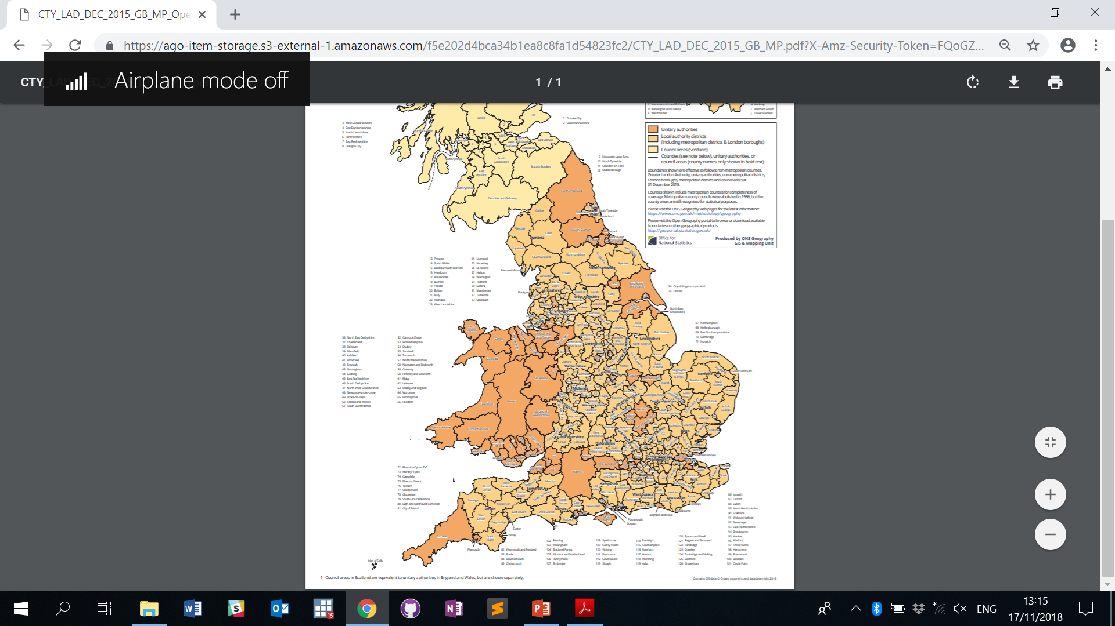

Slide 6
Analytical Approach
Unit of analysis: Local authorities in England & Wales
Outcome: Charity density = number of registered charities per 5,000 residents
Key explanatory factor: Level of material deprivation = Townsend Score
Controls: Urban/Rural classification; previous level of density
Models: Linear Regression, Count Regression (Poisson, NBREG).

Slide 7
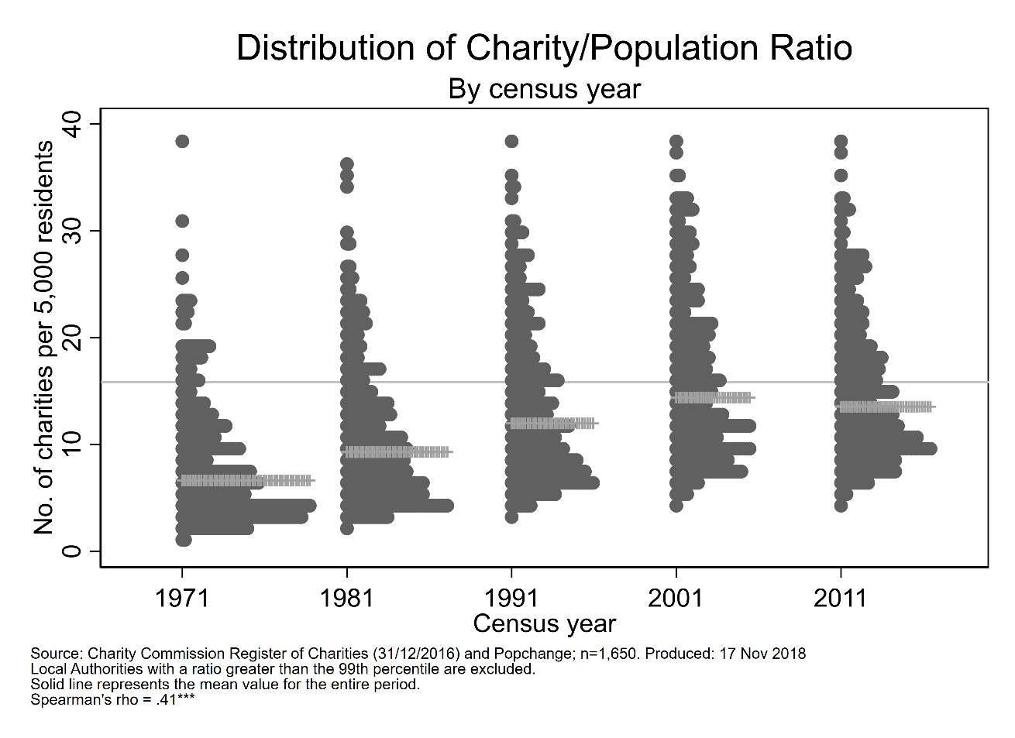
Results – Univariate (outcome)

Slide 8
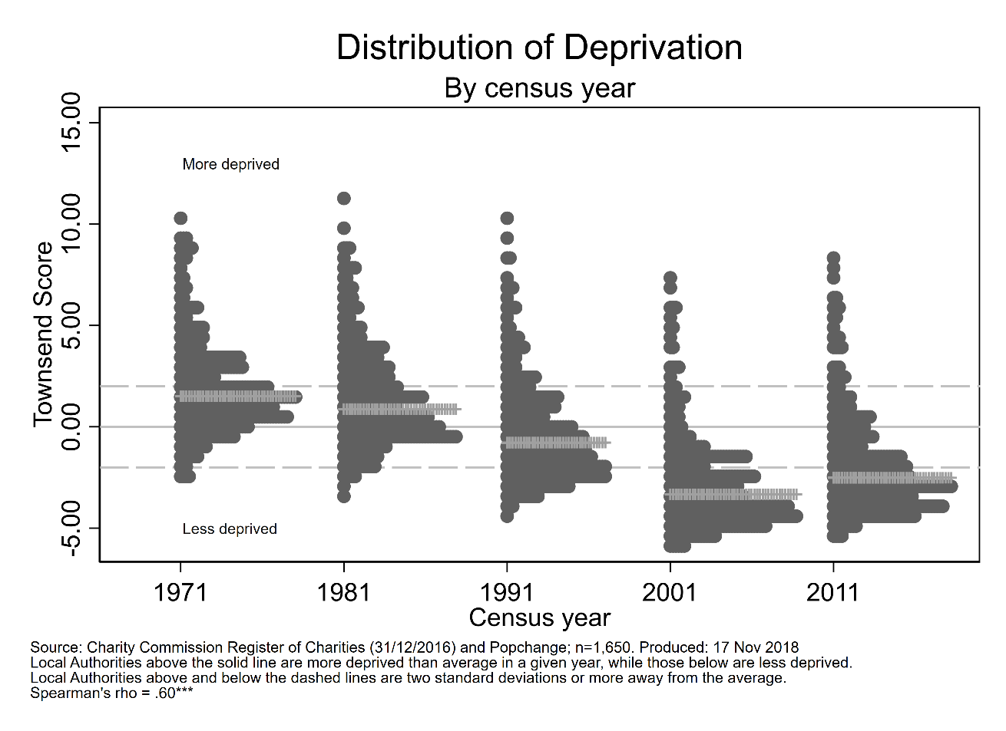
Results – Univariate (key factor)

Slide 9
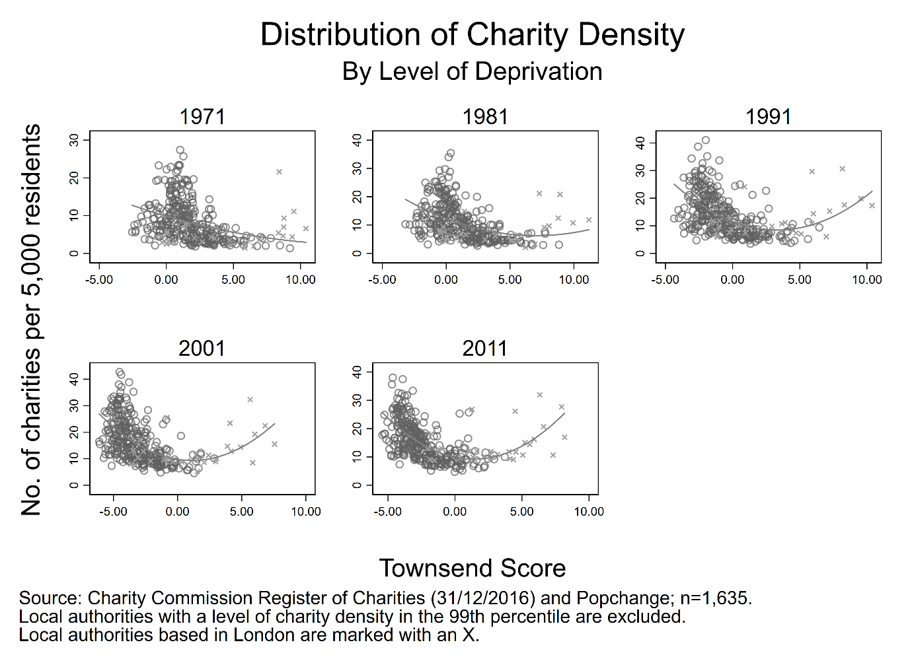

Results - Bivariate

Slide 10
Results – Statistical Model
See Table

Slide 11
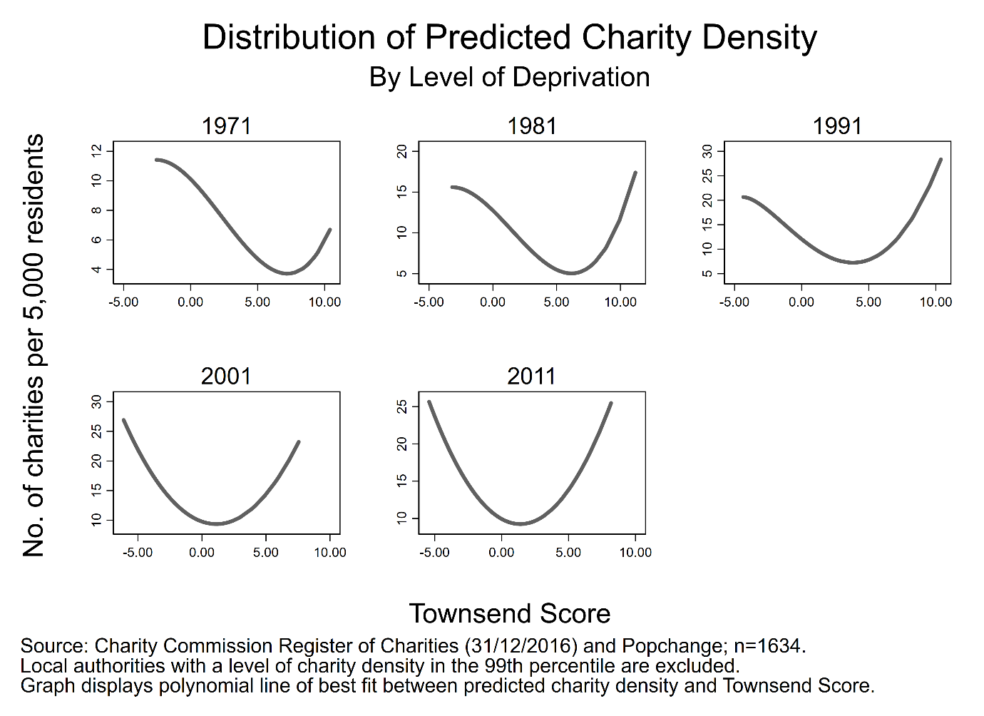
Results – Predictions

Slide 12
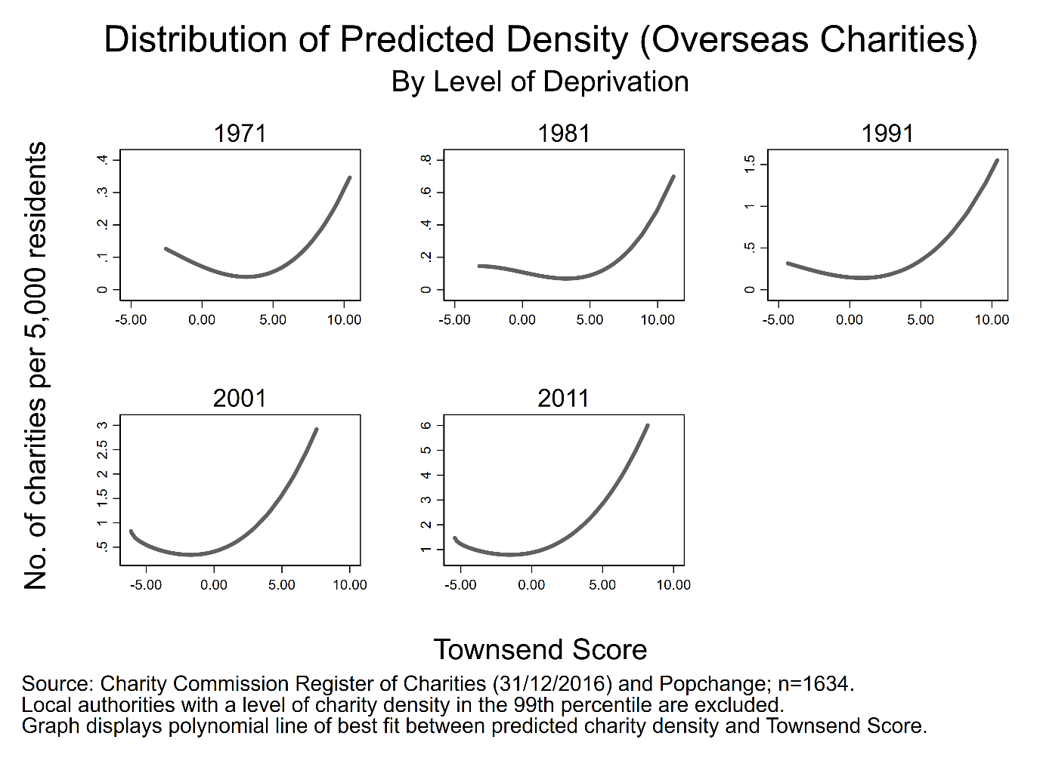
Results – Predictions

