Slide 1
Mission Accomplished? A Cross-national Examination of Charity Dissolution
Dr Diarmuid McDonnell, Univ. of Birmingham
Prof. Alasdair Rutherford, Univ. of Stirling
Prof. Carolyn Cordery, Aston Business School

Slide 2

Context
Increasingly straightforward for stakeholders to access large-scale data about charities and their regulation.
The sector’s claim to exist for the public good no longer assumed, must be evidenced.
Charity success/failure literature tends to focus on survival and financial ratios, not mission accomplishment.

Slide 3
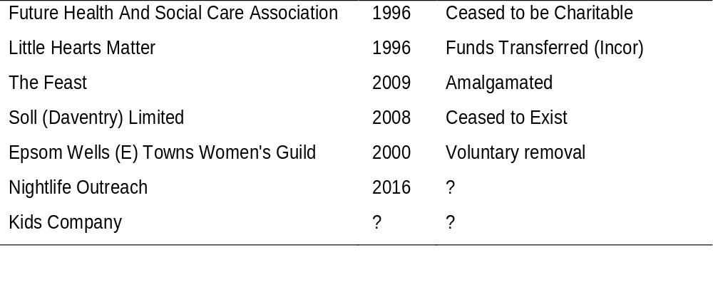
Examples
Notes:
Examples of (mainly Birmingham) charities that are no longer registered with CCEW. Info gleaned from CCEW open data.

Slide 4
Focus
Can we measure mission accomplishment? If not, can we at least differentiate between various types of charity dissolution?
Can we apply this research to multiple jurisdictions, in a way that contains some insights for charity regulators?
Can we perform all of these tasks in a reproducible, open-science manner?

Slide 5
Literature
The ultimate indicator of nonprofit success is the accomplishment of mission objectives (Helmig et al., 2014).
Methodological challenges around varying:
Construct definitions
Theoretical frameworks
Sectors analysed
It is a fragmented research area (Helmig et al., 2014).
Notes:
Therefore, they should be evaluated against this aim.
Constructs: survival, dissolution, market exit, resource reduction, specific performance re service quality, access etc
Theoretical frameworks: resource dependence, stakeholder theory, population ecology, org sociology
Sectors: focus on economically important (in the US at least) subsectors e.g. Health and Human Services
Given the fragmentation and challenges, what is the current state of affairs?

Slide 6
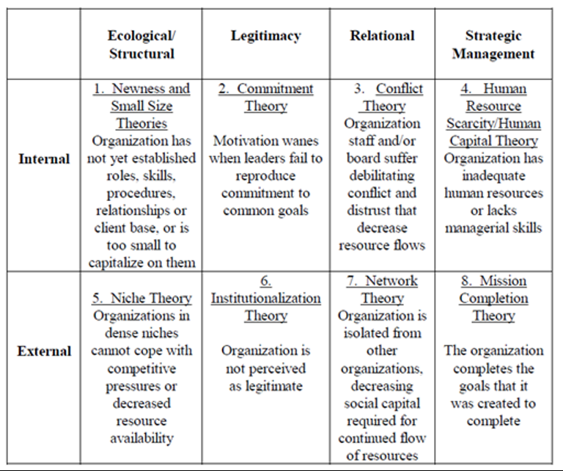
Theory
“…mission completion, more than the other explanations, may tend to be a rationalization or a way of thinking about the terminal events in an organization rather than an event in its own right.” (Hager, 199: 197)
Notes:
Hager’s (1999) influential typology of nonprofit demise; even back then identified difficulties disentangling different types of demise.
Mission completion theory: spans the boundary of internal and external.
He has a doctoral student working on an update to this framework – check her out at ARNOVA.

Slide 7
Empirics
Large (US dominated) literature on predictive factors of dissolution e.g. organisational size and age (Freeman et al. 1983; Harrison and Laincz 2008), governance issues (Callen et al. 2010), regulation (Jordan, 2001), staff motivation (Packard 2010).
24 studies of mission accomplishment (Helmig et al., 2014).
Charities in more deprived neighborhoods have a higher rate of dissolution than those in less deprived neighborhoods. This gradient persists when controlling for size and age (Clifford, 2018).

Slide 8
Research Design
RQ1: What is the rate of charity dissolution, and does it vary across jurisdictions?
RQ2: What factors predict mission accomplishment, and do they vary across other forms of charity dissolution?
Open data derived from multiple charity regulators, in particular England and Wales, New Zealand and Canada.
Multidisciplinary approach.
Notes:
Reason for these three jurisdictions: multiple recorded categories of removal from the respective charity registers. We are also collecting data from Aus, NI and exploring what’s available from other jurisdictions (e.g. Japan, Rep. of Ireland).
Disciplines: data science, accounting, public admin, quantitative sociology.
Progress: we are at the end of data collection, beginning of data cleaning.

Slide 9
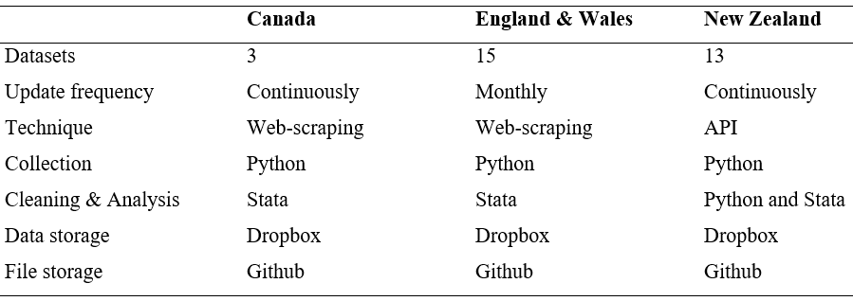
Data
Notes:
I’ll speak briefly about measurement issues near the end of the presentation.

Slide 10

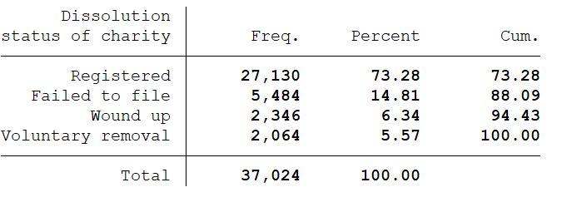
Results

Slide 11
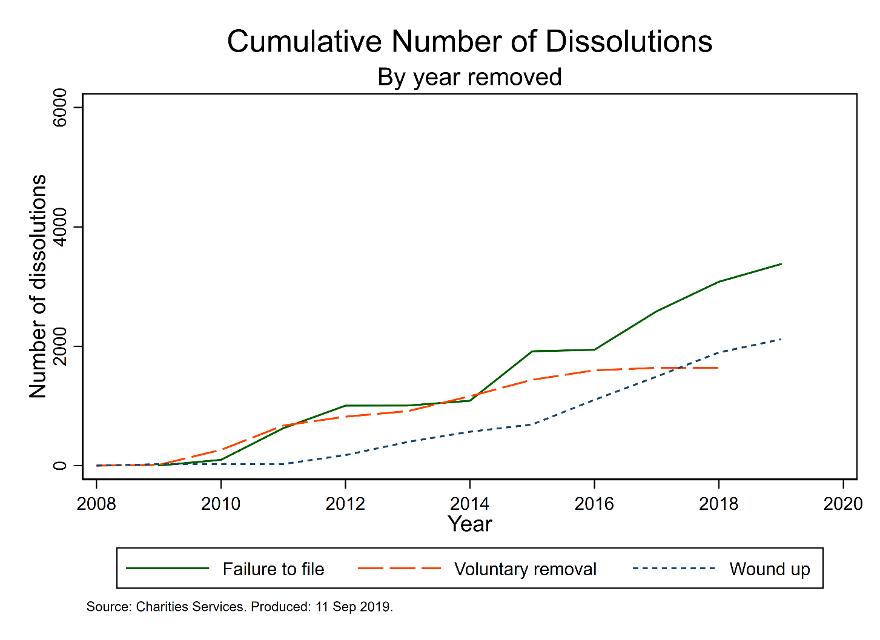
Results

Slide 12
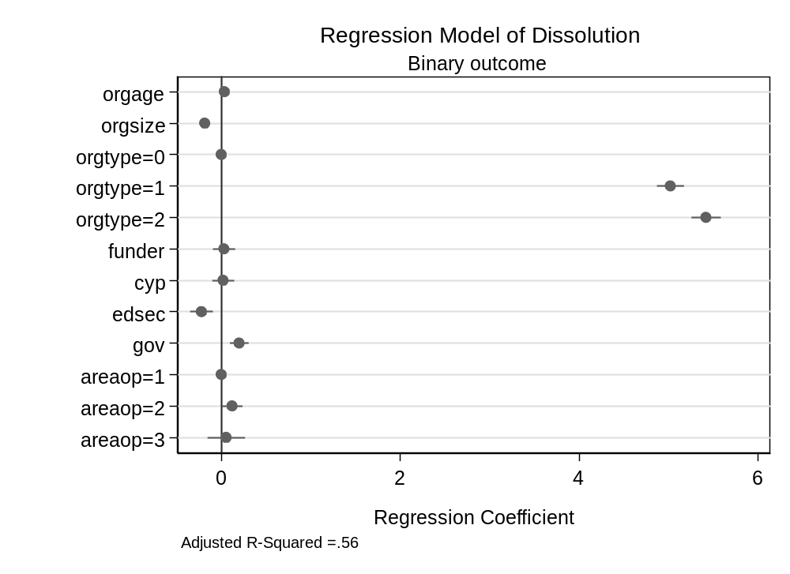
Results

Slide 13
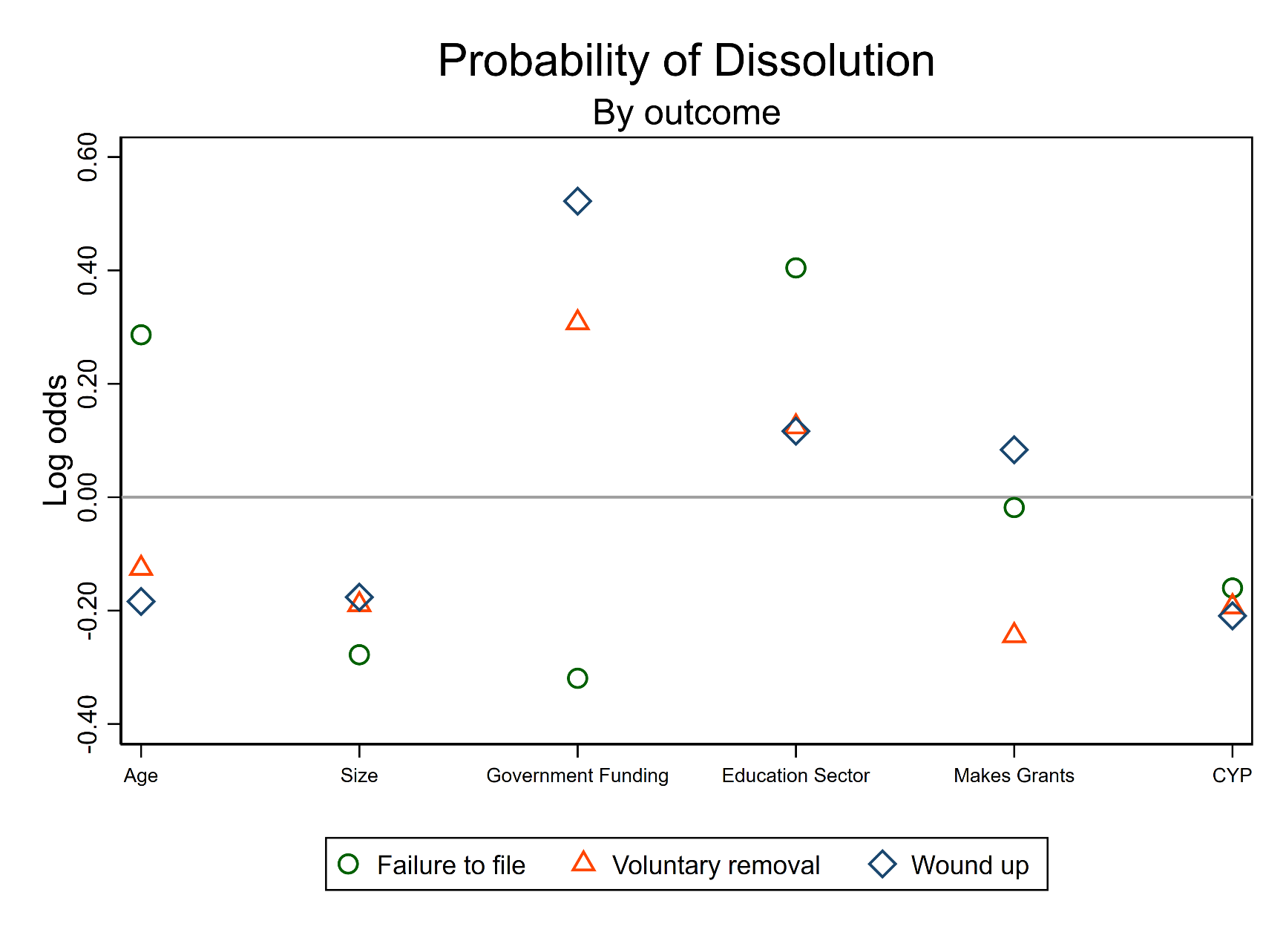
Results

Slide 14
Challenges
Measurement issues:
  Voluntary dissolution is overestimated in NZ.
  Requires domain-specific expertise.
  - Meaning equivalence across jurisdictions.
Data collection issues:
  - Scraping financial data for Canada charities is very time consuming (perhaps the old ways are best?).
Data analysis issues:
  - Trouble operationalising predictors of dissolution.

Slide 15
Reflections
Bigger piece of work than (I) anticipated.
Possible to measure dissolution to reasonable degree of granularity, in NZ and a handful of other jurisdictions.
Difficult to produce harmonized explanatory factors.
Rich data resources for each jurisdiction.
Notes:
Mention David Kane work.
Comment on next steps.

Slide 16
Thanks
My Co-Investigators
British Academy
Regulators
Charities
VSVR 2019
d.mcdonnell.1@bham.ac.uk
@DiarmuidMc
https://github.com/diarmuidm
https://www.thinkdata.org.uk/

