Slide 1
Data Analysis for the Social Sciences
Quantitative Data Analysis I
2023-09-19
Notes:
Welcome everyone to the first of two lectures on quantitative data analysis.
Our focus today is on two important topics:
How we design a piece of analysis
How quantitative data are structured

Slide 2
Data

Slide 3

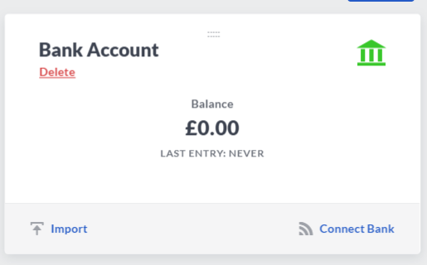
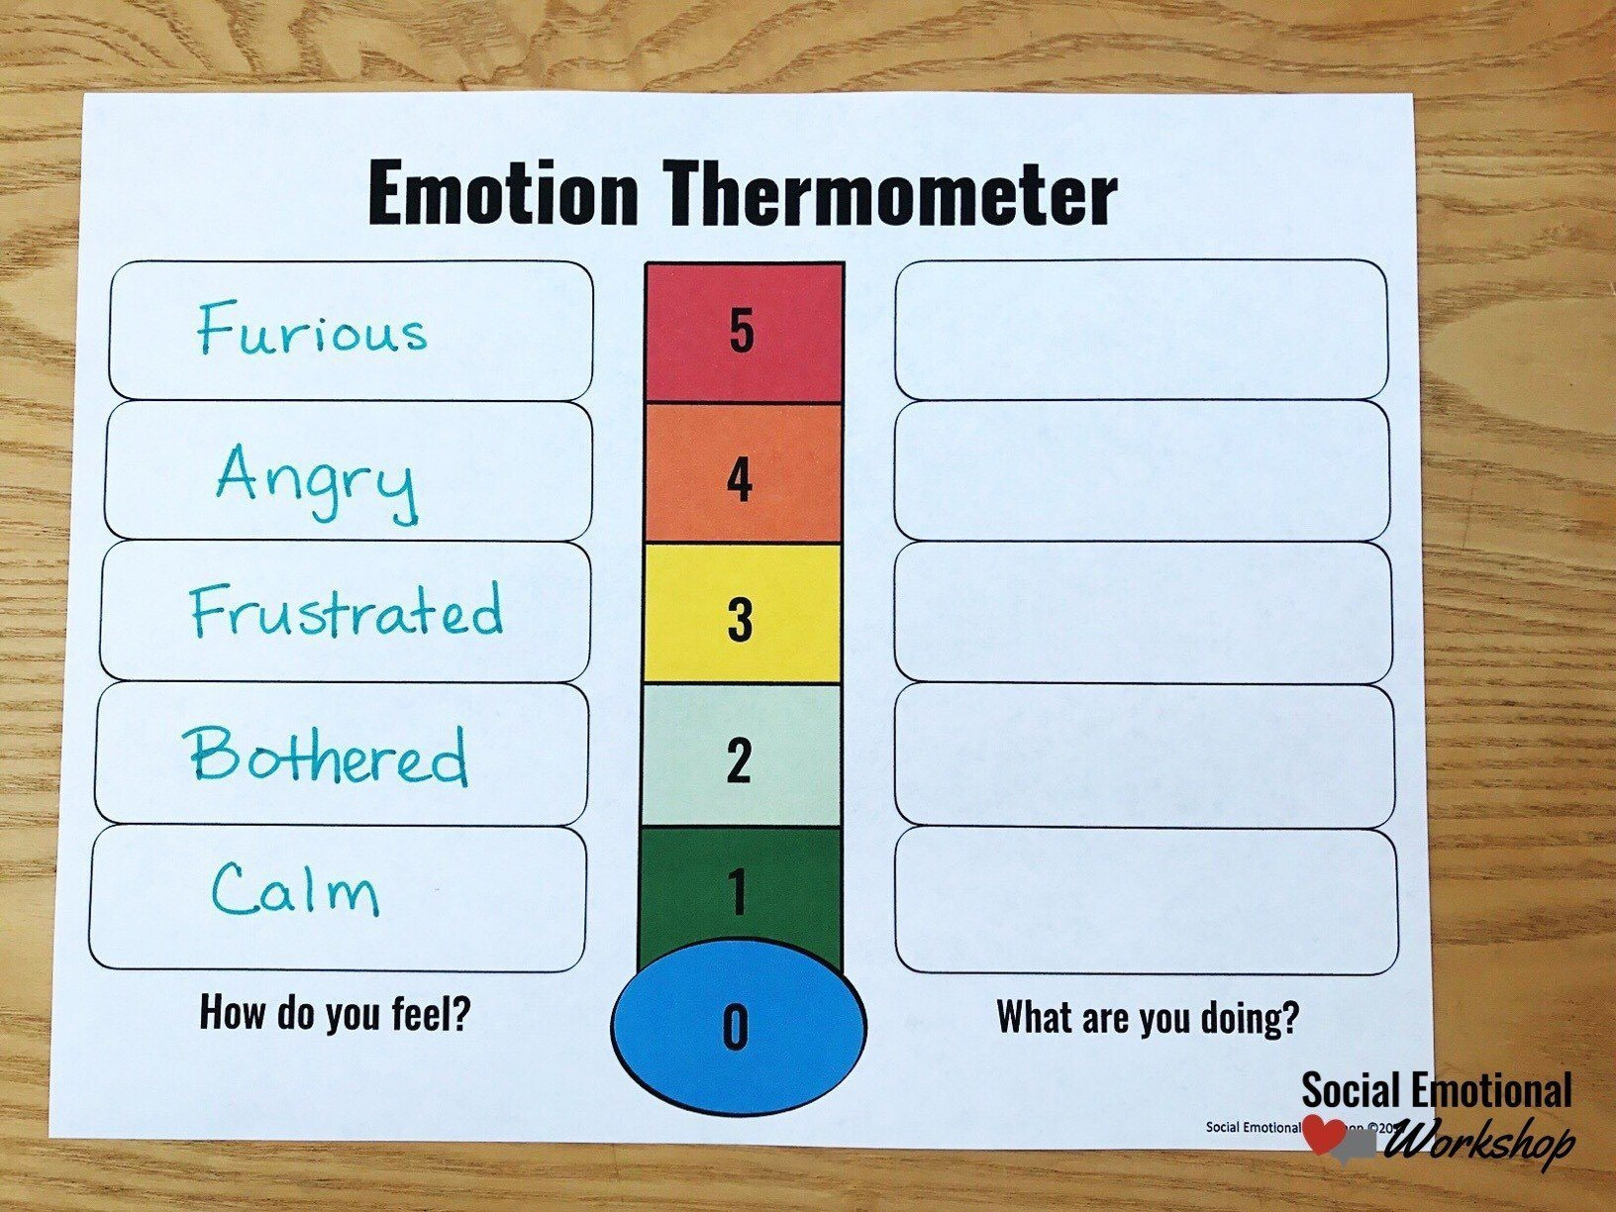
Numbers, numbers everywhere
Notes:
Numbers are everywhere (whether you like them or not). On the positive side, you are much more adept at understanding and using numbers than you may give yourself credit for (think of your ability to manage finances, bills, academic and personal lives) – this translates into research also. On the negative side, people and institutions have been known to manipulate numbers to their advantage (and thus your disadvantage).
Some numbers are real i.e., the thing you are measuring is naturally numeric (bank balance, height, distance from Paisley campus to your accommodation).
Some numbers are labels i.e., we use numbers to represent characteristics, qualities or emotions so that we may count these things and make comparisons.

Slide 4
What are data?
A collection of observations (Agresti, 2018):
An observation is a set of measurements for a case.
A measurement is a description of some characteristic of a case.
A case (or subject) is the entity we are observing e.g., individuals, countries, animals, companies, networks etc.
Notes:
Let’s start with a simple definition (Agresti, 2018).
This definition applies to qualitative or quantitative data.

Slide 5
What are quantitative data?
A collection of observations in a particular format [Variable-by-case matrix]
Case = the entity we are observing e.g., individuals, countries, animals, companies, networks etc.
Variable = what we are measuring about a case e.g., a characteristic
Value = the result of measuring a variable for a given case (MacInnes, 2017)
Notes:
Quantitative data are data arranged in a particular format.

Slide 6
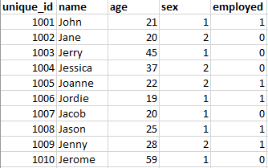
What are quantitative data?
Notes:
Here is what a variable-by-case matrix looks like.
We’ll see real examples in the lab later today.

Slide 7
Designing

Slide 8
What is your estimand?
“The estimand is the object of inquiry—it is the precise quantity about which we marshal data to draw an inference.” (Lundberg et al., 2021: 532)
Who are you studying? [Unit of analysis | case | subject]
What are you trying to quantify? [Conceptualisation]
How will you quantify it? [Operationalisation]
What does your attempt to quantify it look like? [Level of measurement]
Notes:
Some of this will be (should be?) familiar to those of you who took Foundations of Quantitative Research Methods at level 8.

Slide 9
Conceptualisation
“We must convert our ideas about social phenomena into data by deciding what to measure and how to measure it.” (Agresti, 2018: 23)
Unit of analysis = Individual
Object of inquiry / Topic | Conceptualisation
Fuel poverty | Spending more than 10% of net household income on energy costs
Social mobility | Being in a higher occupational class than your father / mother

Slide 10
Conceptualisation
Unit of analysis = Individual
Object of inquiry / Topic | Conceptualisation
Food insecurity
General wellbeing
Notes:
Take a couple of moments to think about some definitions of these topics. That is, what do we mean by these terms?

Slide 11
Operationalisation
“We must convert our ideas about social phenomena into data by deciding what to measure and how to measure it.” (Agresti, 2018: 23)
Unit of analysis = Individual
Object of inquiry / Topic | Conceptualisation | Operationalisation
Fuel poverty | Spending more than 10% of net household income on energy costs | ?
Notes:
Operationalisation is the process of applying a rule for measuring our concept.
The trick here is think about what values go in the column for fuel poverty in our data.

Slide 12
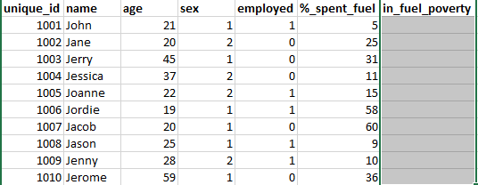
Operationalisation

Slide 13
Operationalisation
“We must convert our ideas about social phenomena into data by deciding what to measure and how to measure it.” (Agresti, 2018: 23)
Unit of analysis = Individual
Object / Topic | Conceptualisation | Operationalisation
Fuel poverty | Spending more than 10% of net household income on energy costs | Categorical variable with two categories: In fuel poverty (1) Not in fuel poverty (0)
Notes:
Remember how you conceptualised fuel poverty in order to decide what values the ‘in_fuel_poverty’ column can take.

Slide 14
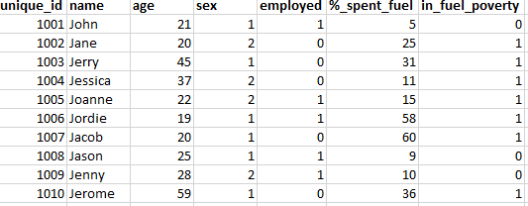
Operationalisation

Slide 15
Measuring

Slide 16
Measurement
Measurement Scale | Level of Measurement | Description | Example
Categorical | Nominal | Presence of some attribute | Sex at birth, Ethnicity
Categorical | Ordinal | More or less of some attribute | Social class, Degree classification
Numeric | Interval | More or less of some attribute (and by how much) | Income, Number of deaths, Age
Notes:
Identifying and understanding which level(s) of measurement are present in your data is crucial, as it determines which analytical techniques you can use (e.g., does it make sense to calculate average marital status?).
Intervals can be discrete or continuous.

Slide 17
Measurement
Notes:
Can you identify the level of measurement for each column in the table?

Slide 18
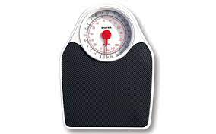
Measurement
Properties of good measures:
Reliable
Valid
Notes:
Regardless of the measurement scale / level of measurement, we want our measures to possess two properties:
Reliable: produces the same results under equivalent conditions.
Valid: actually measures the concept we are interested in.

