Slide 1
Data Analysis for the Social Sciences
Quantitative Data Analysis I
2024/25
Notes:
Welcome everyone to the lecture on quantitative data analysis.
Our focus today is on how to structure and conduct a sensible, robust piece of quantitative data analysis.

Slide 2
“The combination of some data and an aching desire for an answer does not ensure that a reasonable answer can be extracted from a given body of data.” John Tukey

Slide 3


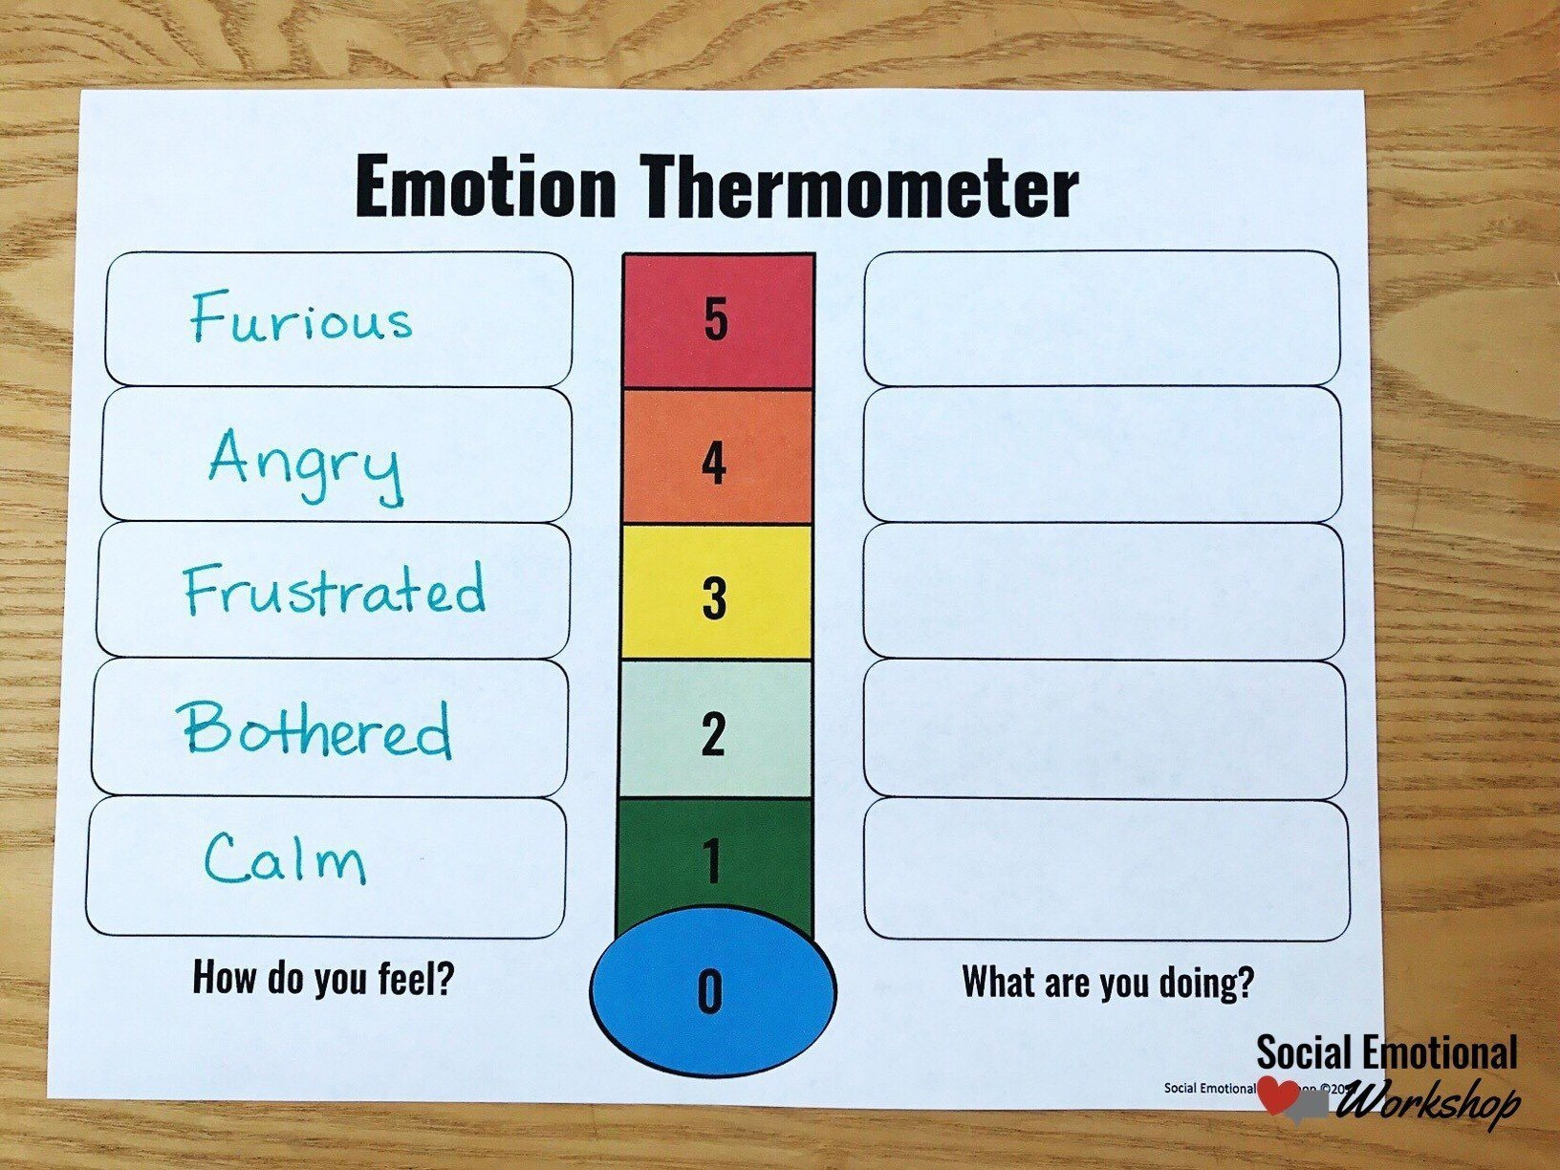
Numbers, numbers everywhere
Notes:
Numbers are everywhere (whether you like them or not). On the positive side, you are much more adept at understanding and using numbers than you may give yourself credit for (think of your ability to manage finances, bills, academic and personal lives) – this translates into research also. On the negative side, people and institutions have been known to manipulate numbers to their advantage (and thus your disadvantage).
Some numbers are real i.e., the thing you are measuring is naturally numeric (bank balance, height, distance from Paisley campus to your accommodation).
Some numbers are labels i.e., we use numbers to represent characteristics, qualities or emotions so that we may count these things and make comparisons.

Slide 4
What are data?
A collection of observations (Agresti, 2018):
An observation is a set of measurements for a case.
A measurement is a description of some characteristic of a case.
A case (or subject) is the entity we are observing e.g., individuals, countries, animals, companies, networks etc.
Notes:
Let’s start with a simple definition (Agresti, 2018).
This definition applies to qualitative or quantitative data.

Slide 5
What are quantitative data?
A collection of observations in a particular format [Variable-by-case matrix]
Case = the entity we are observing e.g., individuals, countries, animals, companies, networks etc.
Variable = what we are measuring about a case e.g., a characteristic
Value = the result of measuring a variable for a given case (MacInnes, 2017)
Notes:
Quantitative data are data arranged in a particular format.

Slide 6
Measurement
Measurement Scale | Level of Measurement | Description | Example
Categorical | Nominal | Presence of some attribute | Sex at birth, Ethnicity
Categorical | Ordinal | More or less of some attribute | Social class, Degree classification
Numeric | Interval | More or less of some attribute (and by how much) | Income, Number of deaths, Age
Notes:
Identifying and understanding which level(s) of measurement are present in your data is crucial, as it determines which analytical techniques you can use (e.g., does it make sense to calculate average marital status?).
Intervals can be discrete or continuous.

Slide 7
Research Aims and Variables
Notes:
Our first task is to explicitly state what our aim is and what variables we have.

Slide 8
Research aims
We can use quantitative methods for (Agresti, 2018):
Designing research studies to investigate questions of interest (including the process of obtaining data)
Description – summarising the data appropriately
Inference - making predictions using the data, in a way that deals with uncertainty of our analysis
Notes:
We are not interested in 1 in this module (covered last year in Foundations of Quantitative Research Methods), as we will use data that have already been collected. But quantitative methods can help us design sampling strategies e.g., who to sample and how (+ how many).

Slide 9
Research aims
Description and inference are two ways of analysing data.
"Descriptive statistics summarize the information in a collection of data. Inferential statistics provide predictions about a population, based on data from a sample of that population." (Agresti, 2018: 17)

Slide 10
Identifying variables
Are climate change beliefs influenced by a person’s sex and age?
Notes:
Say we have a research question. How can we use it to structure our analysis? Put another way, which concept are we interested in explaining?

Slide 11
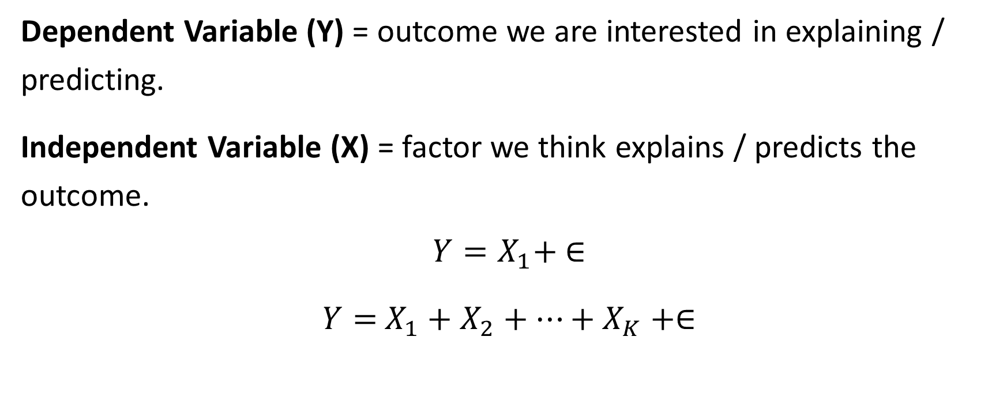
Identifying variables
Dependent Variable (Y) = outcome we are interested in explaining / predicting.
Independent Variable (X) = factor we think explains / predicts the outcome.
$$Y=X_{1}+ ∈$$
$Y=$ $X_{1}+X_{2}+…+X_{K}+∈$
Notes:
Y = X + e is a simple model for when we have one independent variable.
We usually focus on more than one independent variable in social science analyses.

Slide 12
Identifying variables
Are climate change beliefs associated with sex and age among British people?
Y = Climate change beliefs
X1 = Sex at birth
X2 = Age
Notes:
Returning to our research question, is it now apparent what our dependent and independent variables are?
In practice there may be more than one dependent variable e.g., many questions asking about climate change beliefs.

Slide 13
Implications
Research Aims | Affects choice of analytical technique | Mean, median, standard deviation, correlation statistics = descriptive statistics Chi-squared, confidence intervals, p-values = inferential statistics
Identifying Variables | Affects what variables are included in analysis and to what degree | 1 Y and 5 X = six variables needing to described, and five relationships needing to be explored

Slide 14
Structuring your analysis
Order | Type of analysis | Purpose | Techniques
1 | Univariate | Analyse each variable individually | Frequency table Mean, median and mode
2 | Bivariate | Examine the relationships between the dependent variable and each independent variable | Scatterplots Cross-tabulations
3 | Multivariate | Examine whether the bivariate relationships vary across values of other variables | Cross-tabulations by groups Statistical model
Notes:
These are in order
[Break]

Slide 15
Univariate

Slide 16
Univariate analysis
Univariate analysis is concerned with summarising a single variable, specifically:
The central tendency of the values
The variability (distribution) of the values

Slide 17
Measures of central tendency
Mean = typical value
Median = typical observation / case
Mode = most common value
"The mean, median, and mode are complementary measures. They describe different aspects of the data. In any particular example, some or all their values may be useful." (Agresti, 2018: 53)
Notes:
Measures of central tendency try to summarise variables using a single number. Is there a representative / typical value for a variable?

Slide 18
Measures of central tendency
Properties of these measures (Agresti, 2018):
Mean | Median | Mode
Influenced by outliers | Not influenced by outliers | Not influenced by outliers
Not necessarily an actual value | Actual value | Actual value
Applicable to numeric variables | Applicable to numeric and ordinal variables | Applicable to all variables

Slide 19
Measures of variability
Range = difference between maximum and minimum values
= 88 – 16 = 72
Standard Deviation (s) = typical difference between a value and the mean
The larger the standard deviation is, the more spread out the observations are (Agresti, 2018).

Slide 20
Measures of variability
Notes:
Consider two investment opportunities:
Which one would you prefer to take? [Class Poll]

Slide 21
Bivariate

Slide 22
Bivariate analysis
Bivariate analysis is concerned with making comparisons using two variables.
The purpose of comparing two or more variables is to uncover relationships.
Relationships can be strong, moderate or weak; positive, negative or non-existent (Huntington-Klein, 2021).
In quantitative data analysis: is a dependent variable related to one or more independent variables?
Is academic performance related to attendance at workshops?

Slide 23
Bivariate analysis of categorical variables
 | Achieved a 2:1 in module (%)
Attended at least 50% of workshops | Yes | No
Yes | 38 | 62
No | 26 | 74
 | 32 | 68
Notes:
Question: is there a relationship between these two variables?
Representing the joint distribution of two categorical variables is called a crosstabulation or contingency table.
For example, we can ask the question: is your likelihood of achieving at least a 2:1 contingent on attending workshops?
Dependent variable is usually in the columns, independent variable in the rows, and we use row percentages to make comparisons between categories of the independent variable.

Slide 24
Correlations
Examining the joint distribution of two variables is informative but leaves one outstanding question:
How can we quantify the pattern in the joint distribution? (De Mesquita and Fowler, 2021)
Correlations tell us about the extent to which two features of the world tend to occur together. (De Mesquita and Fowler, 2021)
Notes:
Thinking of the pattern shown in the previous table, it would be good to quantify how strong or weak a relationship is.
Therefore a correlation is simply a single number that summarises a relationship between two variables.
There are lots of different correlation statistics and the choice of the most appropriate one is determined by the level of measurement of your variables.
We’ll see examples in the lab today but some you may have heard of: Pearson’s r coefficient, Kendall’s Tau, Gamma, Cramer’s V.

Slide 25
Multivariate

Slide 26
Multivariate analysis
Multivariate analysis is concerned with testing whether the bivariate analyses vary across values of a third / fourth / fifth etc variable.
The social world is complex and there many relevant factors for a single outcome (or many independent variables affecting a dependent variable).
Is there a difference in the earnings of men and women?
Is this the case for all age groups? Or is it really only older men who earn more than older women?

Slide 27
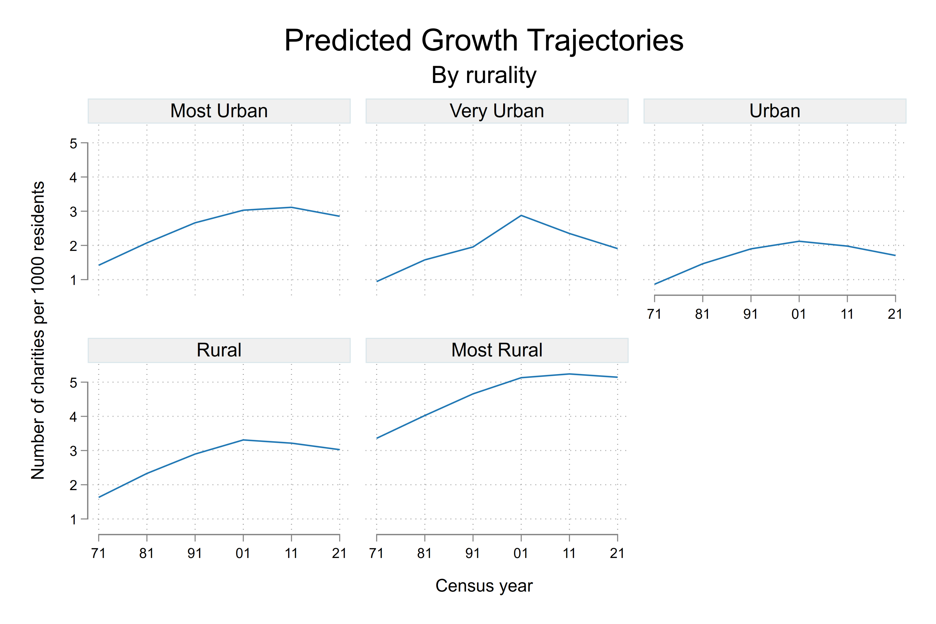
Multivariate analysis
Notes:
We covered loads today, so please take the time to revise the lecture, engage with the core reading etc before the first assessment.
If you get through all of the content associated with this week you will have an excellent grasp of what quantitative data analysis involves, regardless of whether you conduct some QDA for assessment 2.

