Slide 1
The value, logic and practice of web scraping
Web Scraping to build social research data

Slide 2


Restoring credibility
Notes:
After showing myself to be a bit dim with the Bruce Springsteen, let me demonstrate how web scraping can be used to construct rich, interesting social science datasets.
[Demonstrate Aus Charity script]

Slide 3
What is web scraping?
It is a computational technique for capturing information stored on a web page.
It is generally implemented using a programming script, although there are software applications that you can use.
It is relatively simple to implement using open-source programming languages e.g., Python, R.
Notes:
Computational is the key difference: copy-and-pasting information from web pages is usually allowed (or undetectable!), though the manual approach carries considerable disadvantages in terms of accuracy and labour resource.
I always advocate the flexibility of writing your own code (nevermind the intellectual benefits that accrue from learning such skills), however the ultimate aim is to collect data, so there are out-of-the-box solutions you can avail of e.g., Excel, Scrapy.
You do not need to be highly computationally literate, nor write screeds of code: this is a popular and mature computational method, with tons of documentation and examples for you to learn from.

Slide 4
Why collect data from the web?
Web pages can be an important source of publicly available information on social phenomena of interest.
Web pages can store a range of different data types including files, text, photos, videos, lists etc, all of which may be collected and marshalled for research purposes.
Once collected, data can be reshaped into a familiar format (tabular) and linked to other sources of social science data.
Notes:
Coming from a social research perspective here, though it is of course commercially valuable also e.g., Google or price comparison sites.
However, the data stored on websites are typically not structured or formatted for ease of use by researchers: for example, it may not be possible to perform a bulk download of all the files you need (think of needing the annual accounts of all registered companies in London for your research...), or the information may not even be held in a file and instead spread across paragraphs and tables throughout a web page (or worse, web pages). Luckily, web-scraping provides a means of quickly and accurately capturing and formatting data stored on web pages.

Slide 5
What is the logic of web scraping?
We need to know the following:
The location (i.e., web address or URL) where the web page can be accessed. For example, the BBC homepage can be accessed via https://bbc.co.uk.
The location of the information we are interested in within the structure of the web page. This involves visually inspecting a web page's underlying code using a web browser.
Then we need to do the following:
3. Request the web page using its web address.
4. Parse the structure of the web page so your programming language can work with its contents.
5. Extract the information we are interested in.
6. Write this information to a file for future use.
Notes:
Coming from a social research perspective here, though it is of course commercially valuable also e.g., Google or price comparison sites.
However, the data stored on websites are typically not structured or formatted for ease of use by researchers: for example, it may not be possible to perform a bulk download of all the files you need (think of needing the annual accounts of all registered companies in London for your research...), or the information may not even be held in a file and instead spread across paragraphs and tables throughout a web page (or worse, web pages). Luckily, web-scraping provides a means of quickly and accurately capturing and formatting data stored on web pages.

Slide 6
What is the value of web-scraping for social science research?
Web scraping is a mature computational method, with lots of established packages (e.g., `requests` and `BeautifulSoup` in Python), examples and help available.
Using computational, rather than manual, methods provides the ability to schedule or automate your data collection activities.
The richness of some of the information and data stored on web pages is a point worth repeating.
Web scraping can be an accurate and reliable data collection method.
Notes:
Coming from a social research perspective here, though it is of course commercially valuable also e.g., Google or price comparison sites.

Slide 7
What are the limitations of web-scraping for social science research?
Web pages are frequently updated, therefore changes to their structure can break your script. It can be a lot of work maintaining your code, especially if you make it available for use by others.
Some websites may be advanced enough that they throttle or block scraping of their contents.
Web scraping, and computational social science in general, is dependent on your computing setup.
Some ethical and legal complications that must be navigated/avoided.
Notes:
That’s enough text, let’s see the results of some web scraping.

Slide 8
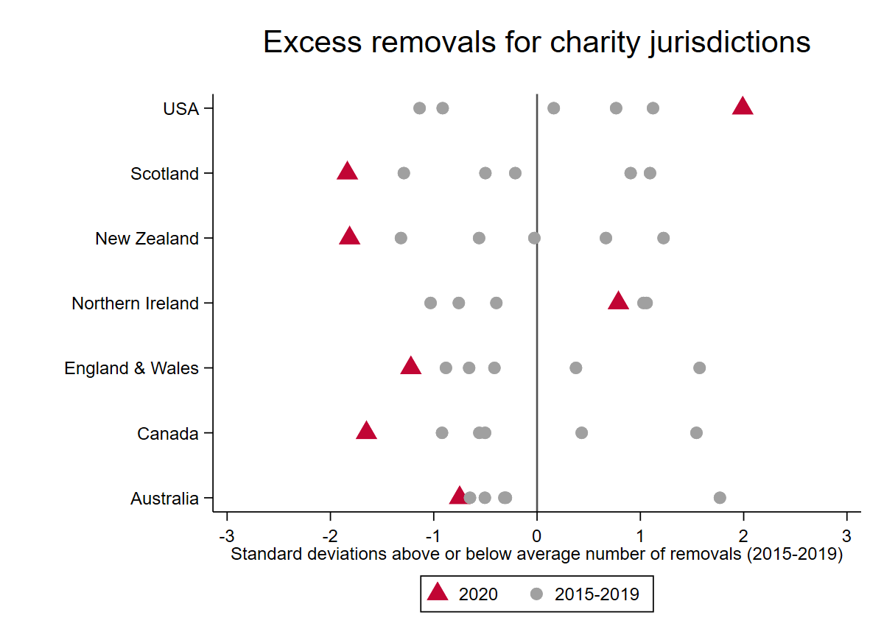
Social science outputs
Notes:
That’s enough text, let’s see the results of some web scraping.

Slide 9
Questions

