Slide 1
Mission Accomplished? A Cross-national Examination of Charity Dissolution
Dr Diarmuid McDonnell, Univ. of Birmingham
Prof. Alasdair Rutherford, Univ. of Stirling
Prof. Carolyn Cordery, Aston Business School

Slide 2
Context
Increasingly straightforward for stakeholders to access large-scale data about charities and their regulation.
The sector’s claim to exist for the public good no longer assumed, must be evidenced.
Charity success/failure literature tends to focus on survival and financial ratios, not mission accomplishment.

Slide 3
Aims
Explore the extent to which large-scale regulatory data can be used to differentiate between different types of charity dissolution.
Examine cross-national trends and predictive factors around charity dissolution.
Provide evidence and guidance for charity regulators.
Build capacity around large-scale data in the nonprofit academic/research community.

Slide 4
Motivations
“Because it’s there” (George Mallory).
Public trust, regulatory alignment (approach and pressures), explore variation in context of global factors (e.g. financial crisis).
No such thing as a free lunch, impact agenda.
No shortage of research questions, definite shortage of data science/wrangling skills.
Notes:
More serious motivation for using large-scale regulatory data: evaluate its value for use in nonprofit research; imperfect but often the best we have.

Slide 5
Research Design
RQ1: What is the rate of charity dissolution, and does it vary across jurisdictions?
RQ2: What factors predict mission accomplishment, and do they vary across other forms of charity dissolution?

Slide 6
Data
Data from three regulatory jurisdictions:
  England & Wales (1853)
  Canada (1967)
  New Zealand (2007)
A synoptic assessment suggests all three have rich potential to address our research questions:
  Sufficient scale and granularity
  Open data
  Comprehensive coverage of sector and time period
  Multinomial measure of dissolution

Slide 7
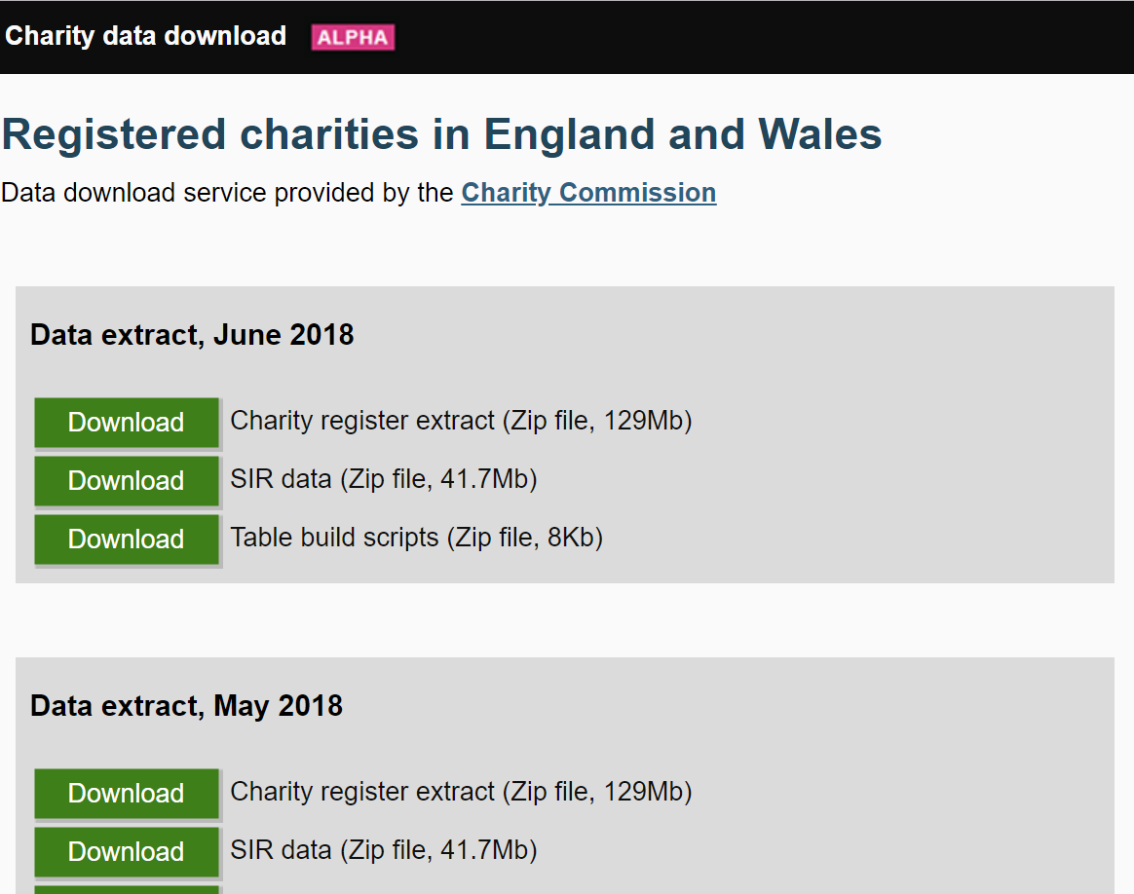
England & Wales
Notes:
Beginning in September 2017, the Charity Commission for England & Wales releases monthly extracts of the data it holds about charities. The extract consists of three ZIP files: Charity register extract; Supplementary Information Return (SIR) data; and Table build scripts, which consists of code for constructing the fifteen datasets contained in the Charity register extract ZIP file. The datasets are provided in the .bcp file format, which is an SQL backup format. In order to convert these datasets to a more amenable format for research – comma separated values (CSV) files – we employed the use of Python scripts produced and publicly shared by the National Council for Voluntary Organisations (NCVO): see https://github.com/ncvo/charity-commission-extract. The execution of these scripts results in fifteen CSV datasets – see Table A2 in the appendices to understand what each dataset contains. The SIR data is due to be discontinued by the Charity Commission and is not needed for analyses of the England & Wales charity sector.

Slide 8
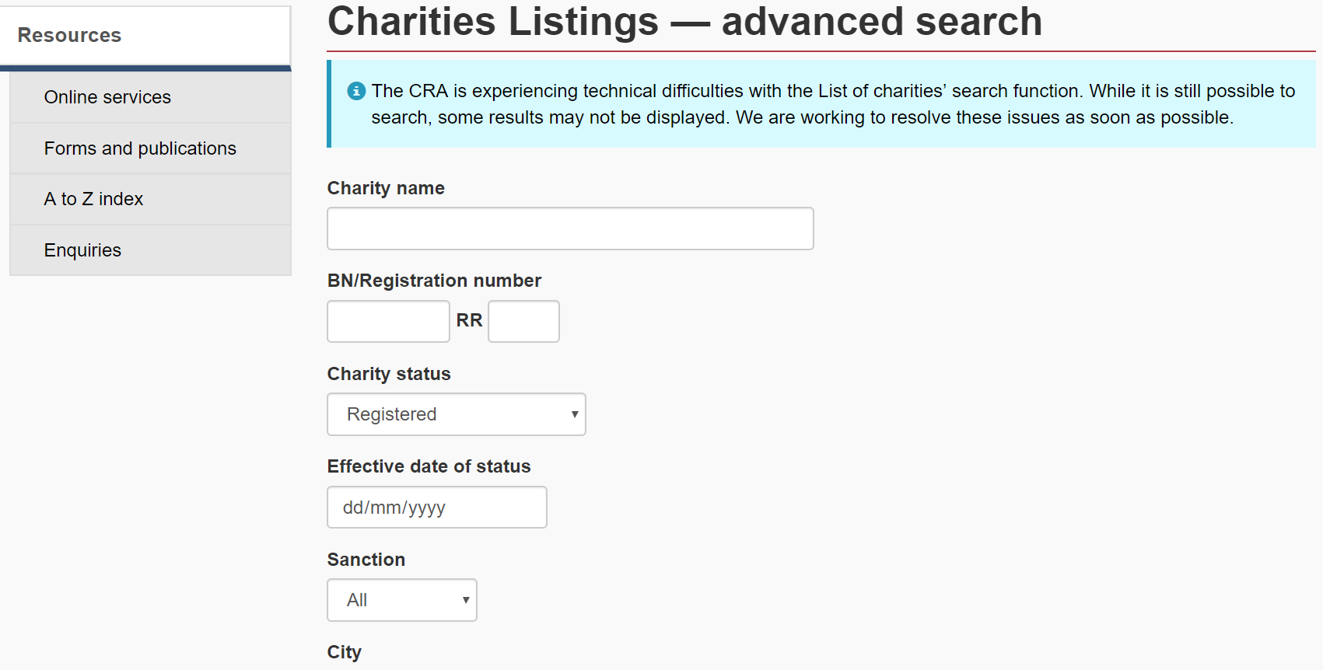
Canada
Notes:
The Canada Revenue Agency (CRA) makes charity data available via its website – see Table A4 in the appendices to understand what each dataset contains. Individuals can use the advanced search function to produce a list of charities containing the following fields: name, registration number, status (e.g. registered), effective date of status, sanction, city, geographical area, postal code, designation (e.g. private foundation), charity type (e.g. education), and category, which disaggregates the five types of charities. Upon performing a search users can download a plaintext file containing the search results. This information can then be used to search for the annual return history of a charity. As the regulator does not provide access to its data via an Application Programming Interface (API, like in New Zealand) or via files hosted on a data portal (like in England & Wales), we needed to employ web-scraping techniques in order to glean some of the financial information hosted on CRA’s website; we discuss this work in more detail in the presentation.

Slide 9
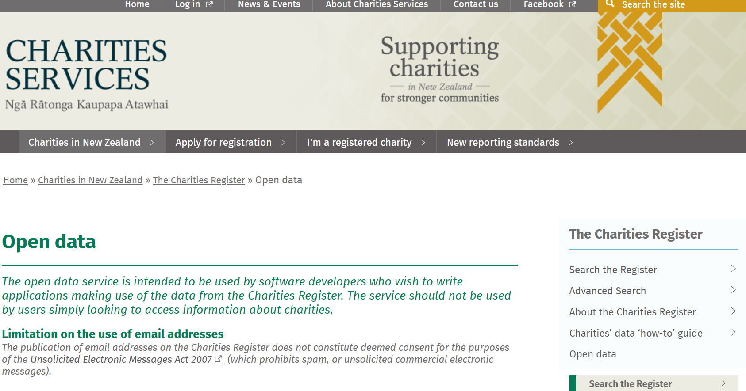
New Zealand
Notes:
Charities Services Open Data web service provides a wealth of information about registered charities, their officers and financial profile. The service is intended for use by software developers looking to create applications based on regulatory data; however, we have found the basic and advanced search functions the regulator provides through its website unreliable (e.g. search requests often time-out) and time consuming. The open data service is housed in a Microsoft stack that is accessed via the OData Protocol, and users can write code in multiple languages to interact with the Protocol (e.g. Python, PHP, Java). Charities Services OData end point can be reached at http://www.odata.charities.govt.nz and there is no authentication required to access it as all access is read only. The Data Dictionary lists 13 datasets that can be accessed via the Open Data web service – see Table A3 in the appendices to understand the contents of each dataset. The datasets can be retrieved in any of three formats: ATOM, JSON and CSV. Note that not all charities have to register with the regulator, similar to the case in England & Wales.
Note that there is insufficient detail on the regulator’s website or in the data dictionary to fully understand what each of these 13 datasets contain; we plan on contacting Charities Services in order to better understand the data they make available.

Slide 10
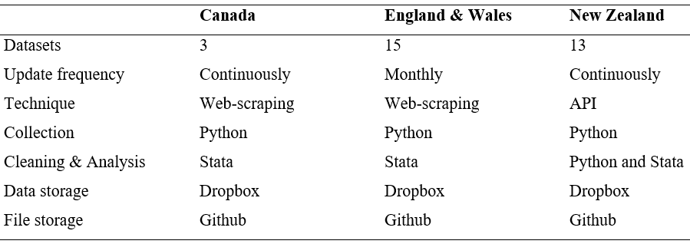
Approach
Notes:
Summary of our approach to sourcing and cleaning data.

Slide 11
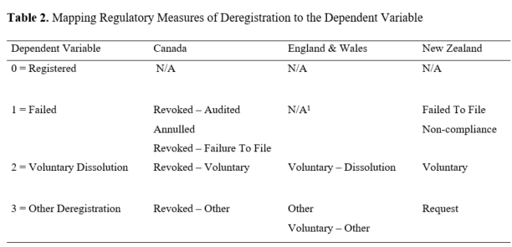
Dependent Variable
A multinomial measure of charity dissolution that is equivalent across regulatory jurisdictions.
Notes:
I’ll speak briefly about measurement issues near the end of the presentation.

Slide 12
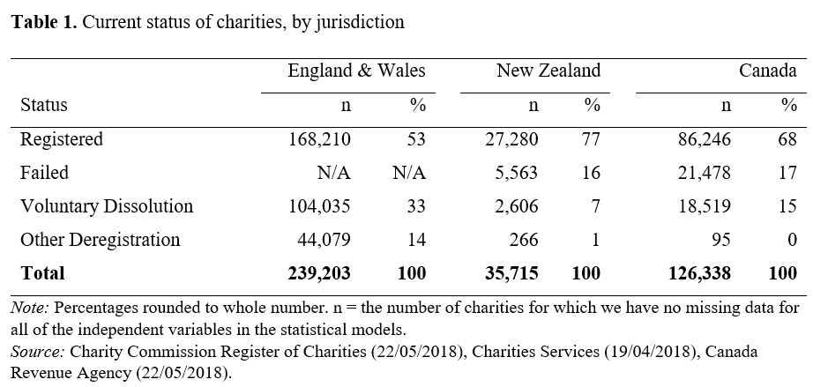

Results
Notes:
The rate of voluntary dissolution varies across the jurisdictions (Table 2), though this is probably due to our inability to clearly identify charities that “Failed” in the England & Wales data.

Slide 13
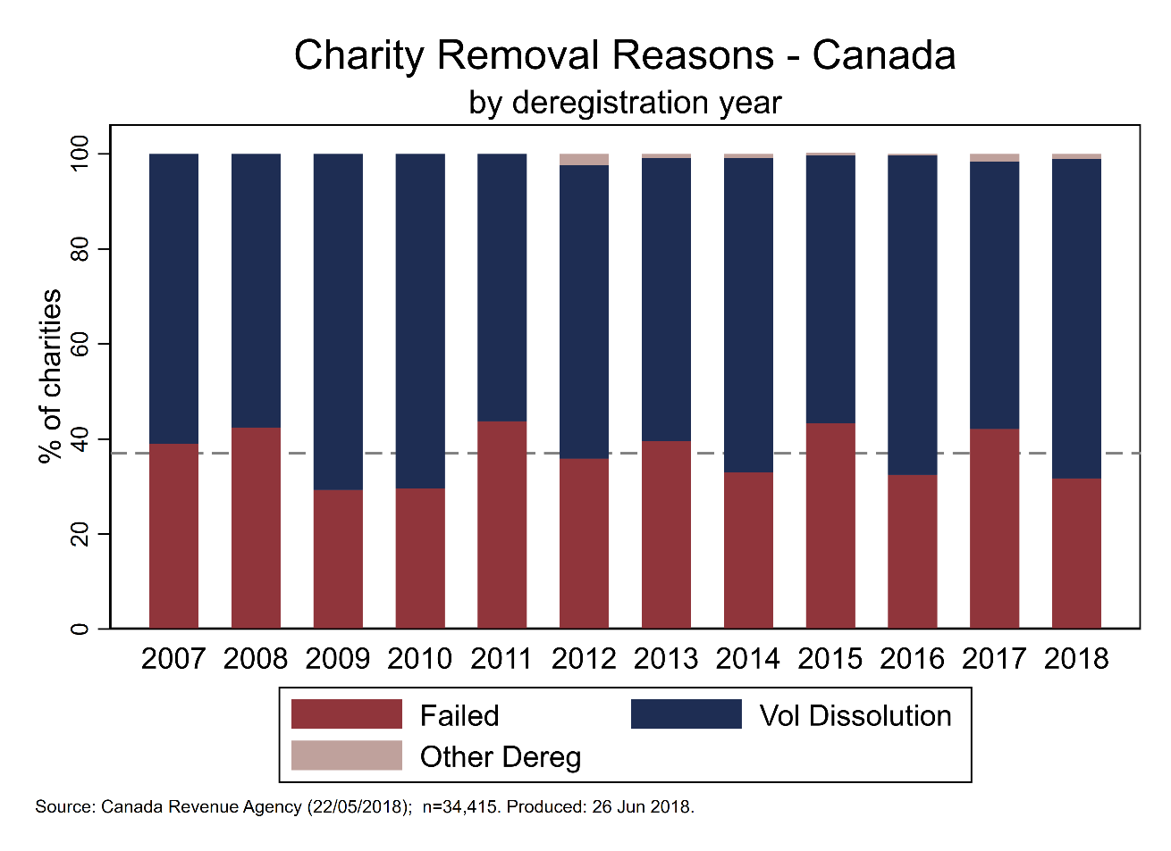
Results

Slide 14
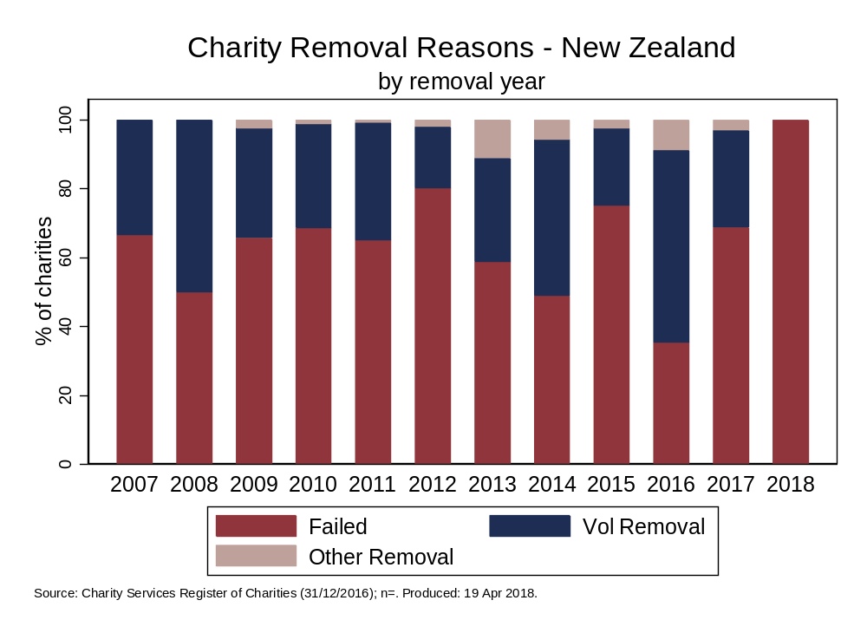
Results

Slide 15
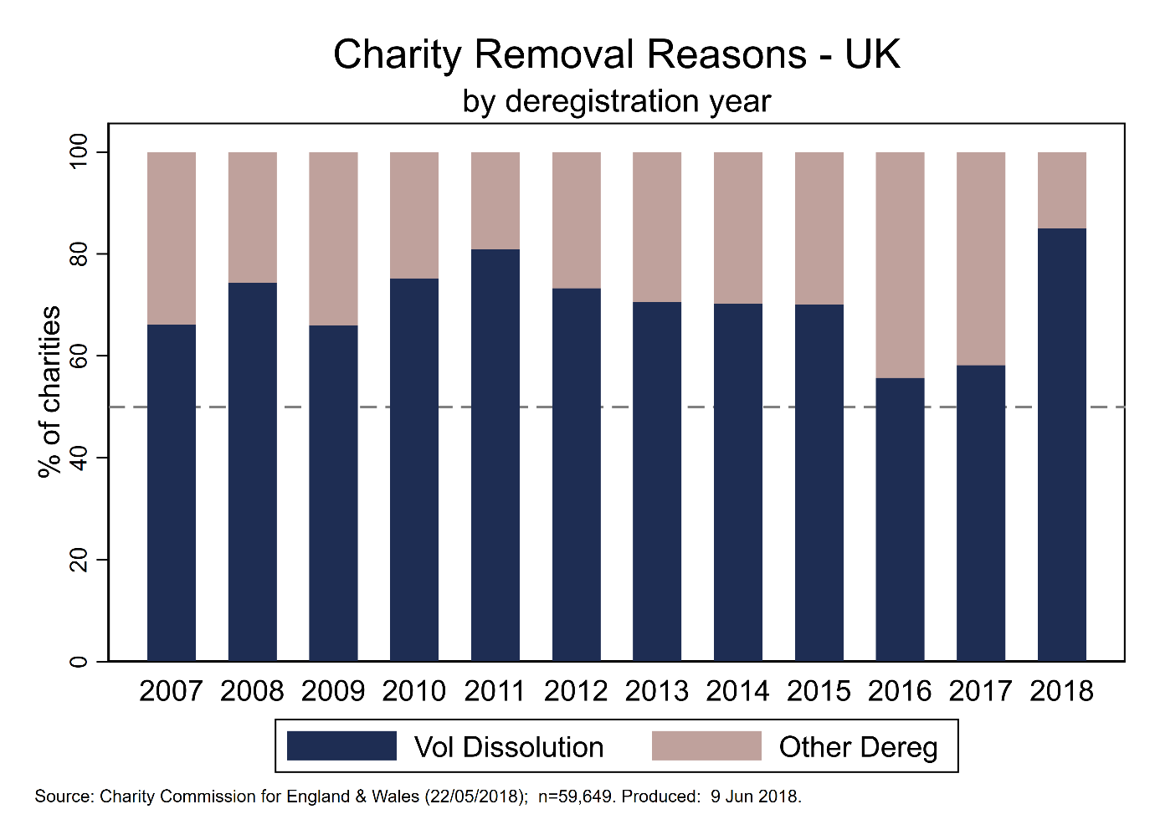
Results
Notes:
There was a sharp increase in the absolute number of voluntary and other dissolutions in England & Wales in 2009: the former from 4,149 in 2008 to 8,197 in 2009, the latter from 1,430 in 2008 to 4,223 a year later.

Slide 16
Results
[Insert statistical modelling results.]

Slide 17
Challenges
Measurement issues:
  Voluntary dissolution is still not a homogenous category.
  Meaning equivalence across jurisdictions.
Data collection issues:
  New Zealand download can time out (file size).
  Scraping financial data for Canada charities is very time consuming (perhaps the old ways are best?).
Data analysis issues:
  No shortage of suggested predictors.

Slide 18
Next Steps
Secure small research grant (~£10k) to complete this work.
Maintain and enhance repository of code, syntax and research materials germane to this project.
Collaborate with scholars/researchers working with data from other jurisdictions.
Notes:
Present the Github repository and summarise thoughts so far: worthwhile project; no shortage of data; a challenge to find enough harmonised independent variables.

