Slide 1
Scrum 4 Report Voting Web Page
Team Members: Ezra, Malik, & Ethan
CIS 266 - May 2026

Slide 2
Team Roles
Ethan (Scrum Master & Lead): | Malik (Server Connection): | Ezra (Client):
Scrum Master & coordinator | Setting up Socket.IO | HTML interface
Designing project structure | Function for updating all clients | Connecting Socket.IO server
PowerPoint slides & IO captures | Storing vote object | Sending votes to server
Final zip submission & integration oversight

Slide 3

Method Used
Key Technologies Learned & Reinforced:
Node.js- Sever runtime
Socket.IO- For real-time communication on voting result
HTML- UI structure
Bootstrap- UI styling
JavaScript- Client logic

Slide 4

Project Goal
Real Time Voting System Web Service:
A real time voting web page that show voting update instantly for everyone viewing the page
Allow
Allow multiple user to vote simultaneously
Display
Display live results without page refresh
Use
Use server-client communication using events

Slide 5

Example of Client-Server connection

Slide 6
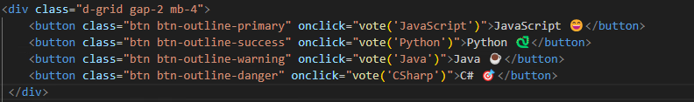
index.html
User click on the button

Slide 7
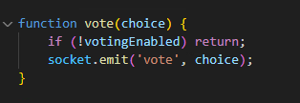
app.js
Sent the event to the server

Slide 8
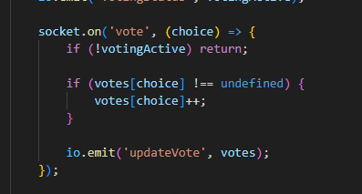
index.js
Store the vote and updates the data

Slide 9
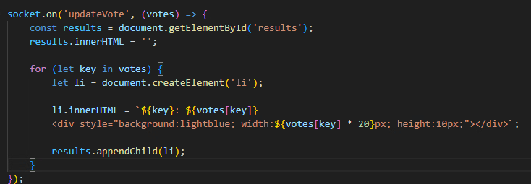
app.js
Receives updates and update UI elements

Slide 10
Debugs/Fixes
Still voting after timer went off
Added server side block for vote after timer ended
Added votingActive
Winner UI still repeating
Added votingActive to setInterval on index.js
Winner only show once
Event name mismatch
updateVote vs updateVotes
Review all event name for constant naming convection

Slide 11
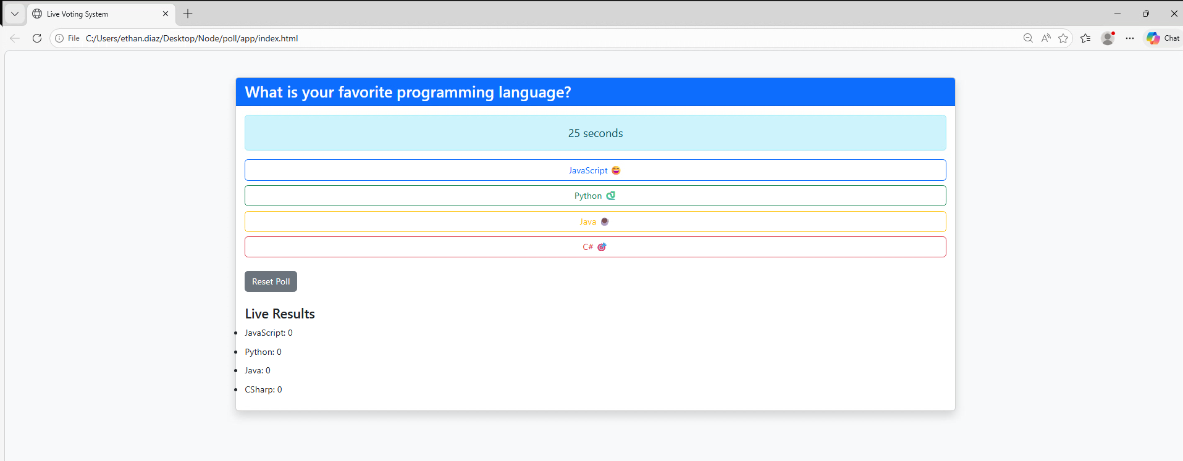
Demo

Slide 12
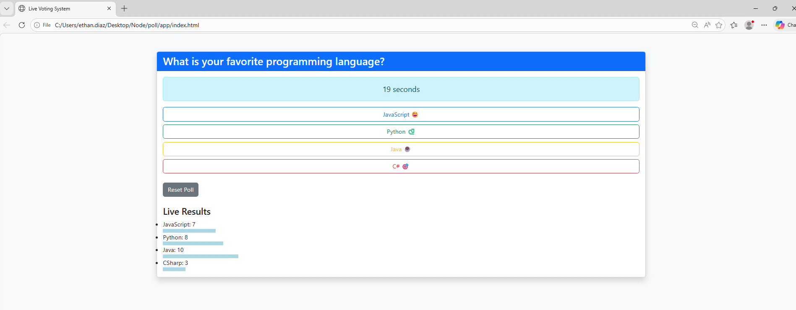
Demo

Slide 13
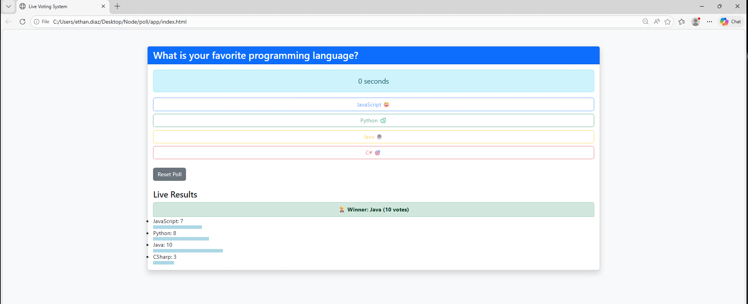
Demo

Slide 14
Thanks for Watching!

