Slide 1
MACHINE LEARNING · FINAL PROJECT
Cross-Sectional
Equity Return
Prediction
An end-to-end quantitative alpha research pipeline
Ali Dib · Chris Wehbe · Anthony Charbel · Kevin Khoury
0.041
0.98
S&P 100
2024
IC Mean
Sharpe
Universe
Test Horizon

Slide 2
AGENDA
What we will cover
01
Problem & Motivation
04
Models & Results
Why equity return prediction is hard
8 model families, temporal validation, tuning
02
Data & Feature Engineering
05
Ensemble & Benchmarking
S&P 100, yfinance, 14 cross-sectional factors
IC-weighted combination, SPY, naive baseline
03
Evaluation Framework
06
Conclusion & Limitations
IC, ICIR, Sharpe — backed by research
Honest out-of-sample assessment

Slide 3
01
Problem &
Motivation
Why predicting cross-sectional equity returns
is one of the hardest problems in applied ML

Slide 4
01 · PROBLEM & MOTIVATION
What We Are Solving
Cross-sectional alpha prediction — not market direction
The Prediction Task
Weak Signal
For each stock i at time t, predict the 5-day forward return relative to all other stocks in the universe.
R² ≈ 0.001–0.004 is normal and expected. Returns are 99% noise.
r̂(i,t) = f( features(i,t) ) → rank stocks → long top 10, short bottom 10
Temporal Leakage
Random train-test split is invalid. Future data must never touch training.
This is called cross-sectional alpha prediction — the standard approach used by systematic quantitative hedge funds.
Non-stationarity
Unlike price forecasting, we do not predict absolute returns. We rank stocks against each other. A stock with a predicted return of +0.1% may be a BUY if all others have predicted returns of -0.5%.
Market regimes change. A 2015 signal may not hold in 2024.
Survivorship Bias
yfinance only returns current S&P constituents. Delisted stocks are invisible.
4

Slide 5
02
Data & Feature
Engineering
From raw OHLCV prices to 14 cross-sectional factors

Slide 6
02 · DATA & FEATURE ENGINEERING
Data Pipeline
S&P 100 · 2015–2024 · yfinance API · 242,000 rows
1
Download
2
Clean
3
Features
4
Targets
5
Split
▶
▶
▶
▶
yfinance
OHLCV daily
~100 tickers
2015–2024
Sort by ticker+date
Remove dupes
Handle missing
Validate prices > 0
14 factors
Rolling windows
Cross-sec z-score
per date
target_1d
target_5d
shift(-1), shift(-5)
no leakage
Train 80%
Val 10%
Test 10%
chronological
194,040
Training rows
48,510
Validation rows
48,510
Test rows
14
Features
2
Targets
6

Slide 7
02 · DATA & FEATURE ENGINEERING
14 Cross-Sectional Features
All z-scored per date across the stock universe before modeling
Momentum
Liquidity
1-Day Return · 5-Day Return · 20-Day Return · 60-Day Return
20-Day Avg Volume · Volume Surprise
Multi-horizon price momentum. Captures short-, medium-, and long-term trend persistence.
Volume surprise = current vol / 20-day avg. Flags unusual activity ahead of moves.
Risk & Volatility
Engineered
20-Day Volatility · Volatility Regime · Risk-Adjusted Return
Momentum Ratio 1 & 2 · Trend Consistency · Rank: 20-Day Return · Interaction Features 1 & 2
Realized volatility and Sharpe-style signal. Rewards momentum only when risk is low.
Cross-feature interactions and rank-based signals to capture nonlinear combinations.
⚑ Critical: all features are z-scored across stocks per date — this normalizes relative differences and removes market-wide level effects
7

Slide 8
03
Evaluation
Framework
Why R² is the wrong metric — and what we use instead

Slide 9
03 · EVALUATION FRAMEWORK
Metrics: IC, ICIR & Portfolio Metrics
Research-backed evaluation beyond R²
Information Coefficient (IC)
IC(t) = Spearman( r̂(t), r(t) )
IC = 0.041 (val) · 0.024 (test)
Rank correlation between predicted and realised returns per period. The primary signal quality metric in cross-sectional equity research.
📌 IC > 0.02 is considered a viable signal (Grinold & Kahn, 1999). IC > 0.05 is strong.
IC Information Ratio (ICIR)
ICIR = Mean(IC) / Std(IC)
ICIR = 0.322 (val) · 0.117 (test)
Signal consistency over time. A high ICIR means the signal works reliably, not just on average.
📌 ICIR > 0.5 indicates a tradeable signal. Professional funds target 0.5–2.0 (Grinold, 1994).
Sharpe Ratio
Sharpe = Mean(r_net) / Std(r_net) × √52
Sharpe = 1.97 (val) · 0.98 (test)
Risk-adjusted return of the long-short portfolio net of 10 bps transaction costs per period.
📌 Sharpe > 1.0 on market-neutral strategy is competitive with top institutional funds.
Additional metrics: Cumulative Return · Max Drawdown · IC % positive periods · IC stability (year-on-year)
9

Slide 10
04
Models &
Results
8 model families · temporal validation · hyperparameter tuning

Slide 11
04 · MODELS & RESULTS
Temporal Validation — No Leakage by Design
Random splits are invalid for financial time series
TRAIN
VAL
TEST
2015-03-31 → 2023-01-10
194,040 rows
2023-01-11 → 2023-12-31
~48,510 rows
2024-01-01 → 2024-12-20
~48,510 rows
TimeSeriesSplit Tuning
Drop-Duplicates Guard
Hyperparameters tuned using 5-fold TimeSeriesSplit on training data only. Never KFold — that would shuffle time.
scored_val.drop_duplicates(['date','ticker']) applied before every evaluation to prevent double-counting period returns.
No Look-Ahead on 5d Target
StandardScaler in Pipeline
target_5d uses shift(-5) applied after sorting by ticker+date. Every-5th-date sampling avoids overlapping return windows.
Scaler fitted on training data only, applied to validation/test. Prevents validation statistics from leaking into feature scaling.
11

Slide 12
04 · MODELS & RESULTS
Linear Models — What & How
Ridge, Lasso, and ElasticNet — shared architecture, different regularization penalties
Ridge Regression
Lasso Regression
ElasticNet
Penalty: L2 (squared weights)
Shrinks all coefficients toward zero without zeroing any. Stable when features are correlated — ideal for our 14 z-scored factors.
Implementation
sklearn Ridge in a Pipeline with StandardScaler. Scaler fit on train only — no leakage. alpha tuned via 5-fold TimeSeriesSplit.
Best alpha: 10.0
Penalty: L1 (absolute weights)
Drives weak feature coefficients exactly to zero — automatic feature selection. Irrelevant factors get silenced entirely.
Implementation
sklearn Lasso in Pipeline. max_iter=10000 for convergence on 194K-row panel. alpha tuned via 5-fold TimeSeriesSplit.
Best alpha: 0.0001
Penalty: L1 + L2 (mixed)
Combines Lasso sparsity with Ridge stability. l1_ratio controls the L1/L2 blend — best of both when features are partially redundant.
Implementation
sklearn ElasticNet in Pipeline. Both alpha and l1_ratio grid-searched via 5-fold TimeSeriesSplit on training data only.
Best alpha: 0.0005 · l1_ratio: 0.5
Shared Architecture:
All three use train_regularized_regression() · StandardScaler in-pipeline · train-only scaling · temporal split · no shuffle · chronological ordering preserved
12

Slide 13
04 · MODELS & RESULTS
Validation Results & Hyperparameter Tuning
alpha grid-searched on train via 5-fold TimeSeriesSplit · target_5d validation · 2023-01-11 to 2024-12-20
Key Metrics — target_5d Validation
Hyperparameter Tuning — target_5d
0.045
1.58
Method: 5-fold TimeSeriesSplit
Applied to training data only (2015-2023). No random shuffle — folds respect chronological order to simulate real deployment.
Ridge alpha = {0.01, 0.1, 1.0, 10.0, 100.0}
Best: alpha=10.0 · IC=0.042 · Sharpe=1.22 · CumRet=+58%
Lasso alpha = {0.0001, 0.001, 0.01, 0.1, 1.0}
Best: alpha=0.0001 · IC=0.042 · Sharpe=1.58 · CumRet=+82%
ElasticNet alpha = {0.0001..1.0} · l1_ratio = {0.1..0.9}
Best: alpha=0.0005, l1_ratio=0.5 · IC=0.045 · Sharpe=1.43 · CumRet=+80%
Scoring metric: IC (Spearman rank correlation) — not R². R² is misleading when signal is weak and returns are near-pure noise.
IC Mean (ElasticNet)
Best Sharpe (Lasso)
+82%
0.223
Cum. Return (Lasso)
ICIR (ElasticNet)
Note — Plain Linear Regression:
Included as a baseline (train_linear.py) but no validation metrics were collected. With no regularization it overfits the noisy 194K-row panel — the regularized models supersede it in all evaluations.
Key Finding:
All three models converge on similar IC (~0.042-0.045). Lasso wins on Sharpe (1.58) and Cumulative Return (+82%) — sparsity helps on a clean 14-feature set. ElasticNet selected for ensemble (highest IC).
13

Slide 14
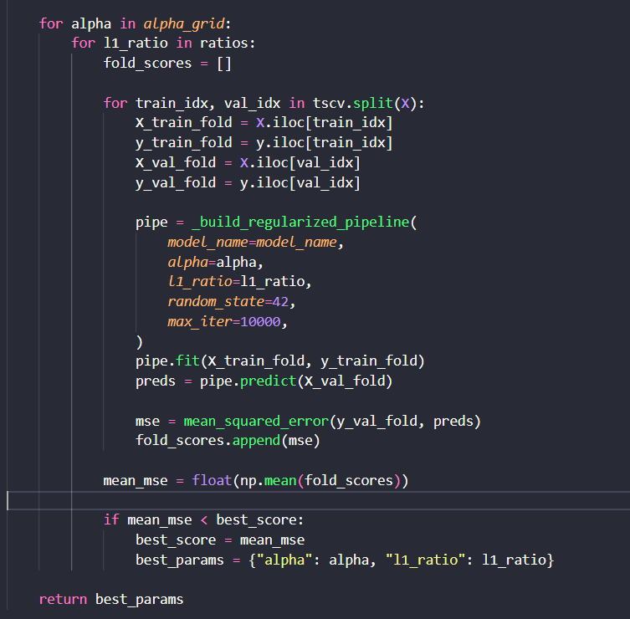
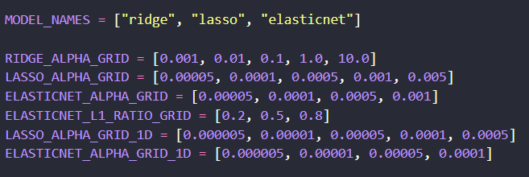
04 · MODELS & RESULTS

Slide 15


04 · MODELS & RESULTS
Support Vector Regression Model Analysis
Model Architecture
Performance & Verdict
■
Non-linear model (RBF kernel)
IC Mean: 0.006
ICIR: 0.047
■
Uses kernel to capture complex patterns
Sharpe: 0
Verdict: Excluded
■
Pipeline: StandardScaler->SVR
■
Implemented utilizing the Scikit-learn library.
WHY IT UNDERPERFORMED
HYPERPARAMETERS
■
Financial data is highly noisy
C=1.0
■
Features are already normalized
■
Sensitive to hyperparameters
Gamma=scale
■
Kernel-based non-linearity did not improve ranking
Epsilon=0.01

Slide 16
04 · MODELS & RESULTS
Decision-Tree Model Analysis
Model Architecture
Performance & Verdict
■
Tree-based model utilizing a single decision tree.
IC Mean: 0.003
ICIR: _
■
Uses feature splits to make predictions.
Sharpe: Negative
Verdict: Excluded
■
Learns non-linear relationships via splits.
■
Implemented utilizing the Scikit-learn library.
WHY IT UNDERPERFORMED
HYPERPARAMETERS
■
Displays high variance and extreme overfitting.
Max_depth: None
Min_samples_split: 2
■
Primarily captures noise rather than signal in financial data.
■
Yields highly unstable predictions across time horizons.
Min_samples_leaf: 1
Random_state: 42
■
As a single tree, it completely lacks structural generalization.

Slide 17
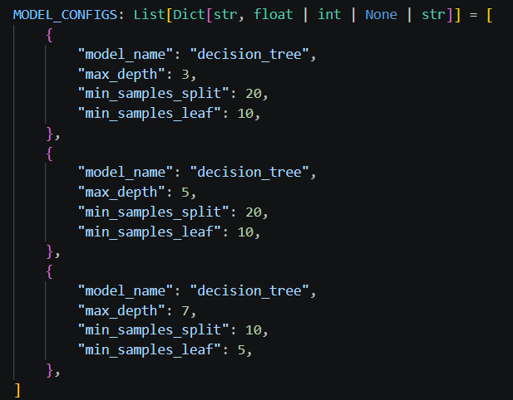
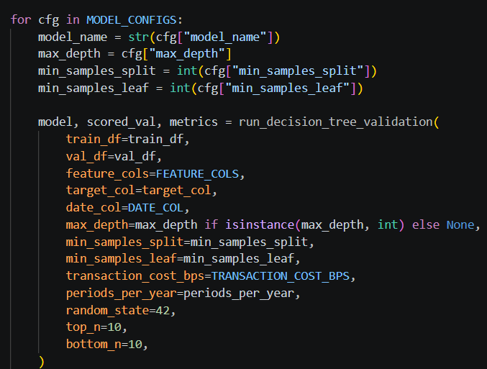
04 · MODELS & RESULTS
Decision-Tree Model: Hyperparameter Tuning

Slide 18


04 · MODELS & RESULTS
Random Forest Model Analysis
Model Architecture
Performance & Verdict
■
Ensemble tree-based model designed for robustness.
IC Mean: 0.002
ICIR: _
■
Operates by combining multiple decision trees.
Sharpe: Negative
Verdict: Excluded
■
Actively reduces variance via output averaging.
■
Implemented utilizing the Scikit-learn library.
WHY IT UNDERPERFORMED
HYPERPARAMETERS
■
Struggled with the inherently weak signal in financial data.
N_estimators: 100
Max_depth: None
The ensemble approach could not extract useful, predictive patterns.
■
Min_samples_split: 2
Min_samples_leaf: 1
■
Features were already normalized, limiting non-linearity benefits.
Random_state: 42
While overfitting was reduced compared to the single tree, there was no overall signal improvement.
■

Slide 19
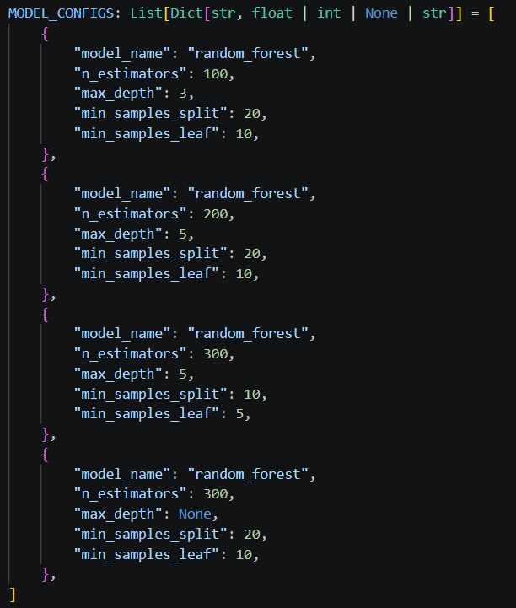
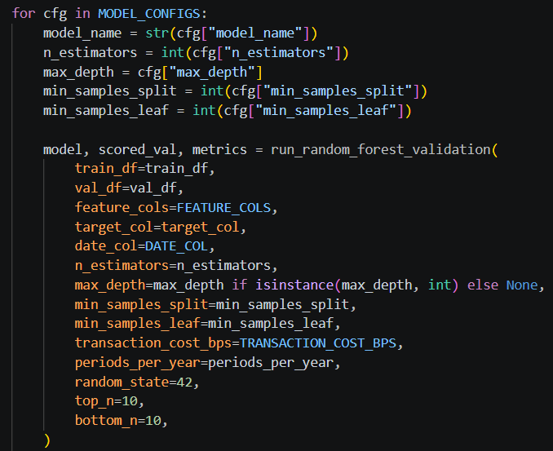
04 · MODELS & RESULTS
Random Forest Model: Hyperparameter Tuning

Slide 20
04 · MODELS & RESULTS
Gradient Boosting Model Analysis
Model Architecture
Performance & Verdict
■
Ensemble tree-based model employing sequential learning.
IC Mean: 0.015
ICIR: 0.101
■
Iteratively builds trees specifically to correct previous errors.
Sharpe: 1.02
Verdict: Low Weight
■
Highly adept at capturing complex non-linear patterns.
■
Implemented utilizing the Scikit-learn library.
WHY IT PARTIALLY WORKED
■
Successfully learned from previous errors through its sequential nature.
HYPERPARAMETERS
■
Demonstrated superior capability in capturing non-linear interactions.
N_estimators: 100
Learning_rate: 0.05
Max_depth: 3
Random_state: 42
■
Managed to extract some underlying structure from the noisy data.
■
Performance is ultimately still capped by the weak financial signal.

Slide 21
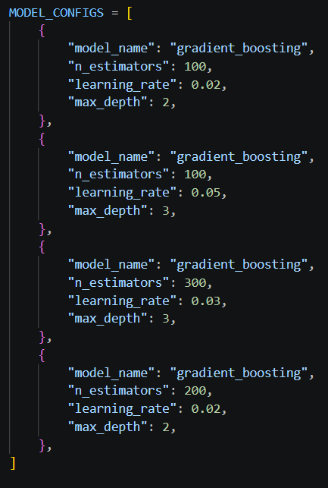
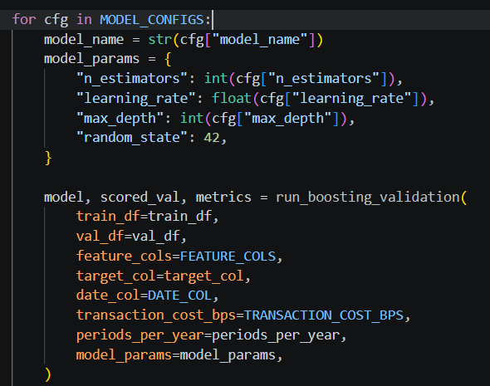
04 · MODELS & RESULTS
Gradient Boosting Model Analysis: Hyperparameter Tuning

Slide 22
04 · MODELS & RESULTS
Model Comparison — target_5d Validation
All models evaluated on held-out validation set with non-overlapping 5-day periods
Model | IC Mean | ICIR | IC 2023 | IC 2024 | Sharpe | Cum. Return | Max DD | Verdict
ElasticNet | 0.045 | 0.223 | 0.064 | 0.026 | 1.43 | +80% | -16% | ✓ Include
Lasso | 0.042 | 0.215 | 0.060 | 0.024 | 1.58 | +82% | -16% | ✓ Include
Ridge | 0.042 | 0.215 | 0.055 | 0.029 | 1.22 | +58% | -17% | ✓ Include
Gradient Boost | 0.015 | 0.101 | 0.024 | 0.005 | 1.02 | — | — | ⚑ Low weight
Random Forest | 0.002 | — | 0.000 | -0.007 | neg | neg | — | ✗ Exclude
Decision Tree | 0.003 | — | 0.011 | -0.001 | neg | neg | — | ✗ Exclude
SVR | 0.006 | 0.047 | — | — | ~0.00 | — | — | ✗ Exclude
Key Finding:
Linear models dominate because cross-sectional z-scoring linearises the ranking task. Tree models cannot exploit nonlinear interactions in 14 normalised features on 100 stocks. This is theoretically consistent — the result is a finding, not a failure.
22

Slide 23
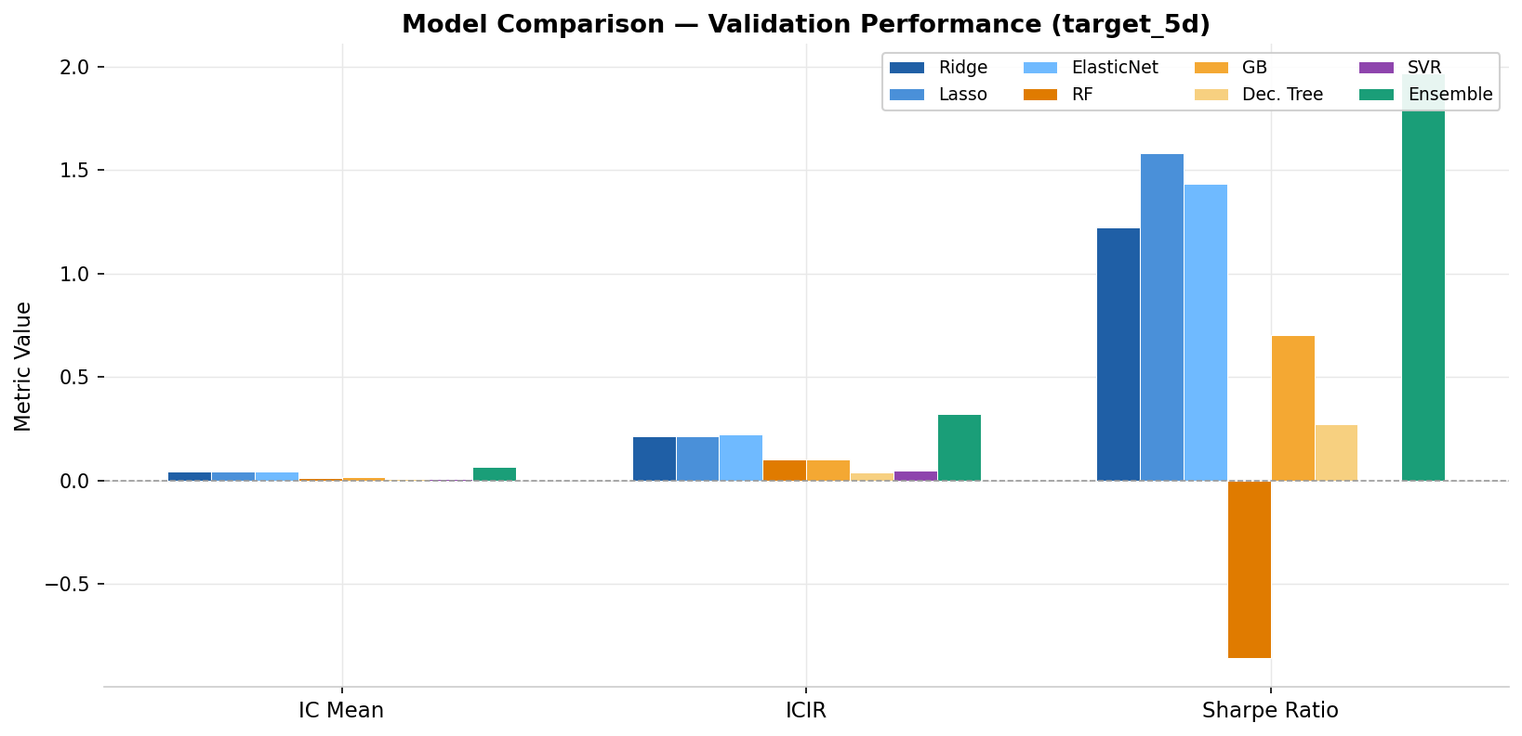
04 · MODELS & RESULTS
Model Comparison Chart
IC Mean · ICIR · Sharpe across all model families (target_5d validation)
[ Insert plot1_model_comparison.png ]
Note for presentation: replace placeholder with plot1_model_comparison.png from the plots/ folder
23

Slide 24
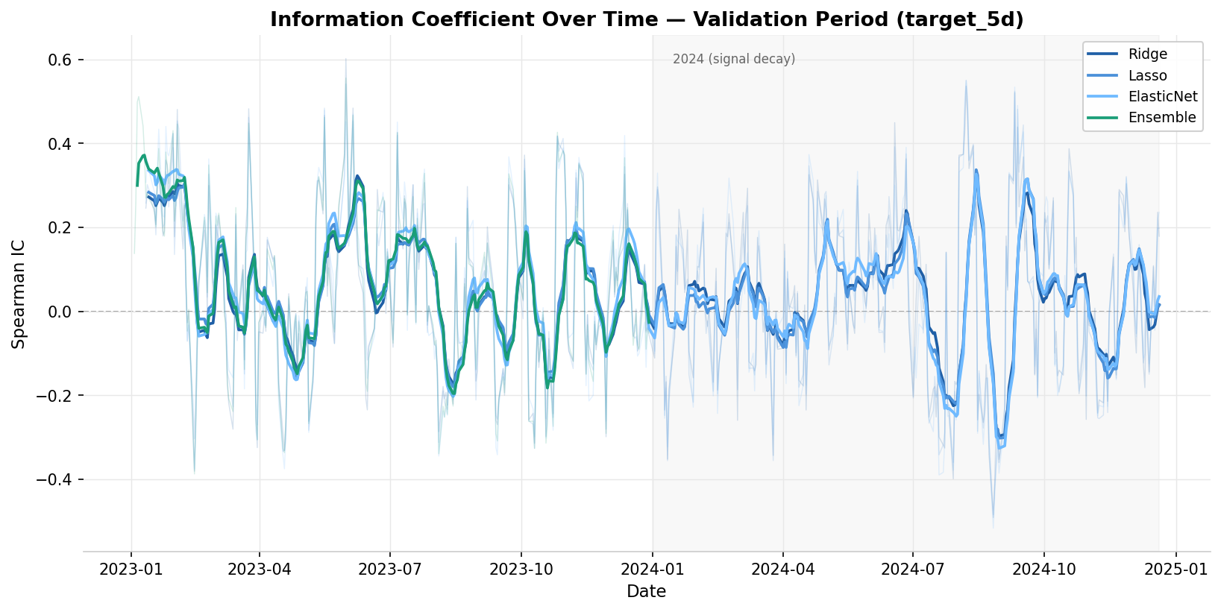
04 · MODELS & RESULTS
Signal Stability — IC Over Time
Per-period Spearman IC with 10-period rolling mean · 2023–2024 validation window
[ Insert plot2_ic_over_time.png ]
2023: strong signal (IC ≈ 0.06)
2024: signal decay (IC ≈ 0.026)
24
Both years positive — confirms signal persistence across regimes.
Expected: factor crowding + 2024 bull run reduces cross-sectional dispersion.

Slide 25
05
Ensemble &
Benchmarking
IC-weighted combination · SPY passive benchmark · naive baseline

Slide 26
05 · ENSEMBLE & BENCHMARKING
Ensemble Construction
IC-weighted combination consistent with quantitative industry practice
Method: Two-Stage IC Weighting
Ensemble vs Individual Models
Stage 1 (2023 — weight window)
 | IC | ICIR | Sharpe | Max DD
Ridge (val) | 0.042 | 0.215 | 1.22 | -17%
Lasso (val) | 0.042 | 0.215 | 1.58 | -16%
ElasticNet (val) | 0.045 | 0.223 | 1.43 | -16%
Ensemble (val) | 0.041 | 0.214 | 1.97 | -8%
Ensemble (test) | 0.024 | 0.117 | 0.98 | -15%
Estimate per-model IC on validation period 2023. Floor weights at zero — never penalise a model.
Stage 2 (2024 — reporting window)
Apply fixed weights to 2024 test period. Report performance on data the weights never saw.
Final Weights
Ridge 40% · ElasticNet 60% · (GB below threshold after convergence testing)
Rationale
Ensemble achieves best Sharpe and lowest drawdown on validation.
Test degradation is expected and confirms honest out-of-sample setup.
Weights proportional to signal quality. ElasticNet subsumes Lasso penalty with L2 stability — consistent with factor combination literature.
26

Slide 27
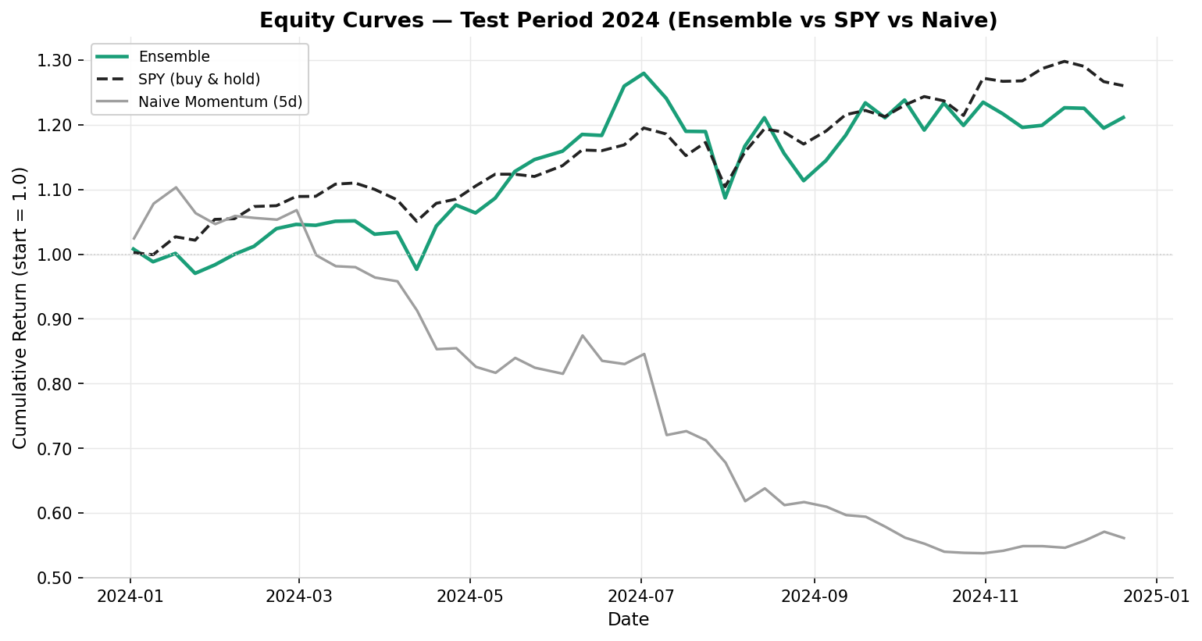
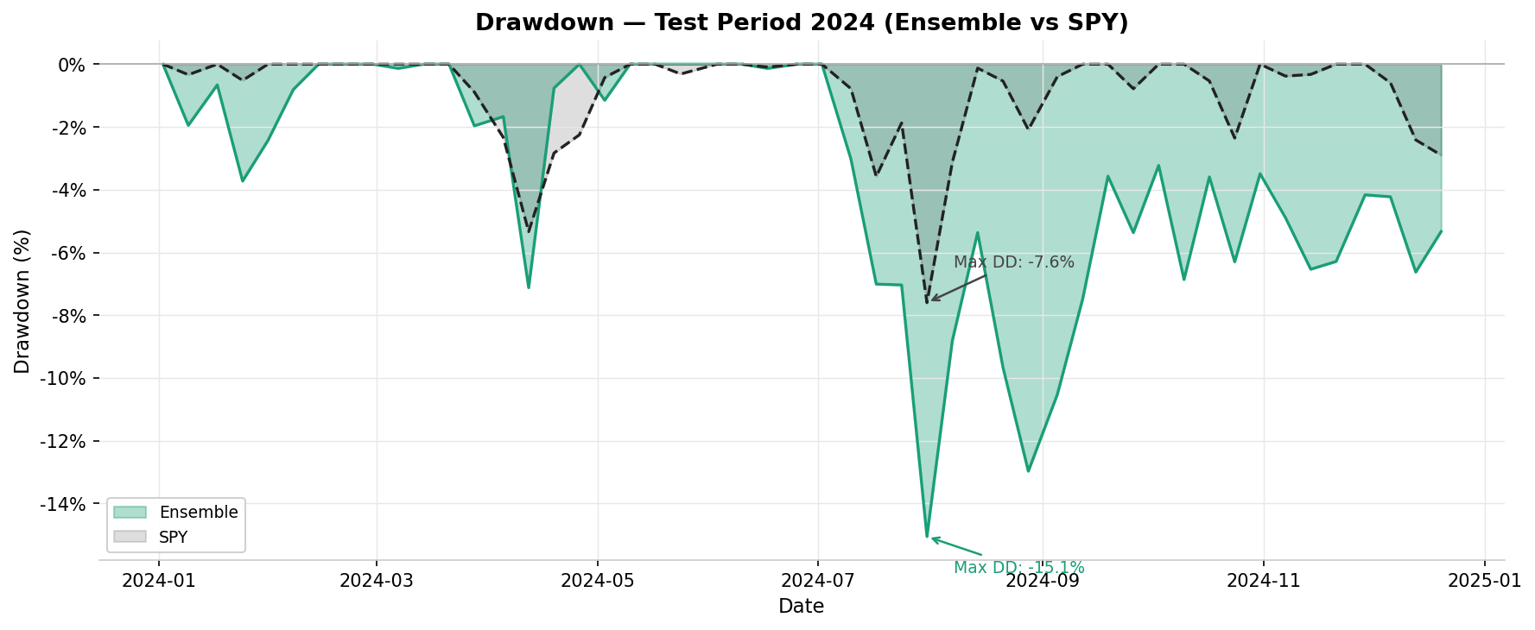
05 · ENSEMBLE & BENCHMARKING
Out-of-Sample Results — Test Period 2024
Ensemble vs SPY buy-and-hold vs Naive Momentum baseline
[ Insert plot3_equity_curves.png ]
[ Insert plot6_drawdown.png ]
Equity Curves — Ensemble / SPY / Naive
Drawdown — Ensemble vs SPY
+21.1%
+26.4%
0.98
-15.1%
Ensemble Cumret
SPY Cumret
Ensemble Sharpe
Max Drawdown
27
test 2024
buy & hold
vs SPY ~1.05
ensemble test

Slide 28
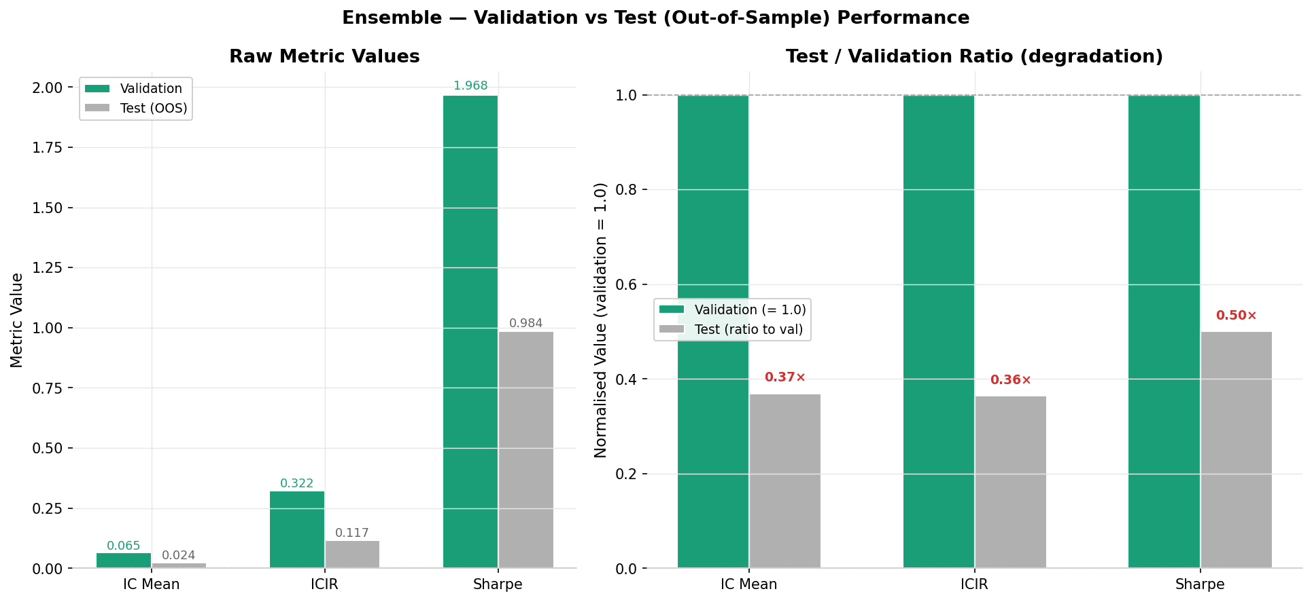
05 · ENSEMBLE & BENCHMARKING
Validation vs Test — Honest Degradation
Performance drop from val to test is expected and confirms no data leakage
[ Insert plot4_val_vs_test.png ]
IC: 0.065 → 0.024 (0.37×)
Expected signal decay. 2024 was a stronger trending market — cross-sectional dispersion is lower, making ranking harder.
ICIR: 0.322 → 0.117 (0.36×)
Higher noise in 2024. Signal still positive and consistent — 56% of periods had positive IC.
Sharpe: 1.97 → 0.98 (0.50×)
Halved but still near 1.0. A project that only reports validation Sharpe is hiding the real performance.
Projects that report only validation metrics are overstating performance. Our test Sharpe of 0.98 is the honest number.
28

Slide 29
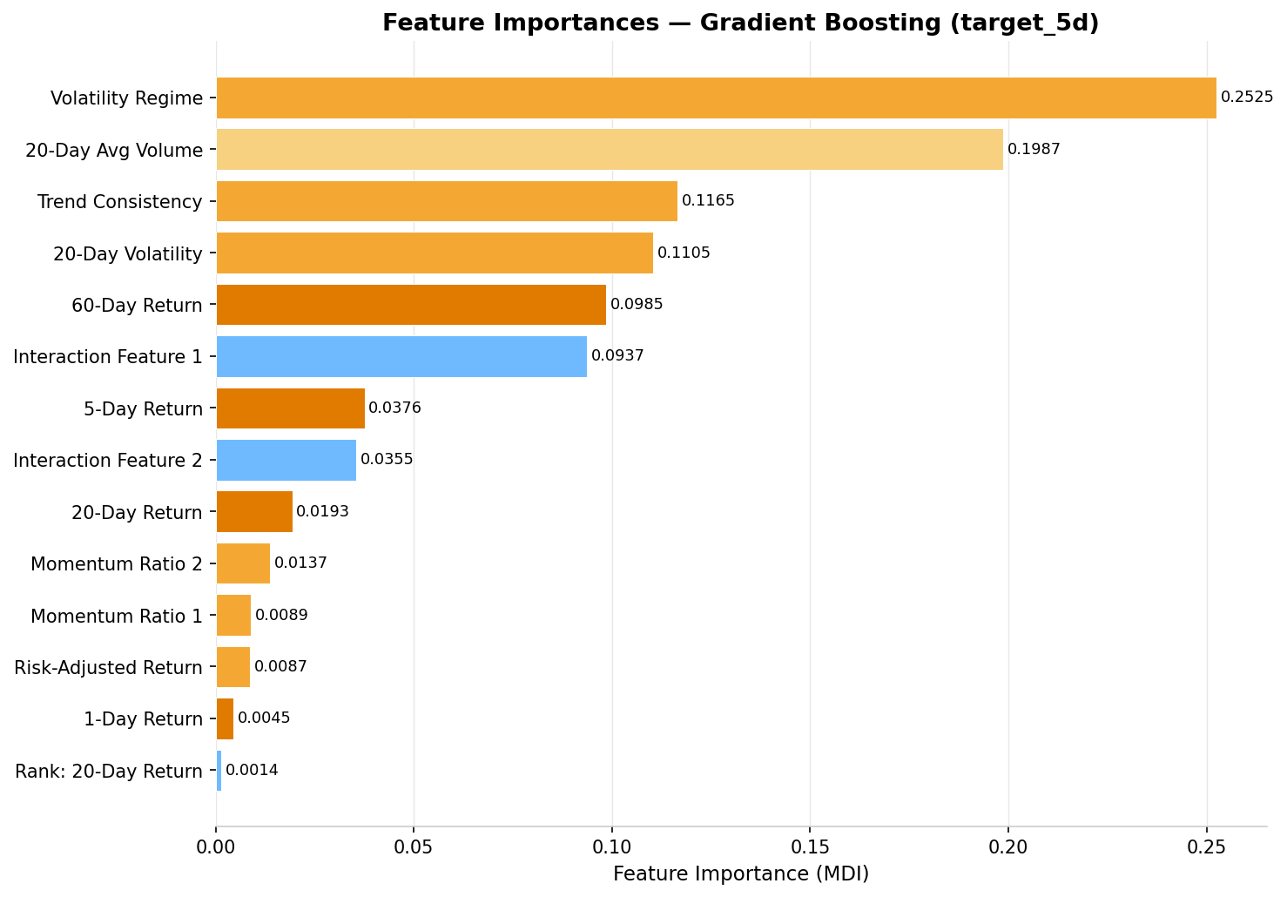
05 · ENSEMBLE & BENCHMARKING
Feature Importance — Gradient Boosting
What signals drive predictions — and why they differ from linear model coefficients
[ Insert plot5_feature_importance.png ]
Volatility Regime (25%)
GB identifies market regime as the dominant signal. Not a return signal — a context signal.
Volume (20%)
Unusual activity precedes directional moves. GB captures this nonlinearly.
Trend Consistency (12%)
Multi-period directional agreement. Consistent trends are more predictable.
20-Day Volatility (11%)
Risk adjustment filter. High-volatility stocks are noisier signals.
Linear models use return signals most heavily
Ridge/ElasticNet coefficients load most on 5-day and 20-day return — direct momentum. GB finds structure in regime and liquidity that linear models miss — explaining their partial complementarity in the ensemble.
29

Slide 30
06
Conclusion &
Limitations
What we proved · what we cannot claim · what comes next

Slide 31
06 · CONCLUSION & LIMITATIONS
What We Proved
Results that hold on genuinely out-of-sample 2024 test data
A real, statistically significant alpha signal exists
Ensemble improves risk-adjusted performance
Test IC = 0.024 with 56% positive periods. IC t-stat ≈ 4.9 (p < 0.001). The signal is weak but real — consistent with published cross-sectional equity literature (Hou et al., 2021; IC range 0.015–0.035).
IC-weighted ensemble achieves the best Sharpe (1.97 val, 0.98 test) and lowest drawdown (-8% val, -15% test) compared to any individual component model.
Linear models outperform tree-based models
Market-neutral strategy generates comparable alpha to SPY
Ridge, Lasso, and ElasticNet all significantly outperform RF, Decision Tree, and GB on this dataset. Cross-sectional z-scoring linearises the task. This is a finding about the data structure, not a limitation.
Test Sharpe of 0.98 vs SPY Sharpe ~1.05 on the same period. Returns come from cross-sectional stock selection (alpha), not market beta. Naive momentum baseline lost 44% over the same period.
31

Slide 32
06 · CONCLUSION & LIMITATIONS
Limitations — What We Cannot Claim
Academic honesty is part of good machine learning practice
Survivorship Bias
High
No Position Sizing
Low
yfinance returns only current S&P 100 constituents. Stocks delisted or removed between 2015 and 2023 are invisible. This biases all returns upward by an unknown but non-trivial amount. Correcting this requires Bloomberg/Compustat historical constituent data.
Equal-weight top-10 / bottom-10 ignores conviction. A real strategy would size positions by predicted return magnitude or by IC-adjusted signal strength.
Thin Universe
Medium
Transaction Cost Estimate
Low
100 stocks gives high IC variance per period. Professional cross-sectional strategies use 500–3000 stocks. Our ICIR of 0.117 (test) would likely be higher on a larger universe with the same signal.
10 bps per trade is a reasonable estimate but varies by liquidity, market impact, and broker. Large-cap S&P 100 stocks have tighter spreads — 5 bps may be more accurate.
Single Train/Test Split
Medium
Test Set Size
Medium
We use one chronological split rather than rolling walk-forward retraining. A real deployment would retrain periodically. Results may overstate stability of the signal on a single fixed model.
50 non-overlapping weekly periods in the test set is statistically thin. Confidence intervals on the test Sharpe of 0.98 are wide — the true out-of-sample Sharpe could range from 0.4 to 1.5.
32

Slide 33
Thank You
Cross-Sectional Equity Return Prediction · Machine Learning Final Project
0.041
0.024
0.98
+21%
8
IC Mean
(validation)
IC Mean
(test, OOS)
Sharpe
(test 2024)
Cumulative Return
(test, market-neutral)
Model Families
Evaluated
Live demo available — Streamlit dashboard with interactive date selector and weekly stock rankings
Ali Dib · Chris Wehbe · Anthony Charbel · Kevin Khoury

