Slide 1
ARPF-TI: Enhancing Network Security Through AI-Driven Threat Intelligence Integration
Your Name

Slide 2
ARPF-TI: Enhancing Network Security Through AI-Driven Threat Intelligence Integration

Slide 3
Presentation Overview
The Challenge of Modern Network Security
ARPF-TI Framework Overview
System Architecture
AI Implementation
Threat Intelligence Integration
Evaluation Methodology
Key Results
Practical Implications
Future Directions

Slide 4
The Challenge of Modern Network Security
Traditional firewalls are increasingly insufficient against:
Advanced persistent threats
Zero-day exploits
Application-layer attacks
Security teams face:
Increasing attack sophistication
Alert fatigue
Resource constraints
Rapid response requirements

Slide 5
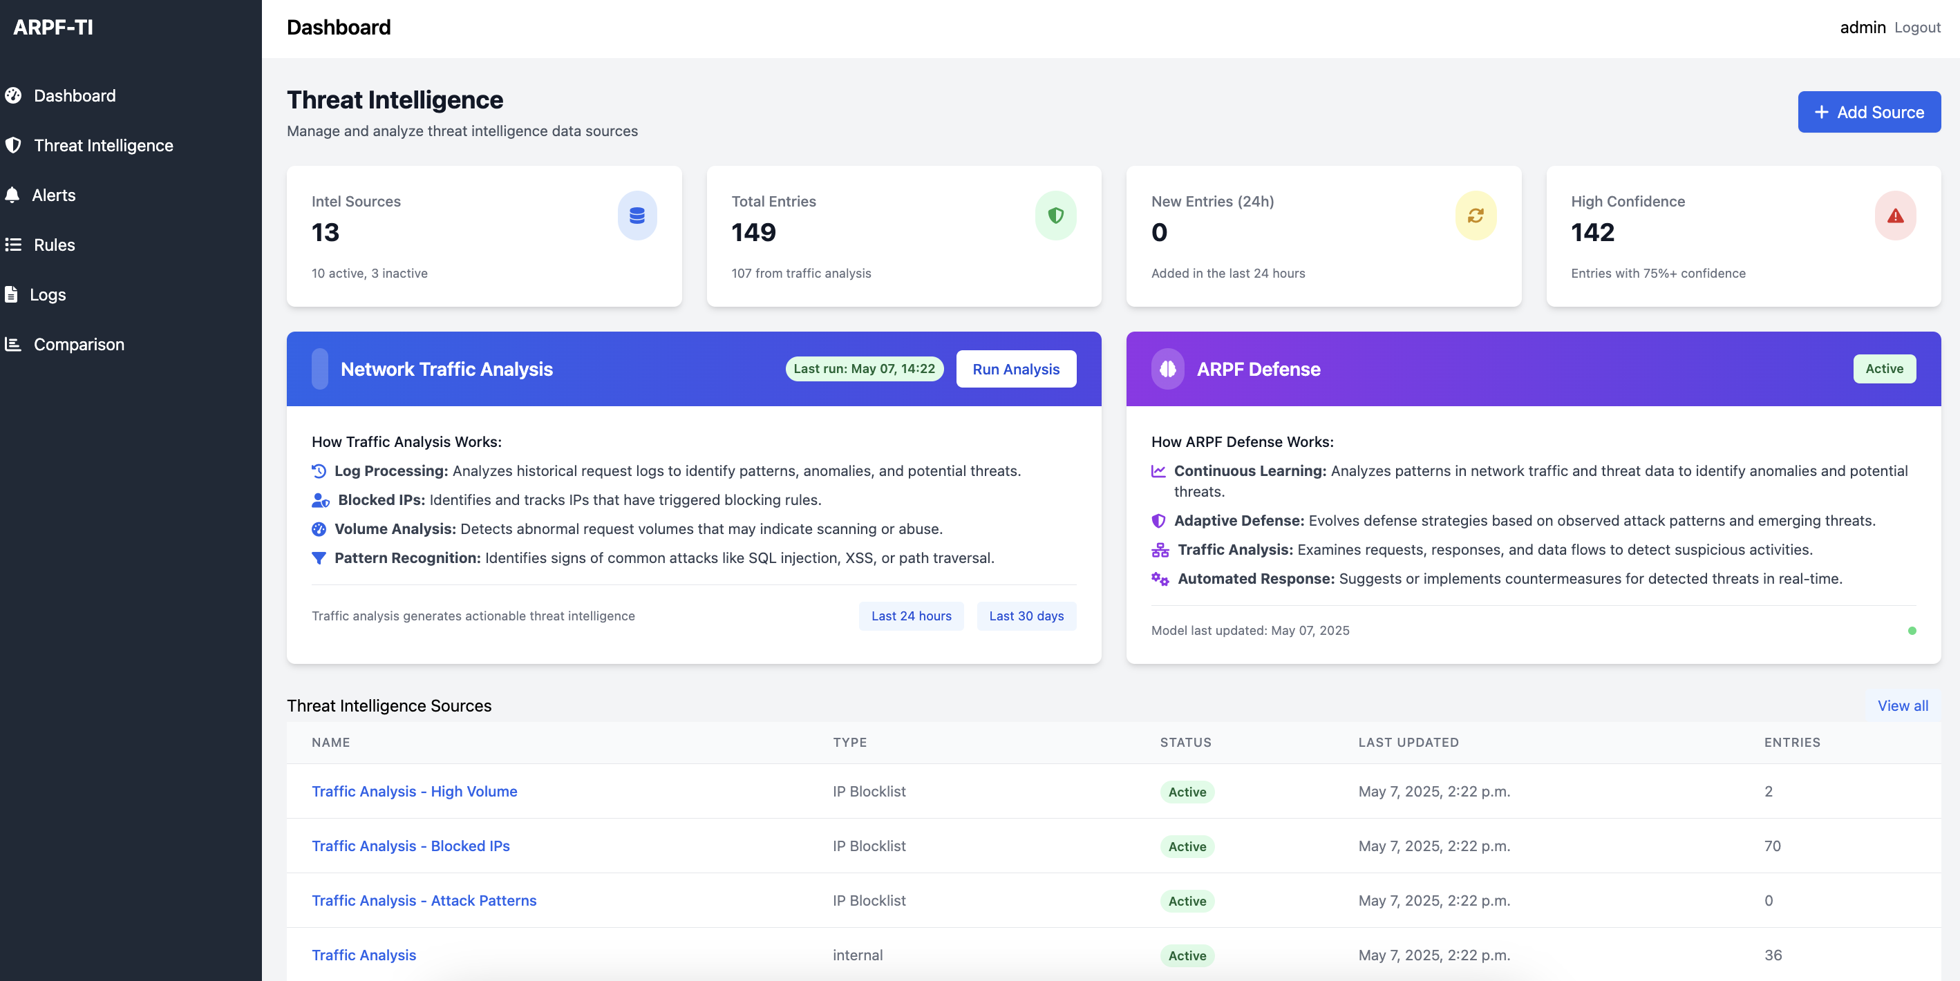
ARPF-TI Framework Overview
Advanced Rule-based Protection Framework with Threat Intelligence
Next-generation firewall solution integrating:
AI-powered threat analysis
Real-time traffic anomaly detection
Comprehensive threat intelligence
Automated rule generation and response
Open-source implementation adaptable for various security needs
Threat Intelligence Dashboard

Slide 6
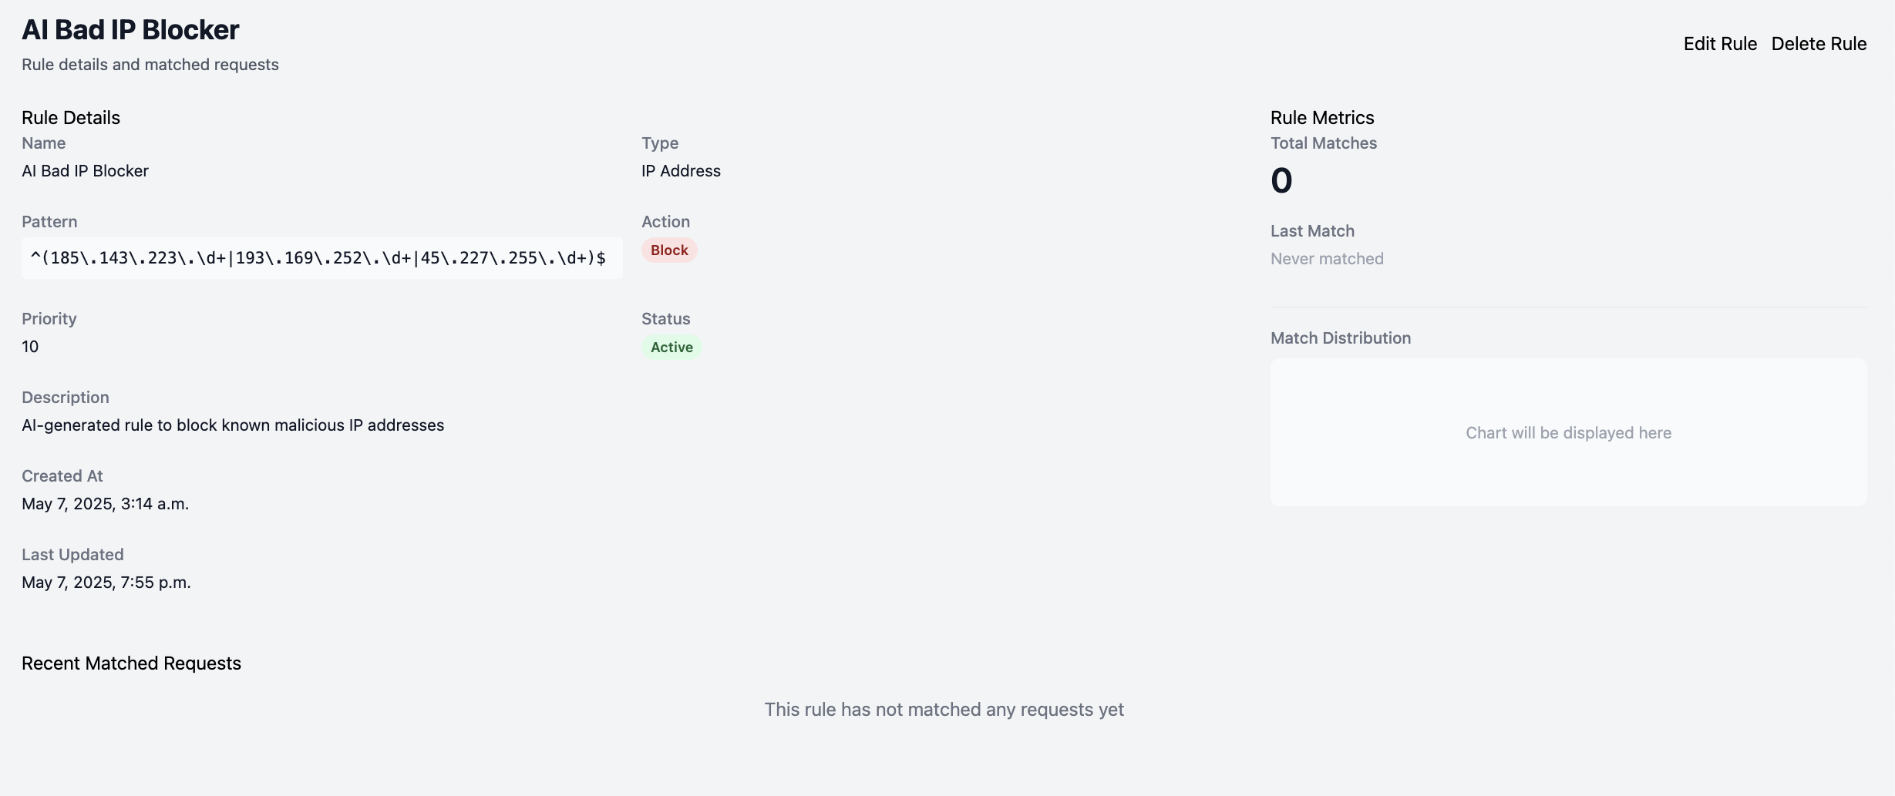
System Architecture
Six Key Components:
Core Processing Engine
Threat Intelligence Module
AI Analysis System
Alert Management System
Dashboard and Analytics
Comparison Framework
Implemented as a Django-based web application
Firewall Rules Interface

Slide 7
AI Implementation
Model | Deployment | Primary Use | Integration
Google Gemini | Cloud API | Rule generation, Pattern analysis | REST API
TinyLlama (1.1B) | Local | Offline analysis | Local inference
Dual AI Model Approach:

Slide 8
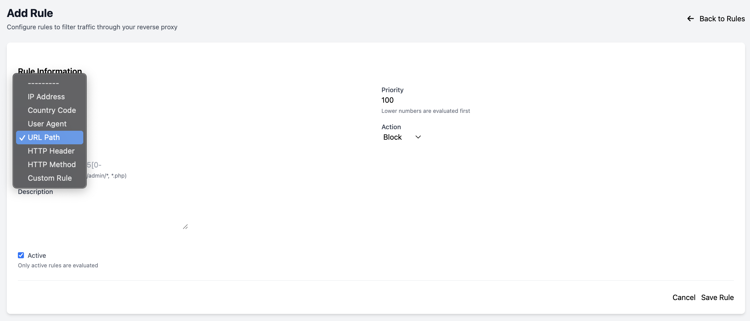
Confidence scoring for each rule suggestion
Continuous feedback loop for improvement
Human-in-the-loop verification
Adding Firewall Rules

Slide 9
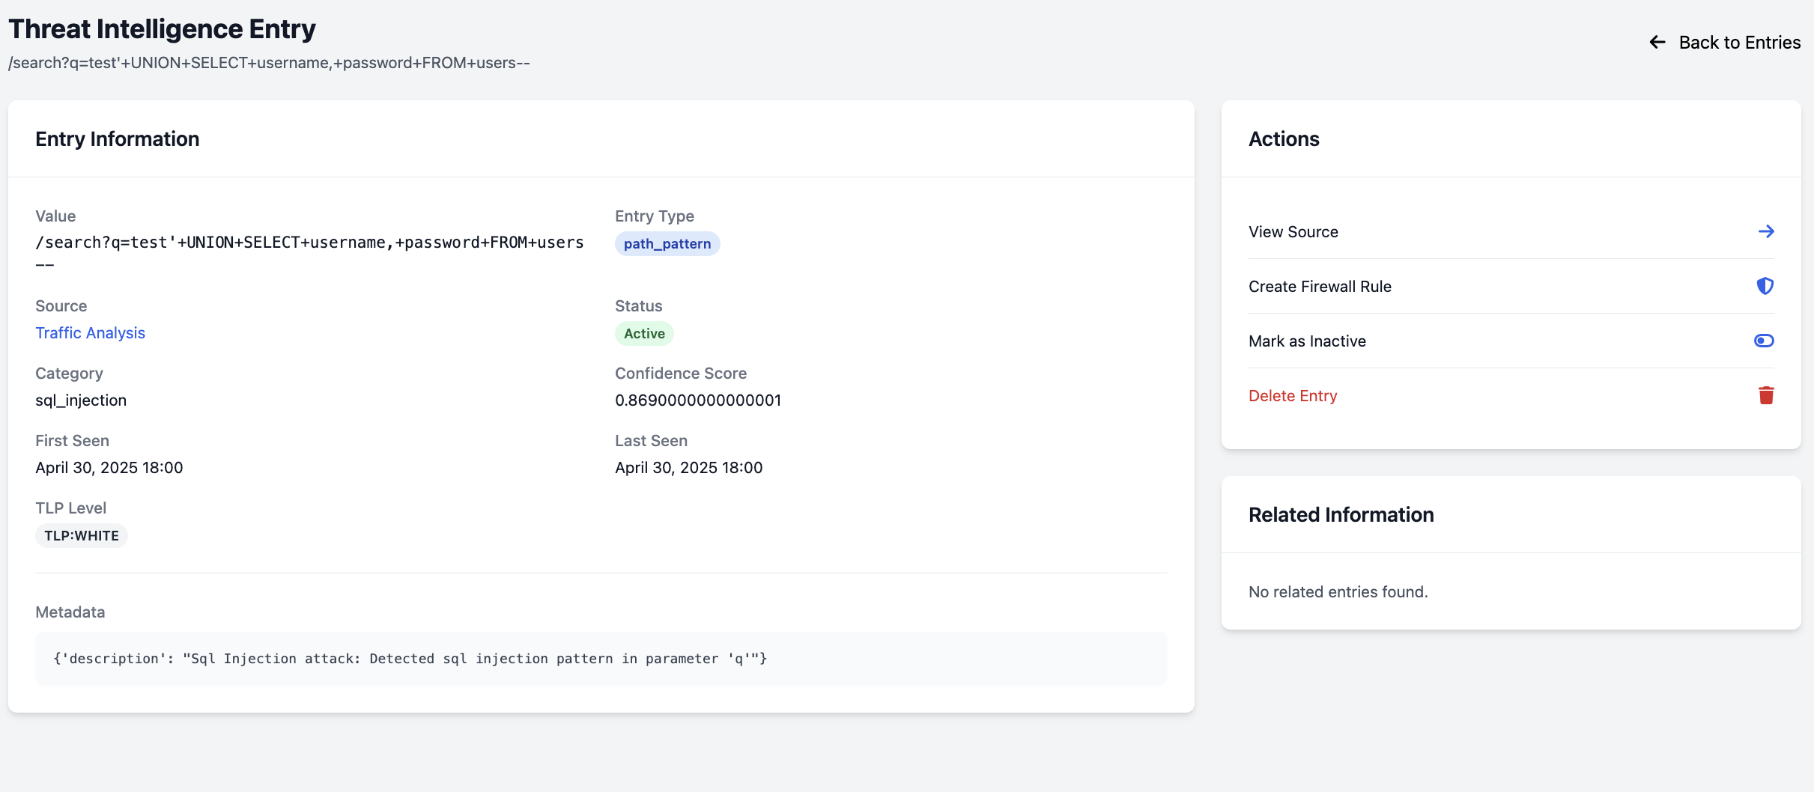
Threat Intelligence Integration
Multiple Intelligence Sources:
MISP (Malware Information Sharing Platform)
TAXII/STIX feeds
AlienVault OTX
Abuse.ch URLhaus
PhishTank
Emerging Threats Community
Threat Intelligence Entry

Slide 10
Evaluation Methodology
Comprehensive Testing Approach:
10-day evaluation period
6,000+ simulated requests
2875 attack attempts across multiple vectors
Test environment utilizing /tests/ scripts:
simulate_attacks.py
generate_traffic_data.py
Comparison framework evaluating AI vs. manual rules

Slide 11
Key Results: Rule Generation
AI system generated 94 rules vs. 12 manual rules
AI rules identified more subtle patterns
Generated more specific rules for various attack vectors

Slide 12
Key Results: Performance Metrics
Metric | AI Rules | Manual Rules | Improvement
Precision Rate | 89.2% | 71.5% | 17.7%
True Positives | 267 | 184 | 45.1%
False Positives | 33 | 74 | 55.4% reduction
Avg. Response Time | 35.7 min | 42.8 min | 16.6% reduction

Slide 13
Key Results: Attack Type Effectiveness
AI rules consistently outperformed manual rules across all attack vectors:
SQL Injection: 89% vs. 60%
XSS Attacks: 92% vs. 55%
Command Injection: 91% vs. 68%
Path Traversal: 86% vs. 63%

Slide 14
Reasons for AI Performance Advantage
Pattern Recognition Capability: Identifies subtle patterns across large datasets
Adaptability: Continuously learns from new data and feedback
Specificity: More targeted rules for specific attack variants
Consistency: Uniform analysis methodology across all traffic

Slide 15
Practical Implications
Reduced Alert Fatigue: 55% fewer false positives
Faster Response: 16.6% reduction in time to implementation
Improved Security Posture: Higher detection rates for sophisticated attacks
Resource Optimization: Security teams can focus on verified threats

Slide 16
Limitations
Training Data Dependency: System effectiveness tied to training data quality
Computational Requirements: Higher resource needs than traditional systems
Explainability Challenges: Complex AI patterns may be difficult to interpret
Test Environment Constraints: Controlled testing may not fully represent real-world complexity

Slide 17
Future Directions
Hybrid Approaches: Optimal combinations of AI and human-created rules
Explainable AI: Enhance understanding of AI-generated rules
Adversarial Resilience: Strengthen against evasion techniques
Resource Optimization: More efficient AI implementations
Cross-Organizational Learning: Federated learning for collective intelligence

Slide 18
Conclusion
ARPF-TI significantly outperforms traditional rule-based approaches
17.7% higher precision
45% more true positives
55% fewer false positives
Framework provides foundation for future AI-enhanced security systems
Open-source implementation available for adaptation and extension

Slide 19
Thank You & Questions
Contact Information: - Email: dkhanal239202@troy.edu | bawasthi@troy.edu - GitHub: github.com/yourusername/ARPF-TI

