Slide 1
Telecom Customer Churn Prediction
By
DIBENDU SAHA

Slide 2
Dataset Overview

Slide 3
Data Manipulation
Replacing the data “No Internet Service” from columns like 'OnlineSecurity', 'OnlineBackup', 'DeviceProtection', TechSupport','StreamingTV', 'StreamingMovies‘ with “No”

Slide 4
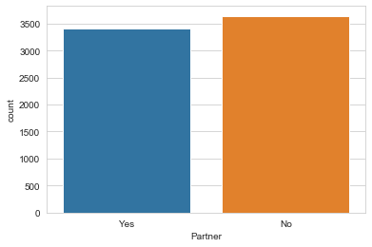
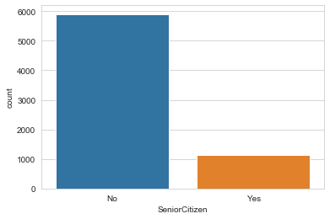
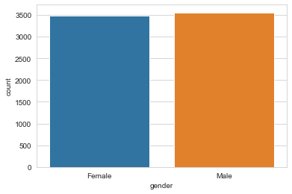
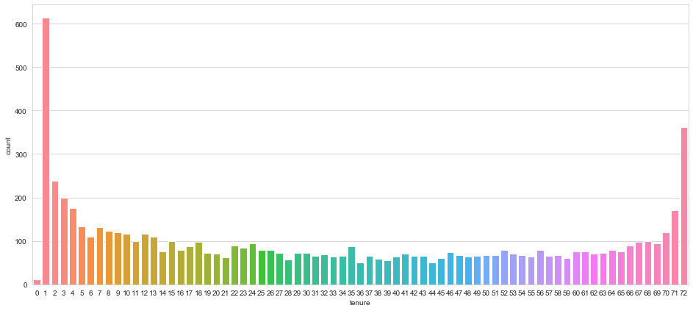
Data Analysis

Slide 5
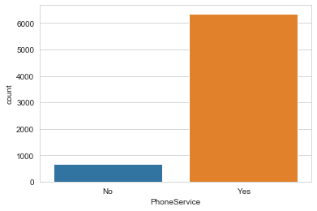
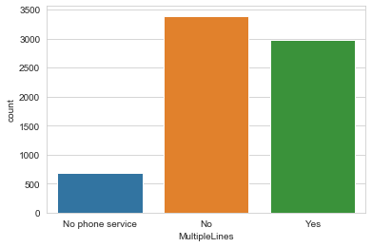
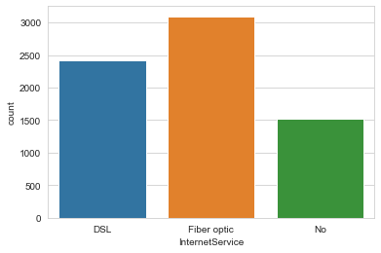
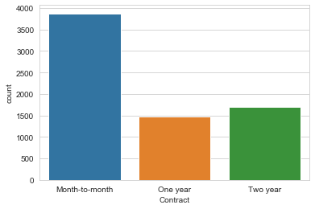
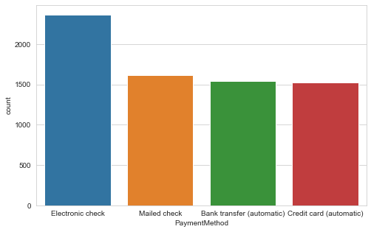
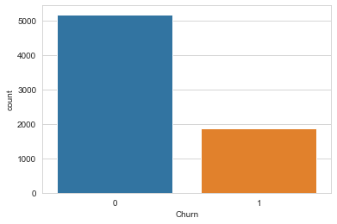
Data Analysis
Target Variable

Slide 6
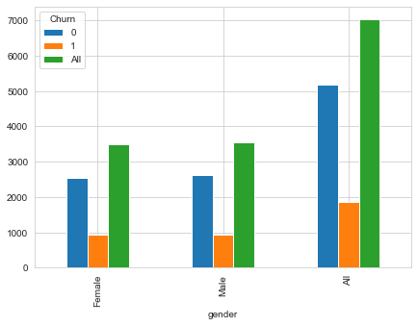
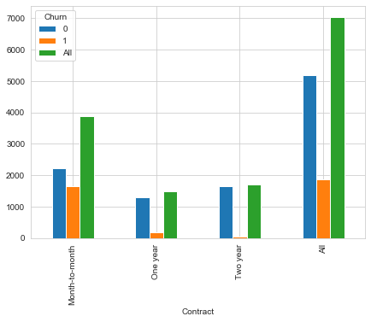
Data Analysis w.r.t Target Variable

Slide 7
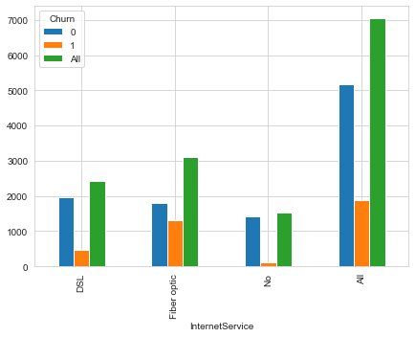
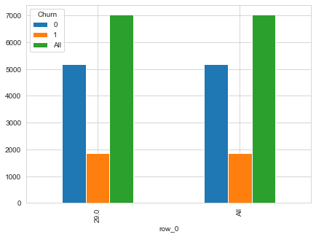
Data Analysis w.r.t Target Variable

Slide 8
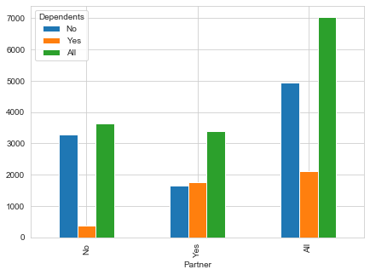
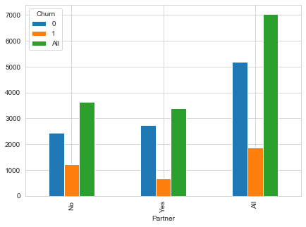
Data Analysis w.r.t Target Variable

Slide 9
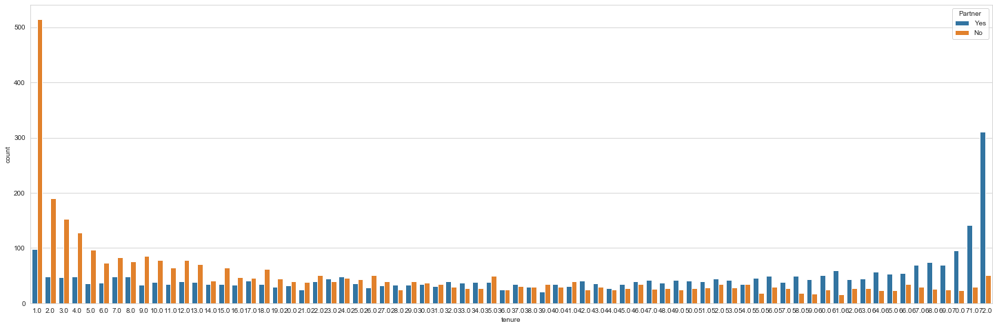
Data Analysis w.r.t Target Variable
Impact of partner on Tenure

Slide 10
Data Separation And Statistical Details

Slide 11
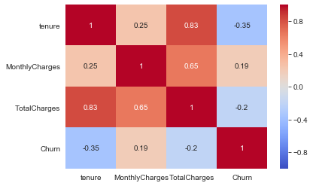
Correlation Matrix

Slide 12
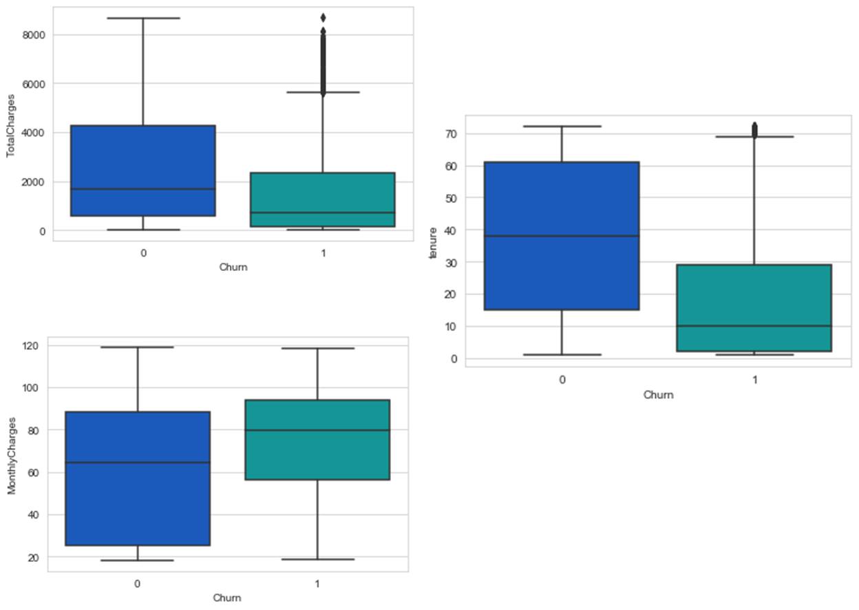
Outliers

Slide 13
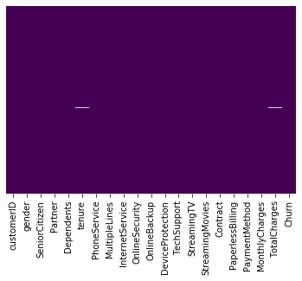
Missing Values And Pre-processing
Replacing spaces with null values in “TotalCharges” column.
Replacing 0 with null values in “tenure” column.
Dropping null values from “TotalCharges” and “tenure” columns which contain .15% missing data.

Slide 14
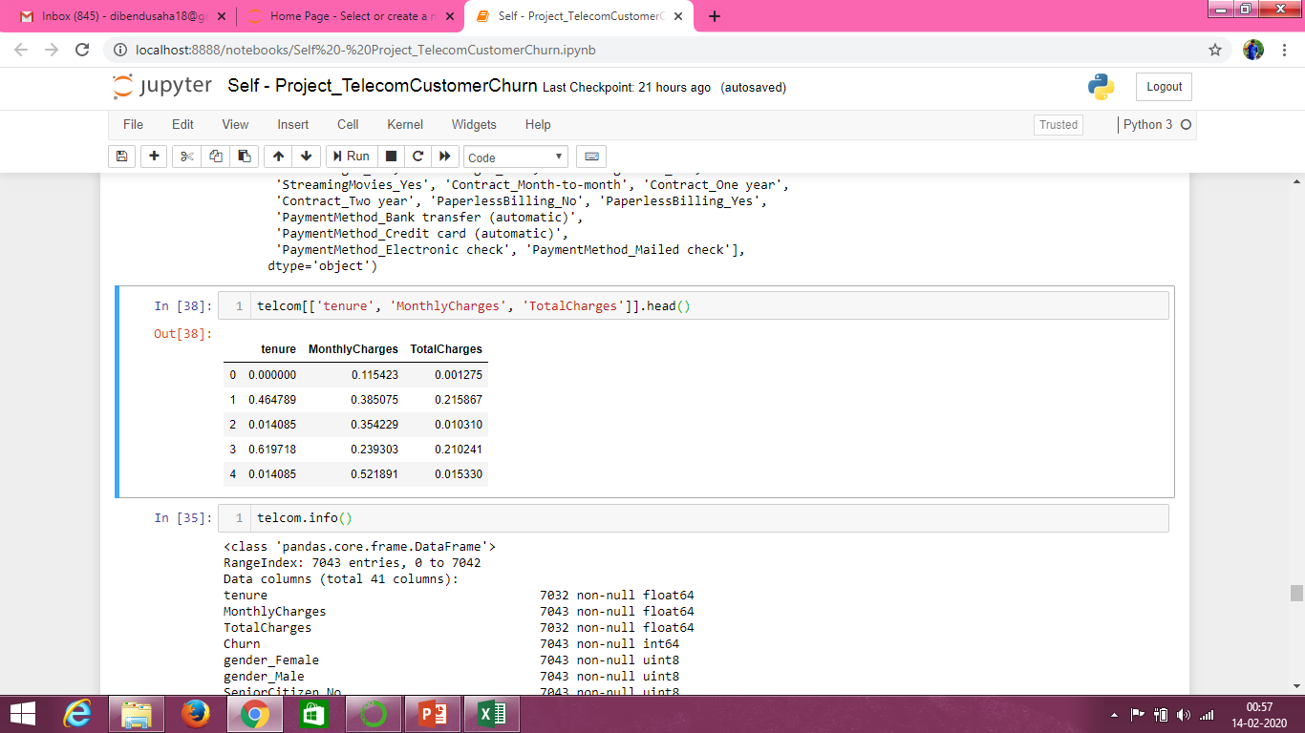
Scaling And Standardization
Standardizing the numerical columns['tenure', 'MonthlyCharges', 'TotalCharges']
Converting all the categorical columns to numerical and getting it ready for modelling.

Slide 15
Data Selection for Modelling
We’ll be using the following data for modelling:-

Slide 16
Modelling & Accuracy Matrix
Validating the Logistic Regression model.

Slide 17
Modelling & Accuracy Matrix
Validating the Random Forest Classifier model.
max_depth = 5, n_jobs = 5, n_estimators = 500
max_depth = 5, n_jobs = 5, n_estimators = 500
So, from the above two matrices we can see that there is not much difference between the criterions.

Slide 18
Modelling & Accuracy Matrix
Validating the Decision Tree model.
max_depth = 7
max_depth = 5
So, from the above two matrices we can see that the Decision_Tree_GINI matrix is slightly better than the Decision_Tree_ENTROPY matrix.

Slide 19
Conclusion
Out of the above models, Random Forest and Logistic Regression model best suits the business case. Both the models are almost similar w.r.t each other. The accuracy for both the models are almost same i.e., 80%. The only difference between there performance is, RF is able to correctly predict 45% of the customer to be churned as true and LR is able to correctly predict 55% of the customer to be churned as true, but also with the false out ratio of 8% and 10% respectively. That means apart from predicting 45% and 55% correctly it is also predicting incorrectly for some 8% and 10% customer as churned (which is not true).

Slide 20
Thank You!!

