Slide 1
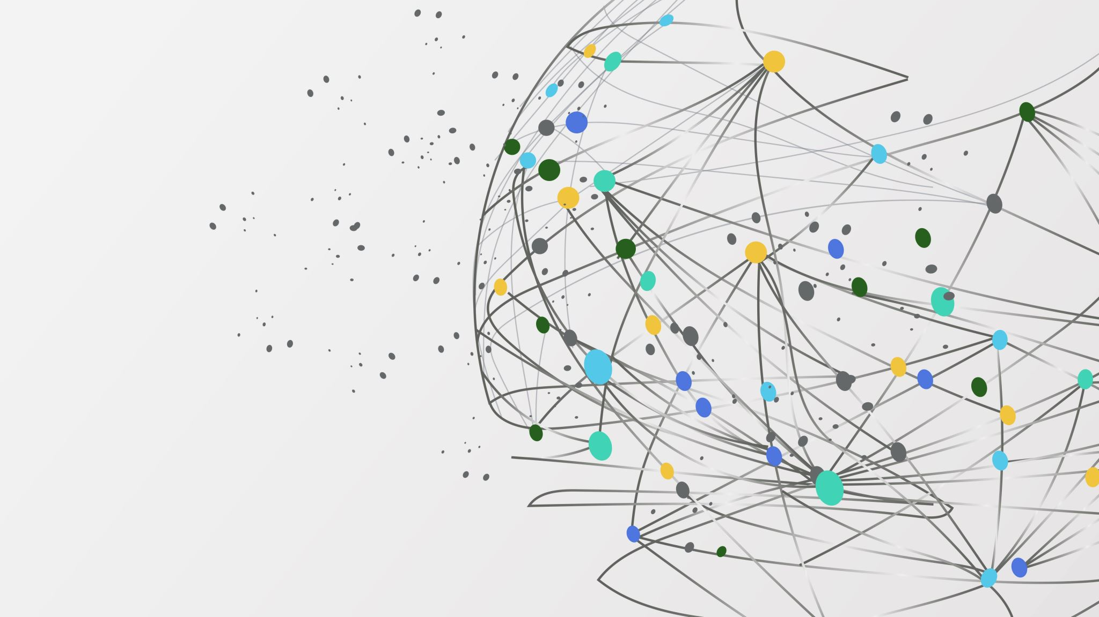
Beauty product sentiment analysis and Recommendation Based on User Behaviour
Presented by
Dibya Pandey
Capstone Project
Dr.Muhammad Ali Yusuf

Slide 2
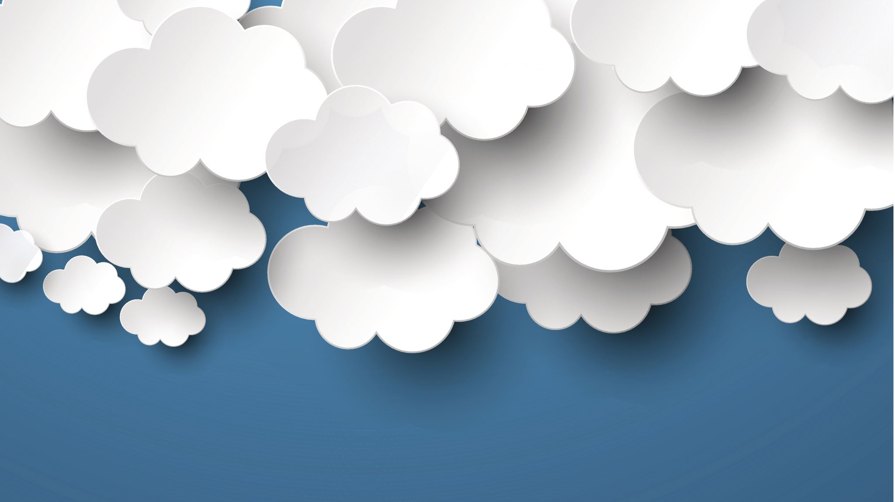
OBJECTIVE
Demonstrate the value of NLP techniques for accelerating discovery and comprehension in beauty products
Provide high-level condensed summaries and a granular analytical understanding of the beauty products by implementing extractive text summarization
Perform contextual analysis to identify sentiments, entities, relationships, and topics
Use visualizations like word clouds and knowledge graphs to reveal linguistic patterns
Apply hierarchical clustering to uncover thematic structures
Build predictive models to predict the sentiment of the user preferences product.
Recommendation of the product on the basis of user behaviour

Slide 3

WHY PRODUCT
RECOMMENDATION
?
Personalized product recommendations significantly increase conversion rates, directly impacting revenue growth.
Tailored suggestions foster a sense of value and understanding, driving repeat purchases and building enduring customer loyalty.
Cross-selling and upselling strategies, facilitated by recommendations, elevate the average order value, maximizing revenue potential.
Recommendations streamline the shopping experience, saving time and simplifying choices for customers.
Precision in suggestions based on individual preferences enhances satisfaction and boosts engagement, making the shopping journey more enjoyable.

Slide 4
WHY TEXT SUMMARIZATION
?
Massive explosion of online content makes manually reading everything inefficient
Summarization distills key ideas and salient points from long documents
Saves time and effort compared to reading full documents
Eliminates biases that exist in surveys, focus groups, interviews
Provides unbiased, objective summaries by digesting data from diverse sources
Applicable across many professional domains and document types

Slide 5
WHY BEAUTY
PRODUCTS?
Analyzing sentiments from beauty product reviews reveals consumer emotions and preferences.
Personal tastes and varied skin types drive unique beauty product preferences, enabling tailored recommendations.
Sentiments in reviews heavily influence purchasing choices and brand perception in the beauty industry.
Sentiment analysis guides businesses in adapting to rapidly changing beauty trends for better recommendations.
Understanding sentiment towards beauty brands aids in brand strategies, while personalized recommendations boost customer satisfaction.

Slide 6

ABOUT THE DATA
Information on over 8,000 beauty products from Sephora, encompassing prices, brands, ingredients, and ratings.
Compilation of more than 1 million user reviews, specifically centered around Skincare products.
Collected using a Python scraper in March 2023, ensuring recent and comprehensive data.
Provides a comprehensive view of beauty products and a significant volume of skincare reviews.
Valuable for in-depth analyses and market assessments within the beauty industry due to its extensive product information and abundant user reviews, particularly in the skincare category.

Slide 7
METHODOLOGY
Product Recommendation
Text Summarization
Sentiment Analysis
Named Entity Recognition (NER)
Topic Modeling
Word Frequency analysis
Word Embeddings and word cloud
Knowledge Graph
Hierarchical Clustering
Predictive Analysis
Cosine Similarity

Slide 8
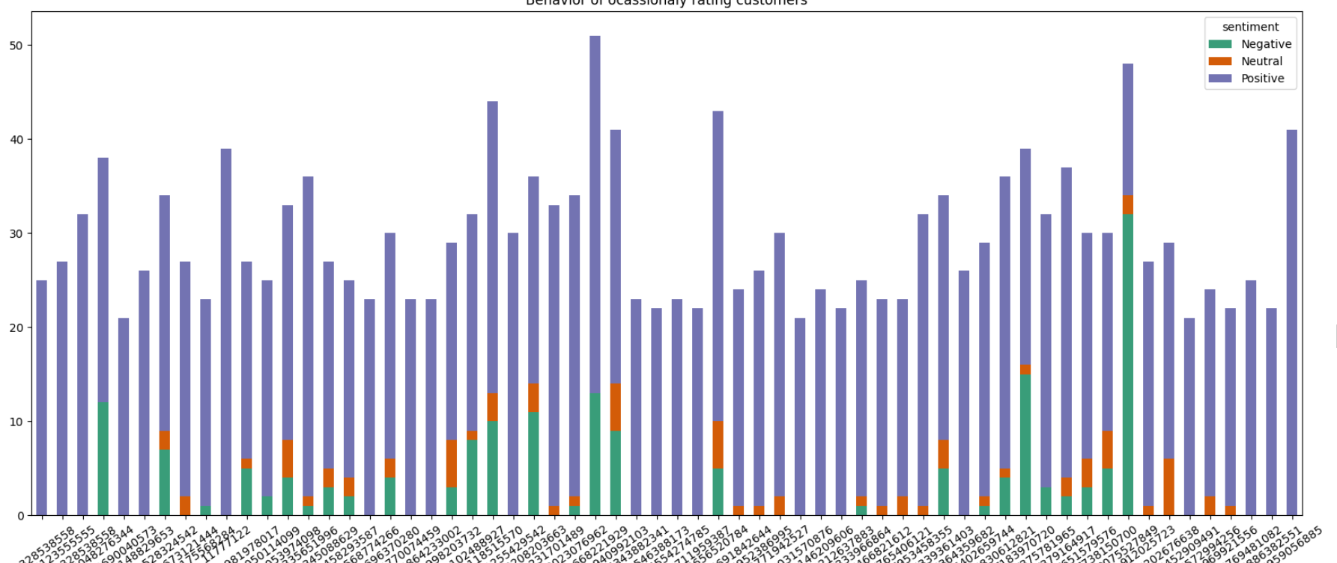
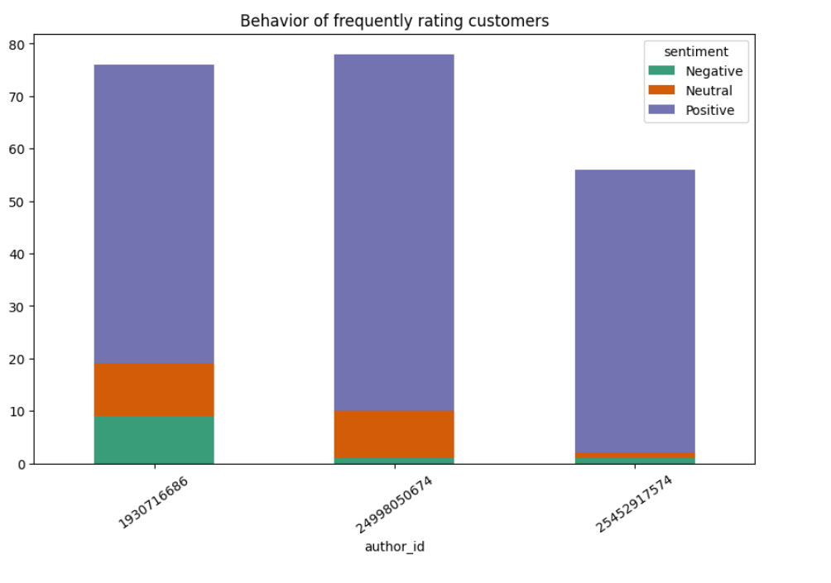
Some EDA

Slide 9
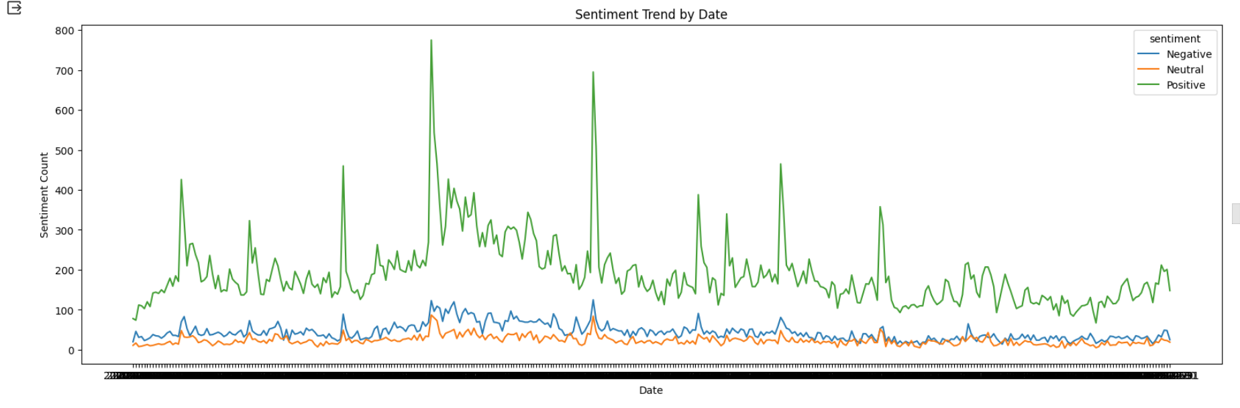

Slide 10
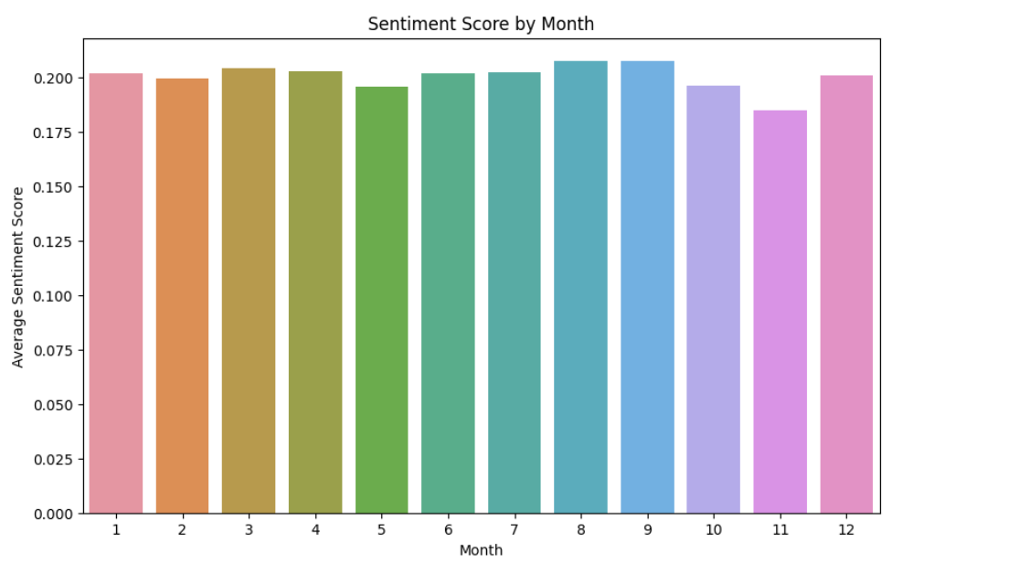

Slide 11
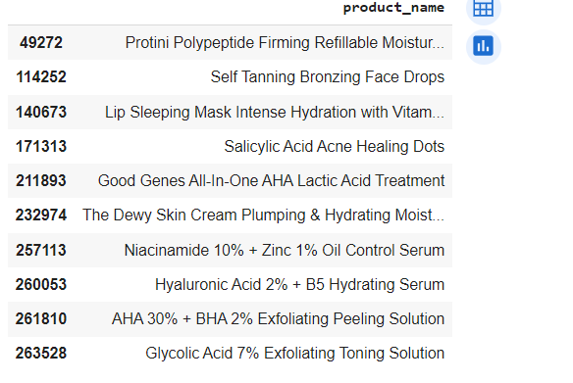
Product recommendation on home page of new customers

Slide 12
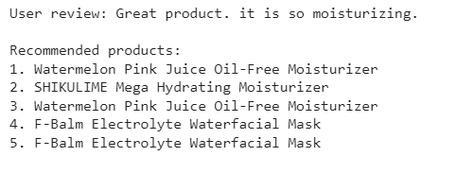
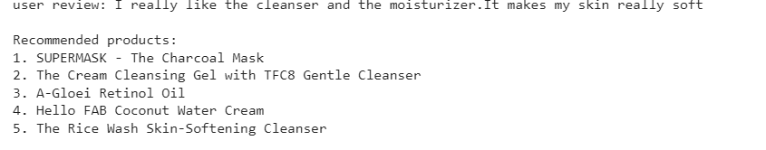
Product Recommendation for existing users

Slide 13
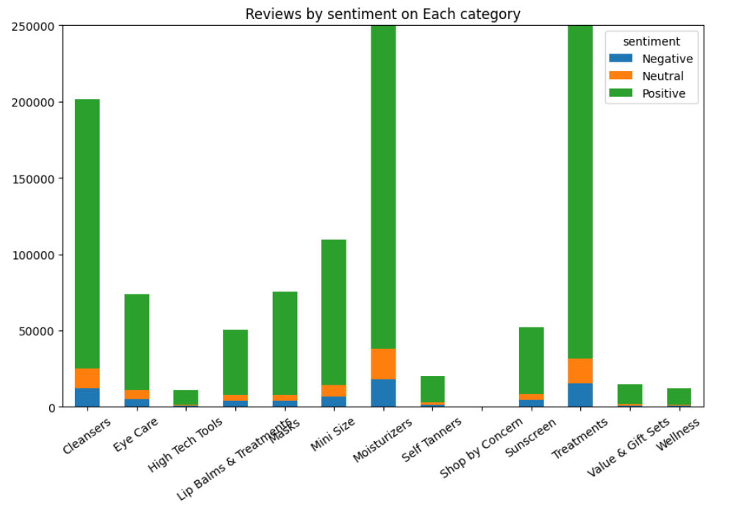
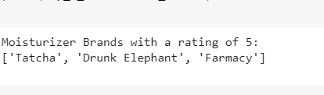
Categories with their sentiments

Slide 14
 | Tatcha | Farmacy | Drunk Elephant
Sentiment Analysis | {{'neg': 0.067, 'neu': 0.356, 'pos': 0.578, 'compound': 0.0258} Subjectivity: 0.479284474206349 The text is more objective. | {'neg': 0.114, 'neu': 0.295, 'pos': 0.591, 'compound': -0.9463} Subjectivity: 0.38706589706589706 The text is more objective. | {'neg': 0.143, 'neu': 0.31, 'pos': 0.548, 'compound': 0.9543} Subjectivity: 0.3870967741935484 The text is more objective.
Percentages Of Sentiment | The percentage of positive sentiment is 57.8% The percentage of neutral sentiment is 35.6% The percentage of negative sentiment is 6.7% | The percentage of positive sentiment is 59.1% The percentage of neutral sentiment is 29.5% The percentage of negative sentiment is 11.4% | The percentage of positive sentiment is 54.8% The percentage of neutral sentiment is 88.2% The percentage of negative sentiment is 14.3%
Named Entities | 25 percent - PERCENT Japanese - NORP Chanel - ORG | Curel - PERSON about 2 months - DATE Cali - GPE Greens - NORP | the day - DATE 1.69 - CARDINAL 4 months - DATE first - ORDINAL
Topic Modeling | Topic 1: buying, complexion, money, love, results, expensive, oily, started, soft Topic 2: smaller, face, feel, like, known,recommend, does,nights Topic 3: annoying, rash, directly, prone, face, loved, difference,sure | Topic 1: dry, weird,moisturizers, face,new, zone,acne, seeing,got,patches,everyday,moisturizer Topic 2: try,really,tried,greasy,lot,texturized,does,results Topic 3: mad,weird,super,lucky,like,skin,stick,fore,cali,disappear,glow,try | Topic 1: improvement,expected,floz,pores,clarity,thicker,im,decent,sink,works Topic 2: pairing,takes,shiny,change,appearance,inside,feelingmeh,lie Topic : cover,enjoy,skeptical,ingredients,realized,purchase,soft,spend
Word Frequency Analysis | ‘skin (9) product (6) use (6) face (5) | skin (8) like (6) oily (5) | moisturizer (3) definitely (2) sensitive (2)
Cosine Similarity | For Tatcha and Drunk Elephant : 0.5239151678462538 For Tatcha andFarmacy:0.491527210203696 For Farmacy and Drunk Elephant:0.595662096899911
Predictive Analysis | Accuracy: 0.88 Precision: 0.91 Recall: 0.88 F1 Score: 0.91 | Accuracy: 1 Precision: 1 Recall: 1 F1 Score: 1 |  | Accuracy: 1 Precision: 1 Recall: 1 F1 Score: 1

Slide 15
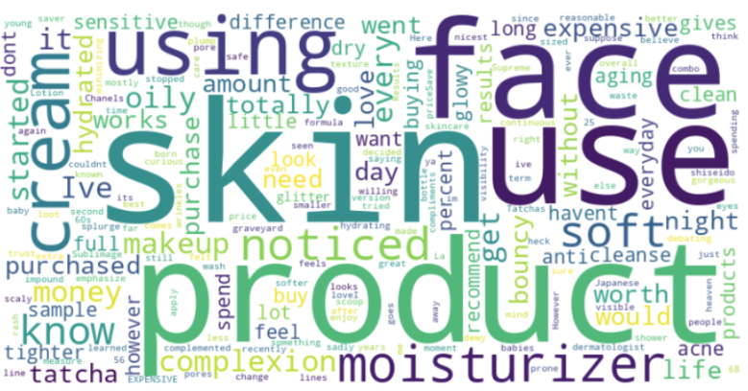
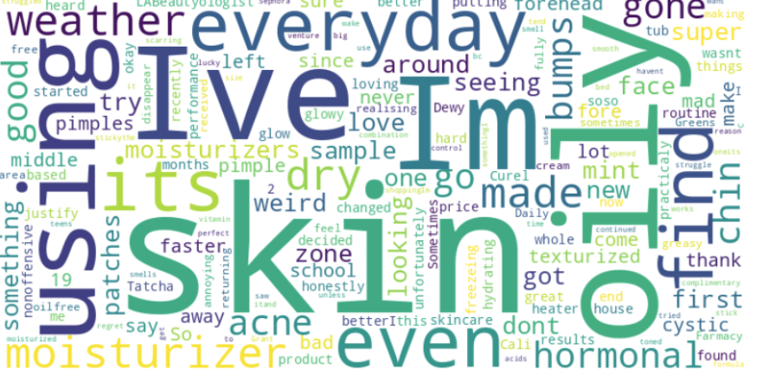
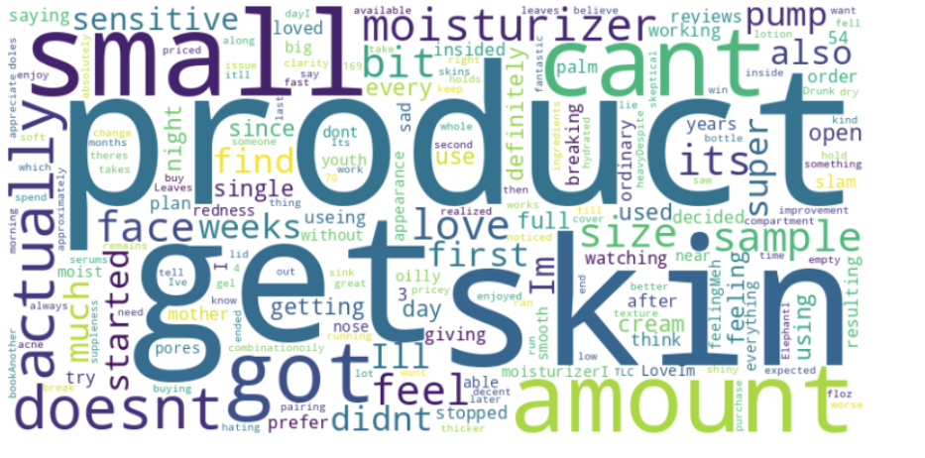
WORD CLOUD
Tatcha
Farmacy
Drunk Elephant

Slide 16
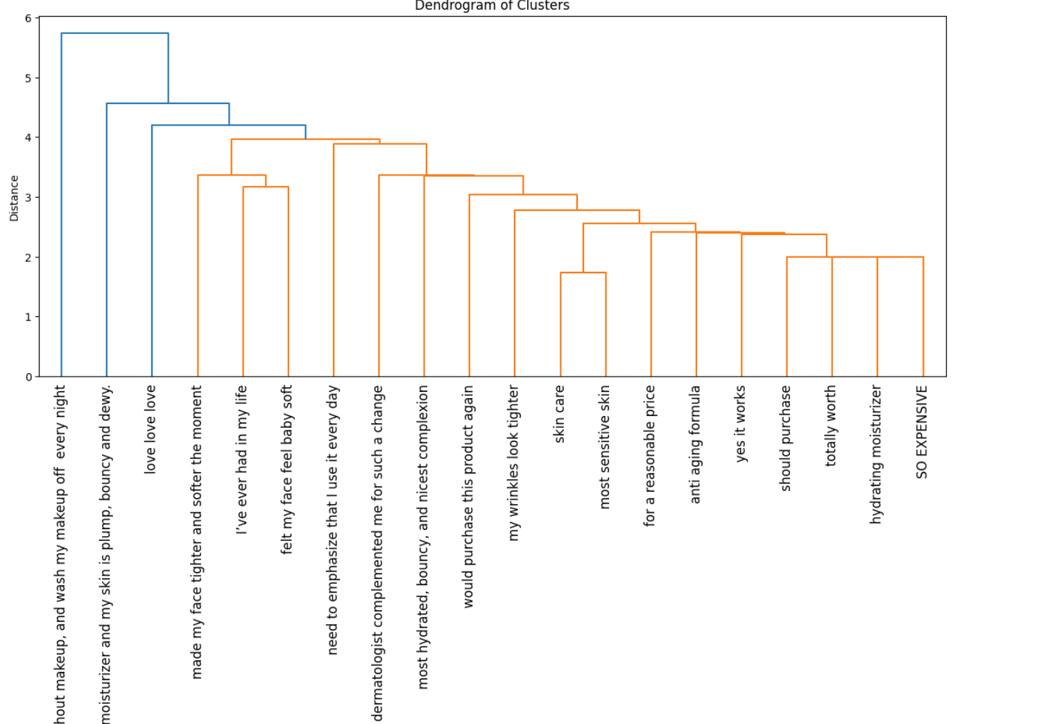
Tatcha

Slide 17
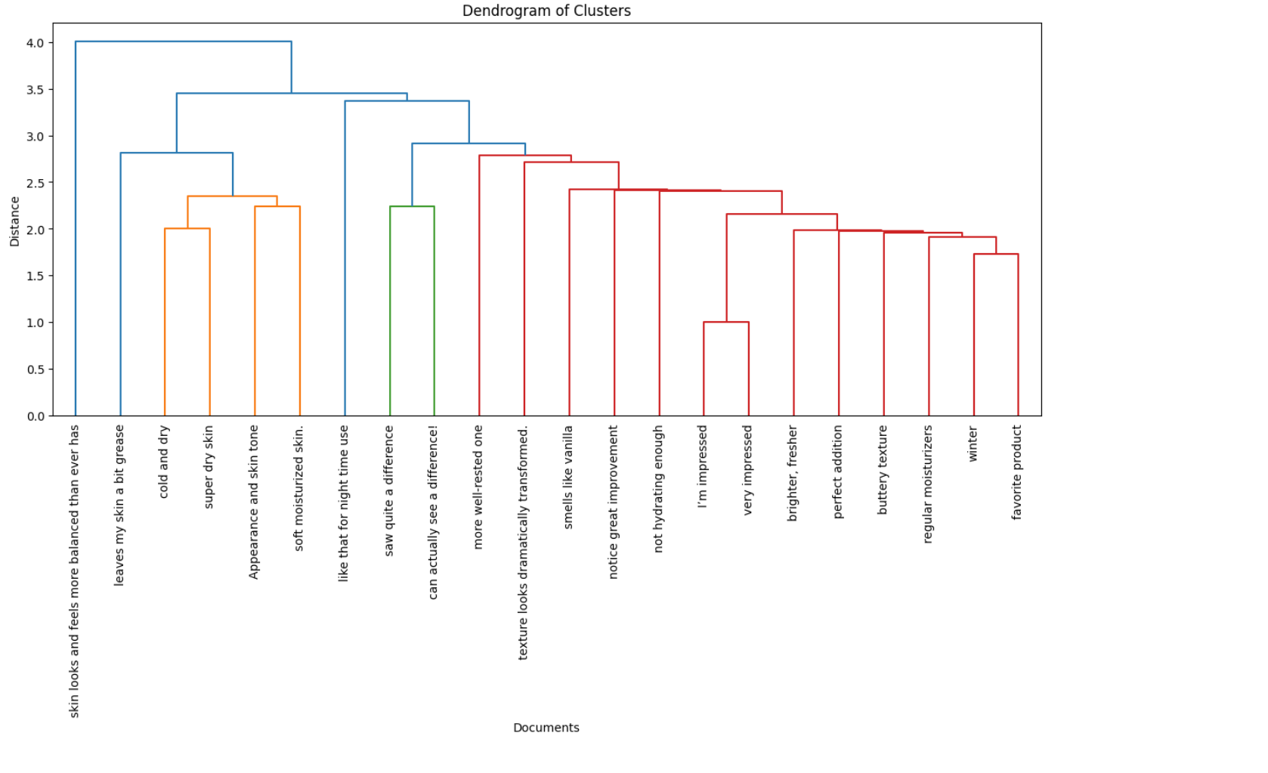
Farmacy

Slide 18
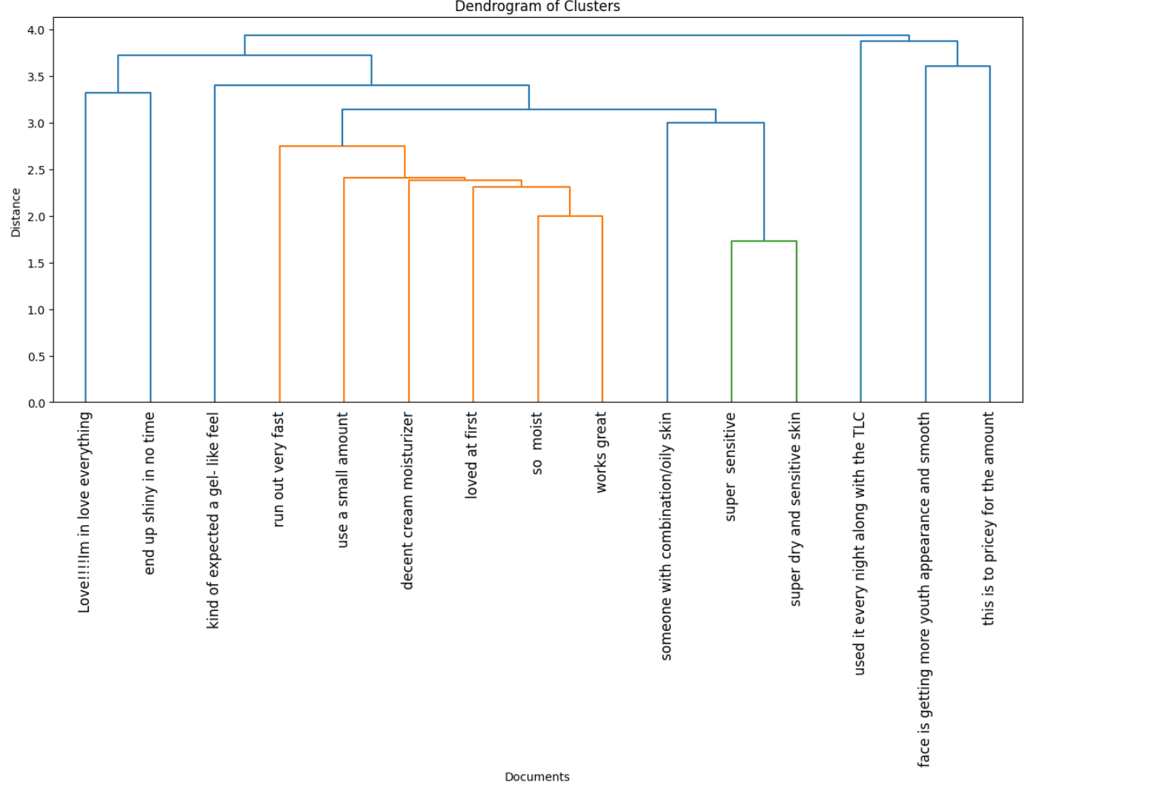
Drunk Elephant

Slide 19
The dendrogram shows the relationship between the number of clusters and their impact on skincare.
The closer the clusters are together, the more likely it is that it unlock a deeper understanding of moisturizers and navigates the vast skincare landscape with confidence.

Slide 20
CONCLUSION
Product recommendation along with text summarization ,Sentiment classification, Topic modeling, Hierarchical clustering techniques, and predictive analytics based on sentiment are invaluable for product recommendation and sentiment analysis by distilling the key findings and conclusions from this vast corpus of review data and research.
These methodologies also help make complex product description more accessible to the public through summarized explainers.
In the race to choose suitable beauty products, text summarization along with Sentiment classification, Topic modeling, Hierarchical clustering, and predictive analytics based on sentiment is an indispensable tool for researchers to benefit from the latest insights emerging across diverse sources of products data and literature.

Slide 21
FUTURE DIRECTIONS
Expand dataset sources, refine preprocessing, and deploy advanced deep learning models for deeper insights.
Combine product, environmental, skin, ingredient, and health data to highlight relationships and interactions.
Engage in varied tasks like semantic labeling and review-based model fine tuning for enriched analysis.
Ongoing research on product benefits, skin health, and data integration for effective communication strategies.
Reinforce validation frameworks, highlighting NLP's potential for transformative product analysis and addressing global challenges.

Slide 22

THANK YOU

