Slide 1

Customer Shopping Behavior
Dibyajyoti

Slide 2
Data Overview
3.75
3,900
$59.76
Avg Rating
Records
Avg Purchase
25
Avg Previous Purchases
Age range: 18–70 · Purchase amount: $20–$100
Dibyajyoti

Slide 3
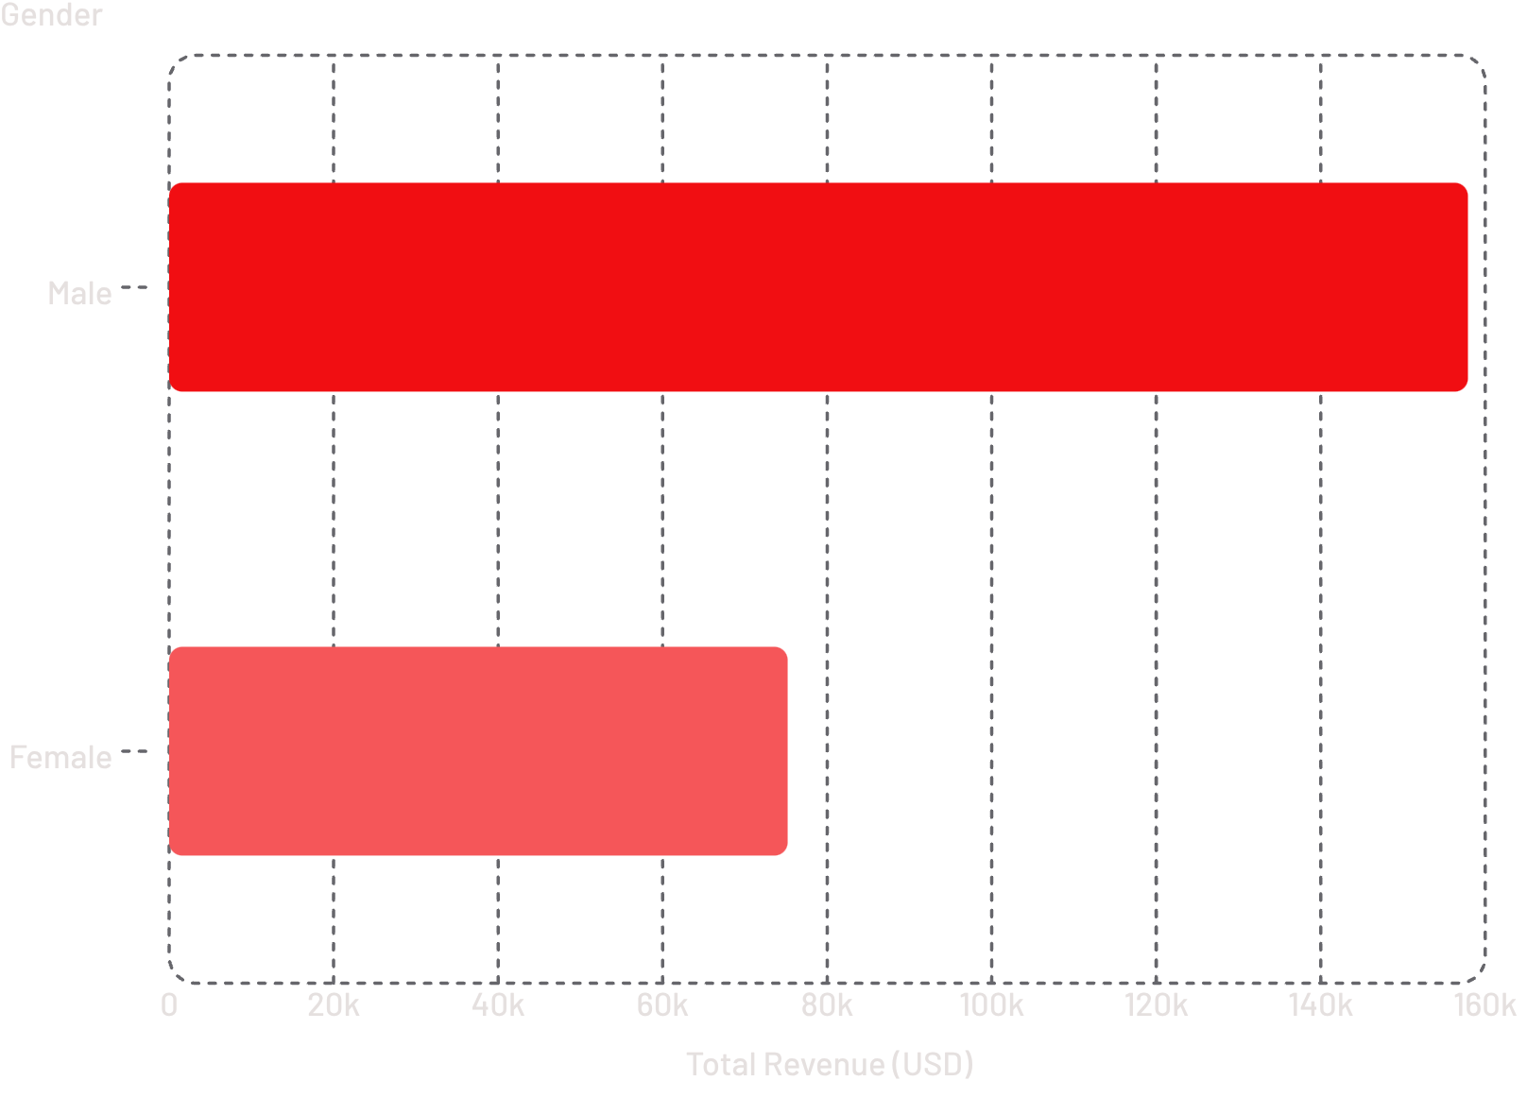
Revenue by Gender
Key Finding
Male customers generated $157,890 — over 2× more than female customers ($75,191)
Dibyajyoti

Slide 4
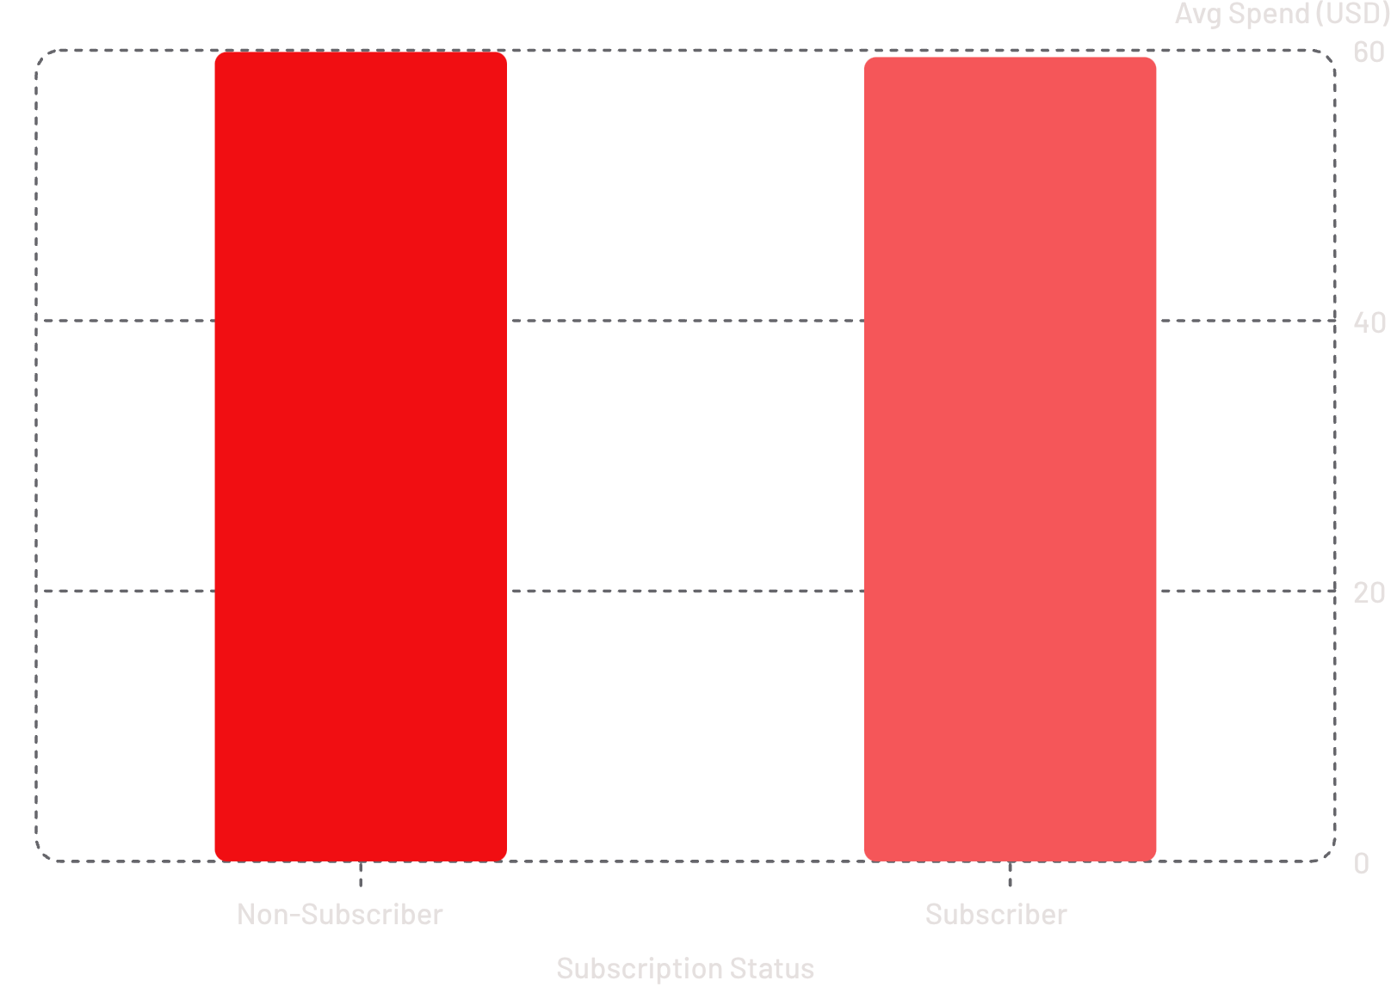
Subscription & Shipping Insights
Subscriptions
Avg spend nearly identical — subscribers not spending more. Non-subscribers: 2,847 customers ($170K revenue) vs. subscribers: 1,053 ($62K).
Shipping
Express avg: $60.48 vs. Standard: $58.46 — minimal difference.
Dibyajyoti

Slide 5
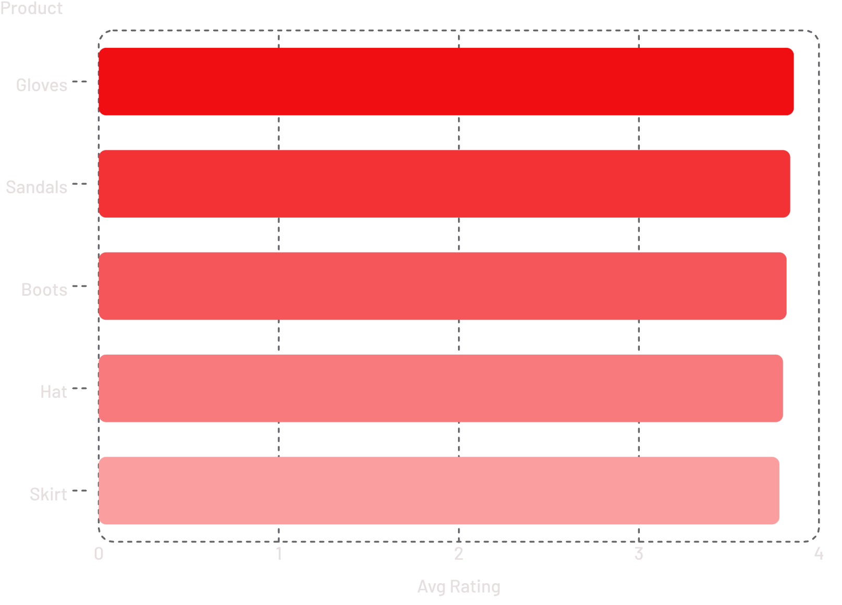
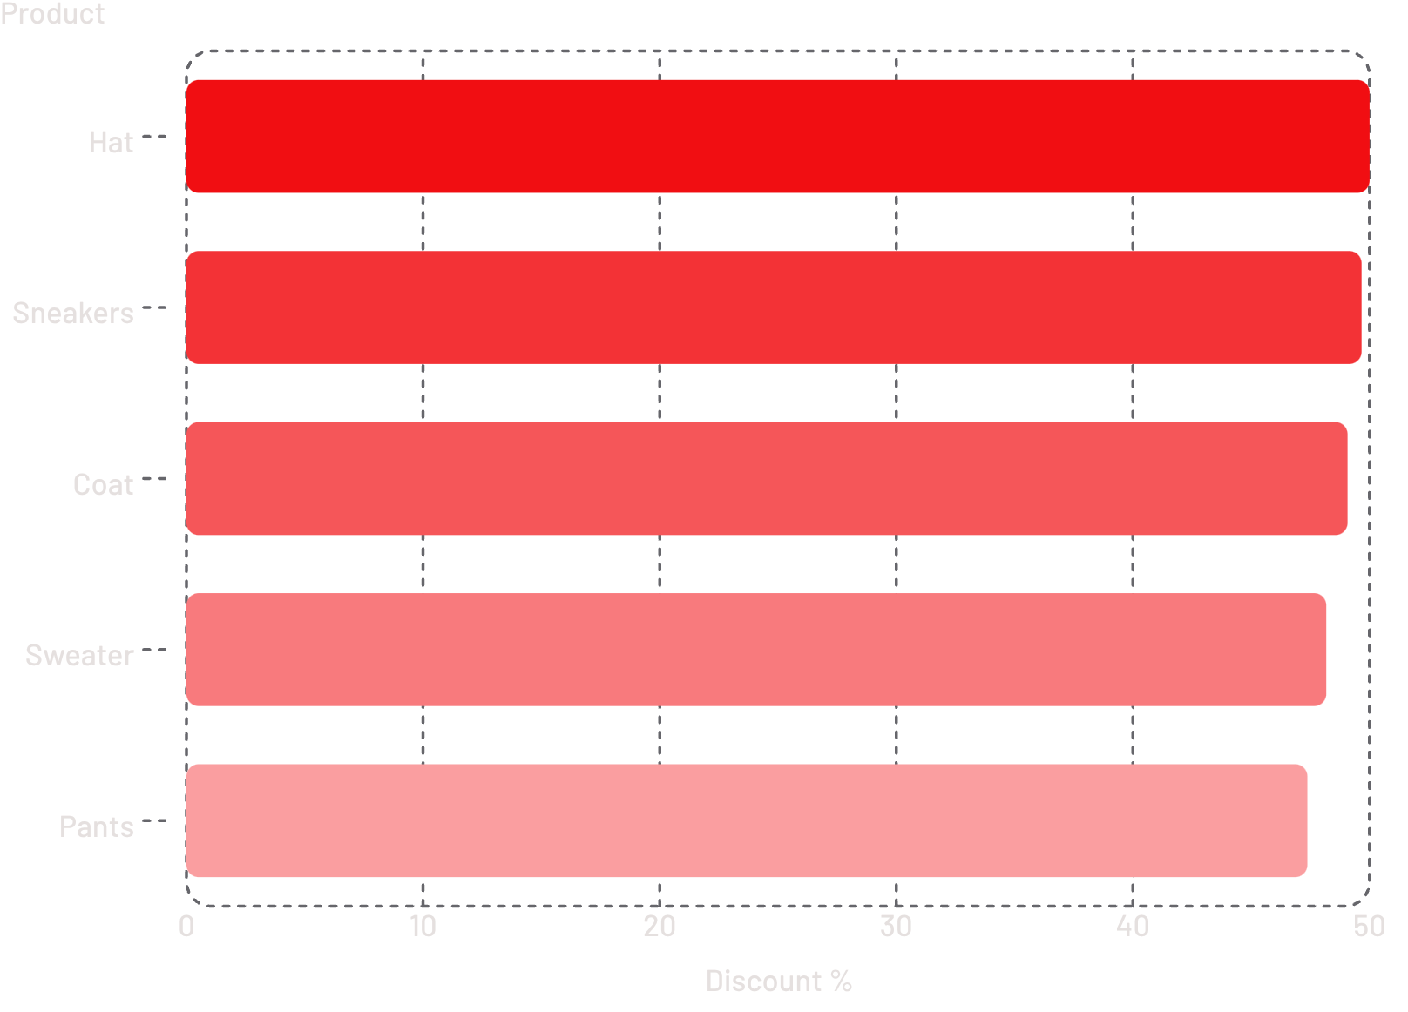
Top Products by Rating & Discount
Top 5 by Avg Rating
Top 5 by Discount %
Dibyajyoti

Slide 6
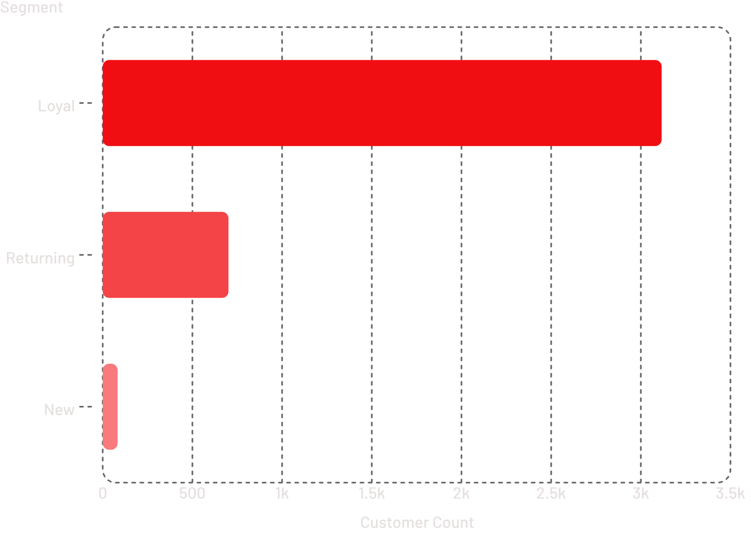
Customer Segments & Repeat Buyers
Segments
Loyal: 3,116 (11+ purchases) · Returning: 701 (2–10) · New: 83 (1 purchase)
Repeat Buyers
Of customers with 5+ purchases: 2,518 non-subscribers vs. 958 subscribers — repeat buyers not more likely to subscribe.
Dibyajyoti

Slide 7
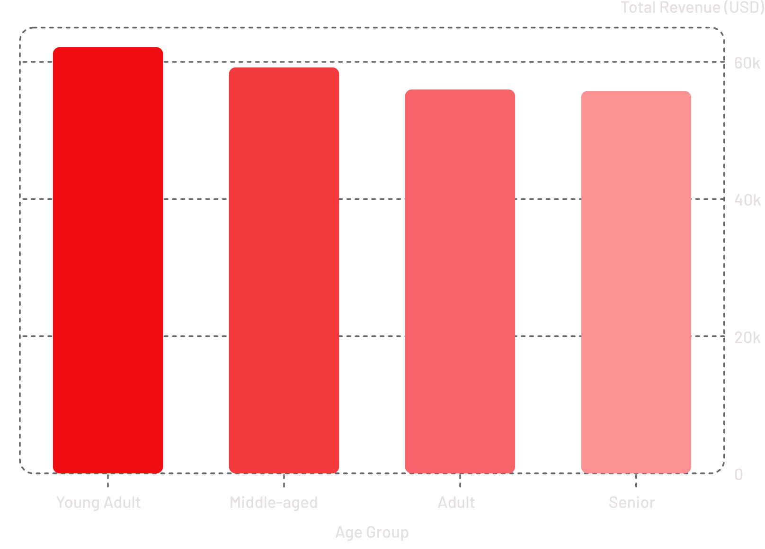
Revenue by Age Group & Top Products
Age Groups
Young Adults lead revenue at $62,143. Distribution is relatively balanced across all four groups.
Top Products by Category
Clothing: Blouse, Pants, Shirt · Footwear: Sandals, Shoes, Sneakers · Outerwear: Jacket, Coat · Accessories: Jewelry, Sunglasses, Belt
Dibyajyoti

Slide 8


Recommendations
Target Males
Highest revenue — focus marketing here
Convert Loyal Buyers
3,116 loyal customers — push subscriptions
Acquire New Customers
Only 83 new — invest in acquisition
Dibyajyoti

