Slide 1

Eco Sustainable App
By-Dibyajyoti Swain

Slide 2
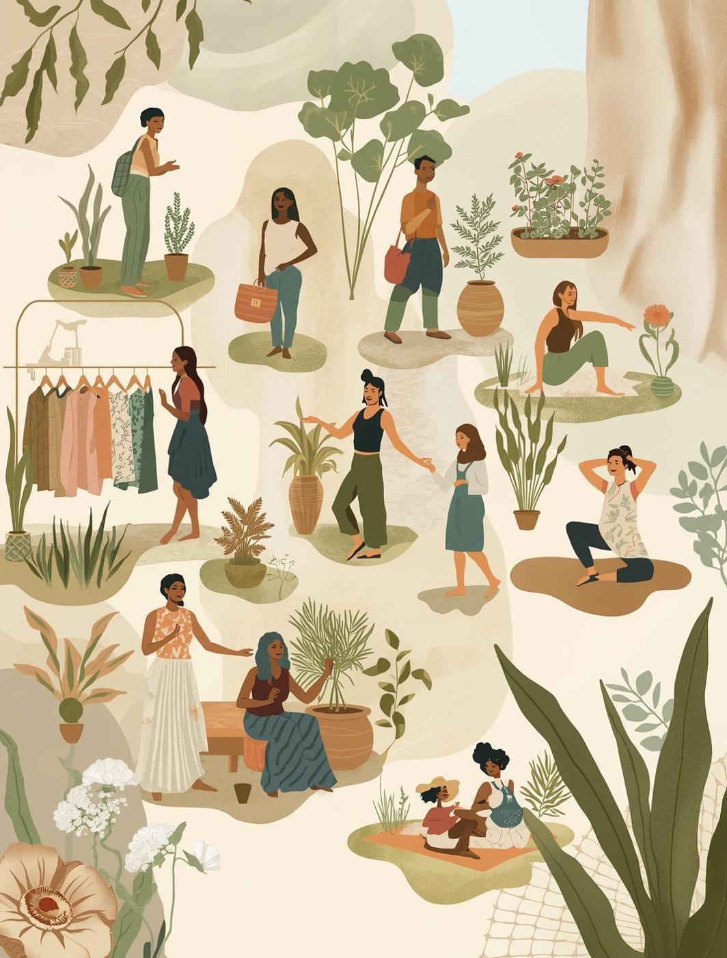
Research and Problem Understanding
Fast fashion significantly harms the environment through high carbon emissions, water pollution, microfiber release, and textile waste. Despite growing sustainability awareness, consumers—especially Gen Z—continue frequent purchases due to low prices, trends, and social media influence, leading to overconsumption and short garment lifespans. Existing sustainable fashion apps lack reliable supply-chain data, clear eco-impact insights, and effective user motivation, limiting their impact.
App Goal: SustainStyle aims to promote sustainable fashion choices using real-time eco-impact scores, AI-driven recommendations, and reward-based engagement.

Slide 3

SOLUTION– SUSTAINSTYLE
SustainStyle is a mobile app prototype that helps users make eco-friendly fashion decisions by:
  Scanning clothing products
  Displaying sustainability (EcoScore)
  Recommending greener alternatives
  Rewarding eco-friendly actions through GreenPoints

Slide 4
DESIGN & PROTOTYPING TOOL
  The complete app interface was designed in Figma
  Includes:
    Clean UI design
    Clickable navigation
    Simulated scanning experience
    Interactive GreenPoints dashboard
Figma allowed rapid prototyping and realistic user interaction.

Slide 5
Unique Features of SustainStyle
Key App Features Implemented:
  Multiple product scanning options:
    Barcode scanning
    QR code scanning
    Style number scanning
  Instant EcoScore generation after product scan.
  Smart recommendations for more sustainable alternatives if the EcoScore is low.
  GreenPoints system to reward eco-friendly user actions.
  Milestone-based rewards, including free sustainable clothing on reaching target points.
  Eco challenges to motivate users to earn more GreenPoints.
  Supports products ranging from basic to premium quality, promoting sustainable choices across all levels.

Slide 6
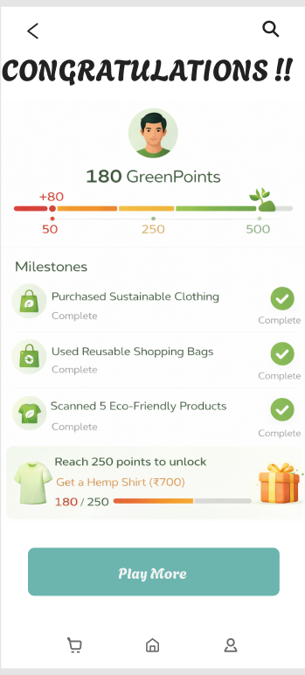
GREENPOINTS, MILESTONES & CHALLENGES
  Users earn GreenPoints for sustainable actions
  Progress levels shown using signal indicators
    50 points (Red)
    250 points (Orange)
    500 points (Green)
  Example milestone:
    Reach 250 GreenPoints → Unlock a hemp shirt worth ₹700
  Weekly eco-challenges motivate continuous engagement

Slide 7
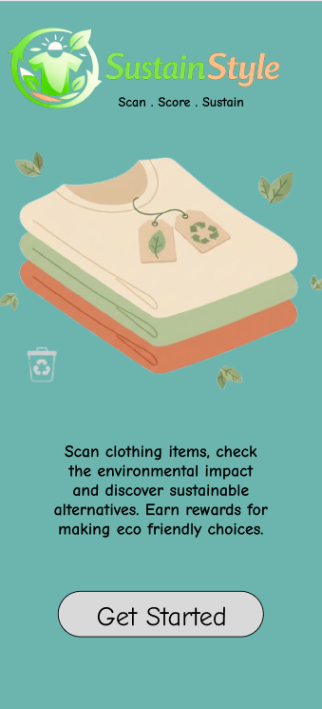
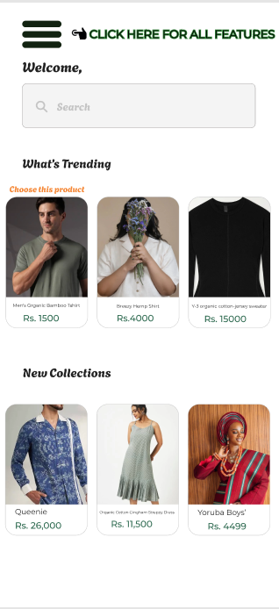
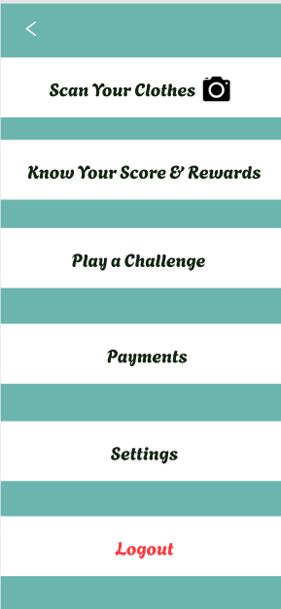
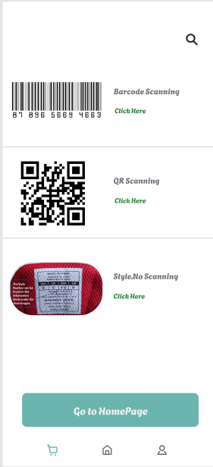
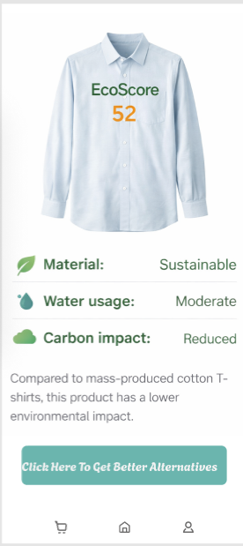
Prototyped App Interface

Slide 8
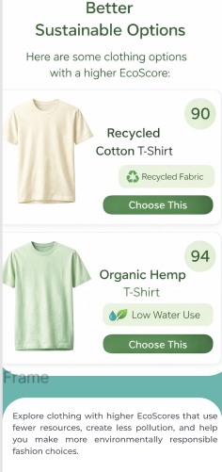
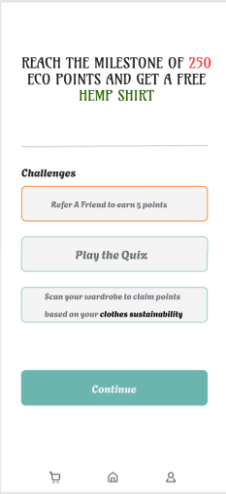
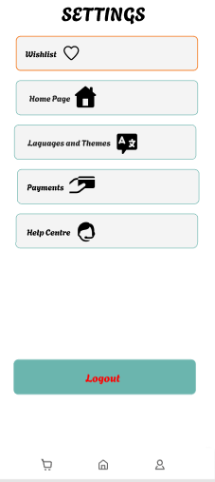
Prototyped App Interface

Slide 9
Links Of the App
DESIGN LINK: https://www.figma.com/design/UaDRXCFUHRDYz2WPkMcoRx/CLOTH-SHOPPING-APP--Community-?node-id=0-1&p=f&t=RP8dxm4tBiMIf1De-0
PROTOTYPE LINK:
https://www.figma.com/proto/UaDRXCFUHRDYz2WPkMcoRx/CLOTH-SHOPPING-APP--Community-?node-id=133-7&p=f&t=RP8dxm4tBiMIf1De-0&scaling=min-zoom&content-scaling=fixed&page-id=0%3A1&starting-point-node-id=133%3A7&show-proto-sidebar=1

