Slide 1
DESIGN THINKING FOR INNOVATION
ENERGY- EFFICIENT LIGHTING SYSTEM
Designing an Energy-Efficient Lighting System for Schools

Slide 2
Table of contents
01
02
03
04
05
06
Introduction
Empathize
Define
Overview of the importance of energy-efficient lighting in educational settings.
Understanding User Needs : Surveys, Collection of feedback & workshops
Setting Goals and Identifying Areas.
Ideate
Prototype
Test
Implementing ideas for Energy-Efficient Lighting
Pilot Program Implementing and Testing
Refining the design based on user feedback.

Slide 3
INTRODUCTION
In the introduction, we highlight the pivotal role of energy-efficient lighting in educational environments. This presentation focuses on the design aspect, not the physical implementation, aiming to address the challenges schools face with conventional lighting.
Our goal is to outline a conceptual framework for an optimized lighting system, emphasizing reduced energy consumption and an improved learning environment. Through a design-thinking approach, we explore innovative solutions, keeping in mind the potential positive impact on both the ecological footprint and the well-being of students, teachers, and staff.

Slide 4
EMPATHIZE
Uncovering user needs is pivotal in designing an effective school lighting system. Through surveys, interviews, and workshops, stakeholders, including students and staff, shared insights into their lighting preferences. This inclusive approach ensures a comprehensive understanding of diverse perspectives, allowing us to tailor the lighting system to specific priorities and challenges.
Additionally, the integration of a Google Form as an interactive feedback tool further ensures ongoing participation, making certain that the design aligns closely with the genuine needs and expectations of the school community.

Slide 5
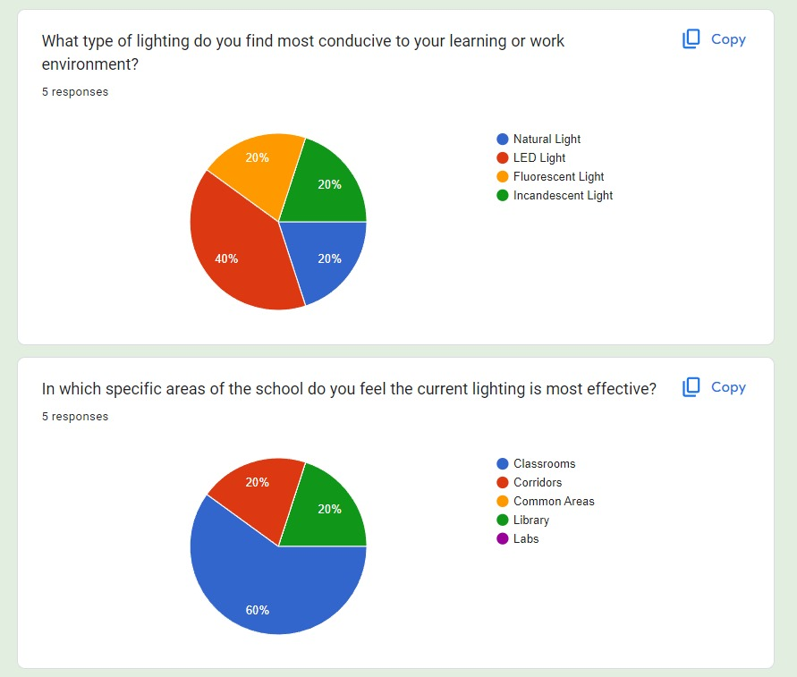
Here are some survey results :

Slide 6
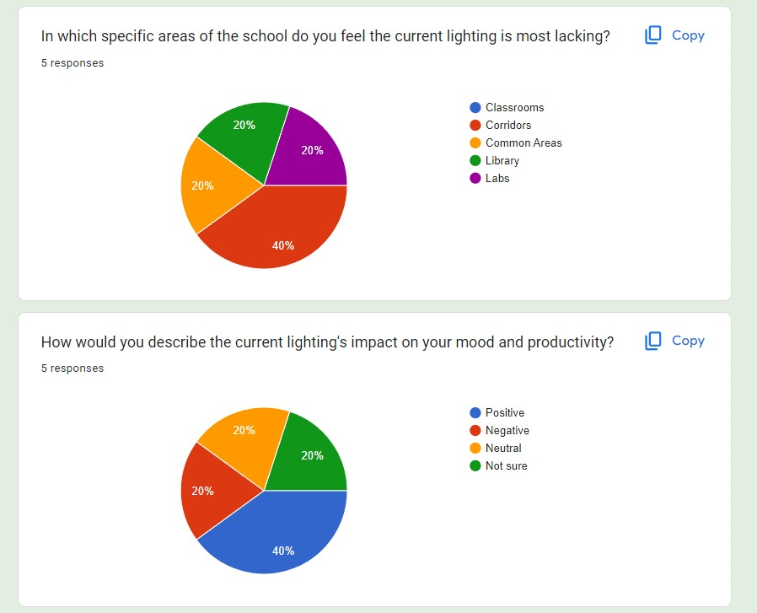
Here are some survey results :

Slide 7
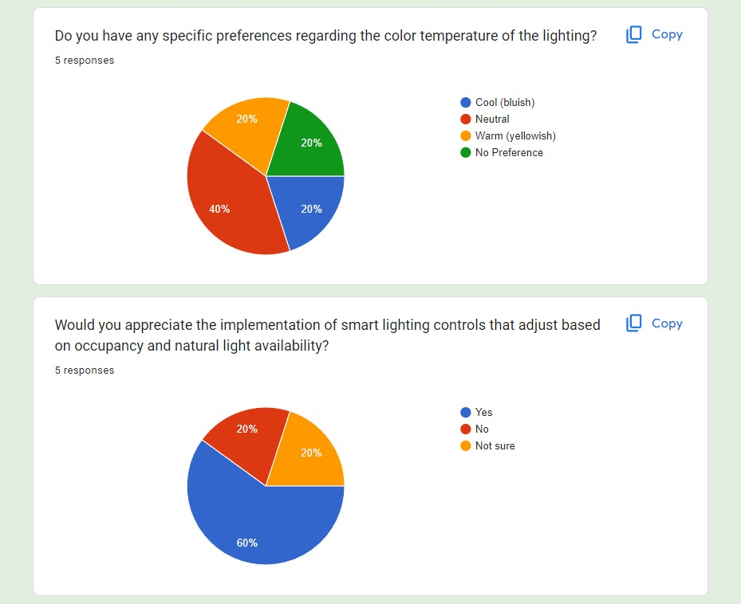
Here are some survey results :

Slide 8
DEFINE
In the Define phase, our focus is on crystallizing the objectives of our lighting design and pinpointing specific areas within the school that demand attention.
Clear Objectives:
- Define the overarching goals of the lighting system, emphasizing aspects such as energy efficiency, enhanced learning environments, and adaptability to diverse needs.
Identifying Priority Areas:
- Examine feedback from stakeholders to identify key spaces within the school—be it classrooms, corridors, or common areas—where lighting improvements are deemed essential.
Tailored Solutions:
- Through a meticulous analysis of user insights, establish tailored solutions to address specific challenges and requirements unique to each identified area.
By defining clear goals and honing in on priority areas, we establish a robust foundation for the subsequent design phases, ensuring that our lighting solutions align precisely with the needs and aspirations of the school community.

Slide 9
IDEATE
Personalized Smart Lighting Control System with Automated Consumption Sensors
In the Ideate phase, we envision a groundbreaking concept - the Personalized Smart Lighting Control System with Automated Consumption Sensors.“
Revolutionizing traditional lighting norms, this innovative system empowers specific users to tailor lighting settings in their respective areas. Integrating advanced sensors and controls, the system not only ensures energy efficiency but also fosters a dynamic and personalized learning or working environment. Users can customize brightness, color temperature, and lighting patterns, catering to individual preferences and specific activities. The addition of automated consumption sensors enhances sustainability, allowing the system to charge lights for backup during periods of lower energy demand. This forward-thinking prototype aims to redefine how lighting interacts with users, creating a versatile and user-centric approach to illuminate different spaces within the school.

Slide 10
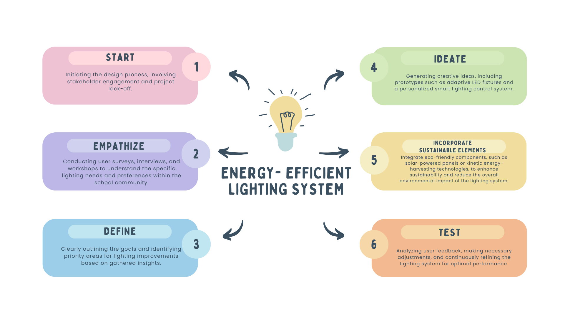
PROTOTYPE OF THE PROJECT
BLUEPRINT OF THE PLANNING

Slide 11
ASPECTS OF OUR LIGHT BULBS
Energy-Efficient Light Bulbs in Classrooms
Motion Sensor Light Bulbs in Corridors
Product: Motion sensor-activated LED bulbs
Features:
  Motion detection
  Energy-saving mode
  Adjustable sensitivity
Benefits:
  Enhances safety
  Reduces energy wastage
  Lowers maintenance requirements
Product: LED light bulbs
Features:
  Low energy consumption
  Long lifespan
  Adjustable brightness
Benefits:
  Conducive learning environment
  Supports sustainability
  Cost-effective for long-term use
Product: Solar-powered LED bulbs
Features:
  Solar panel integration
  Battery backup
  Remote monitoring
Benefits:
  Environmentally friendly
  Provides uninterrupted lighting
  Demonstrates commitment to renewable energy
Solar Power Light Bulbs in Labs and Auditorium

Slide 12
Advantages over other Bulbs
Classrooms:
  Energy-Efficient LED Bulbs
    Provide a conducive learning environment.
    Ideal for long hours of use during classroom activities.
    Consistent and comfortable lighting for better concentration and academic performance.
    Long lifespan reduces maintenance costs.
Corridors:
  Motion Sensor Light Bulbs
    Enhance safety and security by providing instant illumination upon detecting movement.
    Reduce the risk of accidents or unauthorized access in dimly lit areas.
    Contribute to energy conservation by adjusting brightness levels based on motion.
    Minimize energy consumption during idle periods when corridors are not continuously occupied.
Labs and Auditorium:
  Solar Power Light Bulbs
    Ensure reliability during power outages through battery backup.
    Essential for uninterrupted lighting during critical activities in laboratories and auditoriums.
    Align with environmental considerations by utilizing solar power.
    Demonstrate commitment to sustainability, reducing reliance on grid electricity.
    Serve as a visible example of renewable energy adoption, promoting environmental awareness.

Slide 13
Implentation
Pilot Phase:
- Selection: IBCP Block was chosen for initial testing.
- Installation: Various bulbs installed in classrooms, corridors, labs, and auditoriums. Energy efficient bulbs in classrooms, solar powered bulbs in labs, motion sensor bulbs in corridors.
- Evaluation: Monitoring energy consumption, lighting quality, and user feedback.
- Adjustments: Iterative fine-tuning based on findings.
2. Expansion:-
- Gradual Rollout: Phased implementation to other school areas like auditorium, IGCSE Block, CBSE Block, etc.
- Tailored Implementations: Customized solutions based on area requirements.
- Continuous Monitoring: Ongoing feedback loop for adjustments and refinements.
This concise process ensured effective selection and implementation of lighting solutions, optimizing energy efficiency, safety, and user satisfaction across the school campus.

Slide 14
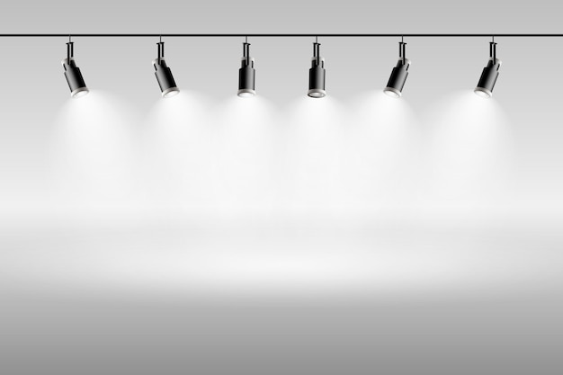
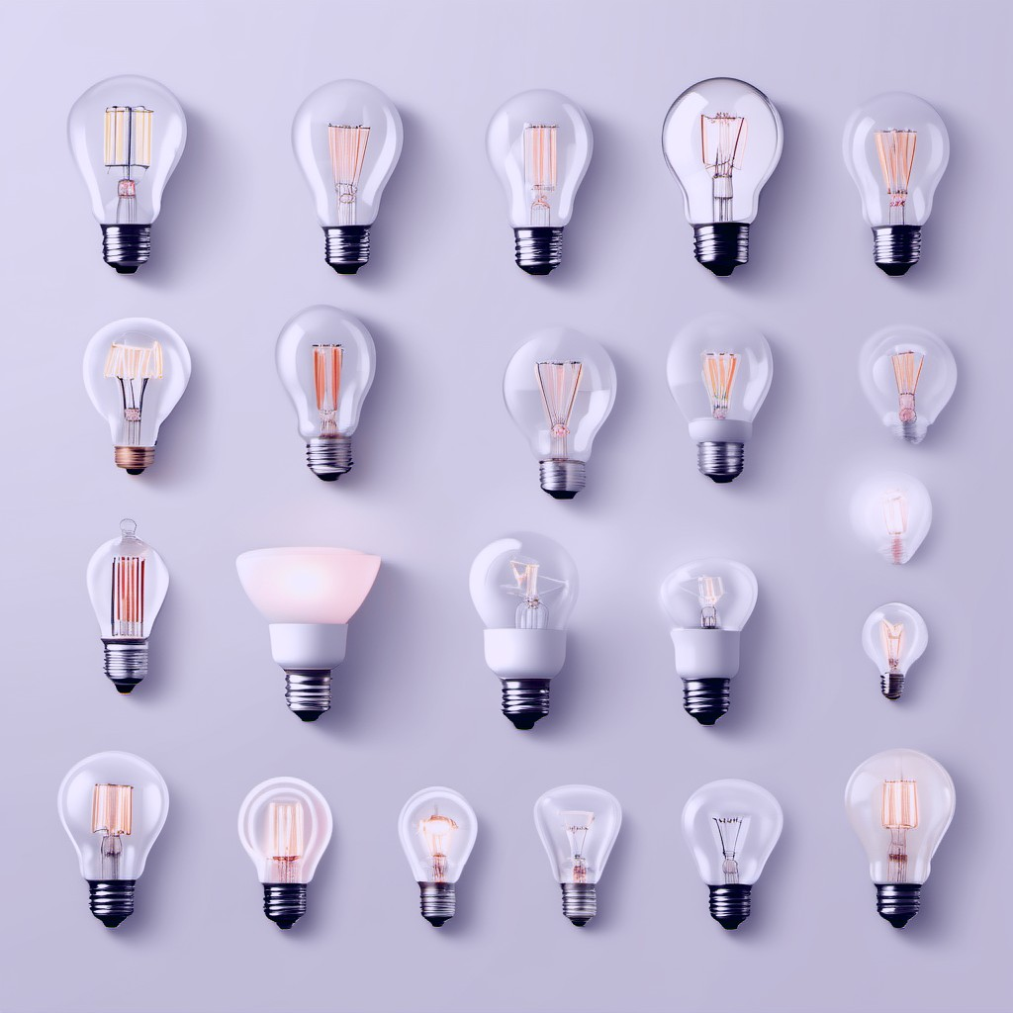
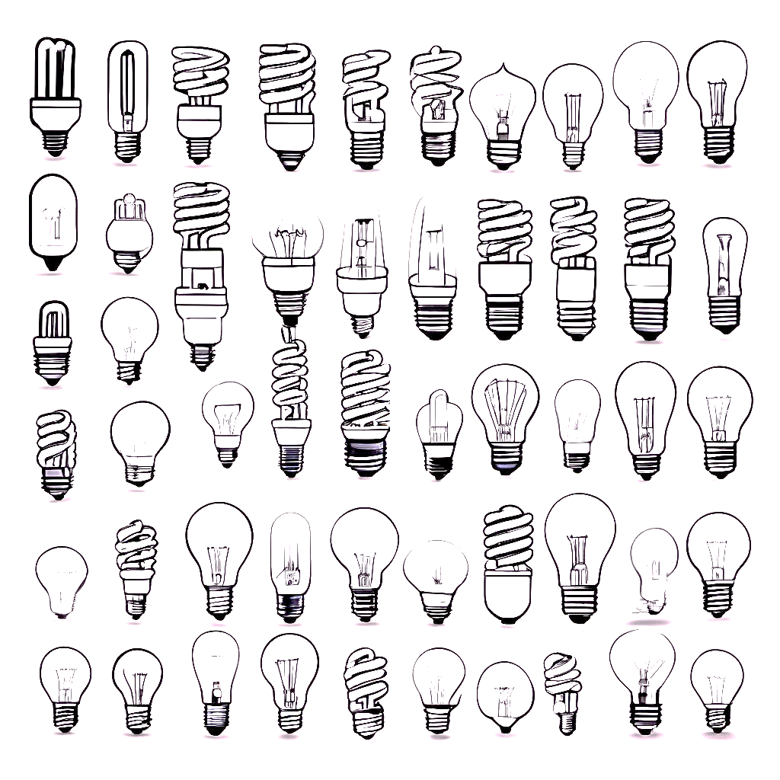
Explore our designed collection of school-friendly light bulbs, showcasing innovation and energy efficiency. Each unique design caters to diverse preferences, providing tailored lighting solutions for a dynamic and conducive learning environment :

Slide 15
THANK
YOU !
REFERENCES :
5 Stages in the Design Thinking Process. (2023, November). The Interaction Design Foundation. https://www.interaction-design.org/literature/article/5-stages-in-the-design-thinking-process
Stevens, E. (2019, July 9). The Key Principles And Steps Of The Design Thinking Process. Careerfoundry.com. https://careerfoundry.com/en/blog/ux-design/design-thinking-process/
Presentation prepared by :
Dibyajyoti Swain

