Slide 1
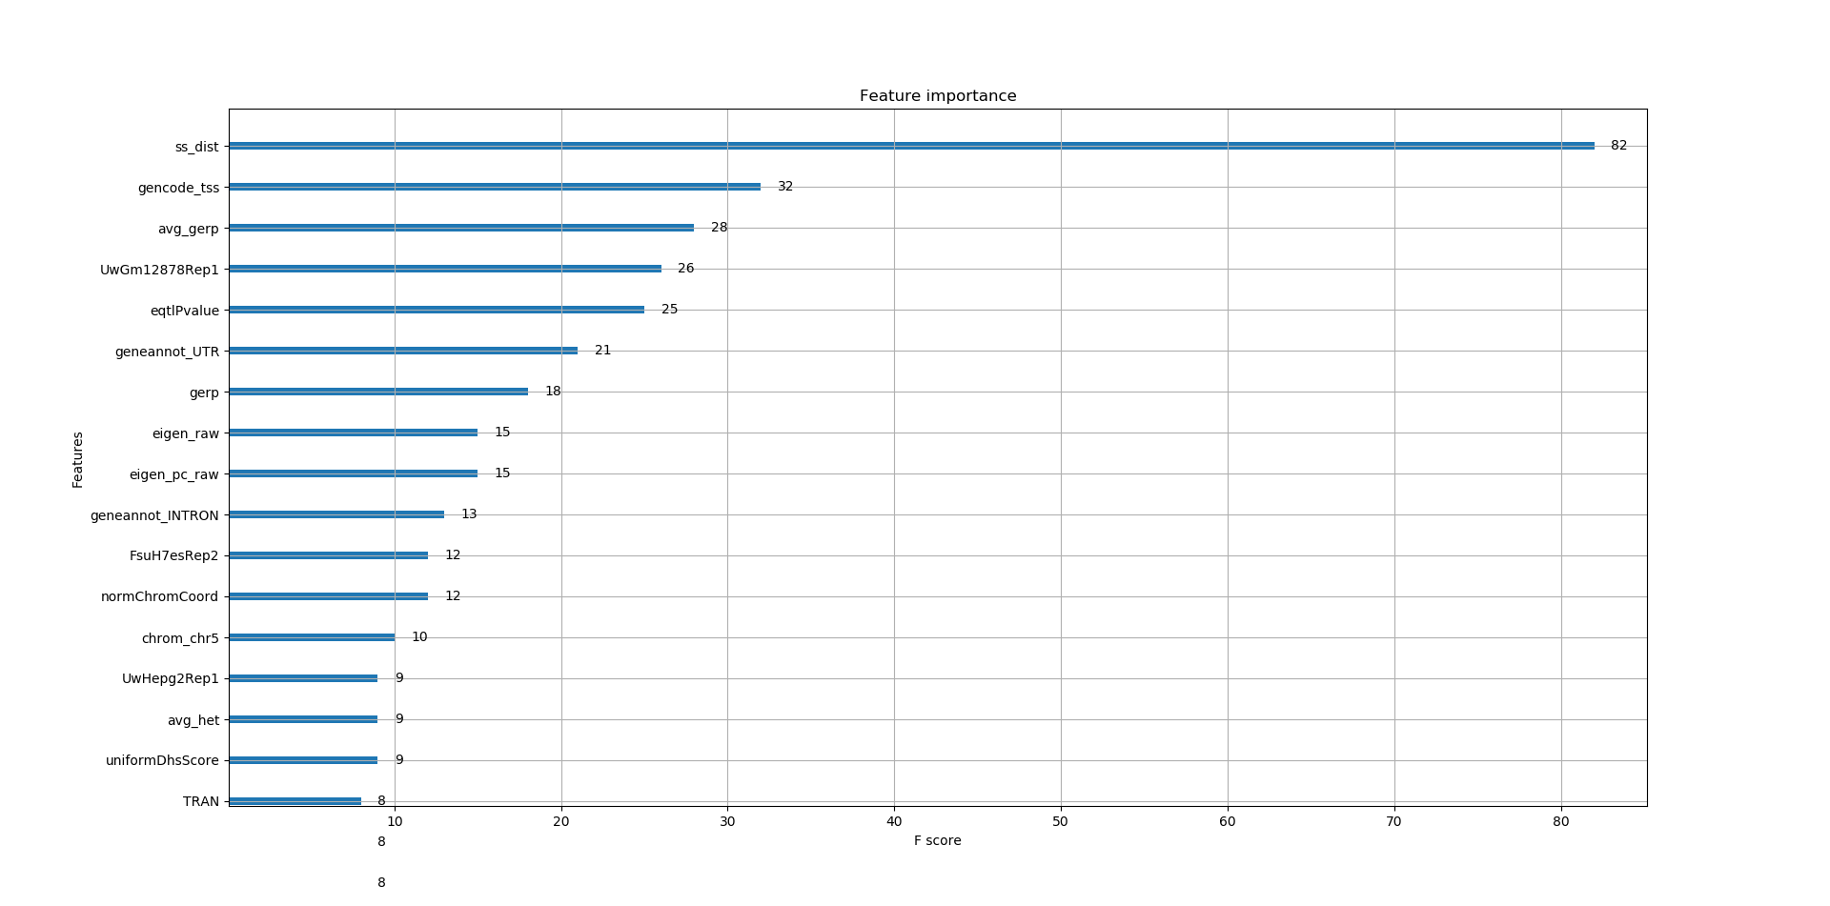
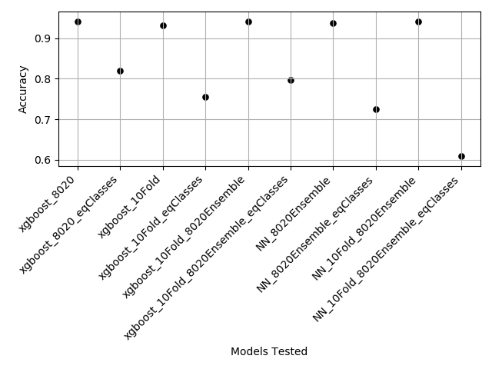
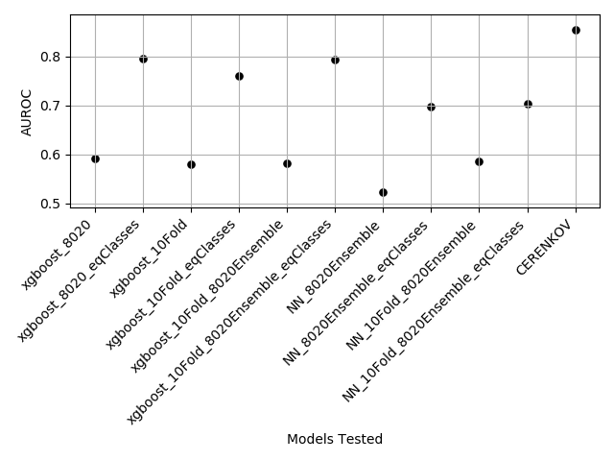
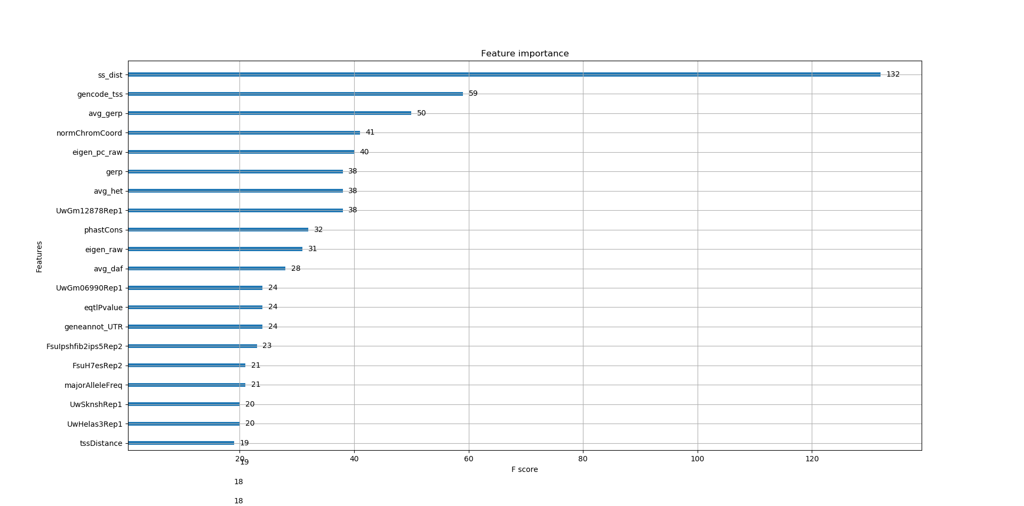
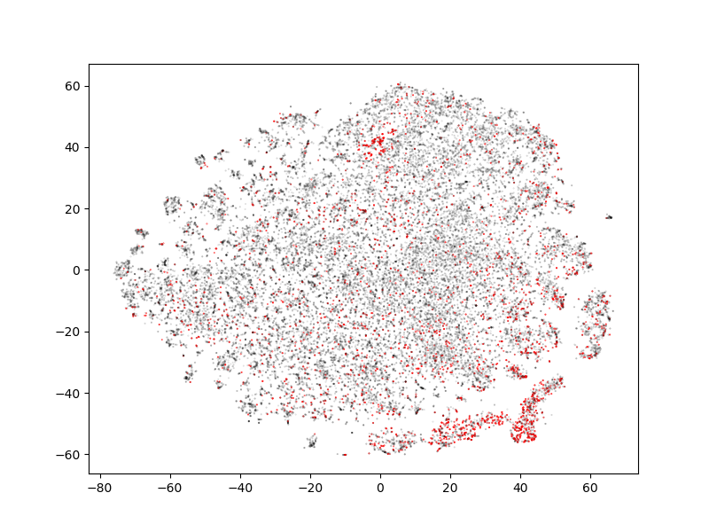
Identifying Regulatory Single Nucleotide Polymorphisms Using Machine Learning
Austin Dibble and Rosalyn Fey
Discussion:
Feature Importance
INTRODUCTION
Equal Class Sizes
The identification of regulatory single nucleotide polymorphisms (rSNPs) in non-coding regions of the genome is a current challenge in the field of computational biology which naturally lends itself to machine learning approaches. In their 2017 paper, Yao et al. distinguish rSNPs from non-regulatory SNPs (cSNPs) using a gradient-boosted decision tree machine learning model and a novel 10-fold cross validation strategy. Here we implement a similar approach to accomplish the same task. Our goal for this project was to match the performance of the CERENKOV model presented by Yao et al., 2017.
Abstract
We present a comparison of machine learning models trained to identify regulatory single nucleotide polymorphisms in non-coding regions of the genome. Specifically, we attempt to reproduce results obtained by Yao et al. with their CERENKOV model. We find that training on equal class sizes affects model performance more than either the method used to split training and validation sets or the type of network employed.
Unequal Class Sizes
METHODS
Data: All data, including features and metadata, were acquired through Dr. Yao Yao and Dr. Stephen Ramsey.
Models: Gradient-boosted decision trees were implemented with xgboost, using parameters as reported in Yao et al. Fully-connected feed forward neural networks with ReLU and sigmoid layers were implemented with PyTorch.
10-fold cross validation: Data was assigned to folds on a per locus (rSNP and associated cSNPs) basis. To ensure an equal number of cSNPs across folds, we used random undersampling to remove cSNPS from all but the least-populated fold until all folds had the same number of cSNPs.
t-SNE embedding of SNP feature sets: Principal component analysis was used to reduce feature set dimensionality to 40 features, then t-SNE was used to further reduce dimensionality for 2D plotting.
All programming was performed with Python 3.7.
All code for this project is on GitHub at
https://github.com/Dibz15/csx46-cerenkov
We extracted the top 17 features that were most important in distinguishing rSNPs from cSNPs for our model with the highest AUROC score (xgboost_8020_eqClasses). For comparison we also examined important features for the same model trained on unequal classes (xgboost_8020). The top three features are the same for these two models; many other important features are shared between them.
It is difficult to compare these results with those of Yao et al. because ours is not an aggregate representation. However, there appears to be some overlap between features deemed important for our models and for CERENKOV, especially the distance between the SNP and the transcription start site, the gene annotations associated with the SNP, and the score from Eigen-PC.
Results: Model Performance
As expected, accuracy is lower for models trained on positively- and negatively-labeled sets of equal sizes (‘eqClasses’ models). This is because a model trained on primarily negatively-labeled data will accurately predict negative labels most of the time. However, equal class models perform with a higher AUROC, a measure of the ratio of true positive rate to false positive rate, indicating that models trained with all of the data predict false positives more often than models trained on less data that is equal across classes. We were unable to match CERENKOV’s performance, as measured by AUROC. We were unable to compare accuracy to CERENKOV, as this metric was not reported in the paper by Yao et al.
Discussion: SNP clustering
To determine whether rSNPs cluster distinctly from cSNPs, we used t-SNE dimension reduction to visualize all SNPs (red=rSNPs, black=cSNPs).
Similar to the results from Yao et al., we observe local clustering of rSNPs. However, the shape of the embedded feature sets is very different from that reported previously, and there are fewer distinct clusters of rSNPs.
This may be due to differences in dimensionality reduction approaches; however, we note that this work uses a pruned version of the feature set used in the 2017 CERENKOV paper. It is possible that the lower performance of our model compared to CERENKOV is indicative of a loss of distinct clustering in the pruned feature set.
References
Yao, Yao, et al. "Cerenkov: Computational elucidation of the regulatory noncoding variome." Proceedings of the 8th ACM International Conference on Bioinformatics, Computational Biology, and Health Informatics. 2017.
Acknowledgments
We acknowledge and thank Dr. Yao Yao and Dr. Steve Ramsey for access to data and metadata not publically available on GitHub.

