Slide 1

Touchscreen
2INFO1
FELIPE – WESLEY – ERISSON

Slide 2

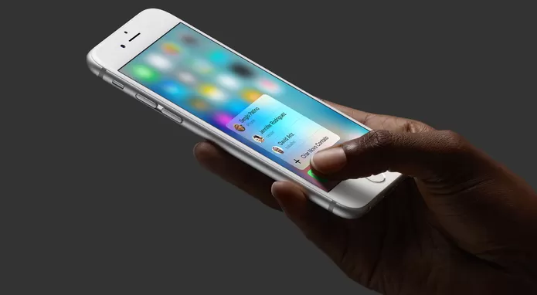
TOUCH SCREEN nos CELULARES

