Slide 1

COM-500 Throughput Optimization for 5G Network via Beamforming
Haoxin Sun,
Zewei Xu,
Yujie Wu
June 2022

Slide 2
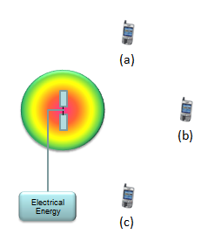
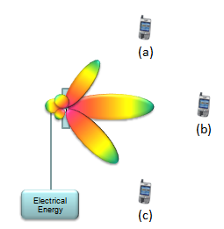
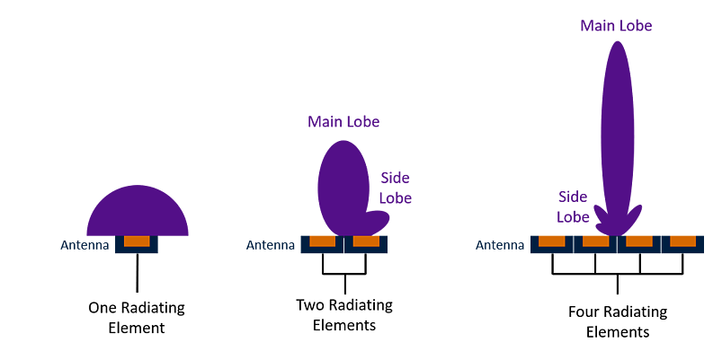
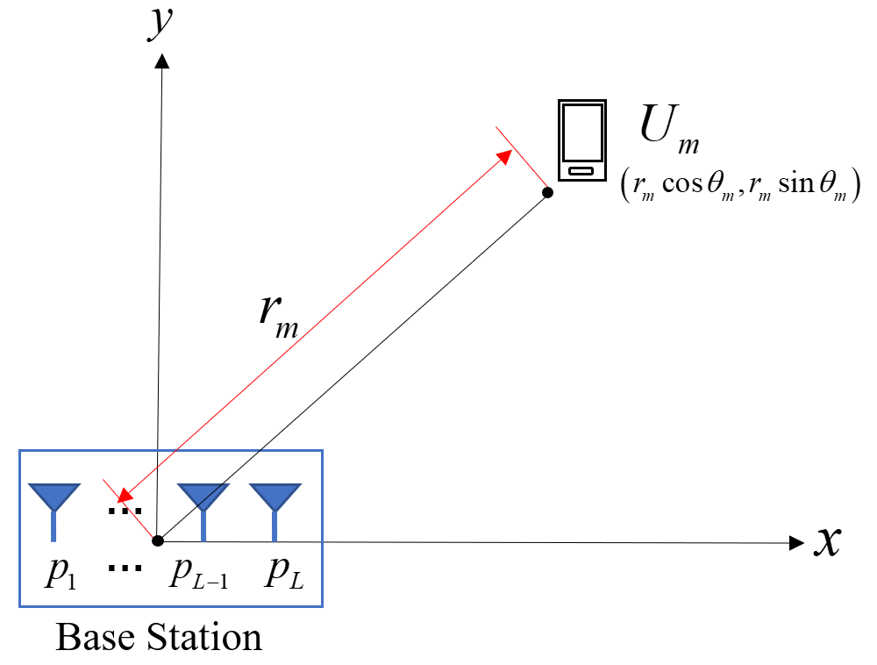

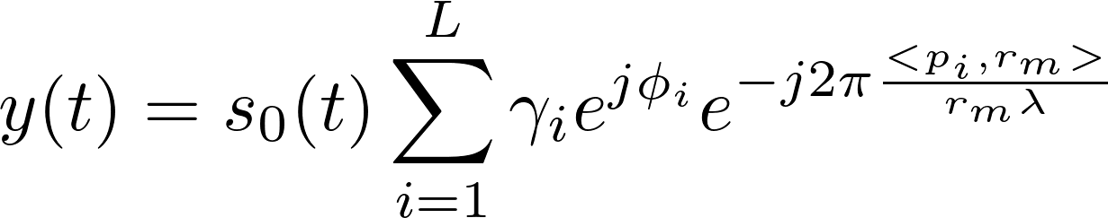

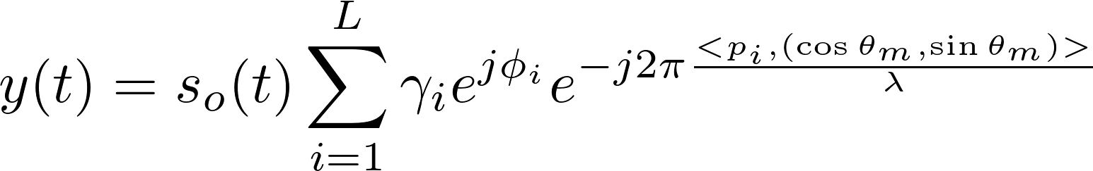

Beamforming in 5G Network
Reason: Loss of millimeter wavelength of signal & high bandwidth demand of users.
Beamforming is used with phased array antenna systems to focus the wireless signal in a chosen direction.
Emitted Signal:
Received Signal:
with DOA the final equation of our system:
Beamforming
Weights
Radiation Pattern without Beamforming
Radiation Pattern with Beamforming
System model

Slide 3
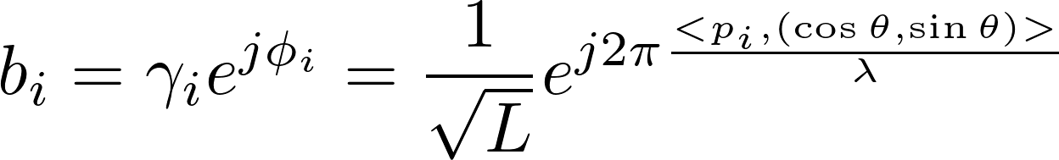
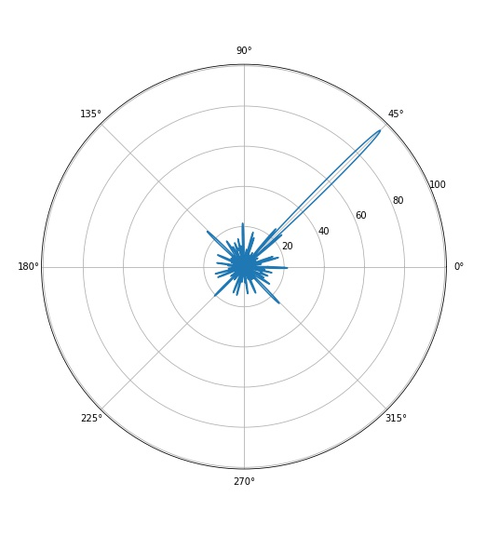
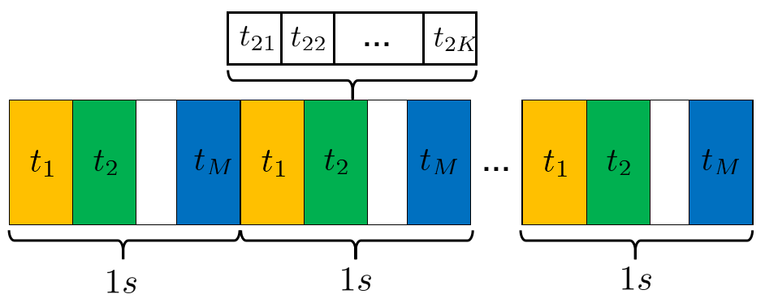
First Method: Matched Beamforming
Matched Beamforming: the beamforming weights is
Slot modelm based on TDMA

Slide 4



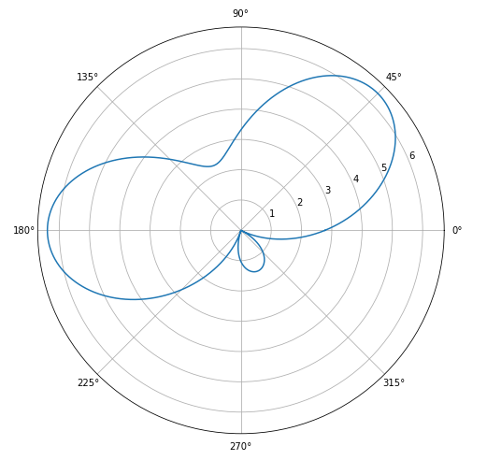


Second Method: Flexibeam
Assumption: There are infinite and continuous transmitting antennas in the 2D plane.
Emitted signal:
Received signal:
Flexibeam weight:
Example: Assume that users follow a 2D Gaussian distribution:

Slide 5
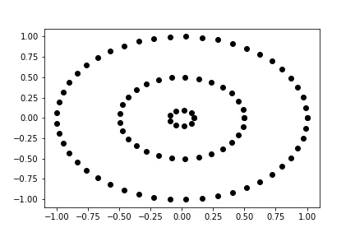
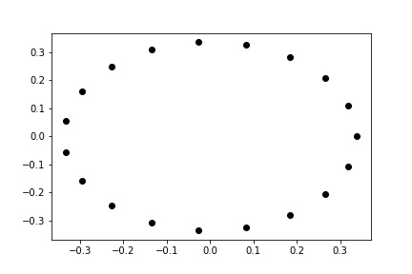
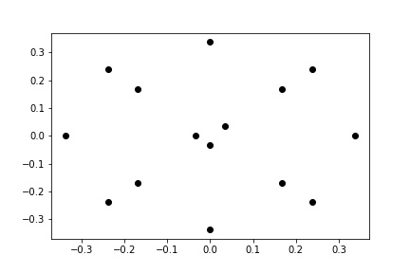
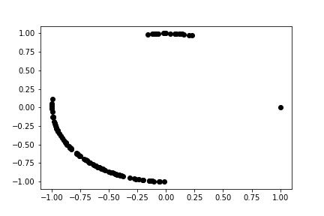
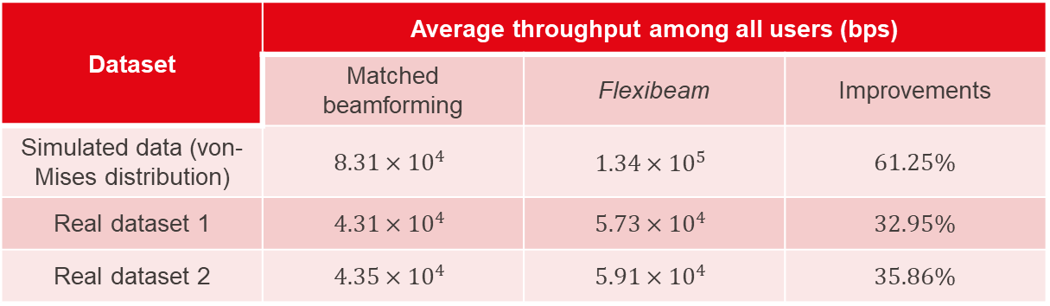
Data Rate Comparison
Dataset | Average throughput among all users (bps)
Dataset | Matched beamforming | Flexibeam | Improvements
Simulated data (von-Mises distribution) | $$8.31×{10}^{4}$$ | $$1.34×{10}^{5}$$ | 61.25%
Real dataset 1 | $$4.31×{10}^{4}$$ | $$5.73×{10}^{4}$$ | 32.95%
Real dataset 2 | $$4.35×{10}^{4}$$ | $$5.91×{10}^{4}$$ | 35.86%
Antenna array in simulated data
Antenna array in real dataset 1
Antenna array in real dataset 2
Real user distribution

Slide 6
Conclusions
Matched beamforming | Flexibeam
Only 1 main lobe | Multiple main lobes
Not robust to DOA estimation error | Robust to DOA estimation error
Performance degrades severely when users are scattered | Still works even if users are not so dense
No specific requirements on the system | Require specific antenna geometry (different distances from the origin)
Low complexity | High complexity
Future works: more complex system model
MIMO
Channel fading
Channel estimation error
…

Slide 7

Thanks
Reference
[1] P. Hurley and M. Simeoni, “Flexibeam: Analytic spatial filtering by beamforming,” in 2016 IEEE International Conference on Acoustics, Speech and Signal Processing (ICASSP), 2016, pp. 2877–2880.
[2] P. Hurley and M. Simeoni, “Beamforming towards regions of interest for multi-site mobile networks,” in International Zurich Seminar on Communications-Proceedings. ETH Zurich, 2016, pp. 94–98. [3] H. Krim and M. Viberg, “Two decades of array signal processing research: the parametric approach,” IEEE Signal Processing Magazine, vol. 13, no. 4, pp. 67–94, 1996.

