Slide 1







IBM Data Analyst Capstone Project: 2019 Stack Overflow Developer Survey Results
Carlos Calva
02/11/2024
Esta foto de Autor desconocido está bajo licencia CC BY-SA-NC

Slide 2



OUTLINE
Executive Summary
Introduction
Methodology
Results
Visualization – Charts
Dashboard
Discussion
Findings & Implications
Conclusion
Appendix

Slide 3

EXECUTIVE SUMMARY
Most respondents are between 20 and 40 years old
The survey shows a high male representation
Web Frameworks Desired for the Future: React.js and Vue.js top the list, with Angular, ASP.NET, and jQuery also in demand.
Top Programming Languages: JavaScript leads in usage, followed by HTML/CSS, SQL, Bash/Shell/PowerShell, Python, and Java.
Databases in Demand for the Future: PostgreSQL and MongoDB are growing in popularity, followed by Redis, MySQL, and Elasticsearch.

Slide 4

INTRODUCTION
In today’s fast-paced tech industry, staying updated with current trends and anticipating future demands is crucial for professionals aiming to remain competitive.
This presentation is based on insights derived from the 2019 Stack Overflow Developer Survey, one of the largest and most comprehensive surveys of developers worldwide.
The survey, conducted annually, also provides valuable demographic information, offering a glimpse into the educational backgrounds, age distribution, and professional experiences of developers across the globe.
Through dashboards and data visualizations, we will explore the skills and tools developers currently rely on and those they are eager to adopt in the coming years.

Slide 5

METHODOLOGY
Data Collection: Extracted from 2019 Stack Overflow Developer Survey, focusing on current and desired technology trends.
Data Processing: Filtered responses to highlight the top 10 entries across categories (Languages, Databases, Platforms, Web Frameworks).
Visualization and Interpretation: Leveraged IBM Cognos Analytics for interactive dashboards, interpreting patterns and insights to forecast industry trends.
Reporting and Insights: Summarized findings to support strategic decisions on technology adoption and alignment with developer trends.

Slide 6

RESULTS

Slide 7
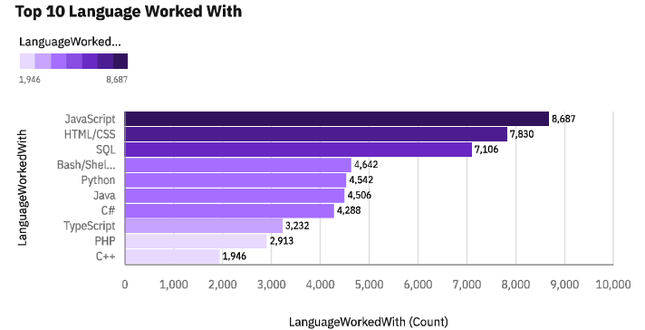
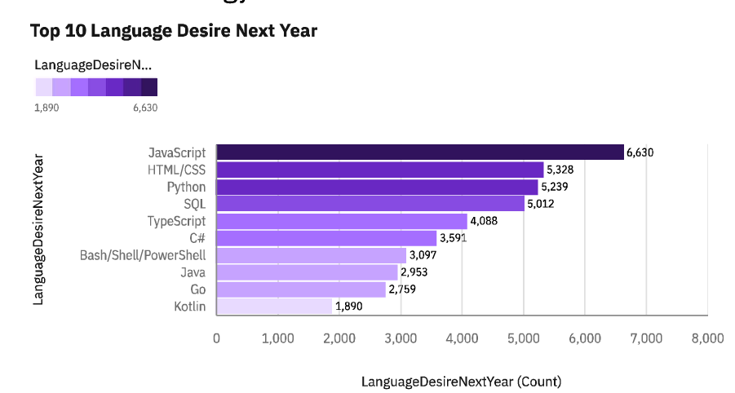
PROGRAMMING LANGUAGE TRENDS
Current Year
Next Year

Slide 8
PROGRAMMING LANGUAGE TRENDS - FINDINGS & IMPLICATIONS
Findings
JavaScript is the most used and desired language, indicating its ongoing relevance in development.
Python's popularity is growing, showing its significance in fields like data science and AI.
TypeScript demand is increasing, suggesting developers are adopting it for scalable projects
Implications
Companies should prioritize JavaScript-based frameworks to stay competitive.
Providing Python training would be advantageous for teams focusing on AI and data analysis.
Adopting TypeScript could improve code quality and maintainability in large projects

Slide 9
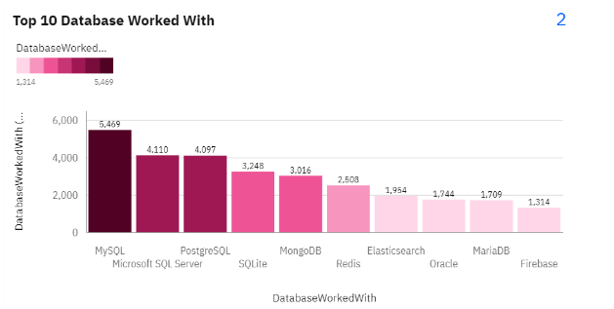
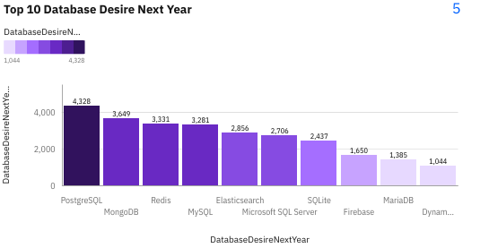
DATABASE TRENDS
Current Year
Next Year

Slide 10
DATABASE TRENDS - FINDINGS & IMPLICATIONS
Findings
MySQL is currently the most used database, but PostgreSQL has the highest demand for the next year.
MongoDB and Redis are gaining interest, showing increased focus on NoSQL databases.
Traditional databases like Oracle and Microsoft SQL Server are seeing less future interest compared to PostgreSQL and MongoDB
Implications
Companies may benefit from investing in PostgreSQL to align with growing developer interest.
Expanding knowledge and support for NoSQL databases like MongoDB and Redis could meet future data needs.
Organizations relying on traditional databases might consider modernizing with PostgreSQL or NoSQL options to stay competitive.

Slide 11

DASHBOARD
https://github.com/Dicerdt1/IBM-Data-Analyst-Capstone-Project/tree/main

Slide 12
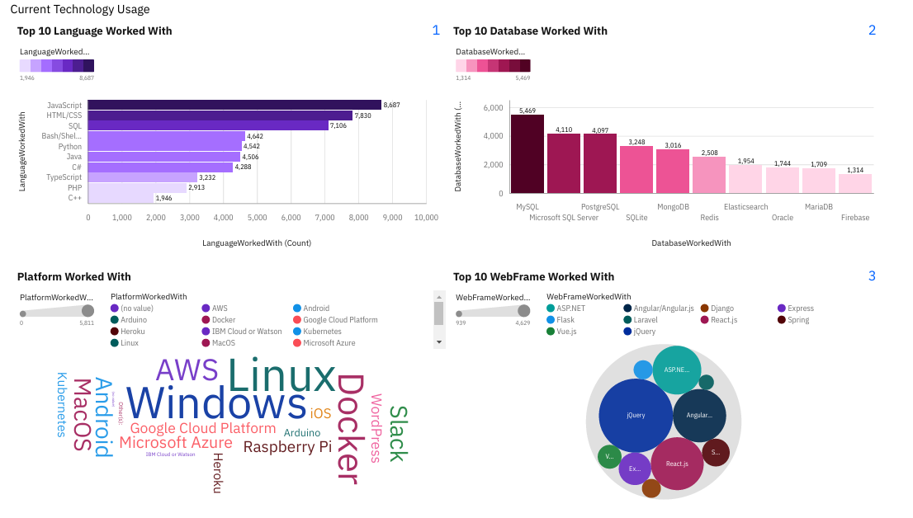
DASHBOARD TAB 1

Slide 13
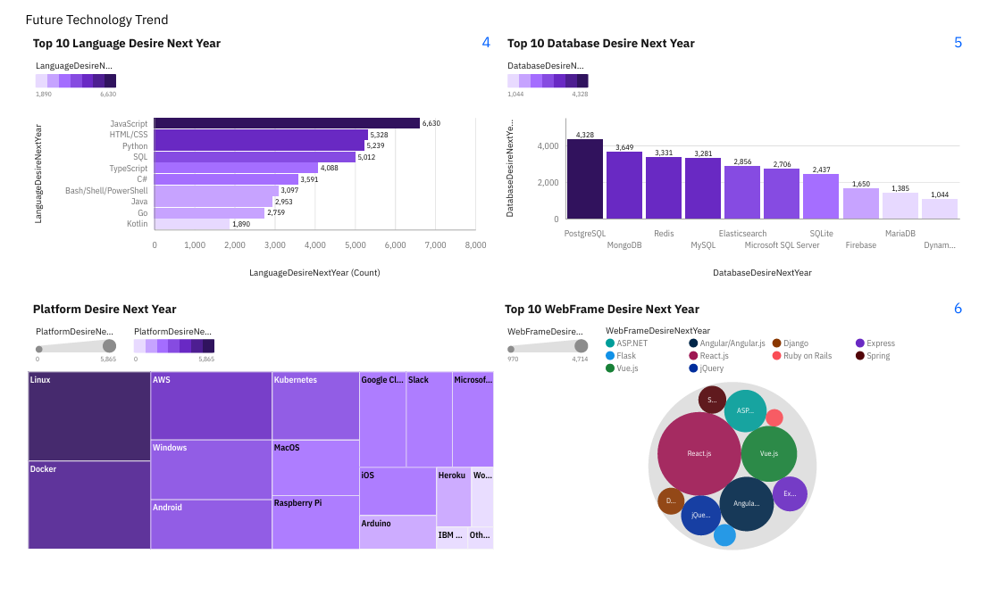
DASHBOARD TAB 2

Slide 14
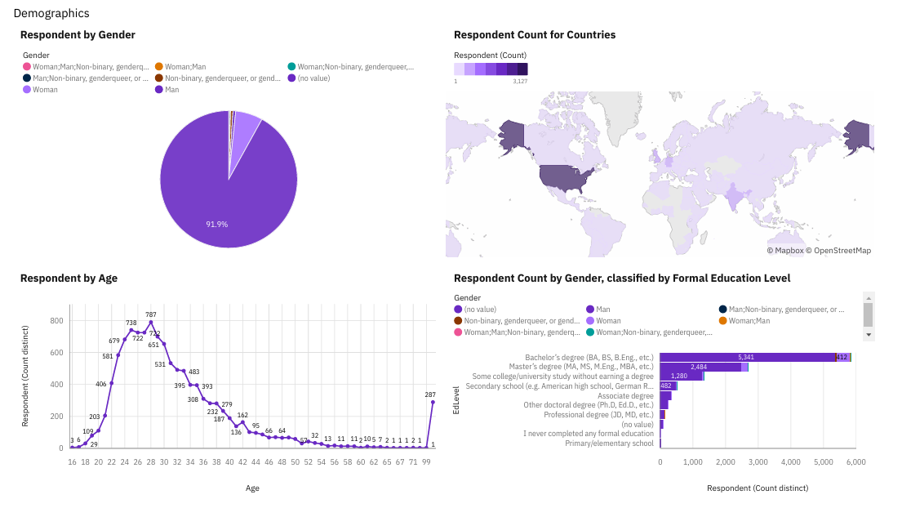
DASHBOARD TAB 3

Slide 15
DISCUSSION
Language Trends: JavaScript remains dominant, but rising interest in Python and TypeScript suggests a shift towards languages that support data science, AI, and scalable web development.
Database Preferences: While MySQL leads in current usage, PostgreSQL is the top choice for the future, reflecting a shift towards more versatile and scalable database solutions. The growing interest in NoSQL options (e.g., MongoDB, Redis) highlights the need for flexibility in data management.
Platform Evolution: Developers continue to favor cross-platform environments, with Linux and Docker seeing steady growth. This trend underlines the importance of containerization and open-source platforms in modern development workflows.

Slide 16
OVERALL FINDINGS & IMPLICATIONS
Findings
JavaScript remains highly popular, but the rising demand for Python and TypeScript suggests a growing focus on data science, AI, and scalable applications.
PostgreSQL is becoming the preferred database, with NoSQL databases like MongoDB and Redis also gaining traction, indicating a shift towards more flexible and scalable data solutions.
The popularity of Linux and Docker shows an industry trend towards open-source, cross-platform, and containerized development environments.
Implications
Businesses should invest in training for Python and TypeScript to support data-driven projects and scalable development needs.
Organizations may benefit from transitioning to PostgreSQL and adopting NoSQL databases to handle diverse data requirements more effectively.
Embracing Linux and Docker can enhance development efficiency, making infrastructure more adaptable and aligned with modern industry practices.

Slide 17

CONCLUSION
The analysis reveals a significant shift in developer preferences towards tools and technologies that support scalability, flexibility, and modern application demands.
JavaScript, Python, and TypeScript lead the language trends, suggesting that companies should prioritize these languages for future projects.
PostgreSQL and NoSQL databases are becoming increasingly favored, reflecting the need for adaptable and robust data management solutions.
The majority of respondents come from a diverse age range and educational background, highlighting the inclusivity of the developer community. Most hold a bachelor’s degree, showing the importance of formal education in tech fields, though there’s still substantial representation from self-taught developers.

Slide 18

APPENDIX
A. JOB POSTINGS
B. POPULAR LANGUAGES

Slide 19
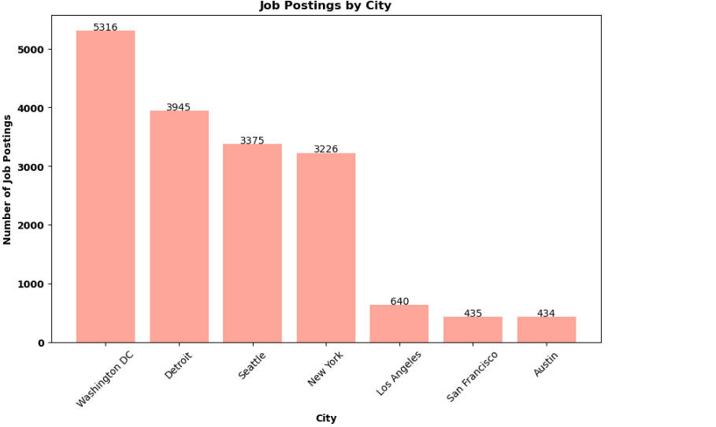
A. JOB POSTINGS

Slide 20
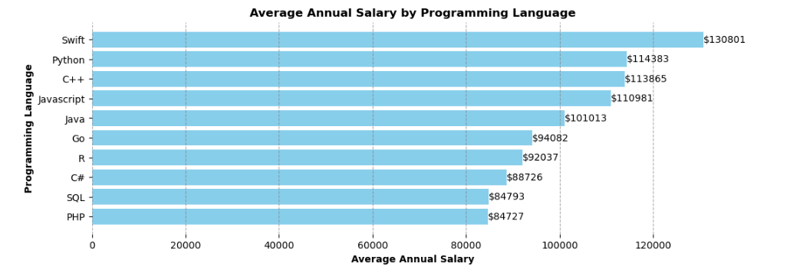
B.POPULAR LANGUAGES

