Slide 1

USAIS Hackathon 2022
Team AutoEncode
Benjamin Sanati, Emil Stoev, Miroslav Milanov

Slide 2
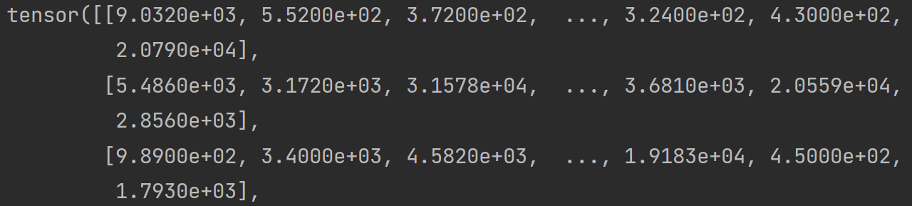
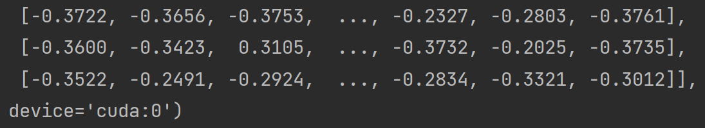
Datasets Analysis
Non-normalized input tensor
By looking at the 3 datasets, we located important features which we believed could be used to analyze the data
Vectorize
Transformations
ToTensor()
Normalize
Normalized GPU located input tensor

Slide 3
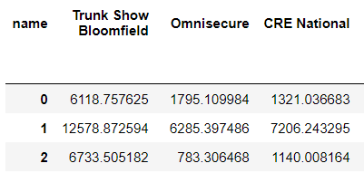
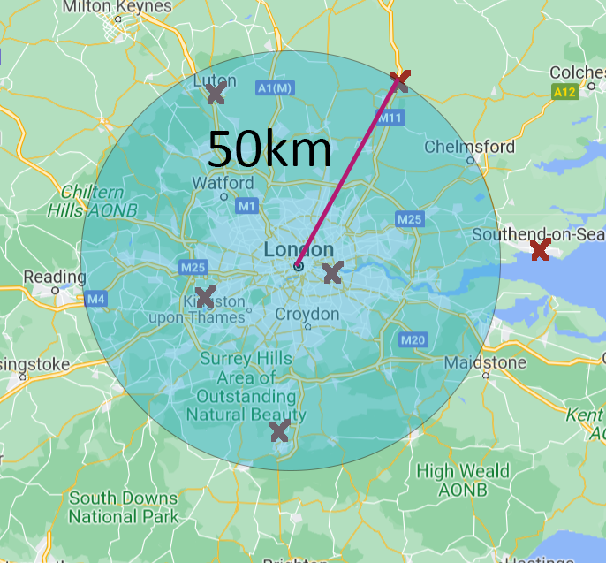
Failed Approach
Model consisted of:
Deriving a radius around each event based on flight volume
Training a model which maximized the difference in volume over a range of days
Calculate most important events using a multiplier
Produced dataset, regarding distance between each event and each airport

Slide 4
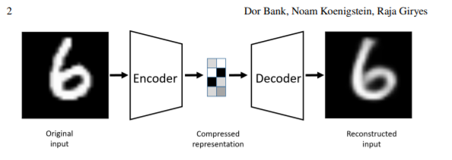
Final Approach
We used an autoencoder to create a reconstruction of the input
General autoencoder architecture [Bank, D., Koenigstein, N., and Giryes, R., “Autoencoders”, arXiv, 2020]
This produces a bottleneck with the most important features (dimensionality reduction → generalized PCA), from which the input is reconstructed
This reconstructed input can be compared with the original image to identify a loss-threshold to be used for anomaly detection
Final layer has tanh activation

Slide 5
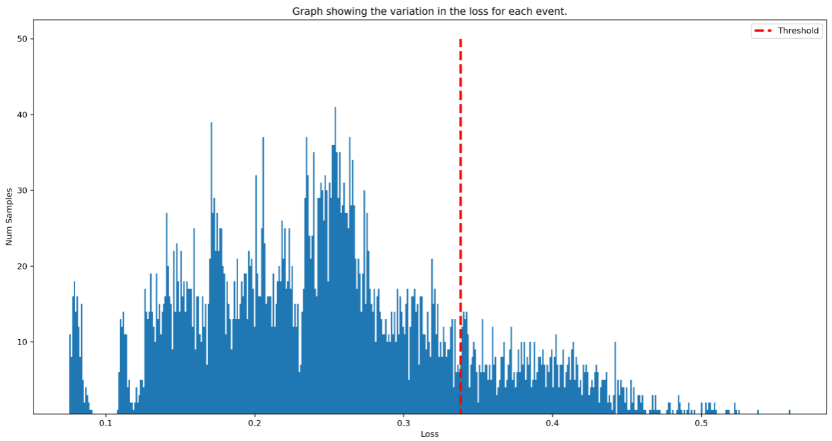

Results
Use the MAE to derive a threshold for anomaly detection
All events above threshold result in anomalous behavior
Can now identify anomalous events and simply index the original dataset
Histogram representing the distribution of MAE between the input and the reconstructed input for each event. The losses above the red threshold represent the anomalies

Slide 6
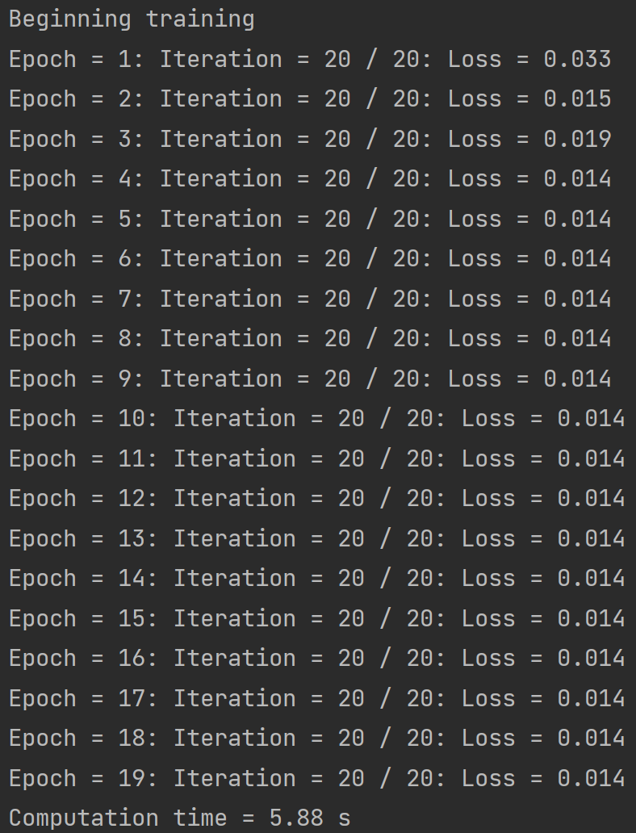
Model Performance
Over 19 epochs of the training of the model took an average of 5.95s
Our final model converged at an MSE loss of 0.014
The model was implemented on the CUDA GPU to improve performance

Slide 7
Improvements to approach
The model implemented was a very basic Autoencoder
We could further optimize the model using a sparse Autoencoder
Although more accurate models could be implemented this would actually be bad for anomaly detection
Further tune hyperparameters

Slide 8
Thank you!
Any questions?

