Slide 1
GPU-Acceleration for VGG-like CNN
By Haocheng Li, Hanxiao He

Slide 2
VGG Network
Image
Conv
Layer
Pooling Layer
Fully
Connect
Softmax
Prediction

Slide 3
Convolution Layer
Type | 1 | 2 | 3 | 4 | 5 | 6 | 7 | 8 | 9
Input Channels | 3 | 64 | 64 | 128 | 128 | 256 | 256 | 512 | 512
Image Size | (224, 224) | (224, 224) | (112, 112) | (112,112) | (56,56) | (56,56) | (28,28) | (28,28) | (14,14)
Output Channels | 64 | 64 | 128 | 128 | 256 | 256 | 512 | 512 | 512
Amount | 1 | 1 | 1 | 1 | 1 | 2 | 1 | 2 | 3
Totally 13 Conv Layers

Slide 4
Pooling Layer
Type | 1 | 2 | 3 | 4 | 5
Input Channels | 64 | 128 | 256 | 512 | 512
Image Size | (224, 224) | (112, 112) | (56, 56) | (28, 28) | (14,14)
Output Channels | 64 | 128 | 256 | 512 | 512
Output Image Size | (112, 112) | (56, 56) | (28, 28) | (14,14) | (7, 7)
Amount | 1 | 1 | 1 | 1 | 1
Totally 5 Pooling Layers

Slide 5
Conv Kernel 1
Thread Block
(0, 0)
Thread Block
(0, 1)
Output
One thread calculates one output pixel (all channel)
Resource Limitation:
Max thread per threadblock: 1024
Use different threadblock to extend the limitation
Output
Thread Block
(1, 0)
Thread Block
(1, 1)
ConvLayer1<<<dim3(8, 8, 1), dim3(32, 32, 1)>>>
Totally (8 * 32) * (8 * 32) = 256 * 256 threads, if image size less than 256, those thread just do nothing

Slide 6
Conv Kernel 2
Thread Block
(0)
Thread Block
(1)
Output
Different thread block handle different output channels.
One thread calculate multiple pixels:
(0, 0) , (0, 32) , (0, 64)…
(32, 0), (32, 32), (32, 64)…
…
Output
Thread Block
(2)
Thread Block
(3)
ConvLayer2<<<outDimention, dim3(32, 32, 1)>>>

Slide 7
Conv Kernel 3
Output
Designed for large input channels
Resource Limitation:
48Kb shared memory per threadblock
11 SMX
One thread block need to handle multiple output channels
Thread Block
(0)
Thread Block
(1)
Output
Output
Thread Block
(2)
Thread Block
(3)
ConvLayer3<<<24, inputDimention, (3 * 3 * inDimention + inputDimention / 32) * sizeof(float) >>>

Slide 8
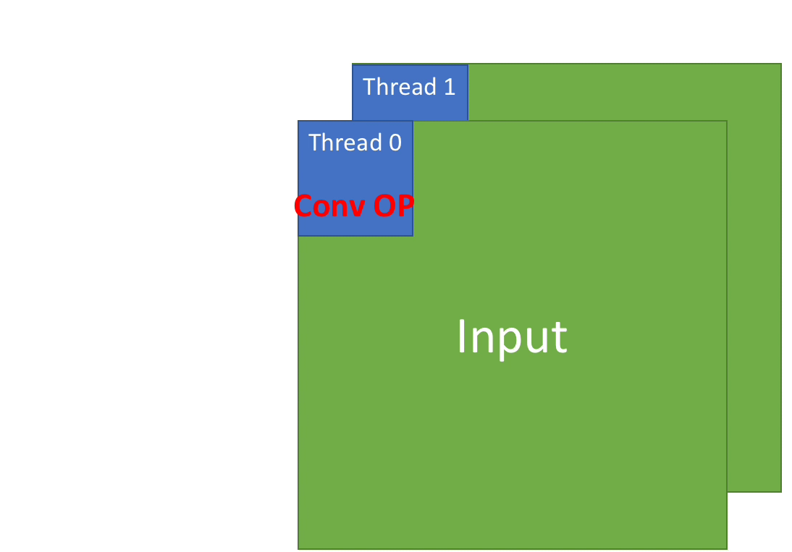
Conv Kernel 3
One thread calculates one dimension convolution.
After each convolution, threads in the same thread block need to do reduce sum.
Different thread block handle different filters
ConvLayer3<<<24, inputDimention, (3 * 3 * inDimention + inputDimention / 32) * sizeof(float)>>>

Slide 9
Conv Kernel 3
Reduction Inside Threadblock
Shuffle down
Shuffle down
Warp 0
Warp 1
…
…
…
Write every warp reduced sum to shared memory
Shared Memory
Shuffle down
…
Final result, writ to output
ConvLayer3<<<24, inputDimention, (3 * 3 * inDimention + inputDimention / 32) * sizeof(float)>>>

Slide 10
Conv Kernel 4
Output
Similar to Conv Kernel 2
Shared memory store the filter weights
Resource Limitation:
48Kb shared memory per threadblock
11 SMX
One thread block need to handle multiple output channels
Thread Block
(0)
Thread Block
(1)
Output
Output
Thread Block
(2)
Thread Block
(3)
ConvLayer4<<<24, dim3(32, 32, 1), (3 * 3 * inDimention) * sizeof(float)>>>
GridDim (24 here) is decided by shared memory limitation
(3 * 3 * inDimention) * sizeof(float) is the shared memory dynamically allocated in one threadblock

Slide 11
Type | 1 | 2 | 3 | 4 | 5 | 6 | 7 | 8 | 9
Input Channels | 3 | 64 | 64 | 128 | 128 | 256 | 256 | 512 | 512
Image Size | (224, 224) | (224, 224) | (112, 112) | (112,112) | (56,56) | (56,56) | (28,28) | (28,28) | (14,14)
Output Channels | 64 | 64 | 128 | 128 | 256 | 256 | 512 | 512 | 512

Slide 12
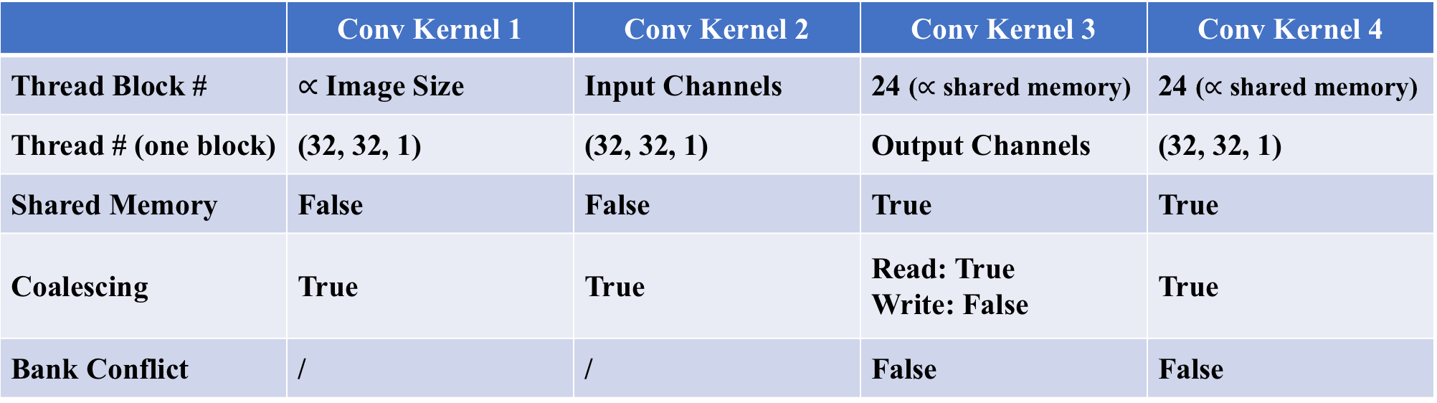
 | Conv Kernel 1 | Conv Kernel 2 | Conv Kernel 3 | Conv Kernel 4
Thread Block # | $∝$ Image Size | Input Channels | 24 ($∝$ shared memory) | 24 ($∝$ shared memory)
Thread # (one block) | (32, 32, 1) | (32, 32, 1) | Output Channels | (32, 32, 1)
Shared Memory | False | False | True | True
Coalescing | True | True | Read: True Write: False | True
Bank Conflict | / | / | False | False

Slide 13
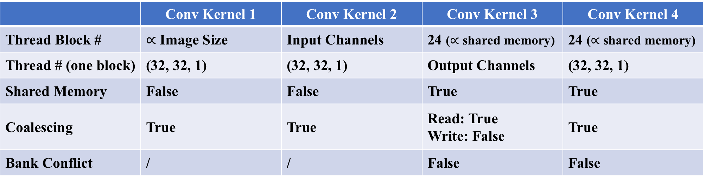
Filters | Scale | Amounts | Conv Kernel 1 | Conv Kernel 2 | Conv Kernel 3 | Conv Kernel 4
filter 1 | 3 * 224 * 224 * 64 | 1 | 0.042 | 0.048 | 3.784 | 0.029
filter 2 | 64 * 224 * 224 * 64 | 1 | 0.762 | 0.659 | 3.652 | 0.615
filter 3 | 64 * 112 * 112 * 128 | 1 | 0.466 | 0.305 | 1.825 | 0.312
filter 4 | 128 * 112 * 112 * 128 | 1 | 0.941 | 0.611 | 1.836 | 0.624
filter 5 | 128 * 56 * 56 * 256 | 1 | 1.552 | 0.295 | 0.840 | 0.292
filter 6 | 256 * 56 * 56 * 256 | 2 | 2.892 | 0.589 | 0.850 | 0.586
filter 7 | 256 * 28 * 28 * 512 | 1 | 5.075 | 0.266 | 0.424 | 0.255
filter 8 | 512 * 28 * 28 * 512 | 2 | 10.335 | 0.530 | 0.434 | 0.513
filter 9 | 512 * 14 * 14 * 512 | 3 | 8.977 | 0.366 | 0.108 | 0.316
Total Time Estimate for Conv: 4.471 s
 | Conv Kernel 1 | Conv Kernel 2 | Conv Kernel 3 | Conv Kernel 4
Thread Block # | $∝$ Image Size | Input Channels | 24 ($∝$ shared memory) | 24 ($∝$ shared memory)
Thread # (one block) | (32, 32, 1) | (32, 32, 1) | Output Channels | (32, 32, 1)
Shared Memory | False | False | True | True
Coalescing | True | True | Read: True Write: False | True
Bank Conflict | / | / | False | False

Slide 14
Pooling Kernel 1
Output
Thread Block
(0)
Thread Block
(1)
Output
Input
Design Idea:
Leverage GMEM coalesce copy to reduce IO time.
Utilize warp manipulation
4(RF)
8(RF)
Thread Block
(2)
Thread Block
(3)
PoolLayer1<<<dim3(Width/8, 8, 1), 32>>>

Slide 15
Pooling Kernel 1
Thread 0
Thread 1
Thread 2
Thread 3
1.1 | 5.1 | 4.3 | 6.7
1.5 | 2.4 | 3.9 | 5.7
0.3 | 3.2
6.7 | 2.0
Design Idea:
Leverage GMEM coalesce copy to reduce IO time.
Utilize warp manipulation
__shfl_down(val, 8)
1.5 | 5.1 | 4.3 | 6.7
1.5 | 2.4 | 3.9 | 5.7
6.7 | 3.2
6.7 | 2.0
__shfl_down(val, 1)

Slide 16
Pooling Kernel 2
Thread Block
(0, 0)
Thread Block
(0, 1)
Output
Input
Design Idea:
Maintain large ILP
2. Not coalesce access
Thread Block
(1, 0)
Thread Block
(1, 1)
PoolLayer2<<<dim3(Width/8, Width/8, 1), dim3(8, 8, 1)>>>

Slide 17
Fully connected
1.1 | 5.1
1.5 | 2.4
0.3 | 3.2
6.7 | 2.0
Design Idea:
Leverage shared memory to accumulate on previous result.
Maintain large ILP.
4096
1.1 | 5.1 | 4.3 | 7.0
57.5 | 45.6
1000
Fully connected<<<1, Width>>>

Slide 18
Type | 1 | 2 | 3 | 4 | 5
Input Channels | 64 | 128 | 256 | 512 | 512
Image Size | (224, 224) | (112, 112) | (56, 56) | (28, 28) | (14,14)
Output Channels | 64 | 128 | 256 | 512 | 512
Output Image Size | (112, 112) | (56, 56) | (28, 28) | (14,14) | (7, 7)

Slide 19
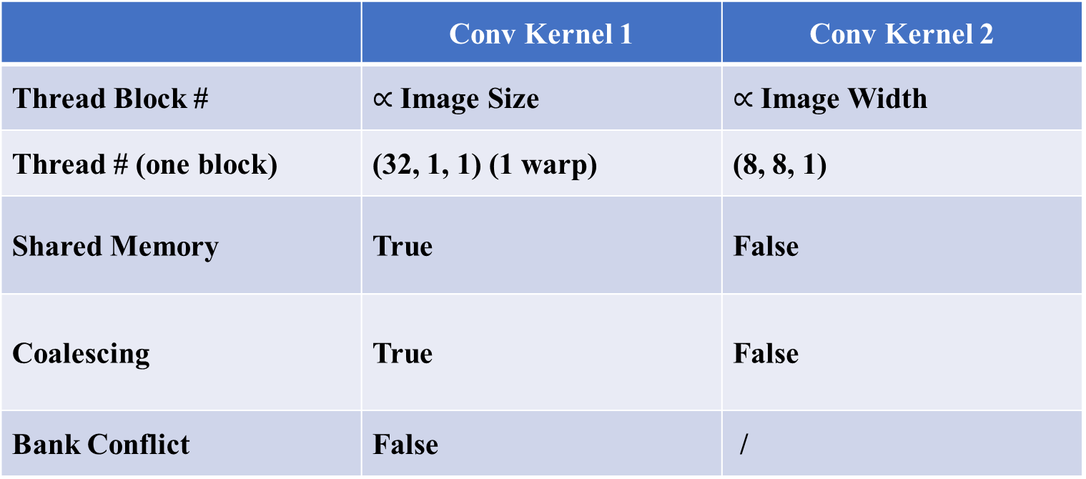
Pooling Layer
 | Conv Kernel 1 | Conv Kernel 2
Thread Block # | $∝$ Image Size | $∝$ Image Width
Thread # (one block) | (32, 1, 1) (1 warp) | (8, 8, 1)
Shared Memory | True | False
Coalescing | True | False
Bank Conflict | False | /
Total Time Estimate for Pooling: 2.393 ms

Slide 20
Fully connect Layer
Type | 1 | 2 | 3
Kernel Size | (7 * 7 * 512, 4096) | (4096, 4096) | (4096, 1000)
Input Size | 7 * 7 * 512 | 4096 | 4096
Output Size | 4096 | 4096 | 1000

