Slide 1
A Git/GitHub Workflow
Grant Braught
Dickinson College
COMP491
Fall 2021
Licensed under a Creative Commons Attribution-NonCommercial-ShareAlike 4.0 International License.
Notes:
Complicated
- No one overview or activity is going to be sufficient.
- Goal here is to walk through the fundamentals once.
- Then we’ll practice them a few times in future activities
- Then you’ll adapt them to the specifics of how your project community works as you engage with them.

Slide 2
Basic Terminology
Origin Is a copy (fork) of the upstream repository in your GitHub. You will have read/write access.
Repository holds all of the code and the history of the project.
origin
upstream
Branch a sequence of snapshots (commits) that make up the development history
Local is a copy (clone) of your origin repository on your local machine.
Upstream belongs to the project. You will have read-only access.
Remotes
On GitHub
Local
On Your Machine
Files are the version of the files that you are currently working with on your local machine.
Files
Stage
Notes:
Before we get going,
- Come common terminology from the readings
- Remotes: Out in the cloud (on GitHub)
- Repository – copy of all of the files and history of the code.
- Upstream – the definitive copy of the project
- Origin – a fork or copy by someone working on the project
- Local – copy of your origin on your machine for local work
- Files – the version of the project files you are working on.
- when you edit and save this is where those changes are saved.
Branch – sequence of commits in your repository
Commits - snapshots of project at a moment in time
- Adds the state of the last save with a comment (commit message) to the repo
- Circles represent commits, time left-to-right
Stage – temporary area where files are “staged” for a commit.
- More later.

Slide 3
Part 1 Before the First Class: Getting Set Up
Grant Braught
Dickinson College
COMP491
Fall 2021
Licensed under a Creative Commons Attribution-NonCommercial-ShareAlike 4.0 International License.
Notes:
Now I want to give you a visual of what you did in the homework activity.

Slide 4
Forking the Upstream (before)
origin
upstream
Remotes
On GitHub
Local
On Your Machine
Main Branch
Files
Stage
Notes:
Upstream: Project repository (typically read-only to you)
- This is the Calculator project in the COMP491 GitHub
- It is playing the role of an open source project going on out in the world that you might join.
Main branch – the name for the main thread of development.
- Used to be called the “master branch”
- GitHub and others have changed the default name to main
- But some older projects have not made the shift so you may encounter “master branches” in projects.
This is the state before you fork the project.

Slide 5
Forking the Upstream (after)
origin
upstream
Fork repo on GitHub
fork
Remotes
On GitHub
Local
On Your Machine
Main Branch
Files
Stage
Notes:
After getting git all setup the first thing you did was to Fork the Upstream.
The Fork operation made a fill copy of the upstream repository from the main project into your GitHub account.
- This includes the main branch (and any others).
- This was done completely in the GitHub GUI through the browser.
Your fork also keeps a record of where it came from
- The think black arros
- This will allow you to contribute changes that you make in your origin back to the main project
- More on that later.
Verify that they all have a fork of the correct repo.
- pair those that do not with someone that does.

Slide 6
Cloning your Origin
origin
upstream
cd Documents
git clone <URL>
cd github-issues-sect1
ls
clone
Remotes
On GitHub
Local
On Your Machine
Main Branch
Files
Stage
Notes:
You then cloned the repository from your origin to your local machine.
- Note that fork and clone both copy the repo, but have different meanings.
The ls command will show that:
- the most recent version of the files in the main branch appear in the directory on your machine.
Local repo keeps track of the Origin
- Small black arrow
- Allows you to “push” changes than you make to the code back to GitHub
- And then ultimately contribute them back to the upstream.
So you will work locally on your clone.
When you have changes ready you can push them to the origin.
And then contribute them to the upstream.

Slide 7
Setting the Upstream Remote
origin
upstream
git remote –v
git remote add upstream <URL>
git remote -v
Remotes
On GitHub
Local
On Your Machine
Main Branch
Files
Stage
Notes:
There are potentially many developers contributing to the upstream.
- So the main branch may change based on contributions from others.
- You will want to be able to get those changes into your repositories (Local and Origin)
However:
- The local repository does not know about the upstream
- It is not possible to get change from upstream into your Origin
- Even though it seems like it should… it does not.
So the way it will work is:
- We’ll tell the local repo about the upstream by setting the upstream remote.
- Then well bring changes from the upstream to your local repository
- And then push thee changes to your origin.
This will allow you to keep your local and origin main branches ”in synch” with the upstream.
- The main branch should be the same everywhere.
- You will not edit the main branch.

Slide 8
Part 2 Hands-on in the First Class: The Branching Workflow
Grant Braught
Dickinson College
COMP491
Fall 2021
Licensed under a Creative Commons Attribution-NonCommercial-ShareAlike 4.0 International License.
Notes:
Complicated
- No one overview or activity is going to be sufficient.
- Goal here is to walk through the fundamentals once.
- Today
- We’ll go through the process of fixing a bug and contributing the fix back to the upstream.
- Friday, we’ll see what happens when your changes conflict with changes made by someone else.
Process:
- Web-page with checkpoints
- Work entirely in your VM
- Be disciplined
- stop at checkpoints
- Don’t work ahead, just wait patiently
- let me know you have finished
- I’ll come around and verify or ask you to verify state

Slide 9
Find an Issue to Fix
Follow directions on the activity page:
Use the Issue Tracker
Comment on an issue with the tag “Round1”
Refresh to see if you are the first.
If so its yours.
If not… try again.
Wait until everyone has an issue.

Slide 10
Branching Workflow: Branch and Fix
origin
upstream
git branch
git branch <branchname>
git switch <branchname>
git branch
Make changes to files
Remotes
On GitHub
Local
On Your Machine
Main Branch
Feature Branch
Files
switch
Stage
Notes:
Once you identify an issue or feature to work on in a project
- You’ll use a “branching workflow” to do your work and contribute it back to the upstream.
Branch: A copy of the current state of your repo
- Not really a full copy but it behaves like it is.
- So don’t worry about the space being used.
git branch:
- lists all of the branches in your repo
- or creates a new branch
git branch <name>:
- Make one of these each time you want to make changes
- Do not make edits in the master branch.
- This way you retain a clean copy
- can go back to it if you screw up or change your mind
- makes it easier to merge in changes to the upstream (we’ll see this later)
git switch <name>
- Switch (used to be called checkout, which still works)
- Switches your files to those in a specified branch.
- switch feature
- switch main
Save your work as you go just like any other time.
- Those changes are saved in your files.
- We’ll see how to get the changes into the repos shortly.
- BE SURE TO ONLY MAKE THE CHANGES IN YOUR ISSUE – DO NOT CHANGE ANYTHING ELSE.
After:
- Mention: Notice working on the files is just like any other time.
- Ask: How can you tell which branch you are on?
- The output of git branch tells you
- the * in the output of git branch
- Ask: Why use a feature branch instead of working on the main branch?
- Resettability
- Philosophically
- only project managers modify main
- Keeps a definitive version in face of many contributors making changes.
- If its your own project then you are the manager so fine.

Slide 11
Branching Workflow: Status, Stage and Commit
origin
upstream
git status
git add <filenames>
git commit –m “message”
git status
git log
Remotes
On GitHub
Local
On Your Machine
Main Branch
Feature Branch
Files
Commit
add
Stage
Notes:
When you have completed some work you will commit it to the repo.
git status:
- displays information about what has been changed since last commit
git add <files>:
- places the listed files onto the “Stage”
- a list of things to be included in the next commit
git commit –m “message”:
- adds the changes on the stage into the current branch as a new commit.
- include a descriptive comment that explains what this set of changes accomplished.
After Ask:
- What did the add do?
- Stages changes for commit – does not put into feature branch.
- What did the commit do?
- Added staged changes to the feature branch.
- Why doesn’t a commit just put all changed files in?
- So that you can pick and choose…
- Philosophy of a commit:
- a commit should be a “nameable piece of work”
- Added fix for blah.
- Added tests for blah.
- so you might have changed multiple files and each might have a different message.
- if you were perfectly disciplined you might not need this, but few of us are that disciplined.
- Typically there will be multiple commits for a bug fix or a feature addition.
- What does git log do?

Slide 12
Branching Workflow: Push Branch to Origin
origin
upstream
git push origin <branchname>
push
Remotes
On GitHub
Local
On Your Machine
Main Branch
Feature Branch
Files
Stage
Notes:
If you want to contribute those changes back to the upstream project
- you need to get them to your origin first.
- you do that by pushing them
- the push transfers the new branch with its commits to your origin.
Verify existence of feature branch on their GitHub.
Why does it work this way?
- Why not just send the changes directly to the upstream?
- #1 – you do not have permissions to put anything into the upstream.
- #2 – Git and GitHub (or GitLab or BitBucket or whatever Remote service you are using) are different tools
- The git tool manages repos and commits and branches
- The repository hosting service (e.g. GitHub) manages the process of requesting an addition to the upstream.
- GitHub calls it a Pull Request
- “Pull my changes in to the upstream”
- GitLab calls it a Merge Request
- ”Merge my changes into the upstream”

Slide 13
Branching Workflow: Making a Pull Request
New Pull Request
Check ”base fork” is main
Check “head fork” is branch
Check comparison
Create Pull Request
Edit comment
include “Fixes #<bugid>”
Create Pull Request
Changes merged into Upstream
origin
pull request
upstream
Remotes
On GitHub
Local
On Your Machine
Main Branch
Feature Branch
Files
Stage
Notes:
The push copied your feature branch and the changes it contains into your origin on GitHub
Pull Request:
- Issued through GitHub web interface in browser.
- Asks upstream project manager to “pull” your changes into the project.
Project manager will merge acceptable chagnes into the upstream main branch.
- Shown as red and blue commits.
- the red one from the shown pr
- the blue one from another one.
After:
- Show the PR’s from the perspective of the upstream.
- Show that they can be merged automatically
- The round 1 issues were carefully chosen so that they do not conflict.
- i.e. they do not change the same lines of code.
- Do each of the merges.
- Show the upstream main code with all changes merged in.
- Show the issues being automatically closed.
- In practice it is rarely so simple.
- Often you will get comments back asking for further changes
- If you make more changes and push the same branch the PR automatically updates.
Ask: What do you notice now about the main branches in the different repo?
- They are different….
- For you to get the changes, you need to synchronize your mains with the upstream…

Slide 14
Branching Workflow: Synchronize with Upstream
origin
upstream
git switch main
git branch
git pull upstream main
git push origin main
push
Pull
Remotes
On GitHub
Local
On Your Machine
Main Branch
Feature Branch
Files
Stage
Notes:
So now the upstream main has changes that you do not.
If you were to begin working on something new you want to start from the current state of the upstream main
So you need to get your mains to look like that one.
You need to synchronize of synch
Pull merges changes in upstream main into local main.
- Automatically because you never changed local main – and you never should.
- that way there will never be any conflicts.
Push pushes the updated master to the origin
- so all are in synch now.
- all changes made to upstream including your pull request are in local and origin now.
Now if you were to make a new feature branch, you start from the most up to date point.

Slide 15
Delete Feature Branch
origin
upstream
git switch main
git branch
git branch -d <branchname>
git branch
git push –d origin <branchname>
Remotes
On GitHub
Local
On Your Machine
Main Branch
Feature Branch
Files
Stage
Notes:
When the changes in your feature branch have been merged into the upstream
There is no reason to keep your branch around
- Even though it feels sentimental.
So you can delete that branch from your local and origin repo.
Confirm you are here.
If not at this point, get me to help you to get there now.
Then

Slide 16
Part 3 Before the Second Class: Make Another PR
Grant Braught
Dickinson College
COMP491
Fall 2021
Licensed under a Creative Commons Attribution-NonCommercial-ShareAlike 4.0 International License.
Notes:
For homework you are going to repeat the process above
- pick a round2 issue
- make a branch
- make the fix
- commit it
- push it
- make PR for it.
The Round2 Issues have been chosen so that they will create conflicts.
So you will get to experience what happens when:
- While you are working
- There are others that are also working
- And a change gets merged into main that conflicts with what you are doing.

Slide 17
Fix a Round 2 Issue: Concurrent Changes (part 1)
origin
upstream
git branch
git branch <branchname>
git switch <branchname>
git branch
Fix the issue
Conflicting changes
made to upstream
Remotes
On GitHub
Local
On Your Machine
Main Branch
Feature Branch
Files
Note: Illustration of the main branch was shortened from prior slides just to make it fit.
Stage
Notes:
Here you have made a feature branch
- working along to make your changes,
- red files
While you are doing that
- others are also working on the project
- in their own branches
- making PRs
- Some get merged
- E.g. the blue commit in the upstream main.
May be that the blue changes and the red changes touch the same code.
- This creates a conflict
Next slide…

Slide 18
Fix a Round 2 Issue: Concurrent Changes (part 2)
origin
Pull Request
upstream
git status
git add <filenames>
git commit –m “message”
git push origin <branchname>
Make pull request
- Cannot be merged automatically
Push
Remotes
On GitHub
Local
On Your Machine
Main Branch
Feature Branch
Files
Commit
add
Stage
Notes:
Now you have your changes (red)
- You stage them
- You commit them
- You push them to the origin
- You make a PR for the changes in your branch.
But…
- The changes in your branch conflict with the changes in the upstream main.
- They cannot be merged automatically
- GitHub doesn’t know which to choose.
When this happens…
- It will requires an intervention by you.
- Typically you will get a message from the project managers
- Something like: Please resolve conflicts with upstream main and update your PR.
- You need to make your changes compatible with the current state of the main branch.
That’s what we’ll see today.
- After last class I made changes to the upstream main that conflict with the Round2 issues.
- So when you fixed them in your branches you got a conflict
- GitHub will have told you that the changes could not be merged automatically.

Slide 19
Part 4 Hands-on in the Second Class: Resolving Conflicts
Grant Braught
Dickinson College
COMP491
Fall 2021
Licensed under a Creative Commons Attribution-NonCommercial-ShareAlike 4.0 International License.

Slide 20
Synch Upstream Changes
Origin
Pull Request
Upstream
git switch main
git branch
git pull upstream main
git push origin main
Push
Pull
Remotes
On GitHub
Local
On Your Machine
Main Branch
Feature Branch
Files
Stage
Notes:
Might imagine project manager taking care of the conflict.
They are busy people… Wil typically ask you.
Synch with upstream again…
- switch to main branch
- pull upstream main
- automatically merges into your main
- because you never changed it!!
- push to your origin
- All main’s are in synch now.
But your feature branch still doesn’t have the blue changes in it.
So it is still not compatible with main
I.e. it is in conflict with main.

Slide 21
Merge master Branch Changes into feature Branch
Origin
Pull Request
Upstream
git switch <branchname>
git branch
git merge main
Remotes
On GitHub
Local
On Your Machine
Main Branch
Feature Branch
Files
Stage
Notes:
So what you need to do is blend
- your red changes
- with the upstream blue changes
- the code files will contain both.
Many ways to do it:
- Usually use a graphical merge tool
- Often built into IDE’s like eclipse / atom / etc
- We’ll see one here…

Slide 22
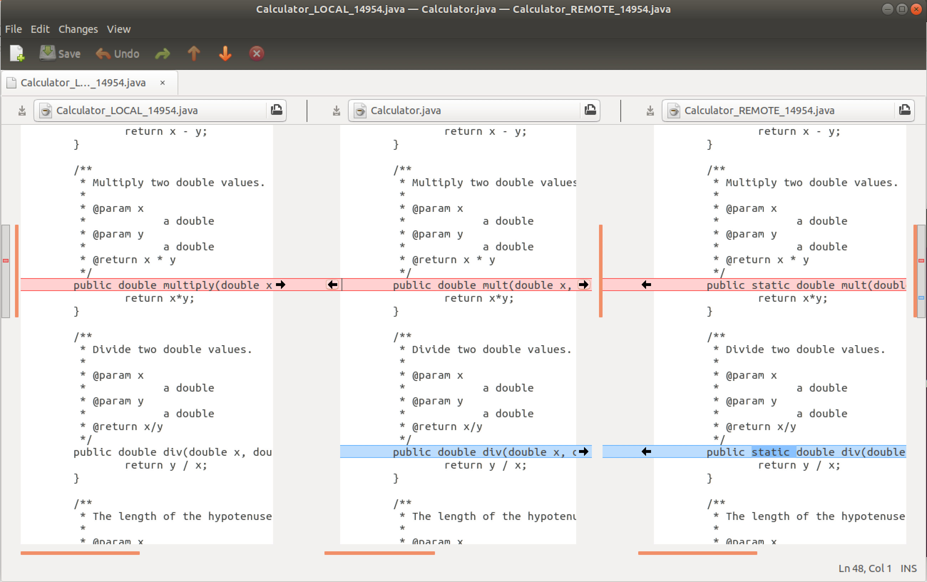
Merge Tool (meld)
git mergetool
Original File / Merged Result
Feature Branch
Main Branch
Notes:
git mergetool:
- launches a graphical Merge Tool
- meld – because we configured it.
Left - Feature Branch:
- shows the changes that you made locally.
Right - Main Branch
- shows your local main branch
- includes changes to the upstream main because you synched.
Center – resolution
- shows original file before your changes or the upstream changes
- Resolve the conflict…
- move code in from left to accept your changes
- move code in from the right to accept upstream changes
- edit directly to blend together the changes.
- Save!

Slide 23
Commit and Push (Update Pull Request)
Origin
Pull Request
Upstream
git status
git commit –m “merged …”
git push origin <branchname>
Push
Remotes
On GitHub
Local
On Your Machine
Main Branch
Feature Branch
Files
Commit
add
Stage
Notes:
You will blend the red and blue changes.
Stage them
Commit them
Push them to your origin
That automatically updates your PR
- Now can be merged automatically.
If against all odds things go really smoothly:
- merge them

Slide 24
Synch with Upstream and Delete Feature Branch
Origin
Upstream
git switch main
git branch git pull upstream main
git push origin main
git branch –d <branchname>
git branch
git push –d origin <branchname>
Push
Pull
Remotes
On GitHub
Local
On Your Machine
Main Branch
Files
Stage
Notes:
After those changes are merged.
Resynch with upstream main to get them
Then delete your feature branch.

Slide 25
Credits
http://foss2serve.org/index.php/Git:_GitHub_Issues_and_Pull_Request
A similar activity produced by Chris Murphy.
http://foss2serve.org/index.php/Git:_GitHub_Workflow_Activity
A similar activity produced by Darci Burdge and Stoney Jackson.
https://github.com/StoneyJackson/github-workflow-activity/blob/master/presentation.pptx
Slides used by Darci Burdge and Stony Jackson with the above activity.
Basic GitHub elements (cloud/arrows/filesystems) were copied from this slide set.
http://foss2serve.org/index.php/Git:_Working_Locally_from_the_Command_Line
Activity introducing some of the basic git commands produced by Stoney Jackson, Nick Yeates.

